Slide 1
Introduction to Indico / DFNconf / Zoom
04/Mar/2020

Slide 2
Agenda
Introduction
Using Indico
Using DFNconf
Using Zoom

Slide 3
Indico
Indico is being developed at CERN as a full blown tool for organizing events and meetings
At EUROfusion it will replace the booking part of fusionTV along with the possibility to upload and share documents.
Indico is being used by a lot of institutes
CERN (obviously), DESY, KIT, …

Slide 4
Features (selected)
Events of different complexity
In Indico you can organize all kinds of events. It provides workflows that let you easily manage small seminars and meetings as well as more complicated workshops and conferences. Indico will aggregate and store all events of your institute.
Hierarchical Protection Scheme
Indico was built with a large organization in mind (CERN). This is why events are organized using a hierarchy of categories and protection of resources at several granularity levels. Different roles can be defined within an event as well. From small schools to large enterprises, Indico is the intuitive solution for organized and secure event storage.

Slide 5
Changing from fusionTV to Indico+DFNconf
Today
Future
fusionTV
Indico
VC
DFNconf/Zoom
VC + Screen Sharing
Booking
Booking
Video Conferencing
Screen Sharing
Screen Sharing is independent of File Sharing!
File Sharing
File Sharing
Video Conferencing
Screen Sharing (fusionTV channels) can access shared files!
Indico is not connect to VC!

Slide 6
Indico: Major Changes I
Major Changes️
In contrast to fusionTV, it does not offer an integrated screen-/presentation-sharing functionality
It is not linked to any kind of VC system.
Events and uploaded files will not expire in Indico (unlike in fusionTV).

Slide 7
Indico: Major Changes II
Major Changes️
Indico handles authentication and user accounts different than fusionTV !
Only persons with a valid EUROfusion accounts can create events!
Guest access to protected resources can only be granted through Access Keys (‘PIN’) for events.
Guests can never upload documents!

Slide 8
Help
Getting help
Support contact for Indico@EUROfusion: indico@euro-fusion.org
Official Indico User Guide: https://learn.getindico.io/
Community Forum https://talk.getindico.io/
All current user documentation will directly available as Materials of the “Test Catergory” https://indico.euro-fusion.org/category/1/

Slide 9
Agenda
Introduction
Using Indico
Using DFNconf
Using Zoom

Slide 10
Live Demo *** In Parallel …***
Steps:
Homepage + Categories
Show „*** Test Category ***“
Create Event
Add Permissions and Access Key
Add Time table
Add Materials
Add Event to Outlook
Login as Participant with Access Key
Use “My Profile” for Quick Access
Add Indico Calendar to Outlook

Slide 11
Indico – Getting Started
Homepage https://indico.euro-fusion.org

Slide 12
Indico Concepts: Categories
Categories are like folders in a filesystem. They are used to group events and to assign permissions.
Categories
are organized hierarchically.
are maintained by category managers
Category security settings
Managers (have all permissions)
Protectionmode
Public / Protected / Inheriting (from parent category)
Access Control List (protected categories only)
Who can view events in this category
Restricted event creation
Who can create events in this category

Slide 13
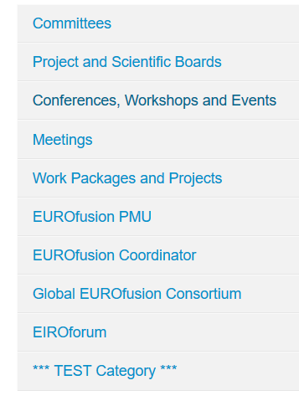
Indico Concepts: Categories
A Category hierarchy has already been designed and implemented.
Top Level Categories

Slide 14
*** Test Category ***
Use the *** TEST Category *** for playing with Indico.
Current User Documentation will always be stored here.
Do not create “real” events here.

Slide 15
Indico Concepts: Events
Events can be of type: Meeting, Lecture and Conference
Event types Lectures and Conference offer a bunch of sophisticated and advanced features.
Typically you might want to use type Meeting
Protectionmode for events can be set individually, i.e. independent of the parent category.
Public
Protected
Inherited (from category)

Slide 16
Protectionmodes: Who can access an Event?
Protected
Category Managers
User/Groups which have been explicitely granted access
With Access Key (if configured)
Inheriting (in Protected Category)
Category Managers
Users with Access rights for the Category
User/Groups which have been explicitely granted access
With Access Key (if configured)
Public
Everybody ☺

Slide 17
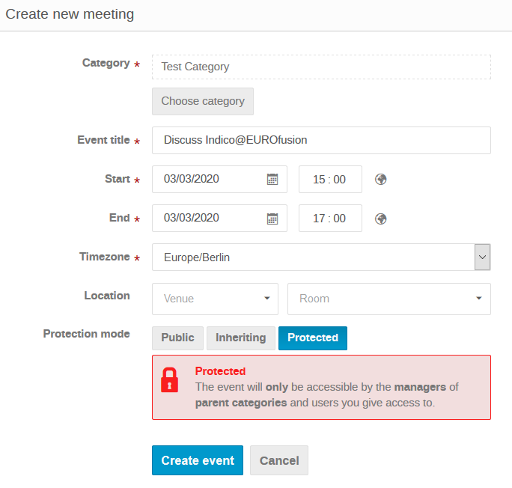
Creating an Indico Event
Choose an appropriate category ℹ️ Indico won’t let you select a category where you don’t have access to
⚠️ Protect your Meeting !️

Slide 18
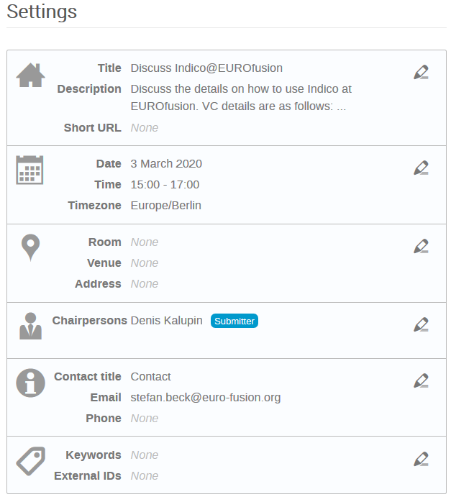
Event Settings
Description is only visible for authorized users. You can provide VC details here.
Chairpersons can upload materials for this meeting.
Contact details are only visible for authorized users.

Slide 19
Handling of VC Details in Indico Event
Recommendation
In general:
Copy VC details to event description
Event description is protected if event is protected.
Event description is available in calendar
DFNconf
Use invitation template for VC details
Copy them to Indico event description

Slide 20
Event Permissions
Permissions for events can be assigned individually, i.e. independent of the parent category.
Access permission allows you to access all Meeting details and Materials. However, it does not allow upload of materials!
One can get Access permission by either using the Access Key or by explicit grant of the Meeting Manager (or by being a manager of the parent category).
By default, only you, the category managers and the Chairperson (if any) can upload materials. You must grant Manage – Submissions rights to additional users in case they should be able to upload materials!

Slide 21
Indico: Major Changes II
Recall !
Major Changes️
Indico handles authentication and user accounts different than fusionTV !
Only persons with a valid EUROfusion accounts can create events!
Guest access to protected resources can only be granted through Access Keys (‘PIN’) for events.
Guests can never upload documents!

Slide 22
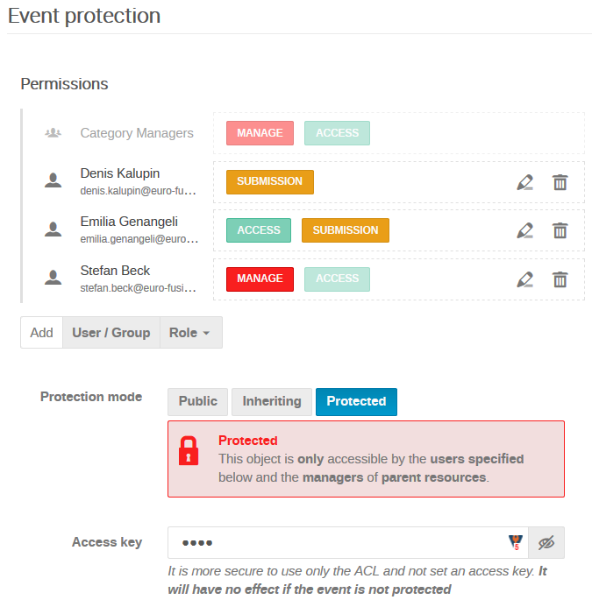
Event Protection
Chairpersons automatically get submission rights for uploading materials.
Additional Indico users can get individual permissions.
The Meeting Manager (You) gets all permissions.
The Access Key allows access to all Meeting details and materials. Non-Indico Users need this for accessing the Meeting.

Slide 23
Pitfall
Whenever you search for users in Indico, ensure that you enable the checkbox Users with no Indico account!
Otherwise your search will only list users that have logged into Indico at least once.

Slide 24
Indico Concepts: (Event) Timetable Sessions, Session Blocks, Contributions
Time
Event
Contribution (e.g. Welcome)
Time Table Elements
Session A (e.g. Morning)
Session Block A1
Contribution A1-1
Contribution A1-2
Break (e.g. Coffee)
Session Block A2
Contribution A2-1
Contribution A2-2
Break (e.g. Lunch)
Session B (e.g.Afternoon)
Session Block B1
Contribution B1-1
Contribution B1-2
Break (e.g. Coffee)
Session Block B2
Contribution B2-1
Contribution B2-2
All timetable parts are optional! You do no need add any!

Slide 25
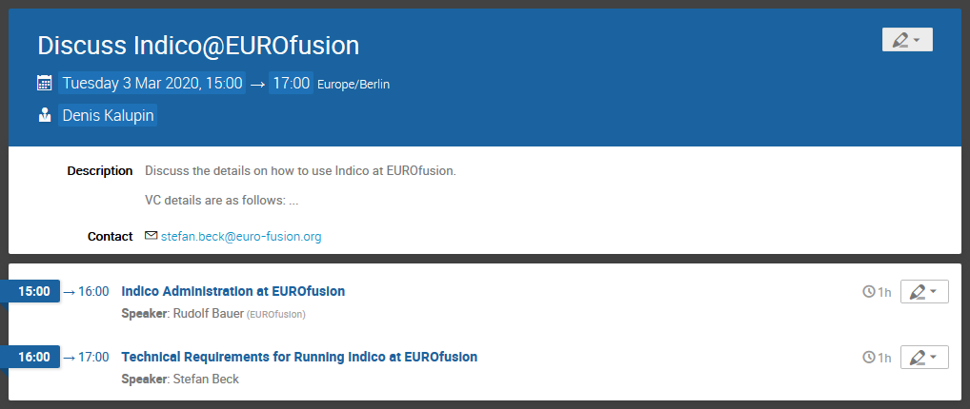
Final Event

Slide 26
Indico Concepts: Materials
Materials are document attachments to categories, events and contributions.
They can be organized in folders
They can have security settings on their own.
Typical attachments are PowerPoint slides or PDF documents.
You can add links, too. E.g. links to IDM documents.
Note: Documents cannot be altered during the meeting and then saved for download as it was possible in fusionTV.

Slide 27
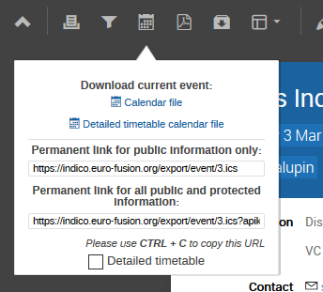
Adding Event to your Outlook calendar
Use the calendar symbol on the Event page and select the desired download format: Calendar file vs Detailed timetable calendar file.
Detailed timetable calendar file creates multiple Outlook events if the Event has multiple contributions.
Copy this one ->

Slide 28
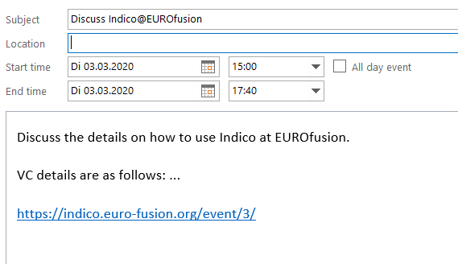
Adding Event to your Outlook calendar
Event description plus direct link to the event is included in Outlook appointment.
You can use this event to send Outlook invitations. So you get feedback who will attend.

Slide 29
Login as Participant with Access Key
If you configure an Access Key for your Event, unauthorized users can enter the Access Key here:

Slide 30
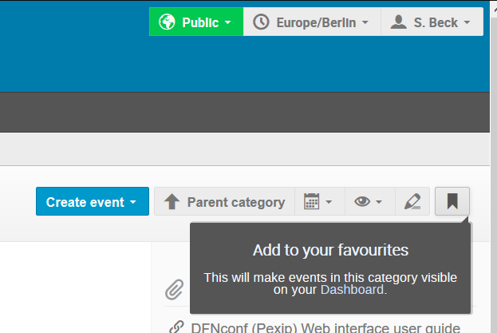
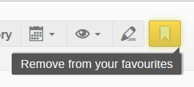
Favourite Categories
We have 100+ categories!
Tipp: Add your important categories as favourites

Slide 31
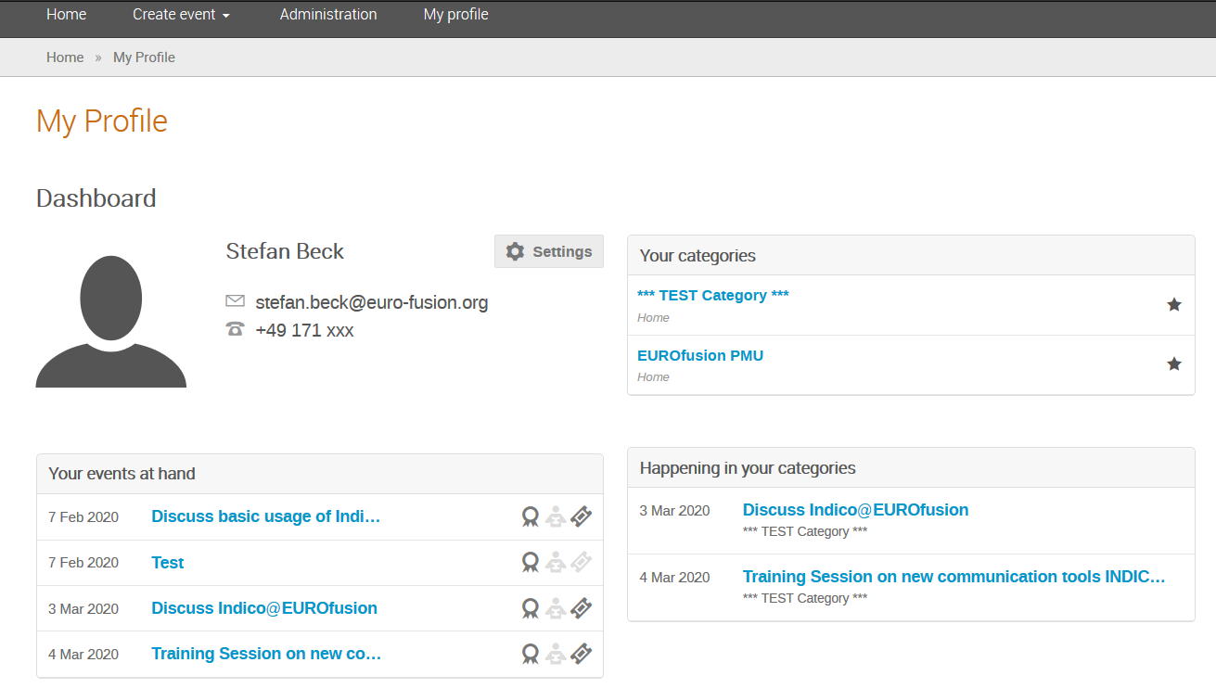
Using My Profile / Dashboard for Quick Access

Slide 32
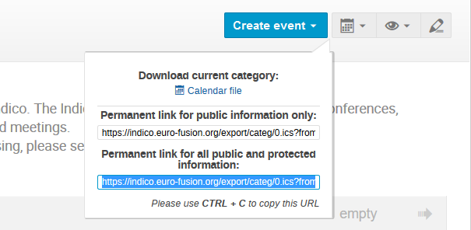
Add Indico Calendar to Outlook
You can add all Indico events (for which you have access to), as a separate calendar to your Outlook.
Gets by default automatically updated every 30m: Outlook -> File -> Options -> Advanced -> Send and receive).
Login to the Indico Homepage and use the Calendar Icon:
<- Copy this one

Slide 33
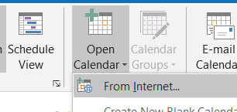
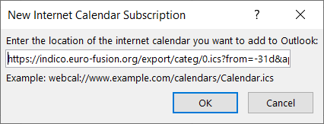
Add Indico Calendar to Outlook
Open Outlook calendar and use Open Calendar / From Internet and paste the URL.
Rename calendar
Paste URL

Slide 34
Agenda
Introduction
Using Indico
Using DFNconf
Using Zoom

Slide 35
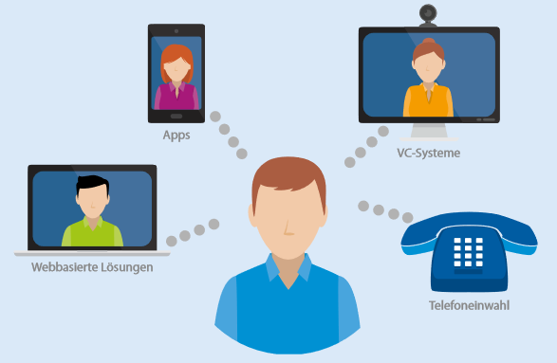
DFNconf
DFNconf is a new generation videoconferencing service for the scientific community. The service can be used by different means.
Mobile smart phone using the Pexip App
Skype for Business / Microsoft Teams
SIP/H.323 room system or software client
Desktop Application
Web Browser (e.g. Google Chrome
Telephone
(audio only)

Slide 36
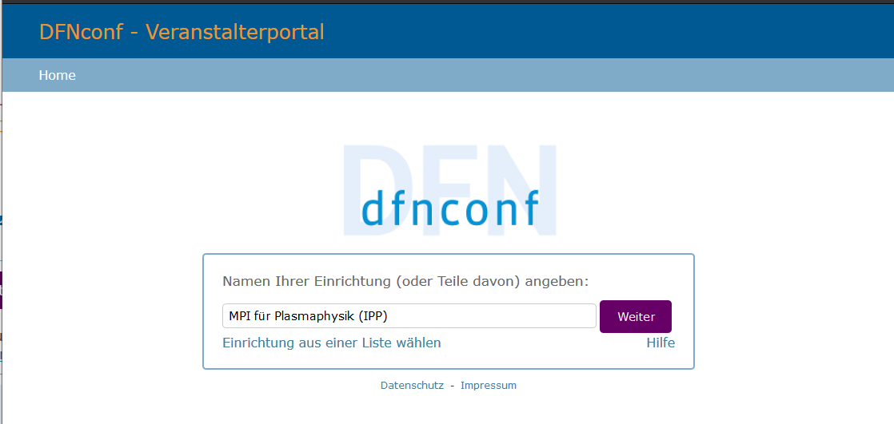
Login as Organizer
The DFNconf login page: https://my.conf.dfn.de/
Start by choosing your home organization first:

Slide 37
Create Meeting
Select New Meeting Room

Slide 38
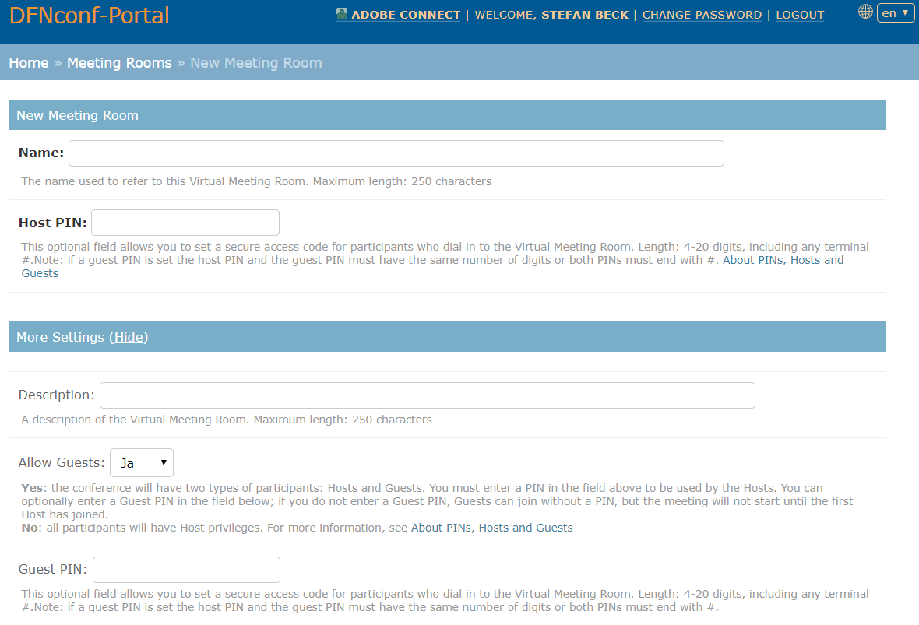
Create Meeting

Slide 39
Meeting Security
# | Access | Roles | Host PIN | Allow Guests | Guest PIN
1 | Anyone - no PIN required | All participants have the same Host privileges. | Leave blank | Select No | Leave blank
2 | All participants must enter the same PIN | All participants have the same Host privileges. | Enter the PIN | Select No | Leave blank
3 | Hosts must enter a PIN but Guest do not | Participants who enter the PIN have Host privileges. All other participants have Guest privileges and do not need to enter a PIN. | Enter the PIN | Select Yes | Leave blank
4 | Hosts and Guests must enter different PINs | Participants who enter the Host PIN have Host privileges. Participants who enter the Guest PIN have Guest privileges. | Enter the PIN (must be different from the Guest PIN) | Select Yes | Enter the PIN* (must be different from the Host PIN)
 | * If you configure a Guest PIN, you must also configure a Host PIN.

Slide 40
Invitation Template

Slide 41
DFNconf Demo
Live Demo of DFNconf
Create Meeting
Join Meeting

Slide 42
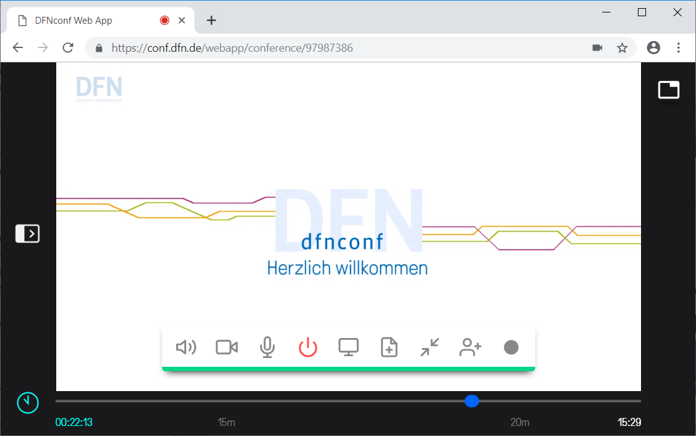
DFNconf Web Browser Interface
Show selfview
Show side panel
Main Panel
Timeline

Slide 43
DFNconf Web Browser Interface
Main Panel
Disconnect
Add Participant
Camera
Present Files
Speakers
Share Screen
Start Recording
Microphone
Float video window

Slide 44
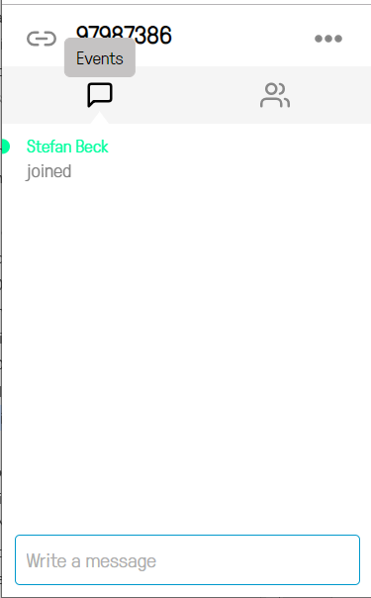
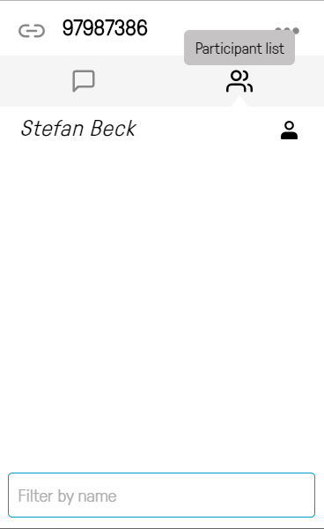
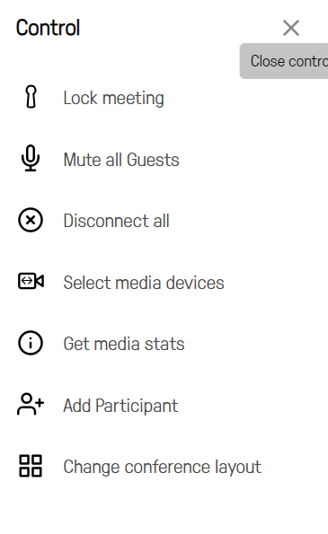
DFNconf Web Browser Interface
Side Panel
List Events
List Participants
Open Control

Slide 45
DFNConf - Presentation
Presentation can be done with:
In meeting rooms:
the meeting room PC picture is injected to the VC
Office and Travel use:
screensharing
present files

Slide 46
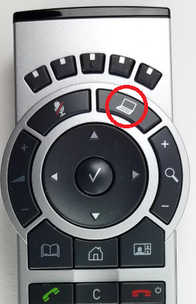
DFNConf - Presentation
Start meeting room presentation injection
push “laptop” button
on the remote control
you can also connect your laptop to the KVM-switch
make sure to have all materials uploaded to Indico

Slide 47
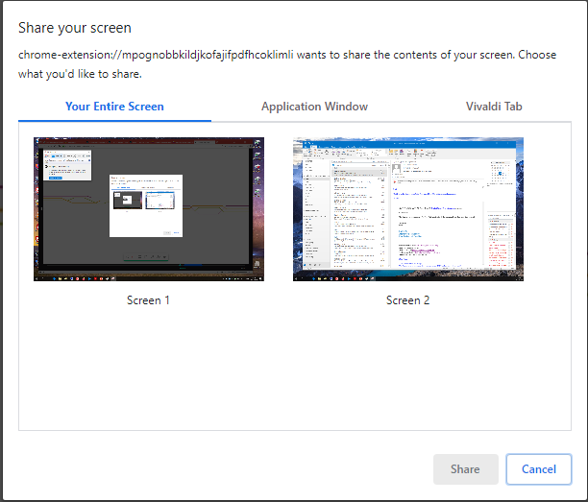
DFNConf - Presetation
Screensharing
to start screen sharing
entire Screen
single applications
single browser tabs

Slide 48
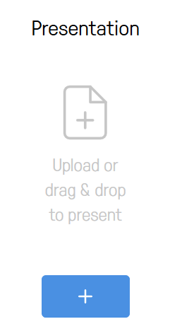
DFNConf - Presentation
Present Files
Share images or PDFs with all other participants by selecting “Present Files” from the main panel
You can add multiple images (.JPEG, .BMP, .PNG, or .GIF) and PDFs. Each image will be converted into an individual slide, as will each page of each PDF.

Slide 49
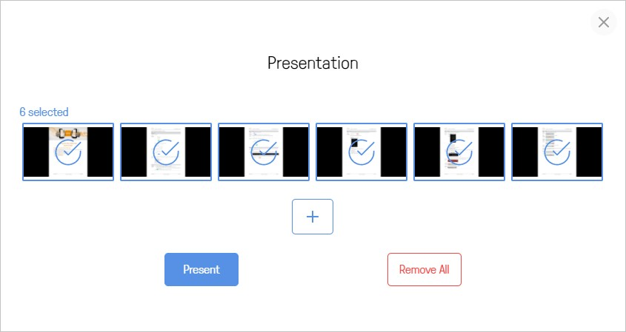
DFNConf - Presentation
Present Files
By default, every slide will be selected for presenting, but you can click on individual slides to select and deselect them

Slide 50
DFNConf - Presentation
Present Files
When you have selected all the slides you want to share, select Present.
Use the left < and right > on-screen controls, or the arrow keys on your keyboard, to scroll through the slides.
Whether you are the presenter or a participant, you can view the current presentation in a separate pop-out window.

Slide 51
Agenda
Introduction
Using Indico
Using DFNconf
Using Zoom

Slide 52
ZOOM – Pro Account Guide - 1
Up to 100 participants
Meeting duration limit set to 24 hours
Features:
User management (add, delete and assign roles and add-on features)
Admin (advanced meeting controls - enabling and disabling recording, encryption, chat and notifications)
Reporting (Run usage reports to learn how many meetings are taking place in your organization, which days, number of participants, number of meeting minutes and more)

Slide 53
ZOOM – Pro Account Guide - 2
Assign scheduler
Allows you to assign someone else to set up your meetings for you. Assignee must also have a Pro plan)
1GB of MP4 or M4A cloud recording
Record meetings in the Zoom Cloud, where the file can then be downloaded and/or streamed from a browser. Available formats include MP4 (video), M4A (audio) and txt (chat) More details here)
Skype for Business (Lync) interoperability
Allows Lync users 2010, 2013 and Skype for Business users to initiate a Zoom meeting from the Lync contact list)

Slide 54
ZOOM – Pro Account Guide - 3
Zoom Pro Account Adds-on:
H.323/SIP Room Connector - Enable H.323/SIP room systems to communicate with desktop, tablet and mobile devices. More details here.
Zoom website offers a comprehensive documentation and training materials on how to use Zoom on different platforms -- https://support.zoom.us.

Slide 55
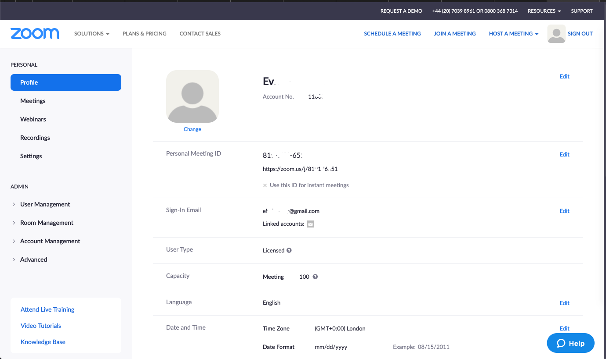
ZOOM – Pro Account Sing In and Profile
Go to: https://zoom.us
and click on “Sign In” link to get into your account.
We highly recommend to generate a new meeting id every time you want to host a meeting!
Profile details – i.e. Personal Meeting ID (a unique zoom number: 123-456-7890) and the web link: https://zoom.us/j/1234567890 (can be used for instant meetings)

Slide 56
ZOOM – Schedule a Meeting - 1
Click on the “SCHEDULE A MEETING” link and enter couple of info in the fields displayed on the form, i.e.:
Topic - choose a relevant topic name
Description (optional) - choose a relevant description, if you want
When - choose the date and time
Duration - choose the duration of the meeting
Time zone and recurring - as and if you need it
Registration - typically, you don’t need to set this as required, as you don’t want people that are invited to the meeting to register for it

Slide 57
ZOOM – Schedule a Meeting - 2
Meeting – better option is the system to generate an automated meeting id
Meeting password – - good practise is to select Required, and a text box will appear to enter a password. You will need to send this password when sending the meeting details email to the participants
Video – both Host and Participant set as on (if the need is of a video conference)
Audio – set Both
Hosting options – it is good to set Enable join before host, as everybody can join the meeting before the host arrives.
Alternative hosts – no real need to set up anything here

Slide 58
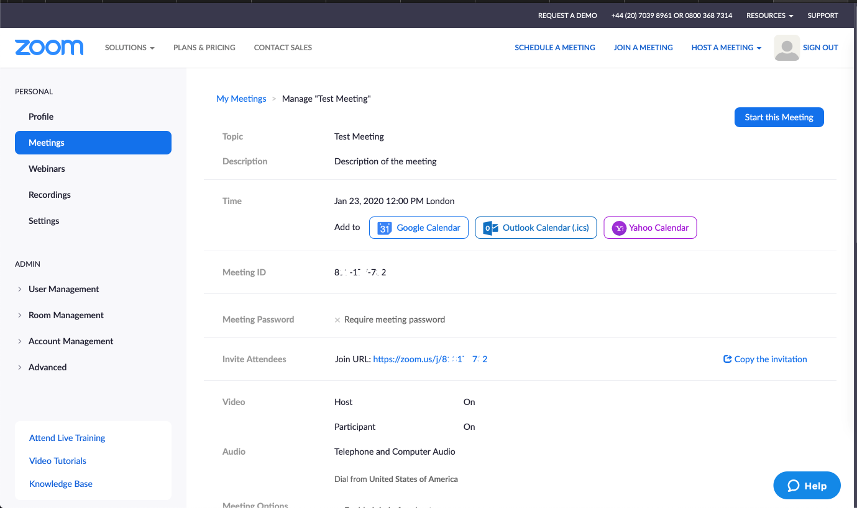
ZOOM – Schedule a Meeting - 3
At the end click on Save. Meeting details will be shown.

Slide 59
ZOOM - PMU / JEU in Culham
Zoom platform at Culham is only available to EUROfusion PMU and JEU users based at Culham. It is not available to external EUROfusion users.
The Zoom rooms (physical or virtual rooms) can be booked through the roombooker application at Culham (at present only through Vicky and Doreen).
Details on Zoom application, user guide / instructions and FAQ document are available via the Users website.

Slide 60
The End …
***
Thanks for listening!
***
? ? ? Questions ? ? ?
***

