Slide 1
Progress of the support activities for remote-participation of the LHD experiments
Remote participation support team (S. Ohdachi )

Slide 2
Goal of the support for the remote participation
Many collaborator cannot directly visit NIFS from the COVID-19 symptoms. To activate the international/domestic collaboration, our group has been working to build the support framework for the collaborators. Our goals are,
Access to the information of the LHD experiments remotely.
Video image of the front screen is shared by Zoom (9:00-21:00 Tue-Friday)
Chat, oral discussion and file sharing are supported by Microsoft Teams. Theme Group.
Make the data handling easier.
MyView2 is improved for sharing the plot template file. Plotting of the fundamental parameters becomes much easier. (Kobayashi-san, Emoto-san)
Documents for the diagnostics are updated. (Mukai-san)
Libraries / documents are updated and reorganized. Now, Python3 (Anaconda) is recommended environment since Enthought Canopy is no longer supported.
Kaiseki web is re-built and all (or most) documents are written in English.
Lower the hurdle for the newcomer.
Tutorial documents written in English is made.(Fujiwara-san, Takemura-san)
https://www-lhd.nifs.ac.jp/LHD/resouces.html

Slide 3
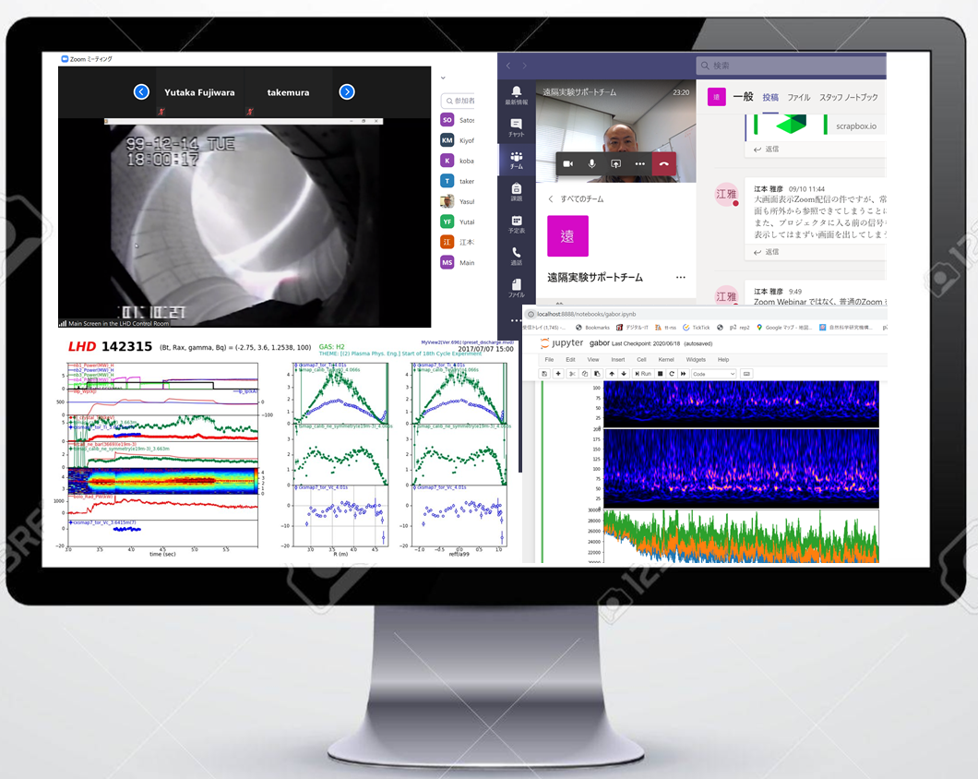
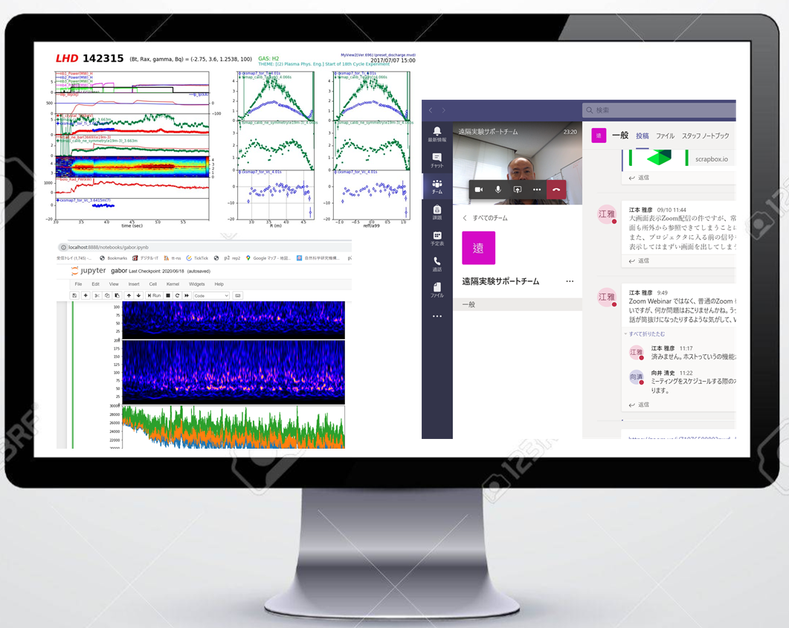
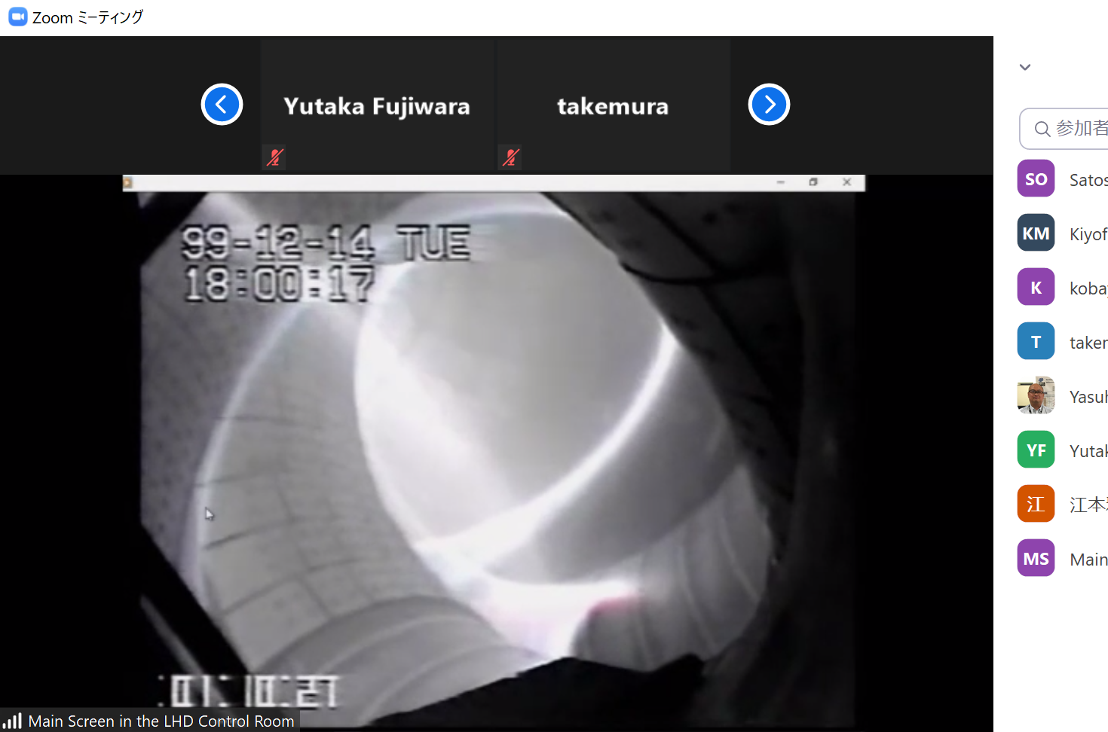
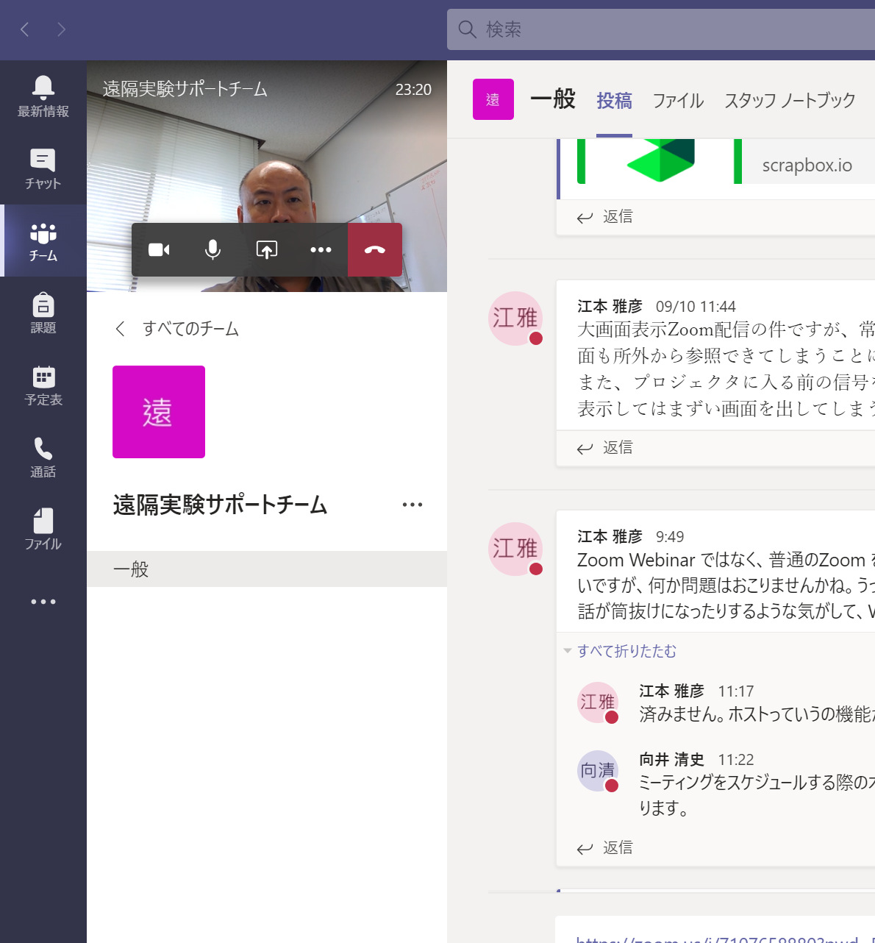
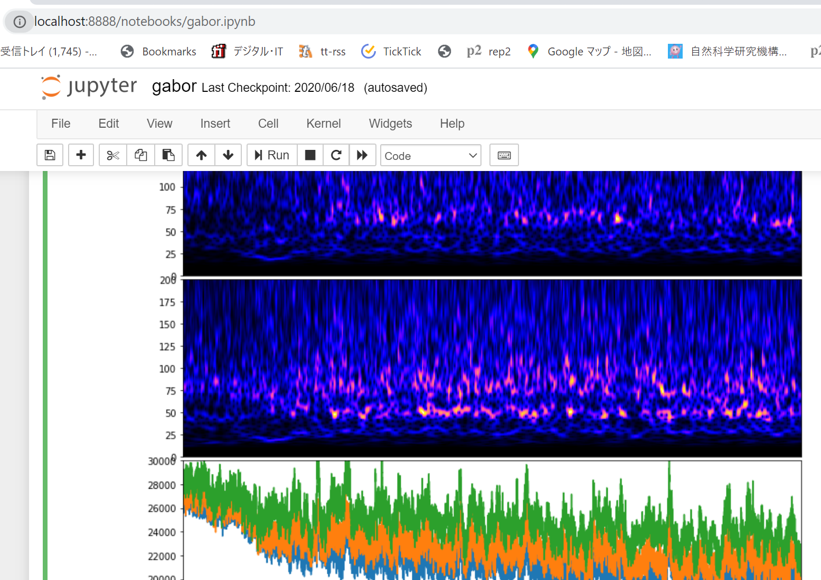
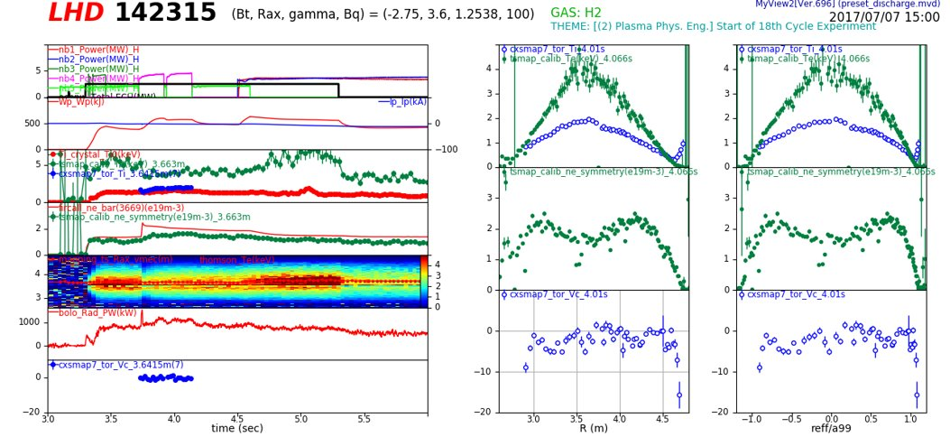
Concept of remote participation
of LHD Experiments
sei
Main Screen via Zoom
Chats and File sharing (via MS TEAMS)
LHD Control Room
Experiment
Group
Main Screen
Data Viewer “MyView2 “
(via VPN connection)
Data Analysis by Python
(via VPN connection)
Shot summary via VNC is also available.
Microsoft Teams
Console image of a remote participant of the LHD experiments

Slide 4
Chat and oral discussion via Teams can be made, while Zoom connection is activated simultaneously

Slide 5
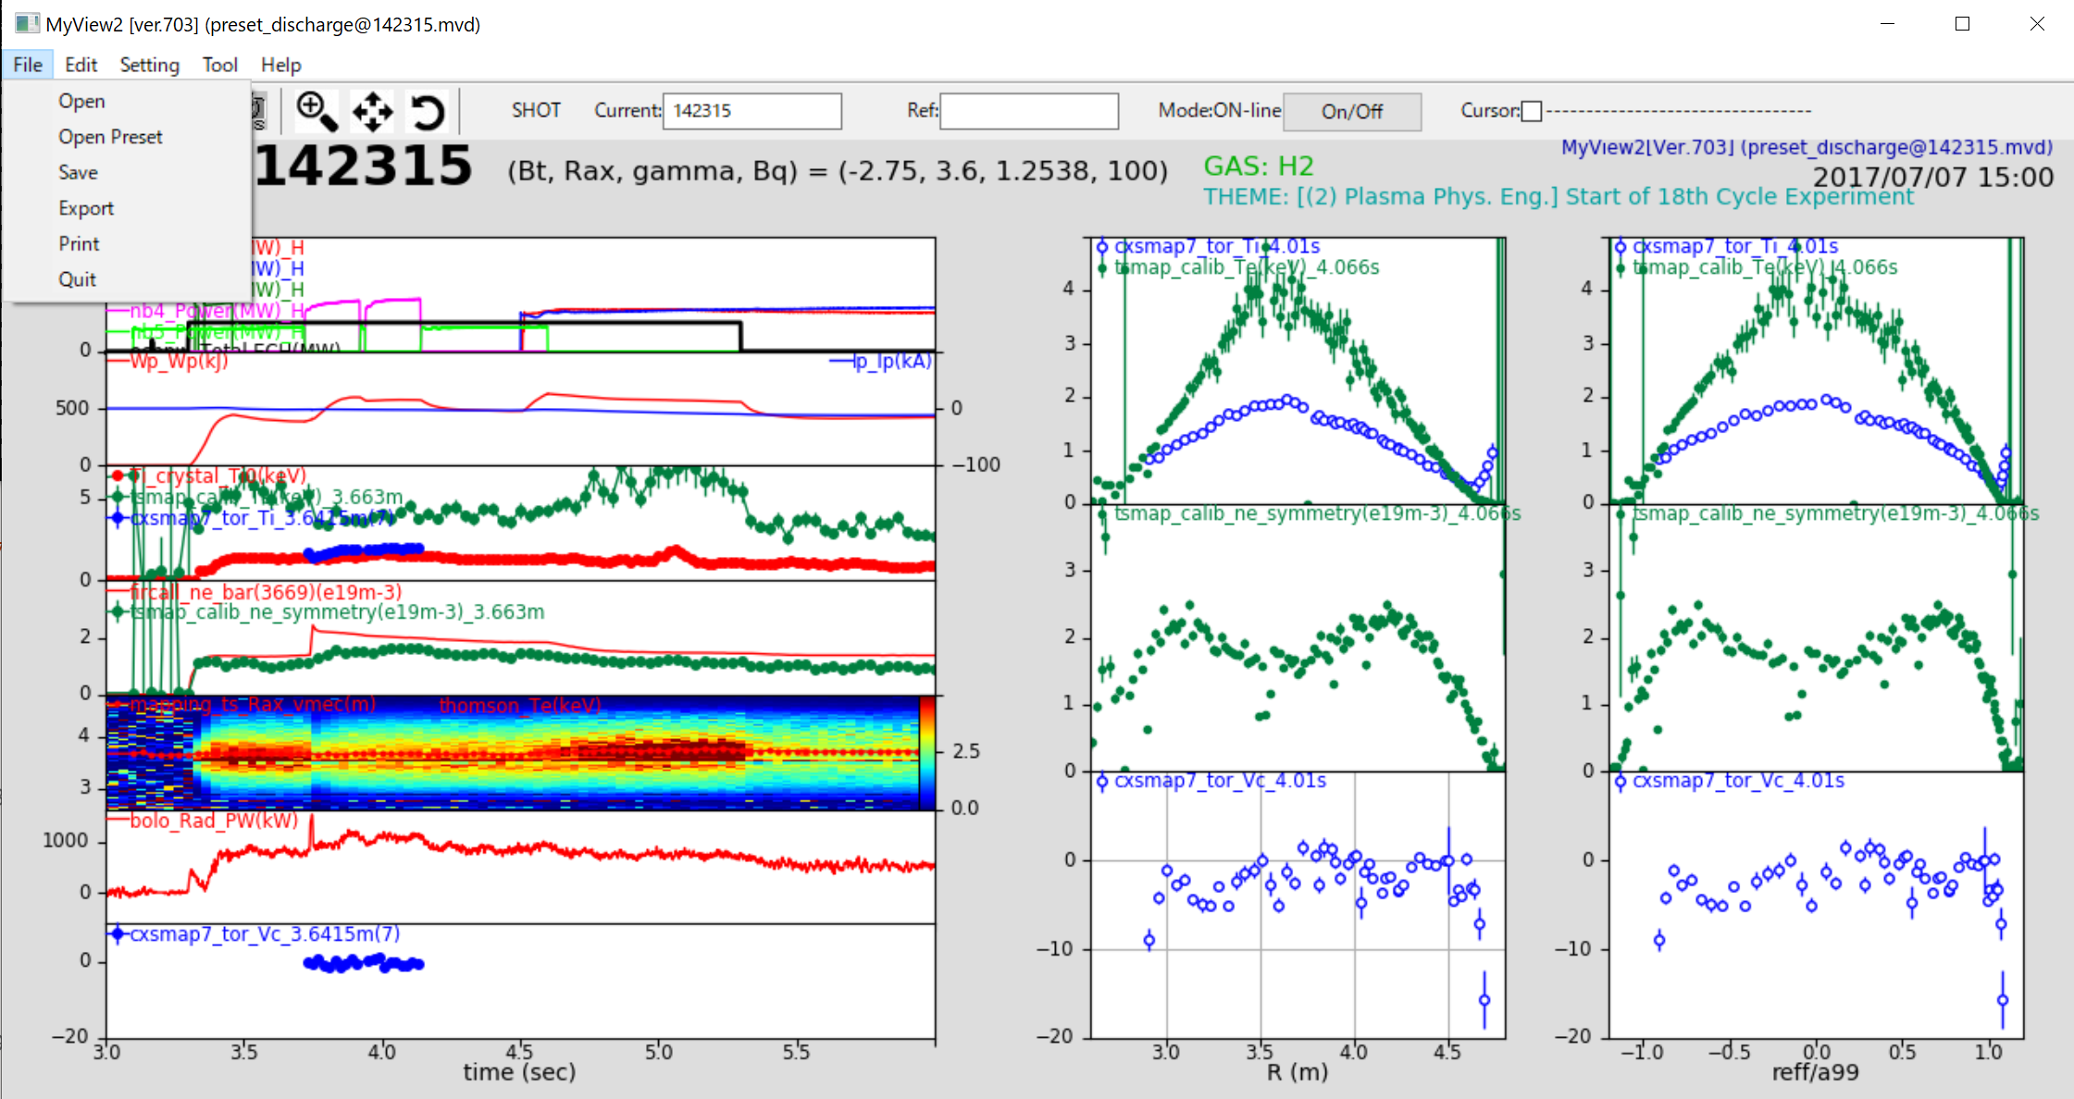
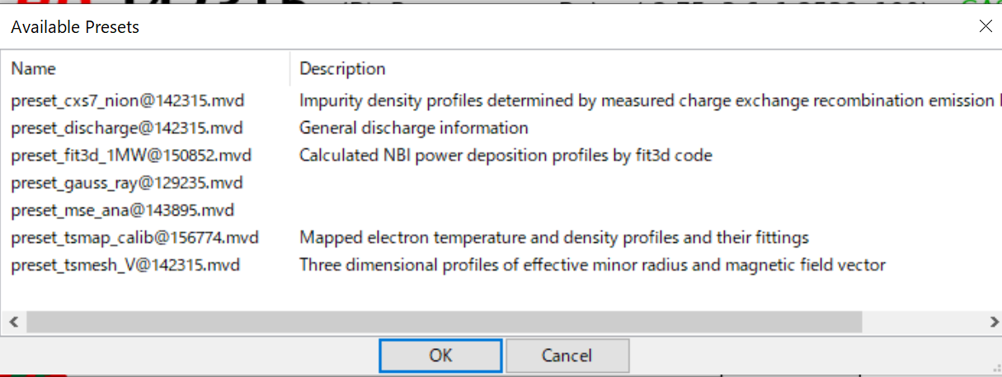
Make the data handling easier. new MyView2
MyView2 and related softwares are updated to use Python 3 (Anaconda is recommended).
Open Preset menu for fundamental parameters. It is ready just after the installation.

Slide 6
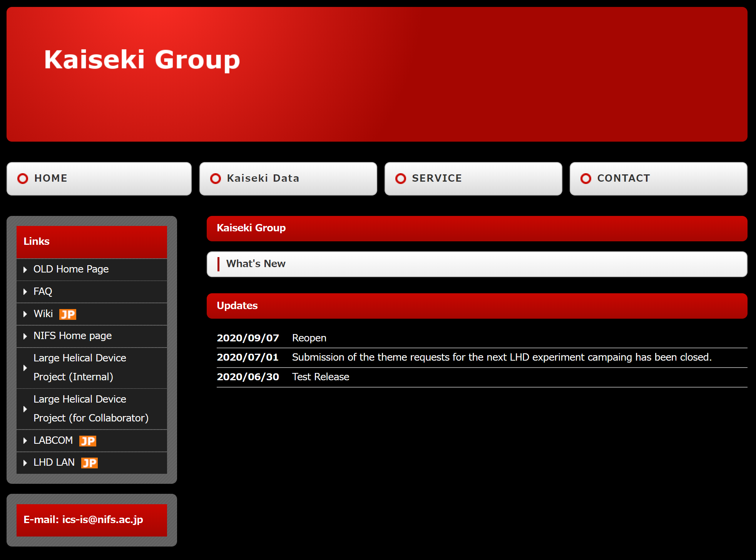
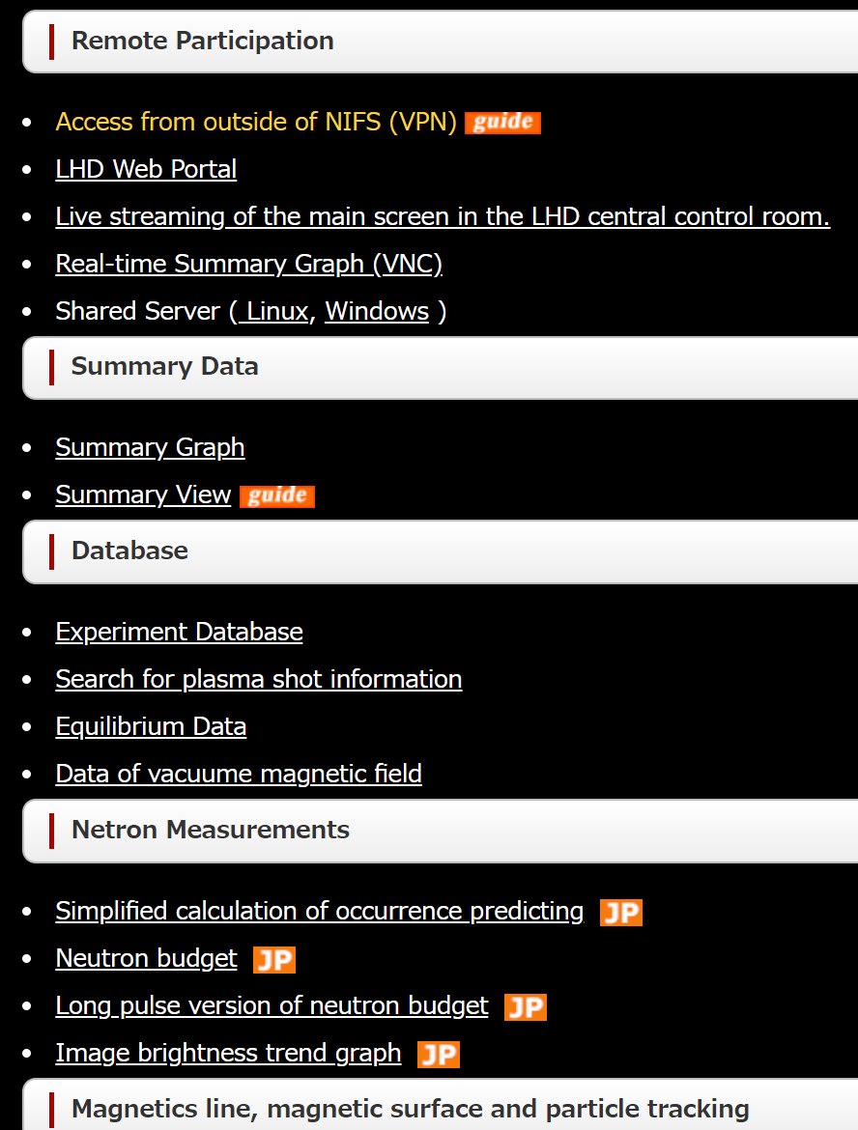
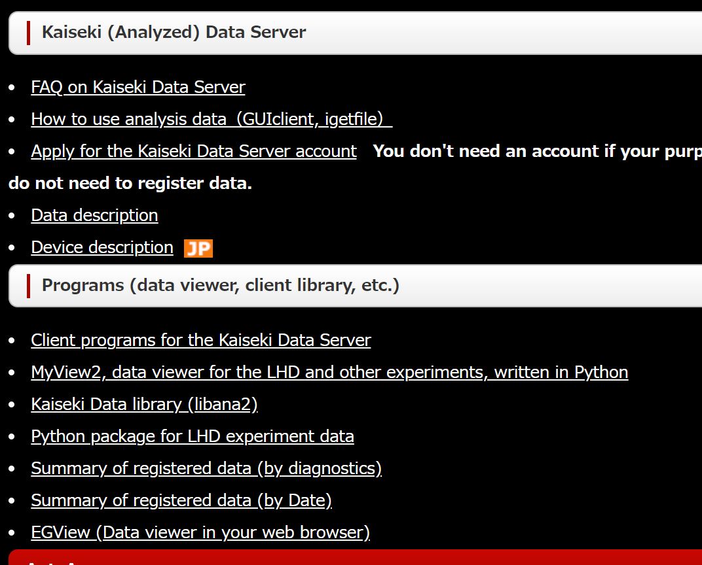
Web page for Kaiseki-data is written in English now
http://kaiseki-dev.lhd.nifs.ac.jp
Contents are being updated. Important information are re-organized in the web page.

Slide 7
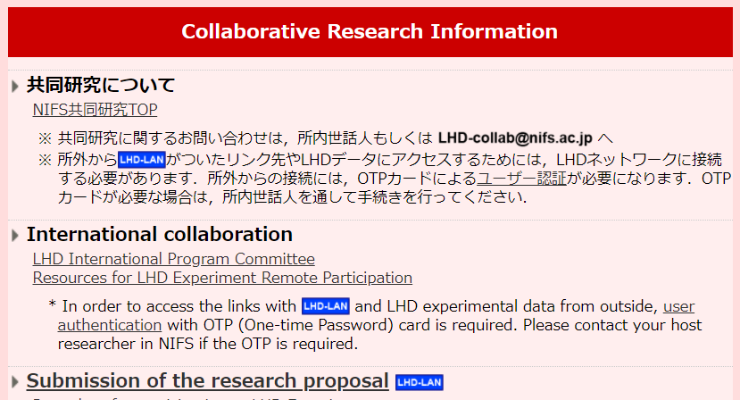
Information about diagnostics are updated.
https://www-lhd.nifs.ac.jp/LHD/TechGuide_2020.html
Information is now based on the status of 2020 instead of 2016.
Links to the resources of the remote participation of the LHD is made and link has been created in the top page of the Large Helical Device Projects
https://www-lhd.nifs.ac.jp/LHD/resouces.html

Slide 8
Tutorial documents are being completed…
Tutorial documents targeting newcomer to the LHD experiments is being prepared by Fujiwara-san and Takemura-san.
Please make comment after the tutorial is completed.

Slide 9
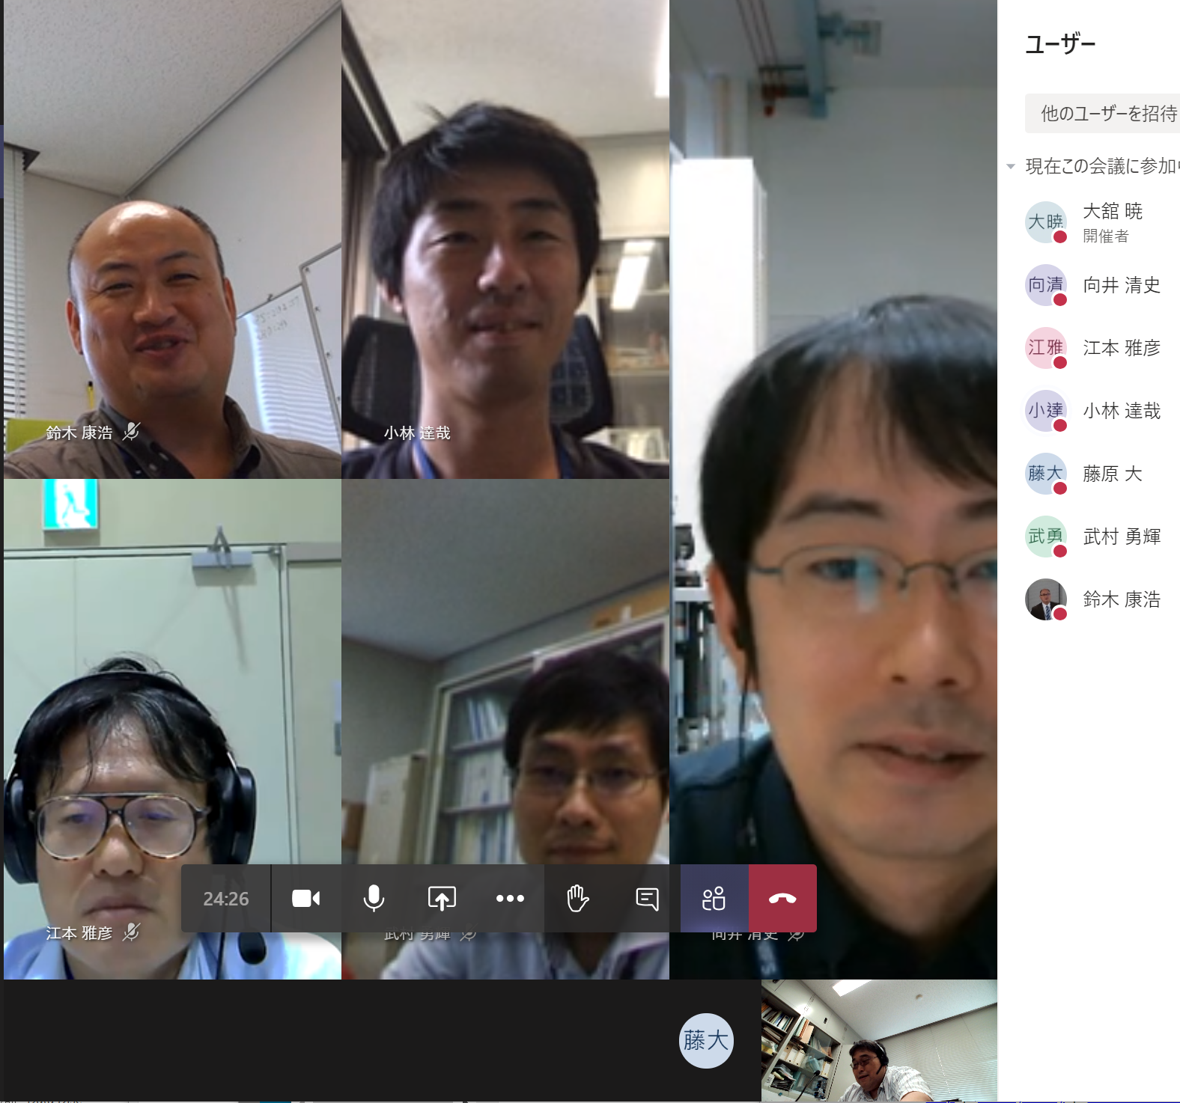
Summary / Information
Our team try to supply the three issues for supporting remote participation. Please give us comments for improving the supporting environments.
PC server for Windows and Linux are also available for limited number of persons due to the limit of the performance of the server. Windows server will be improved. (See, kaiseki-dev.lhd.nifs.ac.jp)
Please form a team in MS Teams by each experimental group.
Seminar for the collaborator (to Japanese colleague, to EU colleague and to US Colleague) will be held on Oct 22th, 2020 (Zoom: Meeting ID: 954 6658 4673 passcode: 277164 )
9:00-10:00 JST (US, Asia and Domestic collaborator)
17:00-18:00 JST (EU, Asia and Domestic collaborator)
Ohdachi will give basic information.
Yoshinuma-san will give a lecture for MyView2.
Dryrun for the experiments will be held on
Oct 16th 15:00-16:00 JST
Oct 23rd 9:30-10:30 JST
Thanks for the cooperation,
Emoto-san, Mukai-san, Kobayashi-san, Fujiwara-san (no photo),
Takemura-san and Suzuki-san

