Slide 1
Thrust 2 | WP Plasma-Wall Interactions and Exhaust in FP9
Sebastijan Brezinsek

Slide 2
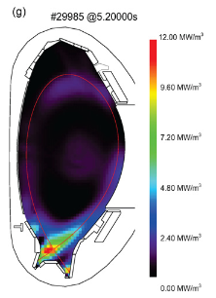
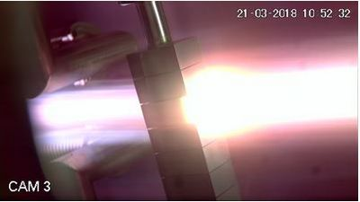
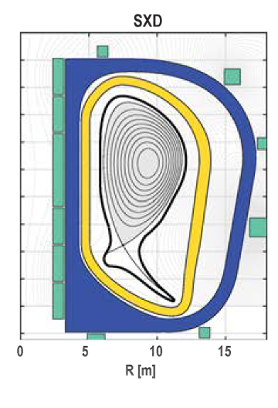
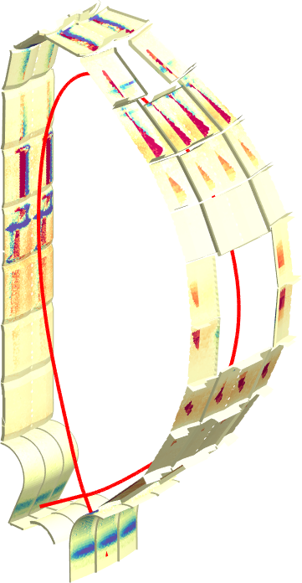
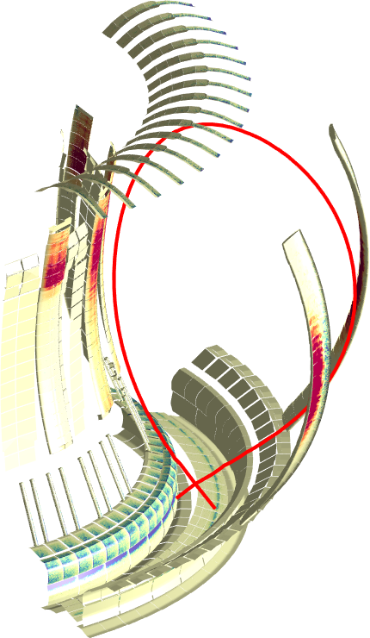
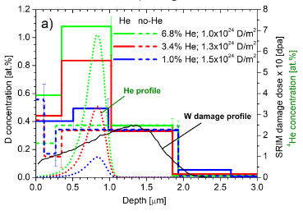
Plasma-Wall Interactions & Exhaust
Focus on ITER and DEMO materials, H, isotopes, He, seeding gases, and impurities.
Goal on steady-state operation.
Radiative divertor
Tungsten +
seed gas (Kr/N₂)
Particle and heat flux
Tungsten + Deuterium
Advanced Divertor Solutions
Tungsten
AUG
DEMO
MAGNUM
[T. Morgan]
JET
ITER
[M. Bernert]
[F. Militello]
WP PWIE covers laboratory experiments, linear plasma devices, and high heat flux facilities and modelling.
[J. Romazanov]
[S. Markelj]
3D erosion & deposition modelling
Beryllium
Fuel (Tritium) retention
Tungsten + Deuterium/Helium
WP PWIE supports experiments at toroidal devices including W7-X.

Slide 3
WP PWIE role in EUROfusion
Works hand in hand with FTD in the area of DEMO PWI, exhaust solutions, and safety
Complements WP DIV studies regarding (plasma) qualification of PFCs for DEMO & JT60-SA, DTT, W7-X
TSVV
FTD
TSVV
Neutral Gas Dynamics
in the Edge
WP MAT
WP DIV
WP DES
WP SAE
Plasma Exhaust:
Fluid/Gyrofluid Edge Codes
Impurity Sources,
Transport, and Screening
WP PWIE
Plasma Exhaust:
Gyrokinetic/Kinetic Edge Codes
Plasma-Wall Interaction
in DEMO
WP PrIO
WP TE
WP W7X
WP SA
FSD
via WP TE and thrust 1!
THRUST 2
Addresses Mission 2 in FSD in laboratory experiments, linear plasma devices, and toroidal devices
Works hand in hand with WP TE (and JET-1) in the areas of PWI and PFC-compatible exhaust solutions
Executes post-mortem analysis of PFCs (JET, WEST, AUG etc.) and associated interpretation

Slide 4
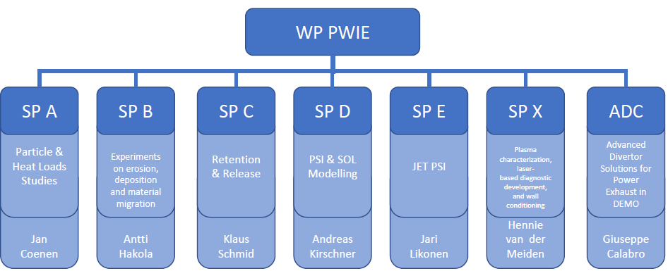
Structure of WP PWIE
PL: S. Brezinsek
DPL: G. Calabro
PSO: M. Reinhart
CO: D. Douai
TSVV links to different subprojects and about 30 Tasks per year
Project Managment Plan Available early May for TSVV PIs!
Access to linear devices: MAGNUM-PSI, PSI-2, JULE-PSI for benchmark
Access to toroidal facilties via WP W7-X and WP TE

Slide 5
Thrust
Thrust definition:
A Thrust serves as a communication platform among a group of related TSVVs and WPs, on behalf of the entire E-TASC SB. It consists of a set of TSVV leaders, E-TASC SB members, and relevant PLs/TFLs and is coordinated by a facilitator chosen among the latter. The facilitator provides feedback on the Thrust activities and proposes corrective actions for the TSVV work programmes to the E-TASC SB if and when needed.
We are building a group to foster the discussion and promote the synergies
Thrust 2: Edge Physics & PWI
Facilitator: S. Brezinsek [WPPWIE]
Involving: D. Borodin; G. Ciraolo; D. Matveev [TSVV-5, -6, -7]
A. Alonso; C. Sozzi; A. Hakola [WPW7X, WPSA, WPTE]
B. Braams, D. Tskhakaya [ETASC SB]

Slide 6
Edge Physics & Plasma-Wall Interactions
THRUST 2
TSVV
(Strong) Interaction between the different TSVVs
and associated codes (selection of best)
Neutral Gas Dynamics
in the Edge
Links linear plasmas & laboratory experiments
with tokamaks & stellarators to benchmark
where approrpriate (e.g. detachment)
Impurity Sources,
Transport, and Screening
Plasma-Wall Interaction
in DEMO
Benchmark cases from toroidal devices?
Scheme for ACH interaction? Priorities?
Thrust 2: Edge Physics & PWI
Facilitator: S. Brezinsek [WPPWIE]
Involving: D. Borodin; G. Ciraolo; D. Matveev [TSVV-5, -6, -7]
A. Alonso; C. Sozzi; A. Hakola [WPW7X, WPSA, WPTE]
B. Braams, D. Tskhakaya [ETASC SB]

Slide 7
TSVV-5: Neutral Gas Dynamics in the Edge
Main simulation tool:
EIRENE code (and EIRENE-CFD packages) http://www.eirene.de/
We aim to transform it to IM- and HPC-ready neutral gas module (EIRENE-NGM) suitable for simulations on ITER and DEMO scale with large focus on (semi)detached divertor plasmas
FP-9 deliverables:
Neutral gas code that allows for an efficient use of HPC resources (towards exascale systems and/or HPC booster techniques) through suitable parallelization methods.
Revised and extended physics basis for the neutral gas model. Further development of the underlying collision-radiative model towards the full vibrational resolution for all hydrogen isotopes and specific impurities for seeding.
Improved (in contents and structure) Atomic and Molecular database for volumetric and surface processes. Database access through generalized interfaces to, e.g., atomic, molecular, nuclear and surface (AMNS) physics data.
Interfaces and boundary conditions necessary for future applications; modularization of the neutral gas code to facilitate coupling to computation fluid dynamics (CFD) codes (2D or 3D codes, turbulence codes, time-dependent) and possibly also to gyro-kinetic/gyrofluid plasma codes.
Strategy towards a validated predictive capability for integrated fusion reactor modelling for (semi-)detached divertor plasmas. Liaison with TSVV Tasks 3 and 4.
Neutral gas code that allows for an efficient use of HPC resources (towards exascale systems and/or HPC booster techniques) through suitable parallelization methods.
Revised and extended physics basis for the neutral gas model. Further development of the underlying collision-radiative model towards the full vibrational resolution for all hydrogen isotopes and specific impurities for seeding.
Improved (in contents and structure) Atomic and Molecular database for volumetric and surface processes. Database access through generalized interfaces to, e.g., atomic, molecular, nuclear and surface (AMNS) physics data.
Interfaces and boundary conditions necessary for future applications; modularization of the neutral gas code to facilitate coupling to computation fluid dynamics (CFD) codes (2D or 3D codes, turbulence codes, time-dependent) and possibly also to gyro-kinetic/gyrofluid plasma codes.
Strategy towards a validated predictive capability for integrated fusion reactor modelling for (semi-)detached divertor plasmas. Liaison with TSVV Tasks 3 and 4.
Code performance, parallelization, refactoring, domain decomposition, I/O for HPC, …
Improved physics and features incl. fluid-kinetic hybridisation (FKH) and improved CRMs
Improved AMNS data, both in structure/physics and content
EIRENE as NGM – restructuring, interfaces to other codes, time-dependent runs, kinetic ions
Validation with experiments and test of predictive capabilities for ITER and DEMO

