Slide 1
ACH @ VTT (Univ. Helsinki) Cat. III
Fredric Granberg
Kick-off meeting
TSVV / ACH

Slide 2
Local Management Team
Fredric Granberg, PostDoc in Computational Physics @ Univ. Helsinki
Team leader
Background in PRD-IREMEV, WP-PWIE and TSVV7
Jukka K. Nurminen, Professor in Computer Science @ Univ. Helsinki
Background in AI and Software engineering
Jan Åström, Application Scientist @ CSC
Background in Computational Physics, Code development and HPC
Kai Nordlund, Professor in Computational Physics @ Univ. Helsinki
Background in PRD-IREMEV, WP-PWIE and Member of STAC & ETASC SB

Slide 3
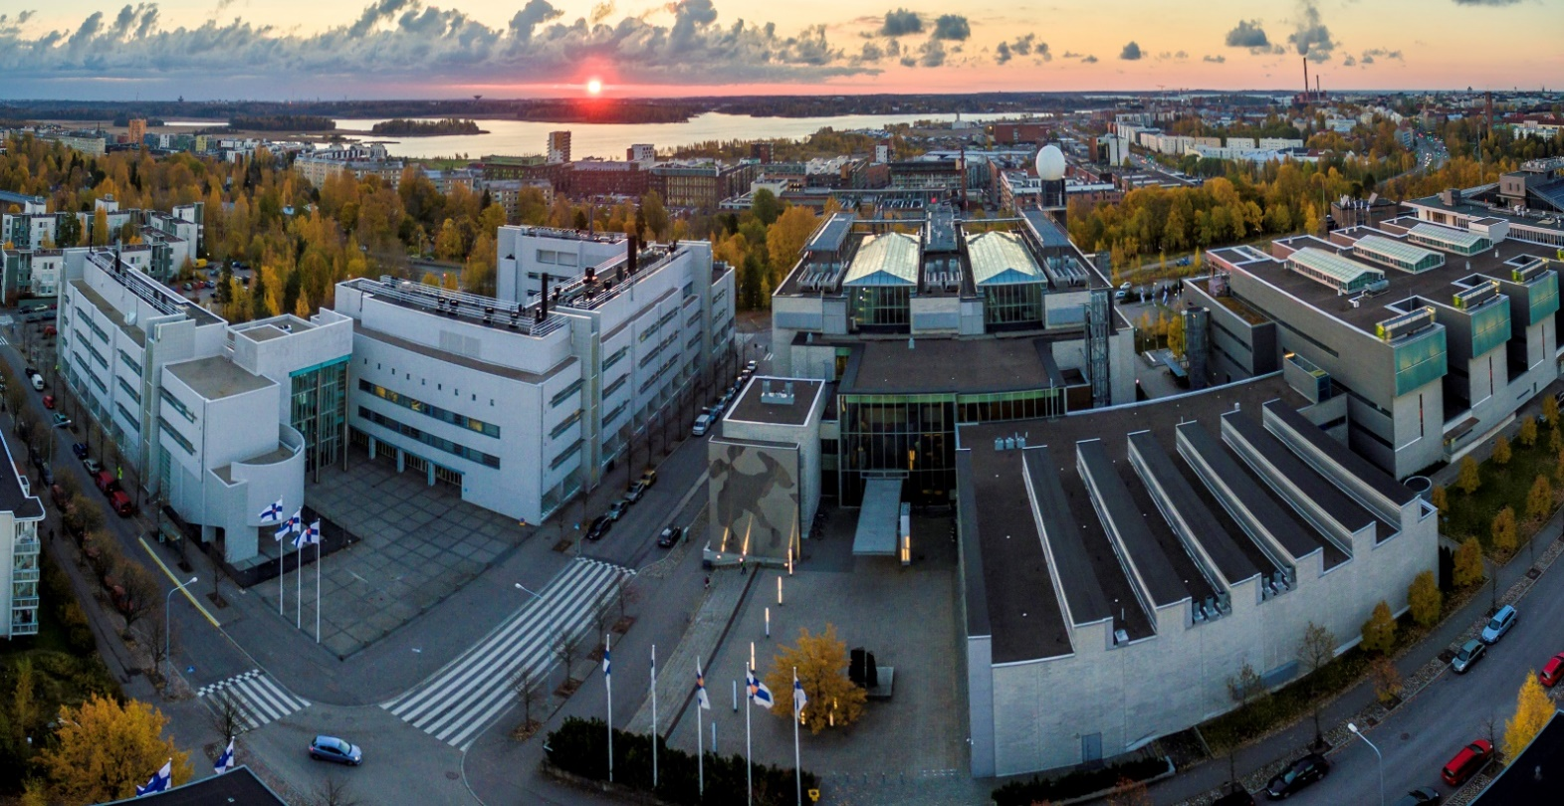
Kumpula Science Campus in Helsinki World-class center for Physics and AI
1200 scientists
1500 publications/year
15 min from HEL

Slide 4
Finnfusion Consortium
VTT the beneficiary towards EUROfusion
Affiliated entities
Univ. Helsinki
Aalto Univ.
Åbo Akademi Univ.
CSC – IT Center for Science
and Fortum, Lappeenranta Univ. Technol. and Tampere Univ. Technol.
ACH @ VTT

Slide 5
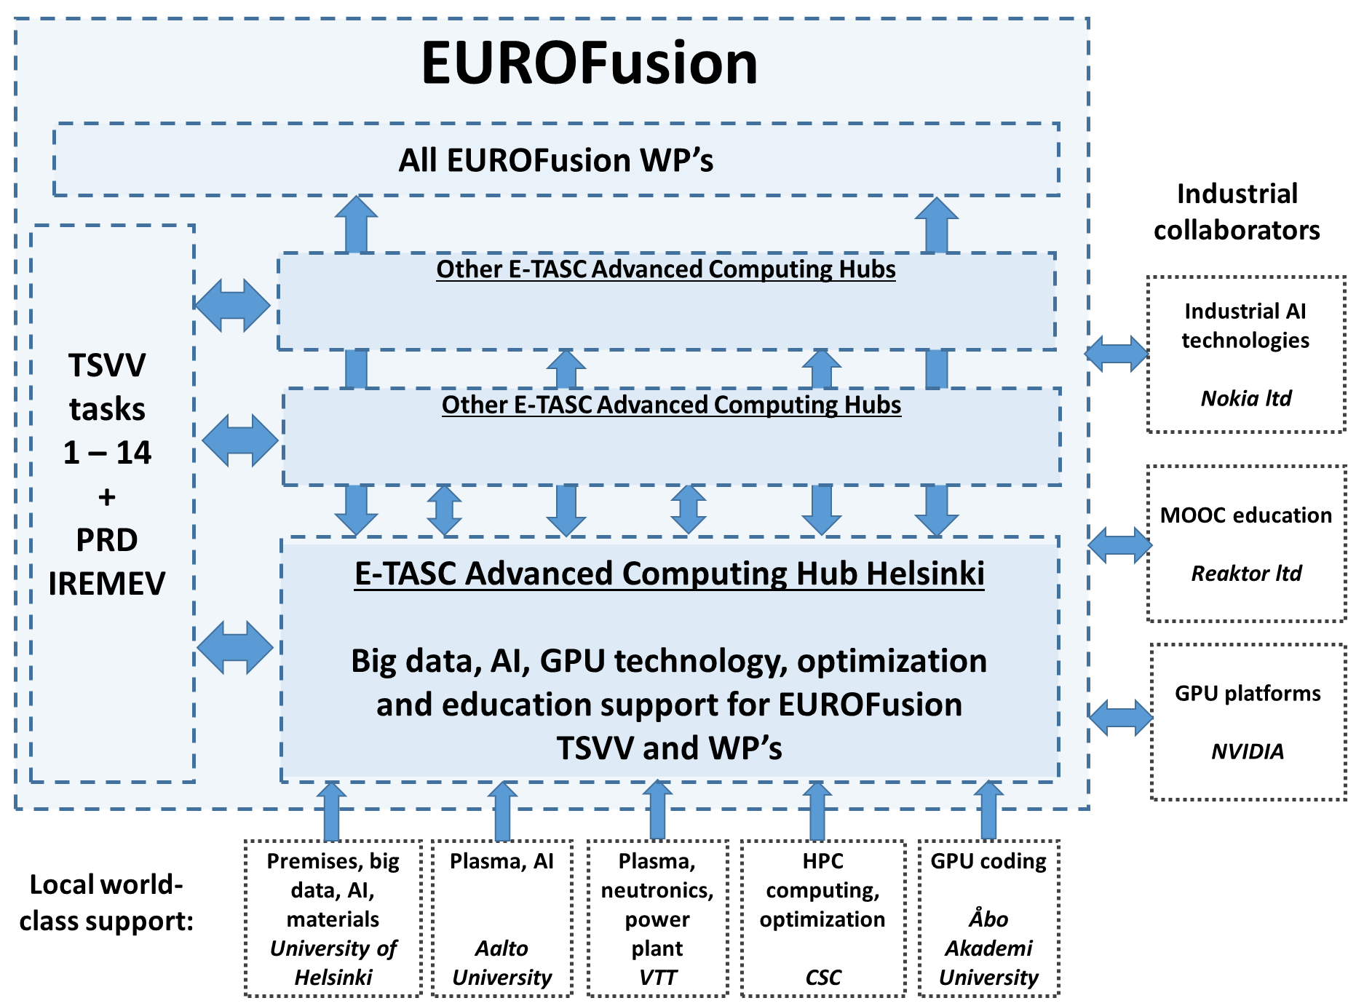
Summary of our ACH
Artificial Intelligence
Education
GPU programming
Big data, AI, Materials
GPU Programming
Plasma, Neutronics, PP technology
HPC, Optimization
Plasma, AI

Slide 6
Personnel @ 2021 (and 2022) Ramp-up phase
Person | Expertise | Involvement
Dr. Fredric Granberg* | Team leader and Materials modelling | 70%
Prof. Kai Nordlund* | Materials modelling | 20%
Dr. Jan Åström* | High performance computing and Code development | 70%
Prof. Jukka K. Nurminen* | Artificial intelligence and Software engineering | 20%
Prof. Keijo Heljanko | Big data and GPU computing | 20%
Ass. Prof. Andrea Sand | Materials Modelling | 20%
Dr. N. N. | Industrial contacts and activation | 50%
Dr. Eero Hirvijoki | Plasma physics and Algorithm development | 50%
Ilari Maarala | Big data handling and Software engineering | 100%
Dr. Laurent Chone | Plasma physics and Code development | 70%
Oskar Lappi | GPU programming | 100%
Dr. Aaro Järvinen | Plasma physics and Verification and validation | 50%
Dr. Umberto Simola | Uncertainty quantification | 100%

Slide 7
Personnel @ 2021 (and 2022) Ramp-up phase
Dedicated person
Data Management
UQ
GPU programming
Several people depending on needs
Data Analysis Tools
Artificial Intelligence
VV
Open Access
TSVV preliminary needs not covered fully immediately
Data Management
Visualization
API
-> covered at latest 2023 (full funding)
Data Management collaboration
with Fair4Fusion
with EUROfusion HPC center

