Slide 1
Coordination on International (IEA-IAEA) Challenges on Long duration Operation (CICLOP) 29/04/2021 Xavier LITAUDON, Hans-Stephan BOSCH, Tomohiro MORISAKI, Matteo BARBARINO (IAEA)

Slide 2
Objective of the CICLOP IEA-IAEA activity
Gain experience with steady-state and long pulse operation in actively cooled devices as they are essential to the ITER experiment and beyond.
Promote activities, collect and disseminate information on long pulse operation issues
share best practice, operational procedures, experimental data, simulation programme and coordinating experiments between the fusion-related IEA Technology Collaboration Programmes in close cooperation (by joint meetings and workshops) with the IAEA activities in the same field (e.g. the IAEA Technical Meeting on Steady State Operation).
The group will address the physics and engineering issues of long pulse operation for tokamak and stellarator facilities. It is an informal body with no decision-making power.

Slide 3
Member of the group as July / 2020
Member of the group will act as contact person per machine in the future we will agree on certain cross-machine topics

Slide 4
Some short terms actions
Set-up a high-level web based multi-machines (tokamak/stellarator) database combining physics and technology for long pulse operation (IMAS format for the link with ITER and ITPA/stellarator database in the long terms).
The description should include limiting factors and problems that limit pulse length and performance.
Three types of graphs have been proposed by the group
Injected power or injected energy vs plasma duration
Fusion performance versus plasma duration
Accumulated divertor fluence versus plasma duration
Common definition of the variables
On-going process to get validated data and first analyses

Slide 5
Database status
A total of 89 discharges
From 10 facilities including tokamak and Stellerator
DIII-D , EAST, JET-C , JET-ILW, JT60-U, KSTAR, TCV, TFTR, Tore Supra, WEST, LHD, W7X
Some initial data were collected by M. Kikuchi for his book Frontiers in Fusion Research II

Slide 6
Recent Update : 04/2021
DIII-D
11 new DIII-D pulses added
Duration and averaged data based on betan signal evolution
EAST :
1 new long pulse added
TCV
4 new pulses added but missing information on Ti
JET
16 pulses have been added to include more recent data with the ILW and old C wall pulses
Particle flux and wall temperature evolution to be added
Duration and averaged data based on neutron flux at 80% of max neutron yield
LHD
Data has been added
WEST / Tore Supra
3 new WEST data
Tore Supra data are doubled checked

Slide 7
Injected Energy vs Power
ITER

Slide 8
Duration vs Injected power
ITER

Slide 9
Tripple fusion product vs duration

Slide 10
Conclusion
Joint IEA-IAEA activity to promote activities, collect and disseminate information on long pulse operation issues
Short term on international database: some activities could be jointly carried out with EUROfusion ?
The group is also responsible for the scientific and technical programme of the “IAEA Technical Meeting on Steady State Operation of Magnetic Fusion devices “that is planned to take place in 2022 (Vienna).

Slide 11
Backup

Slide 12
Formal decision FUSION POWER CO-ORDINATING COMMITTEE 12-13 Feb. 2020 Paris
Xavier Litaudon will chair the international group together with Stephen Bosch and Tomohiro Morisaki as co-chair
Invited the IAEA and IEA to liaise on the creation of a website for the group’s activities
Agreed to rename the SSOCG to Coordination on International (IEA-IAEA) Challenges on Long duration Operation (CICLOP)
Note the report and agree on the revised Term of Reference of the group

Slide 13
Long term objectives
propose action plans to address long pulses issues as identified in the latest version of the ITER research plan (c.f. ITER specific R&D topics);
develop a roadmap of activities to be carried out for long-pulse operation of a fusion thermonuclear reactor including physics, technology, engineering, control, and, modelling/theory;
promote experimental and simulation programmes to address key issues specific to long-pulse operation for ITER and DEMO within the frame of the relevant TCP agreement;
facilitate exchange of staff, codes, tools, procedure and operational practices within the frame of the relevant TCP agreement;

Slide 14
Specific short terms objectives
collect, compare and disseminate information on steady-state and long pulse operation (e.g. set-up a web site);
set-up a high level contact and network for tokamaks and stellarators addressing long pulse issues including future facilities;
liaise with the ITPA (e.g. the IOS group for long pulse scenarios) and chair & co-chairs to attend the ITPA-CC meeting;
strengthen the synergy between tokamaks and stellarators, e.g. high-level multi-machines database for long pulse operation;
identify gaps in physics and technology of long pulse operation or limiting factors in duration and propose actions plan to address the identified gaps or limiting factors;

Slide 15
Long Pulse Operation ?
Overcome and control several plasma-core and plasma-wall interaction time scales to reach stationary conditions
e.g. 400s long H-mode baseline regime belongs to the LPO category
Most present day
ITER
Reactor
second
10
-3
10
-2
10
-1
10
0
10
1
10
2
10
3
10
4
10
5
10
6
Plasma
MHD
Energy confinement
Current diffusion
Heat
ELMs - Disruption
Cooling of PFC
Total thermalization
Particles
Particle confinement
Wall inventory
PFC lifetime/erosion
PWI issues
[E. Joffrin, IAEA Technical meeting on steady state Operation, Nara, Japan 2015]

Slide 16
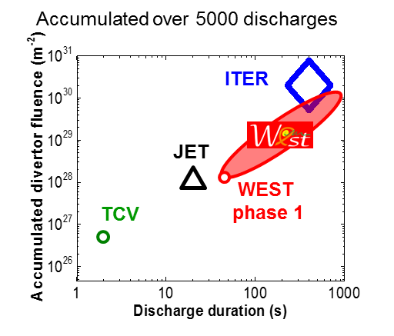
Example of LPO figure of merits
[adapted from G. De Temmerman 2018]
[E. Tsitrone, PSI 2006, JNM 2007]

Slide 17
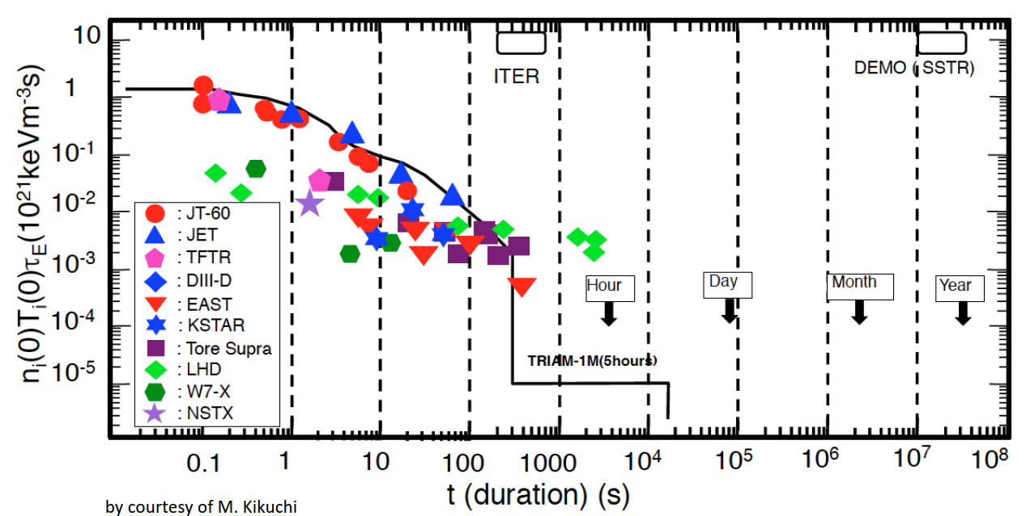
Joint Tokamak/Stellarator database addressing physics / technology LPO issues
As an example Y axis – physics performance , X axis technology/physics limitation
W7-X OP2
OP1.2
OP1.1
OP1.2
W7-X
[Original by Kikuchi, adapted from Sunn Pedersen et al., PPCF 2018; Wolf 2018]

Slide 18
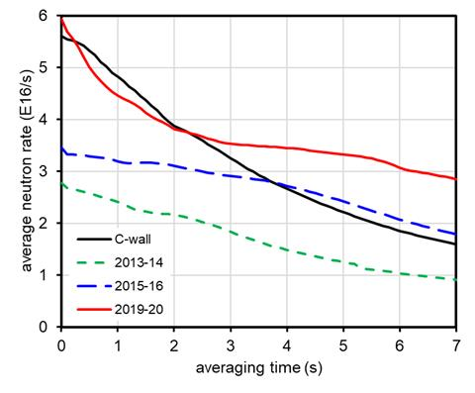
JET fusion performance vs duration (2019-2020)
Stationary fusion performance (5s) above C- Wall record
Significant progress with reliable & steady high NBI power
Peak (50ms) neutron rate significantly higher than in 2016, slightly above C-wall reference !
C-Wall
2015-2016
2019-2020
Average neutron rate [10¹⁶ n/s]
Status for AhG
2013-2014
Averaging time [s]
[C. Challis et al. 2020 ]

Slide 19
Definition of stationarity level
The fusion performance is stationary when the averaged <Y> _{τ} does not vary with respect to time , i.e. any value of τ
First moment remain constant independently of the time window , τ (this is the definition of the weak-sense stationarity)
One can quantify a level of stationarity, S _{τ} , for a given time constant by the ratio of the averaged performance <Y> _{τ} to <Y> τ₁ where τ₁ is lower than τ
S _{τ}= <Y> _{τ} / <Y> _{τ1} for any τ₁ < τ
A stationary pulse should have S _{τ} close to one

Slide 20
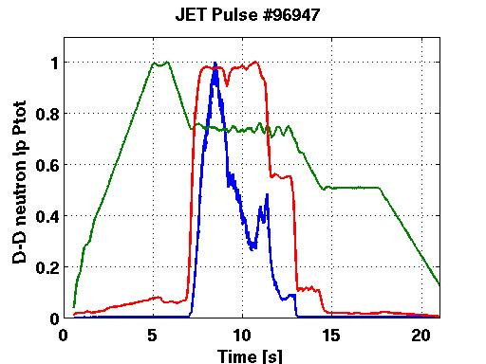
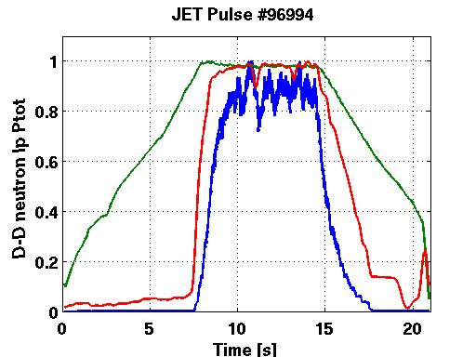
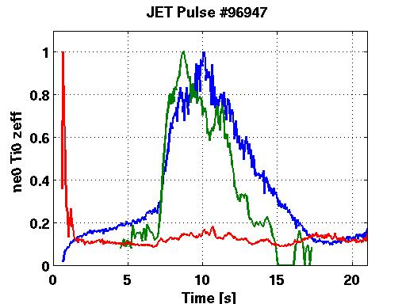
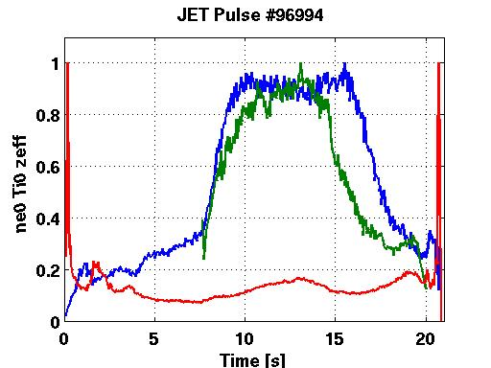
Illustration/application with two JET discharges

Slide 21
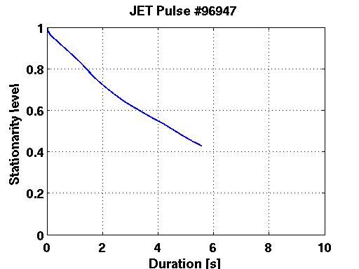
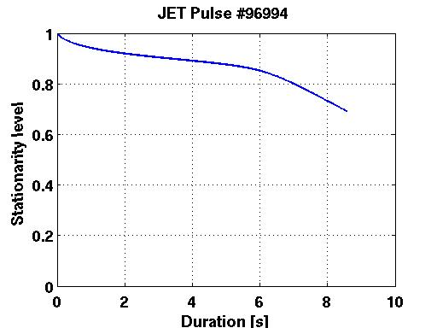
Stationarity level

Slide 22
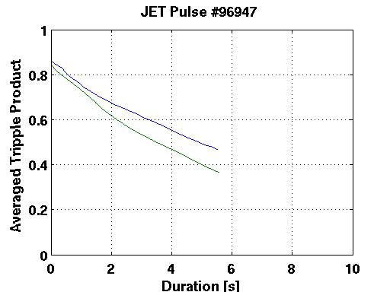
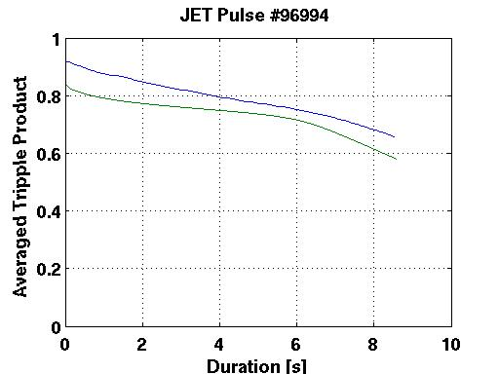
Fusion performance vs Duration

