Slide 1
Plasma System Division of the DEMO Central Team: Introduction
Hartmut Zohm
WPDES Information Meeting, Apr 27, 2021

Slide 2
DEMO physics in EU Framework Programme 9 (FP9, 2021-2025/2027)
Middle circle: System Design
External circle: Technology R&D
Central circle: Plant design
DEMO Central Team (DCT)
DCT Head
G. Federici
Safety Office
M.T. Porfiri (acting)
Plant System Design Division
M. Porton
Plasma System Division
H. Zohm
Project Integration Office
C. Baylard (acting)
BoP
TFV
RM
BB
PES
Plasma
DCT with WPDES assistance
SAE
DIV
MAT
DC
MAG
HCD
Equilibrium & stability
F. Maviglia
Transport
N.N.
Exhaust
S. Wiesen
Scenario Integration
M. Siccinio
Systems codes
M. Coleman
Green: Work Packages
Blue: DEMO Central Team (DCT) with WPDES
Yellow: Plasma (Fusion Science Department FSD)

Slide 3
Designing a ‘qualified’ plasma scenario for DEMO
The present EUROfusion strategy for the DEMO plasma scenario is based around two tools:
a systems code containing 0-D stationary models for all physics and technology elements to design an operational point consistent with the engineering constraints
a flight simulator linking a spatio-temporal plasma description to realistic sensors and actuators to develop and qualify an end-to-end ‚safe‘ (controllable) discharge design
While being used for scoping and design, tools will be updated constantly according to progress in both physics and technology
This implies not only work for WPDES, but constant dialogue with FSD and the WPs
M. Siccinio et al.,
on IDM: 2PAVUS

Slide 4
Main tasks of the DEMO Central Team Plasma System Division
analyse present baseline problems: continuation of previous high priority integration issues (first wall protection, alternative divertors and plasma scenario)
improve physics basis: largely via interaction with physics program (bi-weekly meetings with FSD, TSVV involvement…) and worldwide collaboration, incl. ITER
sharpen our tools FS/SYS: make sure improved physics basis results in better high fidelity models that are then implemented in reduced form in FS/SYS (constantly adapted)
study possible improvements of DEMO baseline (smaller, more margin, longer pulse etc…): assess what is possible under which assumption/constraint, including technology

Slide 5
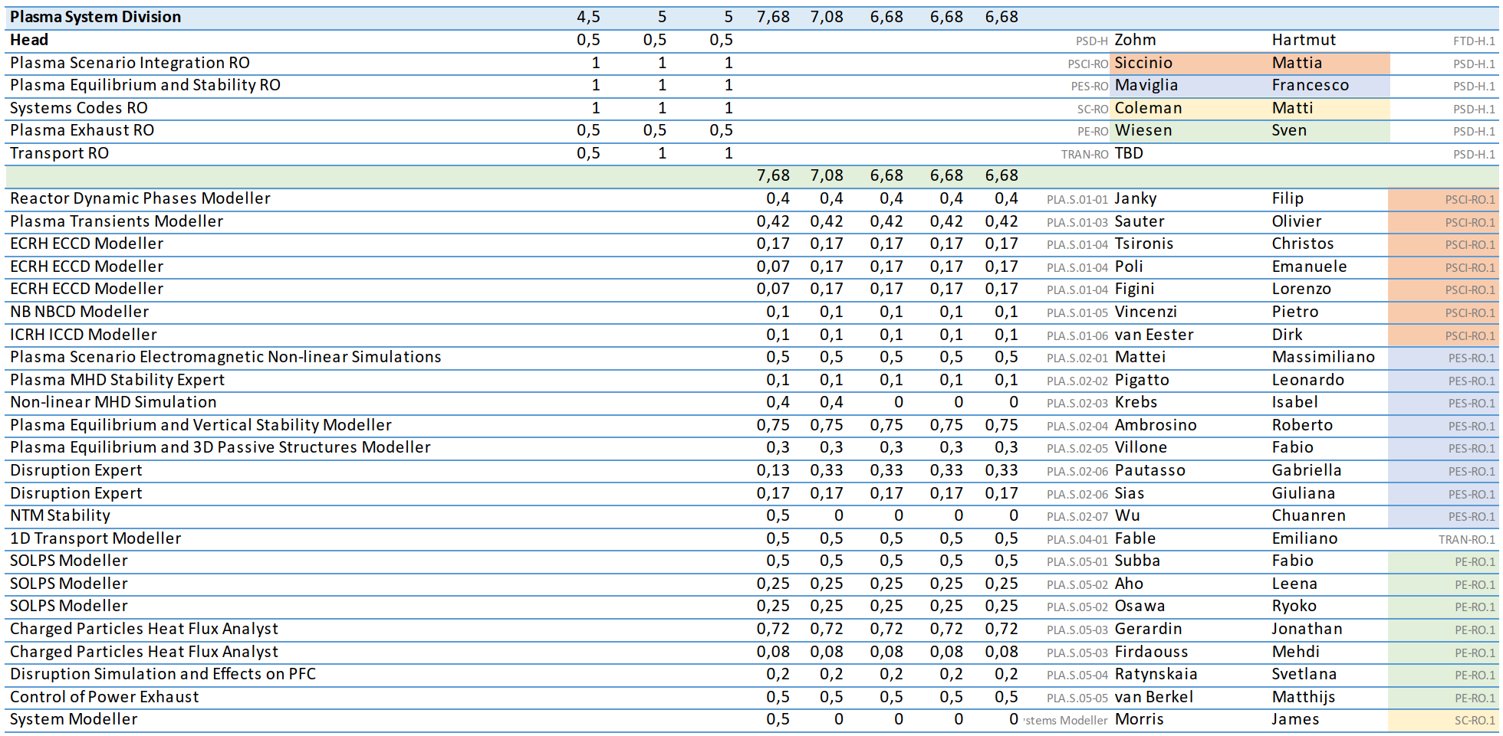
Work Package Design (WPDES), physics part (indicative)
To be expanded…
+ TSVV 14

Slide 6
A glimpse on upcoming work…
Note: more detailed work is being discussed in KoMs which take place last/this/next week, along the lines of the presentations in last week’s EUROfusion science meeting
In addition, we are discussing possible ‘sprints’, i.e. well-defined joint ventures with PSDD:
error field correction coils: static, not necessarily in-vessel, combined with RMPs(?)…
in-vessel coils: dynamic, position control, shape control, sweeping…
review TF ripple compensation: better criteria, impact on machine design…
exploration using the upgraded systems code:
aspect ratio scan
HTSC: use in CS, use to increase B_{TF}, (mabe not by a full factor 2)
negative delta (need a better physics base first, so this will come later...)
….

