Slide 1


DCT Large Meeting
G. Federici, H. Zohm, M. Porton, C. Baylard
The contents of this document cannot be reproduced without prior permission of the authors.

Slide 2
Objectives of the meeting
To present to you
Main messages
DEMO New Organization
DCT managers
Our objectives
WPDES Organization
You are part of the DCT
Converge to a feasible plant architecture and to a attractive plasma operation and power exhaust scenario
Learn how to work together and to trust each other

Slide 3
Agenda
# | Title | Time | Who
1 | New organisation of the DEMO Project | 14:00 | GFI
2 | DCT organisation | 14:10 | GFI
3 | Very brief personal presentation of DCT leaders | 14:15 | MPI, HZM, MPN, CBD
 | Staffing plan and who is reporting to who?
4 | Global organigram + SO | 14:35 | GFI
5 | PSD | 14:40 | HZM
6 | PSDD | 14:45 | MPN
7 | PIO | 14:50 | CBD
8 | WPDES Organisation | 14:55 | CBD, ABM
9 | Concept of TF lead and Syst. Design Lead | 15:05 | CBD
10 | Documentation | 15:15 | CBD
11 | Glimpse of first studies | 15:20 | GFI
12 | Questions/discussions | 15:30 | All

Slide 4
DEMO New organization: overview
Improvements
A reinforced DEMO Central Team assisted by a dedicated work-package
Extend the Scope of Work of the DEMO Central team
Setup an agile project organization with an incremental design approach
Strengthen the DEMO governance and introduce a DEMO Design Authority
A revised articulation between R&D and system design
Plasma is now considered as a system
Strengthen SE and PM culture and enforce procedures

Slide 5
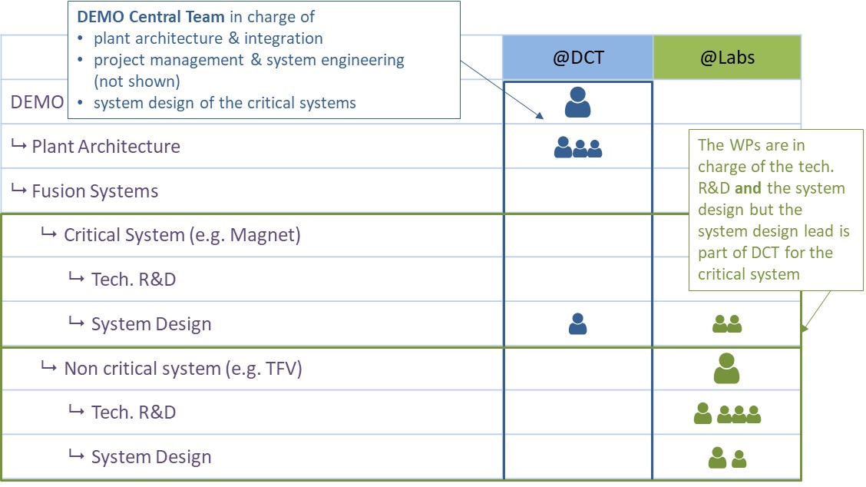
DEMO new organization: DCT role

Slide 6
DCT Organization
Gianfranco Federici
Maria Teresa Porfiri (acting)
Christophe Baylard (acting)
Michael Porton
Hartmut Zohm

Slide 7
Conceptual Design Process Continuum and its Relationships to Critical Decision Development Process
Design work entails making decisions about a continuous variety of options and trade-offs.
Many of these trade-offs lead to adapting the work scope, adjusting resources, adapting personnel (experience and expertise), adjusting schedule, and performing tasks sequentially or in parallel to minimize risks or to optimize the critical work path.
G2: Transition concept selection concept validation
G2: Relatively stable design point (ie, machine parameters and plant configuration)/ Down-selection of design variants mostly completed. This is not end of the concept design phase!!
G1.x Need intermediate gates (DSB!).
Critical issues identified by G1
Plasma physics basis, including the plasma scenario, plasma exhaust, and first wall protection strategy → H. Zohm
Breeding blanket → Sprints being organised under the supervision of F. Hernandez
Remote maintenance and the blanket segmentation and extraction → Sprints underway under the supervision of G. Janeschitz
Building layout→ work underway with industry FWC

Slide 8

Conceptual Design Process Continuum and its Relationships to Critical Decision Development Process
Concept Selection Phase
Concept Validation
CD consolidation
EDA Preparation
G1
G2
G3
G1.1
G1.x
2024
2025
2027
2020
2030
KDII1
Define initial plasma control strategy
In-vessel coils
Confirm plasma control strategy
WORK IN PROGRESS
KDII2
Confirm feasibility of design DEMO as a BB CTF
Select Driver Breeding blanket driver and coolant
Complete integration studies of the plant and individual systems, including RAMI and cost assessment
Conduct conceptual design of less critical systems
Full safety analyses
KDII3
Select divertor configuration for initial integration studies
Confirm divertor configuration and backup
KDII4
Blanket handling strategy, requirements and selection criteria for a # of aspects e.g., blanket poloidal segmentation # of maintenance ports
Select ex-vessel maintenance strategy ensuring upfront attention to contamination control
Important results from PEX ADC programme see next detailed slide
KDII5
Confirm Direct or indirect BOP/PCS
Select coolant BB Driver
KDII6
Define safety/ licensing reqs and constrains on the layout of tokamak building (RoX ITER)
Confirm safety strategy and first
radiological containment barrier
KDII7
Confirm feasibility of MF pumping solution
Strategy to mitigate / control transients
Fix HCD power requirements and systems-mix
KDII8
Preliminary assumptions on Physics Basis
and Route of Plasma Performance Optimization
Others
Define reqs tritium control strategy
Cost trading choices
Select WP TF and CS coils
2021
2022
2023
2024
2025
2026
2027

Slide 9
Agile Organization: global view

Slide 10
Agile Organization: zoom @ 1 sprint
Kick off meeting
Execution
Sprint review meeting
Scope of sprint
Input data (assumptions, baseline elements, etc.)
Resources and task repartition
Organisation (communication, weekly meeting, etc.)
Documentation
Assessment of the work done
(If not performed during execution) production of documentation of the work done
Execution of the agreed tasks
Possible reassessment during sprint
Gap analysis with original objectives and “backlog”
Decision to continue to another sprint

Slide 11
WPDES Organization
Agile Way of Working
No task specification one year in advance
Work “on demand” by your “coordinator” in DCT (see staff plan)
Admin
Gianfranco Federici is the WP lead
Thomas Franke is the overall coordinator in charge of all admin and practical questions
We (will) put very general task specification in IMS corresponding to the profile
Please keep track of the tasks performed, time spent and documents delivered
A summary document (at the one official IMS deliverable) will be asked at the end of the year
Task coordinator (TC)
Normal tasks: your TC is in charge of defining the tasks to be performed
Sprint tasks: the task force leader is in charge of defining the tasks
TC is in charge of follow-up and shall be kept informed at all time when your work for a sprint
TC in charge of task proper documentation, quality of the work done. Reviewer in IDM of the document
In case of conflicting priorities, inform your TC. He will try to solve the issue with you or escalate if needed

Slide 12
WPDES Documentation
For non sprint tasks
Tasks spec to be put into the summary document by the task coordinator
Documents to be put in IDM and reference/link to them to be inserted into the summary document
For sprint tasks
Depends on the decision of the task force leader and the way he/she uses to coordinate various actions
At least a summary of the actions performed shall be inserted into the summary document
Preamble
We are looking for solution to collaborative document editing and for tasks tracking (for instance, JIRA & Confluence). We will installed later this year (after one or two pilots)
Currently not decided yet, so please use currently “standard” ways (emails, meeting minutes, etc.)
In any case, a summary document to be produced at the end of the year as official deliverable

Slide 13
3 (+ 1) Key roles in DEMO org.
WP lead
System Design Lead
Tech. R&D lead:
explain what technology is used where
ensure consistency of the R&D program with the ERICAs
perform tech. survey in and outside fusion community
point out inconsistencies between technologies promises and system needs
write achievable system requirements with system design lead
collaborate with DEMO lead architect and DEMO integration office to ensure integration (functional and geometrical) of the system into DEMO plant
lead all system design (SE) activities, in particular ensure integration of all sub-systems
participate to solutions assessment
conceive and implement the tech. maturity plan
accountable for tech. R&D development
follow-up all tech. R&D activities and report to WP lead in case of issues, delay, etc.
proposes solutions to solve issues
coordinate and monitor all documentation production concerning tech. R&D
Technical and programmatic coordination of the 2 legs:
Lead architect and project manager for all system design activities:
Coordinates tech. R&D activities:
in case of issues or changes, assess impact
propose tech. solutions
Coordinate and review all documentation concerning system design

Slide 14
Transverse function: what is it?
Transverse function are functions/constraints for the plant that affect many (if not all) systems
The main functions are allocated to one system
For instance: safety, nuclear integration, tritium, material, maintenance, etc.
System | F1 | F2 | F3 | TF1 | TF2 | TF3
MAG | x |  |  | x | x | x
TFV |  | x |  | x | x | x
DC |  |  | x | x | x | x
… |  |  |  | x | x | x
BOP |  |  |  | x | x | x
PHTS |  |  |  | x | x | x

Slide 15
Transverse function Lead: their role
The role of a transverse function lead is to ensure to DEMO head that the function
is fulfilled, for this he/she
define the requirements at plant level
propagate the requirements at system level (loads)
conceive, in collaboration with PSDD head, a concept/plant architecture in order to fullfill the function
review system design (with respect to their function)
issue design recommendation for the systems

