Slide 1
WP-PWIE, ADC SPs 2021: KoM
Giuseppe Calabrò

Slide 2
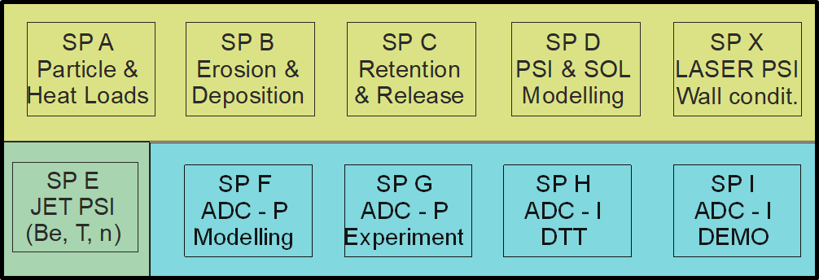
Plasma-Wall Interactions & Exhaust in FP9
FTD
WP MAT
WP DIV
WP DES
WP SAE
WP PWIE
jointly with WP TE!
WP PrIO
WP TE
WP W7X
WP SA
FSD
WP PWIE (ADC part: SPs F-I) includes partially previous WP ADC-DTT activities
Budget Constraint: reduced budget of factor ∼ 3
Stringent time constraints: PEX upgrade timeline, DEMO Gate 2 and I-DTT divertor decision point…

Slide 3
SPs-ADC: an overview
SP | Title | Budget (pm)
F | Modelling of advanced divertor configurations for DEMO and PEX solutions | 24
G | Experimental assessment of PEX solutions and modelling interpretation | 10
H | Engineering boundary conditions related to DTT as ADC test-bed | 15
I | Engineering boundary conditions related to DEMO ADC solutions | 10
Total |  | 59

Slide 4
Agenda of today KoM
Opening, 5 mins
ADC studies: FP8-FP9 relay race, S. Brezinsek, 20 mins
SP-F (25 mins), Leena Aho-Mantila
SP-I (10 mins), Pierluigi Fanelli
Break (5 mins)
SP-G (15 mins), Tilman Lunt
SP-H (15 mins), Roberto Ambrosino

Slide 5
SP-ADCs: today structure discussion
Short description of modelling status and open issues
Description of planned deliverables for 2021
Discussion
Organization of teamwork (information exchange; agree on regular team meetings; timeline

Slide 6
SPs-ADC: 2021 meetings
Meeting | Who | When | Duration (h)
SPs-ADC coordination | PL, DPL, SPs coord.s | ∼ Every 3 weeks | 1
Progress meeting | All | ∼ Middle of July 2021 | 3
Intermediate Meeting | All | ∼ Middle of October 2021 | 3
Final meeting | All | - Early in December 2021 | 4
SP coordinators encouraged to have meetings with their teams!!

