Slide 1
DTT electromagnetic scenario modelling and control
R. Ambrosino^{1,3}, R. Lombroni², G. Ramogida³
¹ DIETI - Univ. Napoli Federico II, Consorzio CREATE
² Department of Economy, Engineering, Society and Business Organization (DEIM), University of Tuscia, Viterbo, 01100, Italy
³ DTT Scarl

Slide 2


Contents
DTT device
Electromagnetic scenarios
Magnetic control issues
2021 WPWIE activities

Slide 3
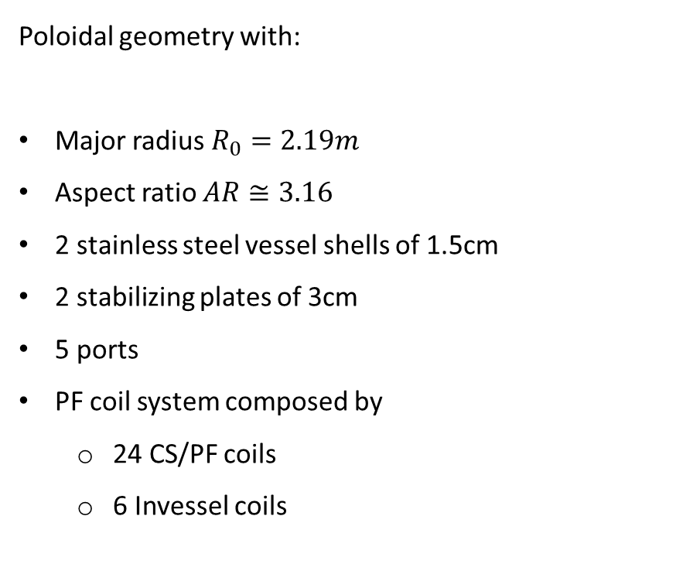
Poloidal geometry
Poloidal geometry with:
Major radius $R_{0}=2.19m$
Aspect ratio $AR≅3.16$
2 stainless steel vessel shells of 1.5cm
2 stabilizing plates of 3cm
5 ports
PF coil system composed by
  24 CS/PF coils
  6 Invessel coils

Slide 4
PF coil system
The PF coils system of the DTT device is up-down symmetric and it is composed by
18 CS coils defining 6 independent circuits: CS3U – CS2U – CS1U – CS1L – CS2L - CS3L
6 independent PF coils: PF1 – PF2 – PF3 – PF4 – PF5 – PF6
4 independent divertor coils: IVC1– IVC2 – IVC3 – IVC4
2 independent invessel VS coils: IVCU – IVCL
CS3U_MF
PF1
PF2
CS3U_HF
CS3U_LF
CS3U
CS2U
PF3
CS1U
IVCU
Each CS circuit is composed by the series of 3 coils at high, medium and low field
CS1L
IVCL
CS2L
IVC1
IVC4
PF4
CS3L
IVC2
IVC3
PF5
PF6

Slide 5
DTT reference equilibria at flat top
Single Null
I_{pl}=5.5 MA
Double Null
I_{pl}=5 MA
Snowflake
I_{pl}=4.5MA
X-divertor
I_{pl}=4.5MA
Negative Triang.
I_{pl}=4MA
For the reference configurations the following scenario phases have been developed:
Preliminary Breakdown
Ramp-up
Flat top
Ongoing activities:
Detailed breakdown
Definition of the ramp down
Definition of the transitions (LH and HL)
Coupling between transport and electromagnetic simulations

Slide 6
DTT Control issues
Control of alternative configurations represents a very challenging problem for the next generation devices. The main issues of the control of alternative configurations are related to:
  Vertical stability
    Needs to increase the elongation to recover the plasma volume
    High distance between plasma and conductive structures
  Shape control
    High sensitivity of the configurations with respect to plasma current variations
  Power exhaust control
    Internal coils needed for the control power exhaust parameters such as flux expansion and connection length
    Possibility to implement additional control strategy to reduce to stress on the divertor plates such as sweeping of the legs and plasma wobbling
    IN THE DTT DESIGN PHASE A PRELIMINARY ANALYSIS OF THE CONTROL ISSUES IS
    NEEDED FOR THE OPTIMIZATION OF THE PLASMA CONFIGURATIONS, PFCs, DIVERTOR AND VACUUM VESSEL

Slide 7
2021 CREATE activities on WPWIE
Electromagnetic modelling
  Support to the DTT physic activities under WPWIE (resp: P. Innocente) in terms of definition of additional DTT plasma configurations
Magnetic control
  Design of the preliminary shape controllers for SN and alternative configurations for the analysis of disturbances and transients (LH and HL). Effect on the divertor design
VDE and Disruptions
  Analysis of the effects of VDE and MD of the plasma facing components
Deliverable ID: | Deliverable Title:
D1 | Engineering compatibility of best promising configurations described in WP ADC-DTT’s final report for DTT facility: recommendations for control and equilibria design
D2 | Engineering compatibility of best promising configurations described in WP ADC-DTT’s final report for DTT facility: recommendations for VDE and disruption consequences

