Slide 1


PWIE-ADC.I: Engineering boundary conditions related to DEMO ADC solutions
P Fanelli

Slide 2
Limiter Tasks 2021
WPPWIE
PWIE-ADC.I.T.001 Engineering boundary conditions related to DEMO ADC solutions (10 PM)
Pierluigi Fanelli (Univ. Tuscia)
Deliverable | Del. Owner | Team | Prov. Title | End Date | PM (@50%)
PWIE-ADC.I.T.1.D001 | Pierluigi Fanelli (Univ. Tuscia) | Tuscia | Plasma-Wall contact points during disruptions and initial evaluation of ADC transients in terms of heat flux impact point | 2021 | 6
PWIE-ADC.I.T.1.D002 | Pierluigi Fanelli (Univ. Tuscia) | Tuscia+Tor Vergata | Initial definition of required size and configuration of ADCs divertor including the baffle | 2021 | 4
Inputs required:
DEMO hybrid ADC equilibria configurations and geometry layout delivered by WP ADC-DTT’s final report
Transients list (Maviglia et al. Fusengd 2020, 158, 111713)
New ADC equilibria that will be produced under WPDES activity (which have a realistic TF coil configuration, hence PF coil)
Recommendations for engineering aspects of DEMO VS control (delivered by WP ADC-DTT’s final report and WPPMI 2020 activity)

Slide 3
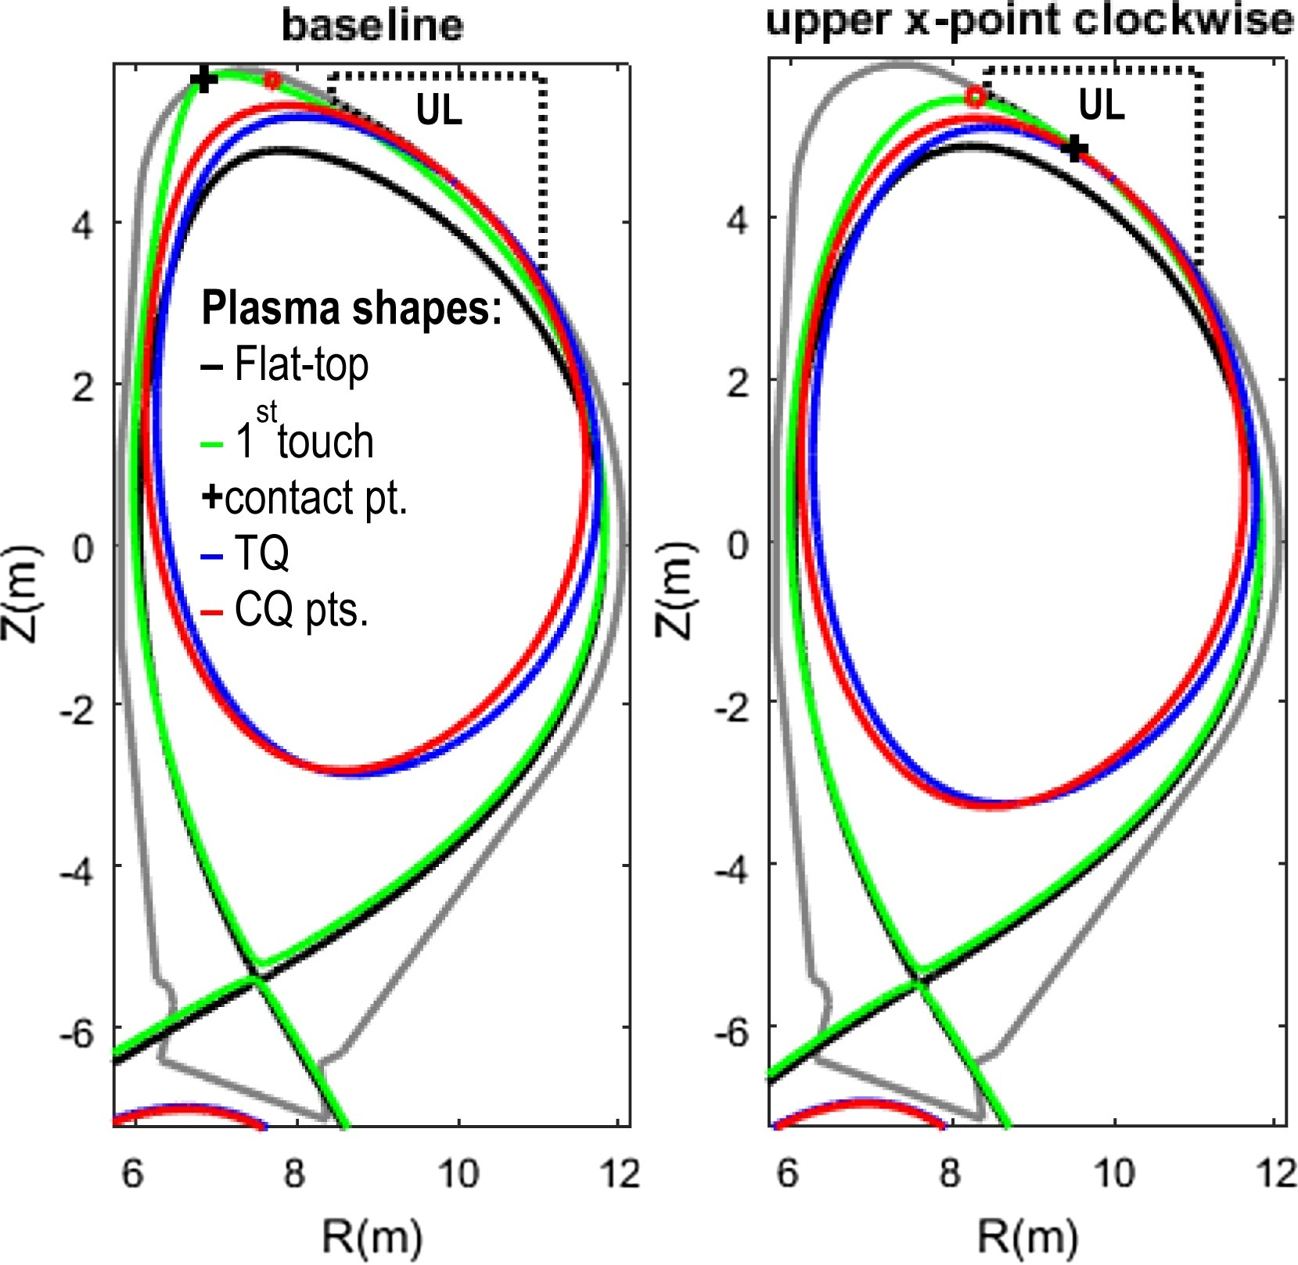
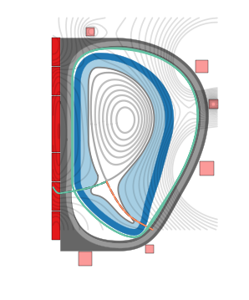
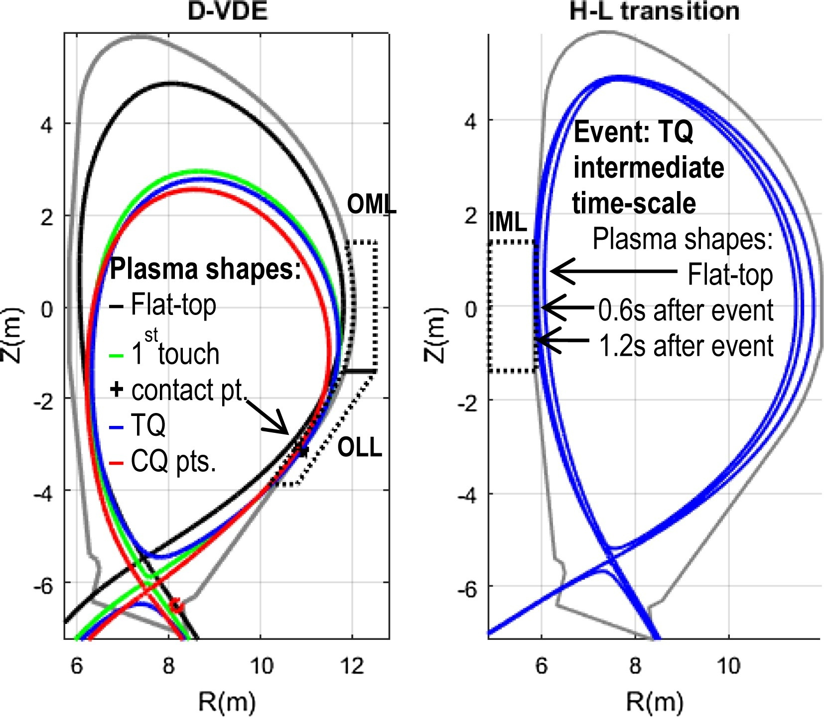
Limiter Tasks 2021
WPPWIE
PWIE-ADC.I.T.001 Engineering boundary conditions related to DEMO ADC solutions (10 PM)
PWIE-ADC.I.T.001.D001 - U. Tuscia (6PM)
Plasma-Wall contact points during disruptions and initial evaluation of transients in terms of heat flux impact point (Del. Owner: Pierluigi Fanelli)
  It investigates most favorable solutions configurations (WP ADC-DTT 2020) in terms of plasma-first wall contact points during U and D-VDE, Major Centred Disruptions (Maviglia et al. Fusengd 2020, 158, 111713)
  Approach similar to KDII1 for SN in FTD
  Definition of possible limiters positions
  First tentative to optimize first wall according to plasma contact points of DEMO ADC configurations, in connection with WP DES, considering engineering constrains
Objective: collect the ADC transients in terms of heat flux impact points; define possible limiter positions
Deliverable: Report and results presentation

Slide 4
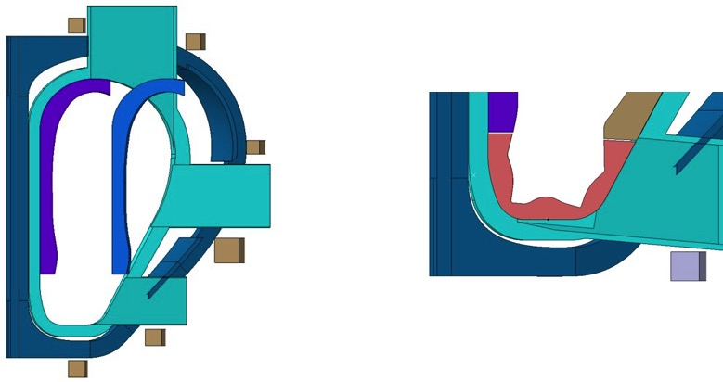
Limiter Tasks 2021
WPPWIE
PWIE-ADC.I.T.001 Engineering boundary conditions related to DEMO ADC solutions (10 PM)
PWIE-ADC.I.T.001.D002 – U. Tuscia + U. Tor Vergata (4PM)
Initial definition of required size and configuration of ADCs divertor including the baffle (Del. Owner: Pierluigi Fanelli)
  Preliminary dimensioning of ADCs divertor (target/baffle area)
  Geometrical and position assessment of baffle
  The sizing of the divertor could help preliminary comparative studies SN/DN FTD – ADCs FSD on RM, port sizes, Tritium Breeding Ratio
Objective: preliminary required size and configuration of ADCs divertor including the baffle
Deliverable: Report and results presentation

Slide 5
PWIE-ADC.I: Engineering boundary conditions related to DEMO ADC solutions
P Fanelli

