Slide 1
Project news: Summary of the TSVV & ACH KoM
E. Nardon, TSVV9 Progress Meeting, 06/05/21
The TSVV & ACH kick-off meeting took place on Friday 23/04
Slides on https://indico.euro-fusion.org/event/922/ (I am not sure if you have access)
Started with an introduction by Volker Naulin (head of Fusion Science Department) and Frank Jenko (chair of E-TASC scientific board) → Next slides

Slide 5
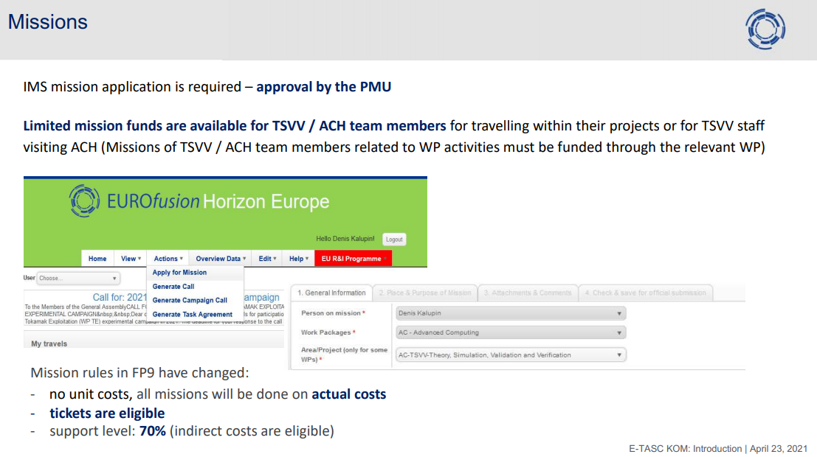

Slide 7
This was followed by presentations from each ACH to introduce themselves
Concerning the IMAS integration of codes, IPPLM will only provide support and documentation; we will have to do the integration ourselves
Allocation of ACH resources to TSVVs is “in thinking”
Ramp-up of ACHs → cut by ~30% initially, ramping down to 0 (i.e. no more cut) by ~2023(?)
They asked us to set priorities. We replied:
Integration of DREAM into IMAS: medium
Parallelization and optimization of DREAM: medium
Optimization of JOREK for particle simulations: high
RE validation database: high
Finally, there were discussions within each thrust. Ours was very short and not much came out. We agreed to have a thrust meeting some time in May.

