Slide 1

Overview and status of SOLPS DEMO activities within the DEMO Central Team
S. Wiesen
May 11th 2021

Slide 2
DEMO physics in EU Framework Programme 9 (FP9, 2021-25/27)
Transport
F. Köchl
S. Wiesen | TSVV-7 KoM | May 11th , 2021| Page 2

Slide 3
Plasma System Division (PSD) WPDES - Exhaust
Divertor Design studies
Core-edge coupling
Wall models
Time-dependent SOL/edge models
ADC (WP-PWIE)

Slide 4
Employment of SOLPS-ITER: from ITER to DEMO
ITER design changed in 2013 to full-metal walls, now completed
Design required considering the most severe target loading conditions for engineering specifications (P_{SOL} = 100 MW, D(T) plasmas with impurity seeding)
Since 2014: New SOLPS-ITER code for divertor design
ITER: Emphasis is to widen the existing simulation database to other operational scenarios (low-power plasmas, limiter phase start-up, H/He plasmas, seeding…) and including refinements of the underlying physics model (wide grids, drifts, currents, transport models, possible systematic errors, …), i.e. features not originally in SOLPS4.3 → SOLPS-ITER

Slide 5
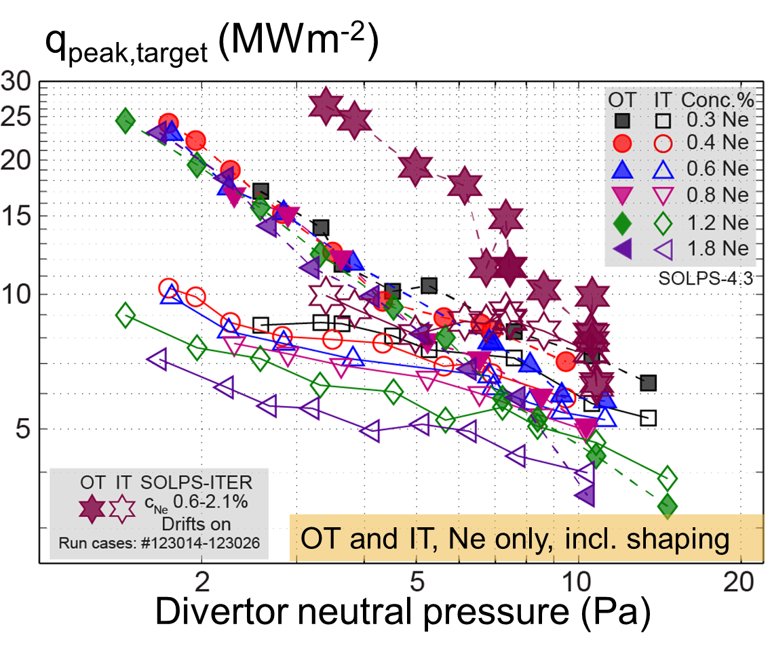
Revised ITER Divertor Design studies: metal wall & SOLPS-ITER
P_{SOL}=100MW
R.A. Pitts, E. Kaveeva, V. Rozhanski, S. Wiesen, X. Bonnin et al, NME 2019

Slide 6
Early assessment for DEMO
SOLPS4.3, Kukushkin
Pacher
2007-2009
D/He/Be +
Ne-seeding
P_{SOL} = 300MW
Density control by
Core + Gas fuelling

Slide 7
Early assessment for DEMO
Full detachment of inner divertor restricts p_{PFR}
Criterion: max T_{e} at inner target falls below certain minimum, i.e. < 5eV
For DEMO: p_{PFR,max} = 18.6 Pa
SOLPS4.3, Kukushkin, Pacher 2007-2009

Slide 8
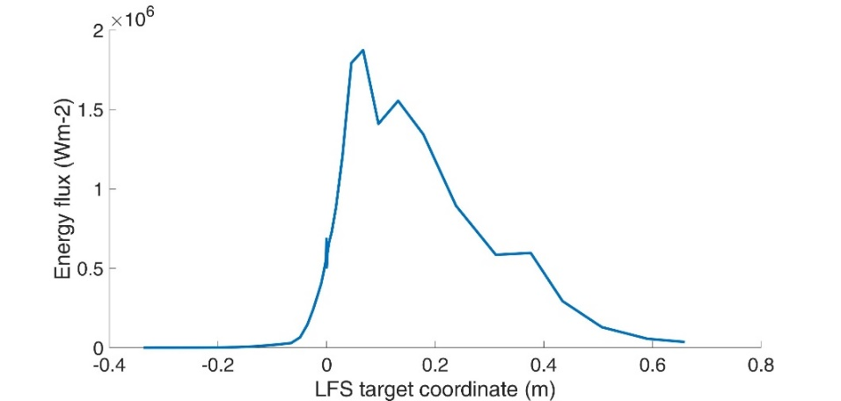
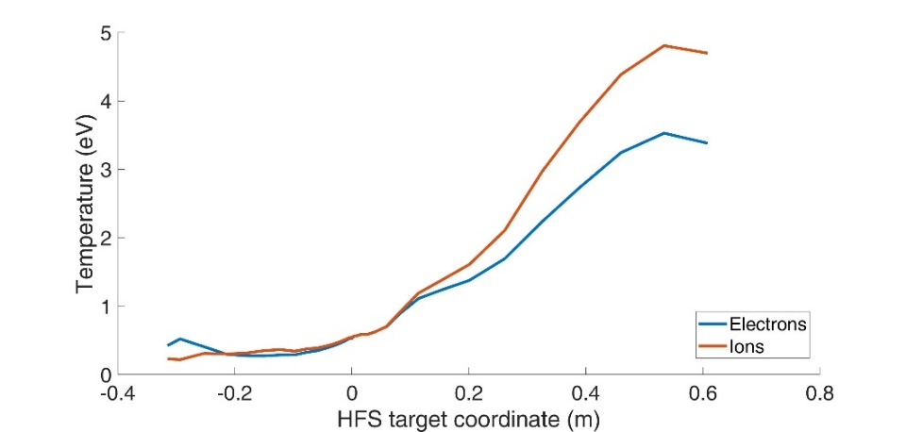
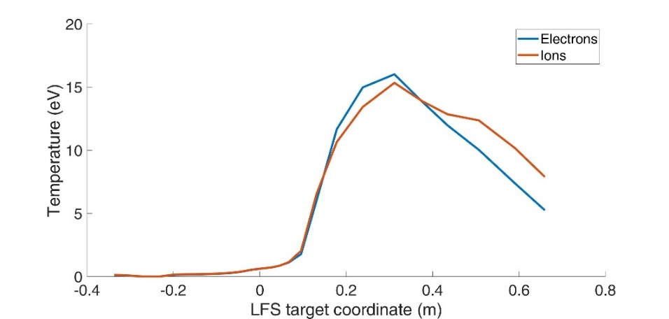
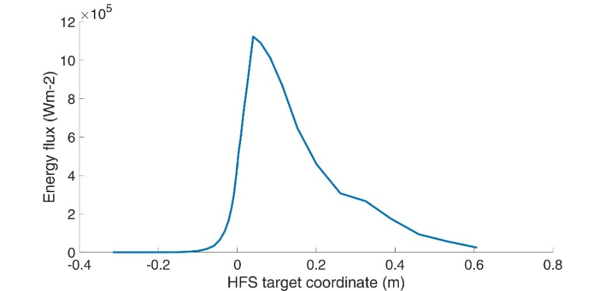
Re-assessment with new SOLPS-ITER
Work only started in FP8: F. Subba EU-DEMO → WPDES
SOLPS-ITER model parameters
  Input power into edge: 150 MW
  D-puff: 1e23 atoms/s (~ 200 Pa m³ s⁻¹)
  Minor D pellet volumetric source: 7e21 (s⁻¹)
  D+He+Ar plasma
  Ar puff: 1.5e19 atoms/s
HFS deeply detached
Low temperatures; <1eV at max particle flux/density
Negligible heat flux ~ 1MW/m²
LFS partially detached
temperature low @ strike-line < 1.5eV
Heat-flux max 2MW/m²
Assessment of several control parameters, together with satisfying a number of constraints (e.g. power loading and core He density or radiation)
→ establishment of DEMO operational windows and SOLPS-ITER based scalings
Extension towards EU-DEMO design: e.g. include XPoint radiation (demonstrate validaity of model first, e.g in WPTE!),
Add physics: inclusion of drifts, line emission opacity, neutral buffering, etc
later include also high candidate ADCs (e.g. DDN)
Zeff ~1.9 in the core
HFS
LFS

Slide 9
Plasma System Division (PSD) WPDES - Exhaust
Divertor Design studies
Core-edge coupling
Wall models
Time-dependent SOL/edge models
ADC (WP-PWIE)

Slide 10

Previous ASTRA/SOLPS4.3 coupling
Core & pedestal:
ASTRA/ICPS model
MMM/Weiland models, shear stabilised; JET/AUG
Edge:
SOLPS4.3 setup as in ITER – but no direct coupling
Provide ASTRA with n_{i}/T_{i,e} DT/He fluxes at spx
Derived scalings for point-of-detachment, i.e.:
$$n_{DT}^{sep}\sim μ^{0.43}$$
H.D. Pacher, G.W. Pacher, A.S. Kukushkin, G. Janeschitz
DEMO conceptual study EFDA TW6-TRP-002

Slide 11
Numerical assessment of integrated DEMO operational space
DEMO operating window, I=21 MA, Ne seeding feedback
Review ASTRA/SOLPS-ITER coupling: functionality and code-implementation (e.g. same functionality as in ASTRA/SOLPS5.0 coupling), versioning
Interface requirements:
Assess overlapping computational region between SOLPS-ITER (2D) and ASTRA (1D); identification of an improved scheme to couple; improved pedestal model (i.e. including core radiation)
H.D. Pacher, G.W. Pacher, A.S. Kukushkin, G. Janeschitz
DEMO conceptual study EFDA TW6-TRP-002

Slide 12
Plasma System Division (PSD) WPDES - Exhaust
Divertor Design studies
Core-edge coupling
Wall models
Time-dependent SOL/edge models
ADC (WP-PWIE)

Slide 13
CX and photon fluxes on (ITER) first wall components
Breakdown of problem: ITER
Also: photons and radiation loads
possible
Collaborative work WPDC, W. Biel

Slide 14
CHERAB DEMO First Wall Estimated Loads
Collaboration WPPWIE & TSVV-7
Continuation requires SOLPS-ITER w/extended wall option (not validated yet);
comparison with other models (e.g. SOLEDGE2D)
Development of numerical diagnostics for heat-fluxes in DEMO:
CX and photon fluxes on walls (energy spectra, angular distribution)
Comparison CHERAB vs EIRENE; (disruptions/VDEs) → RACLETTE
finalization of off-normal radiation loads task
3D field line tracing codes to estimate charged particle HF (PFCflux – SMARDDA)
Later: kinetic models of 3D structures (e.g. toroidal/poloidal gap analysis
Long term: Towards numerical optimization of first wall, steady-state & transients (e.g. disruptions/VDEs), impact on wall, W droplets (MEMOS-U)
Calculations on TQ mitigated Disruptions (or VDEs)
Assessment of active mitigation techniques
Initial thermal energy W_{th}=1.3GJ:
20% radiated @ pre-TQ at MGI/SPI
→ 1GJ remaining
Analysis including averaging techniques
Some relevant differences observed:
  More uniform load distribution
  Estimated peak load appears smaller by about 33%
  Higher accuracy
P_{rad}=800GW
F. Maviglia, IAEA-TM 2020

Slide 15
Plasma System Division (PSD) WPDES - Exhaust
Divertor Design studies
Core-edge coupling
Wall models
Time-dependent SOL/edge models
ADC (WP-PWIE)

Slide 16

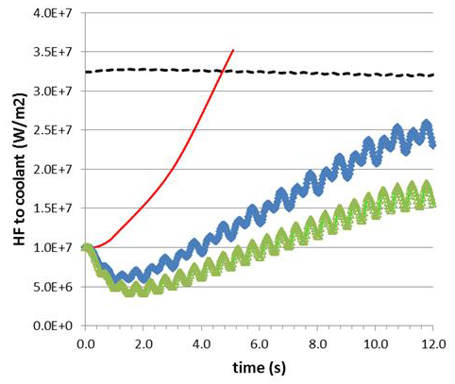
Example: Re-attachment in DEMO
The maximum tolerable steady-state HF on the current DEMO SN divertor plate is 10 MW/m². This value can be achieved only in detached plasma conditions (with seeded impurities).
In case of accidental divertor reattachment, the divertor reaches burn-out (leading to an in-vessel LOCA) in about 3 sec.
Divertor sweeping (to be activated only in emergency cases) to allow the divertor surviving while the current is ramped down [Maviglia, FED 2016].
Needs the presence of IVC.
Siccinio, NF 2019, RACLETTE

Slide 17
Advanced Fluid Neutral Model application to ITER
TSVV-5
Re-attachment/re-detachment studies; requires input from WPTE expts
Time-dependent option in SOLPS-ITER: issue: explicit-implicit coupling of plasma-fluid and neutral Monte-Carlo
Exploit advanced fluid-models in SOLPS-ITER for time-dependent simulations (without EIRENE); integration with core-codes (e.g. ASTRA)
Interaction related ETASC TSVVs (flight simulators, scenario integration) and ENRs on model reduction (e.g. generative neural-networks) as alternative model

Slide 18
Plasma System Division (PSD) WPDES - Exhaust
Divertor Design studies
Core-edge coupling
Wall models
Time-dependent SOL/edge models
ADC (WP-PWIE)

Slide 19
ADC
Mainly covered by WPPWIE/ADC and WPTE (physics)
Extension of FP8 activities (c.f. F. Militello et al, ADC report 2021, WP-DTT1 and WP-DTT1/ADC) - SOLPS-ITER
Requires speed up and/or validated reduced physics models
Extension of WPDES activities towards ADC scenarios, e.g. DN, SXN. Later on
Cyclic monitoring of DCT into WPPWIE/WPTE activities: focus on demonstration of ADC being a possibility for DEMO → input gate review 2024
Work with groups who work on advanced fluid models (e.g. TSVV-5) and numerical divertor optimisation techniques
(e.g. Univ. Leuven, adjoint optimisation techniques)
→ WPPWIE (possible combined PWIE-DES EEG)
Later: assessments of engineering limits for ADCs: transients and configurations (e.g. sweeping etc)

Slide 20
Summary
Divertor Design studies
Core-edge coupling
Wall models
Time-dependent SOL/edge models
ADC (WP-PWIE)

Slide 21
backup

Slide 22
Lessons learned ITER divertor design
SOLPS4.3 has been the main workhorse for the ITER divertor design studies since 20+ years
Physics operating mode for the ITER divertor is to a large extent based on plasma boundary simulations conducted over ~15 years with the SOLPS-4.3 code (B2-Eirene) → mostly C targets!
  A. S. Kukushkin et al. J. Nucl. Mat. 290-293 (2001) 887
  A. S. Kukushkin et al. Nucl. Fusion 42 (2002) 187
  A. S. Kukushkin and H. D. Pacher, PPCF 44 (2002) 931
  H. D. Pacher et al. J. Nucl. Mat. 313-316 (2003) 657
  A. S. Kukushkin et al. Nucl. Fusion 43 (2003) 716
  A. S. Kukushkin et al. Fus. Eng. Design 65 (2003) 355
  A. S. Kukushkin et al. Nucl. Fusion 45 (2005) 608
  A. S. Kukushkin et al. J. Nucl. Mat. 337-339 (2005) 17
  A. S. Kukushkin et al. Nucl. Fusion 47 (2007) 698
  A. S. Kukushkin et al. J. Nucl. Mat. 363-365 (2007) 308
  G. W. Pacher et al. Nucl. Fusion 48 (2008) 105003
  H. D. Pacher et al. J. Nucl. Mat. 390-391 (2009) 259
  A. S. Kukushkin et al. Nucl. Fusion 49 (2009) 075008
  A. S. Kukushkin et al., J. Nucl. Mat. 415 (2011) 2011
  H. D. Pacher et al. J. Nucl. Mat. 415 (2011) S492
  G. W. Pacher et al. Nucl. Fusion 51 (2011) 083004
  A. S. Kukushkin et al. Fus. Eng. Design 86 (2011) 2865
1996
2001
2009

Slide 23
Early assessment for DEMO
SOLPS4.3, Kukushkin, Pacher 2007-2009

Slide 24
Erosion vs Deposition on the ITER port-plug faces
V. Kotov NF 2016

Slide 25
Hierarchy of neutral models
TSVV-5

Slide 26


What else can cause a loss of detachment?
Well, many things…
Fluctuations in the separatrix density.
Fluctuations in the separatrix power (e.g. pellet induced transient α-particle heating)
Combinations thereof.
Technical failure (e.g. impurity puff valve).
Control failure.
…others…
$$f_{rad}=40\%$$
$$f_{rad}=60\%$$
Impurity radiation
control required
ITER/JINTRAC
[Wiesen, NF 2017]

Slide 27
ITER exaple: pellet induced re-attachment
High density
Short bursts of
re-attachment
during pellet ablation
Such simulations
help to predict
and mitigate impact
of unavoidable
transients in HF
→ ITER & DEMO
divertor engineering
and operational design

Slide 28
Issue of particle balance / explicit-implicit coupling
→ long convergence times
A. S. Kukushkin et al. Fus. Eng. Design 86 (2011) 2865

Slide 29
W droplets lifetime in DEMO – preliminary results
ITER vessel geometry with a full W wall, ITER mitigated VDE profiles with late Ne gas
injection during the current quench
Isotropic W droplet injection from the plasma-wall contact point
during a 4 ms window after the thermal quench,
with initial radii 10-150 µm and initial speeds 0-70 m/s
→ Out of the injected droplet MASS, roughly 40% vaporizes,
40% re-solidifies into dust and 20% ends up as liquid splash on wall

