Slide 1
UQ, SDTrim-activities and Ravetime
Udo von Toussaint
TSVV7 Kick-off meeting, May 2021-05-11
UQ
SDTRIM
Ravetime
Notes:
1

Slide 2
TSVV…
T heory
S imulation
V erification
V alidation

Slide 3
Interplay of Simulation – Verification - Validation
physical model of system -
Theory
visualization
data mining/science
optimization
stochastic models
uncertainty quantification
(multiscale) models
validation
mathematical model
Simulation-based decision making
e.g. design, control, operations,
material selection, planning
advanced geometry &
discretization schemes
- parameter inversion
- data assimilation
- model/data error
control
- uncertainty
quantification
numerical model
computer
simulation
scalable algorithms & solvers
data/observations
(actual )
verification
approximation / error control

Slide 4
Validation
Typical challenges in simulation based models:
Aleatoric and epistdemic uncertainties
Medium to large number of uncertain inputs
Non-linear interactions possible / likely
Uncertainty (Reliability) of results?
Increasing awareness of importance: cf. transport shortfall
UQ-methods for computer models
Notes:
So, if you don’t know the solution, how do you test?

Slide 5
Methods in Uncertainty Quantification
Common Approaches to Uncertainty Quantification
Sampling (Monte Carlo methods) : simple, too expensive, lack of higher order info
Spectral Expansion (Polynomial Chaos Expansion)
Non-Intrusive Approach
Intrusive Approach: complete code rewrite
Surrogate models (eg. Gaussian processes)

Slide 6
Methods in Uncertainty Quantification
Spectral Expansion (Polynomial chaos expansion)

Slide 7
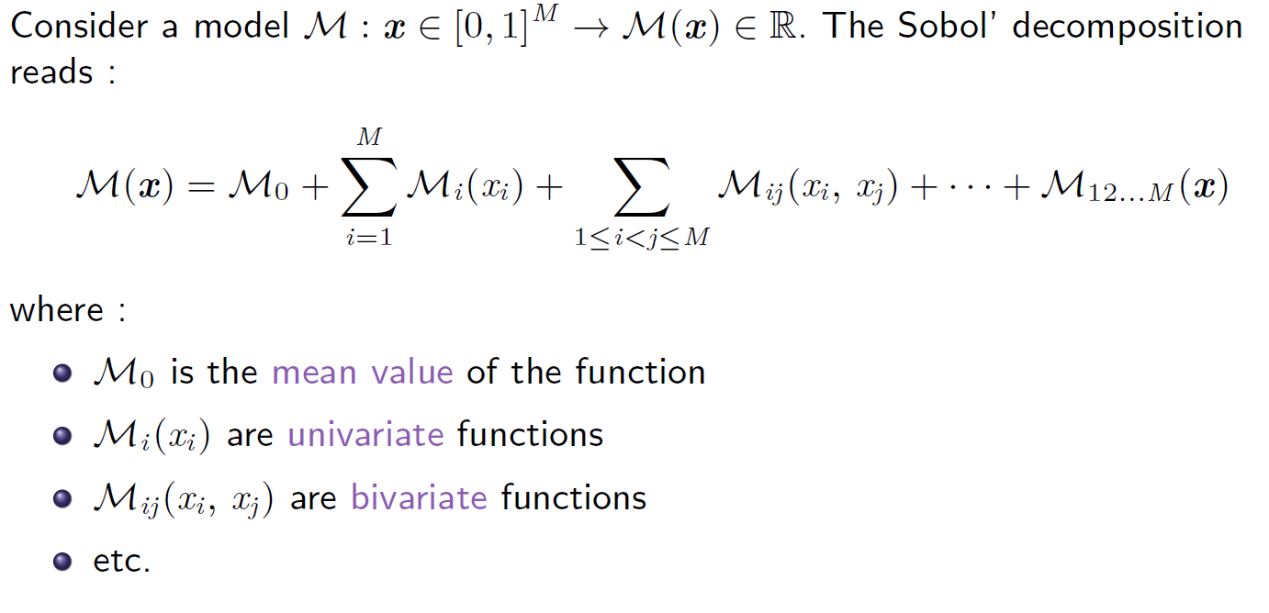
Sensitivity Assessment
Polynomial chaos expansion: Sensitivity to input variables
Once the Polynomial Chaos expansion is available, the full set of Sobol indices are obtained for free

Slide 8
Validation requires UQ
How to realize UQ within project?
PCE requires multiple code runs at dedicated parameter settings
Attempts for dedicates libraries & framworks exists : most are hampered by code complexity & ressources
However, IMAS needs/requires this capability anyway
Establish UQ capability (massiv # of parallel runs) at a generic level
Requires early contact with responsible ACHs
Identification of pilot project
Notes:
8

Slide 9
SDTrimSP in a nutshell (1)
How does it work / what can it do?
Can describe particle bombardment of targets based on binary collision approximation [1,2]
Applicable in eV – MeV range
Widely used to simulate sputtering, backscattering, transmission, damage distributions
Dynamic target composition, arbitrary particle energy / energy distribution
Well suited for sequential and parallel architectures
Provides input for ERO, SOLPS, Transport models etc. → Modelling of PWI
[1] W. Eckstein, Computer Simulation of Ion-Solid Interactions, Springer Series in Material Science, Vol. 10,1991
[2] A. Mutzke, R. Schneider, W. Eckstein, R. Dohmen, SDTrimSP Version 5.0 IPP Report 12/8, Garching, (2011)
Notes:
9

Slide 10
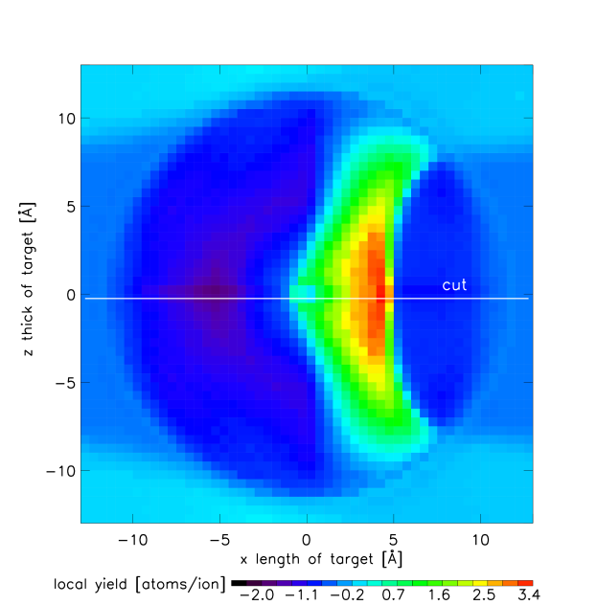
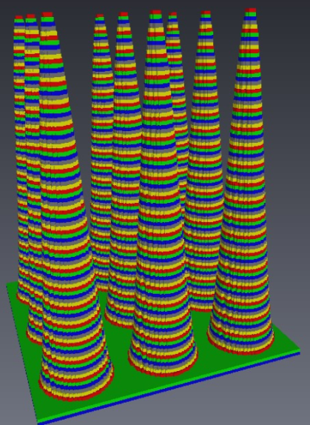
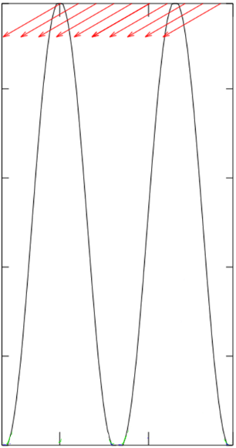
SDTrimSP 2D & 3D
SDTrimSP has been expanded to include 2D / 3D targets
Angle / energy distribution of sputtered particles
Fluence-dependent surface morphology / composition
Fluence-dependent sputter yield
10
[W, Ar⁺, 500 eV]
5
80
0
Length [Å]
60
Length [Å]
-5
40
-10
20
-10
-5
0
5
10
0
20
Notes:
10

Slide 11
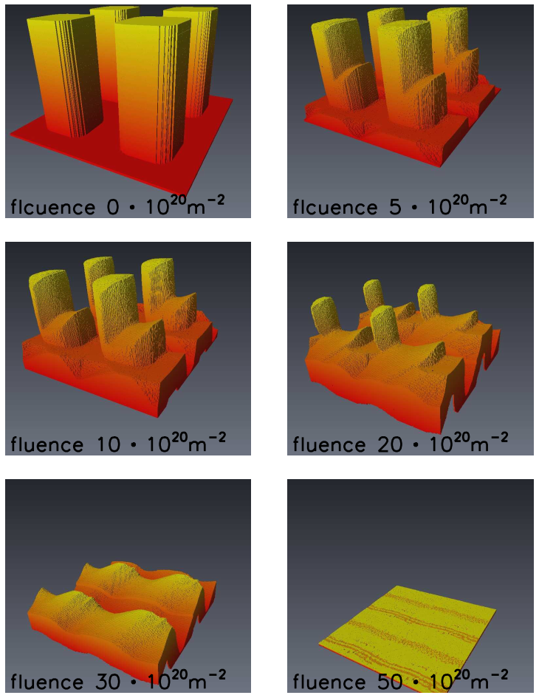
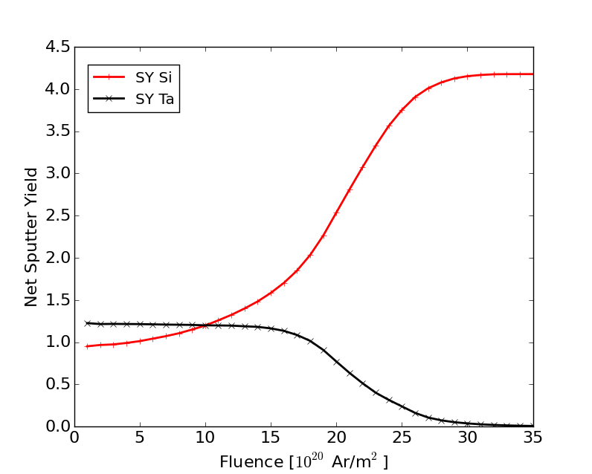
Dynamic simulations
5×10²⁰ Ar/m² ?
5×10²⁰ Ar/m² ?
10×10²⁰ Ar/m² ?
initial
fluence 5 · 10²⁰ m⁻²
10×10²⁰ Ar/m² ?
20×10²⁰ Ar/m² ?
20×10²⁰ Ar/m² ?
30×10²⁰ Ar/m² ?
30×10²⁰ Ar/m² ?
50×10²⁰ Ar/m² ?

Slide 12
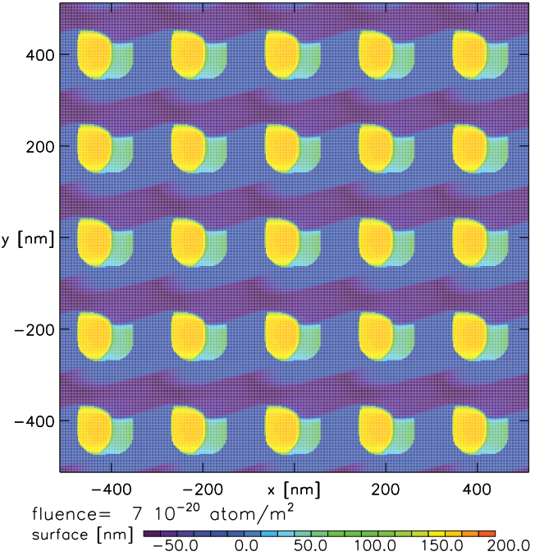
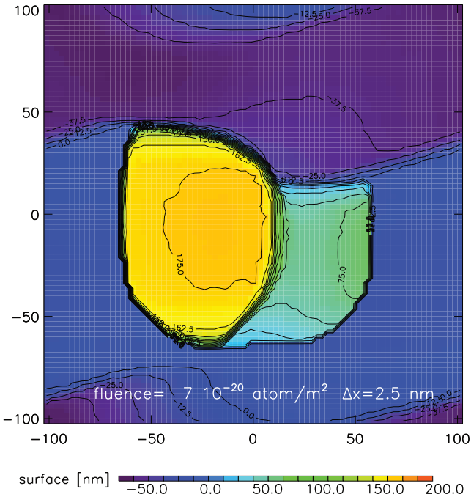
Ta – 45° incidence, 15° rotation
SDTrimSP-3D Ta columns eroded by 5 keV Ar under 45° incidence, 15° rotation
6.2×10²⁰ Ar/m²
500 nm

Slide 13
SDTrim 1D-3D
Intended project work
IMAS-interface
Sample description
Data extraction
Data base for simulation framework

Slide 14
RAVETIME
RAVETIME:
Finite Volume code for Reaction-Advection-Diffusion for Transport in Matter
Key points:
A class of Riccati-type differential equations describes
Fill-level dependent trapping
Most surface- and interface processes (site-saturation, binary molecule formation)
Operator splitting allows
Massive parallel computation → fast
Handling of 3D geometries
UQ-approaches
Status: verification successful, IMAS compatible parallelization pending

Slide 15
Conclusions & Outlook
(*)
Thank you for your attention
Any questions?
(*) SDTRIM-
slides are courtesy
of
Rodrigo Arredondo
4 µm

Slide 16
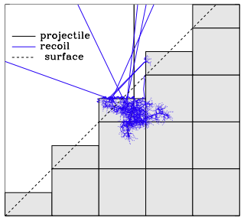
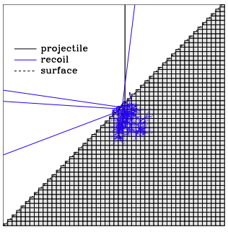
SDTrimSP 2D & 3D
SDTrimSP has been expanded to include 2D / 3D targets
(essentially, parallelized SDTrimSP)
Instead of layers, now we have 3D cubes
Important: Requires small enough cell resolution (nm)
Drawback: Computation time (scales with N_{y} x N_{z} )
STEM → Å
AFM → nm
CLSM → sub-µm
3D 5 keV Ar ⁺ → Si 50×10²⁰ Ar/m²
dx = dy = dz = 2.5 nm 100 x 100 x 200 nm
Processors: 32 calculation-time: 52 h
1D 5 keV Ar⁺ → Si 50×10²⁰ Ar/m²
dx = 2.5 nm
Processors: 32 Time: 0.25 h
Notes:
16

Slide 17
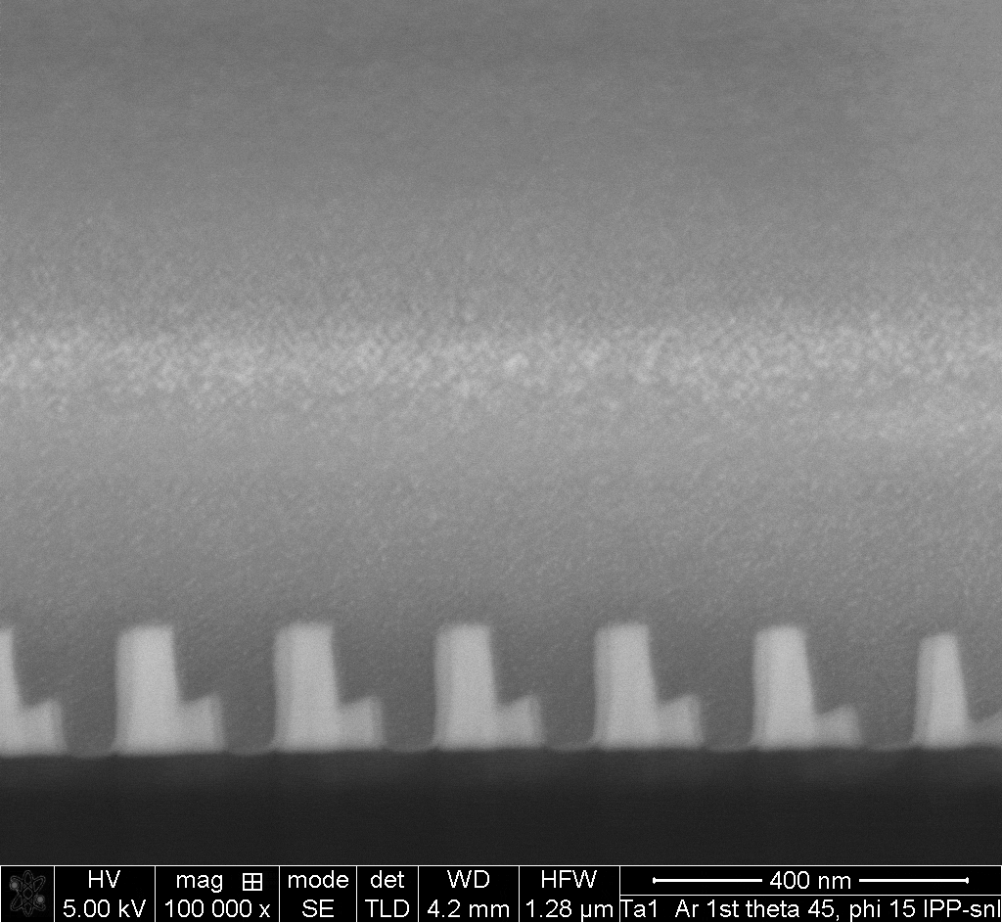
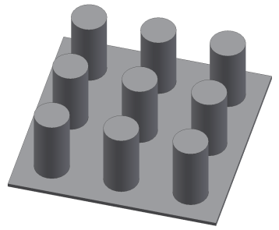
Ta – 45° incidence, 15° rotation
SDTrimSP-3D Ta columns eroded by 5 keV Ar under 45° incidence, 15° rotation
(3)
X
1 µm
1 µm
X - Cut
6.2×10²⁰ Ar/m²

