Slide 1
ATEP kick off meeting – June 09, 2021
WP1: Theoretical framework
M. V. Falessi1,2, F.Zonca1,3, Y. Li1,2,3, L.Chen3,4,1, Z. Qiu^{3,1}
1Center for Nonlinear Plasma Science and ENEA C.R. Frascati, 00044 Frascati, Italy
2Consorzio Create, Via Claudio 21 Napoli, Italy
³IFTS and Dept. Physics, Zhejiang University, Hangzhou, 310027 P.R. China
⁴Dept. Physics and Astronomy, University of California, Irvine, CA 92697-4575, USA
Frascati, June 9th 2021

Slide 2
People Involved
M. V. Falessi
Y. Li
A. Zocco
F. Zonca

Slide 3
Background
Predicting the dynamics of a burning plasma over long time scales, i.e. comparable with the energy confinement time or even longer, is essential to understand next generation fusion experiments
most of the works for the study of core plasma transport are based on a systematic separation of scales between the reference equilibrium and fluctuations
energetic particle (EP) transport in fusion devices is a spatiotemporal multi-scale process
spatio-temporal mesoscales can be observed even in drift wave plasma turbulence simulations

Slide 4
MET legacy
Particle motion in the reference magnetic field is characterized by three integrals of motion, i.e. $P_{φ},μ,ℰ$;
PSZS equation is connected with the macro/meso- scopic component, i.e. $[…]_{S}$, unperturbed orbit-averaged distribution function (Falessi et al. 29):
$$\frac{∂}{∂t}\overline{F_{z0}}+\frac{1}{τ_{b}}{\left[\frac{∂}{∂P_{φ}}\overline{{\left(τ_{b}δ{\overset{˙}{P}}_{φ}δF\right)}_{z}}+\frac{∂}{∂ℰ}\overline{{\left(τ_{b}δ\overset{˙}{ℰ}δF\right)}_{z}}\right]}_{S}=\overline{{\left(\sum_{b}{ } C_{b}^{g}\left[F,F_{b}\right]+𝒮\right)}_{zS}}$$
this expression describe transport processes in the phase space due to fluctuations or collisions and sources

Slide 5
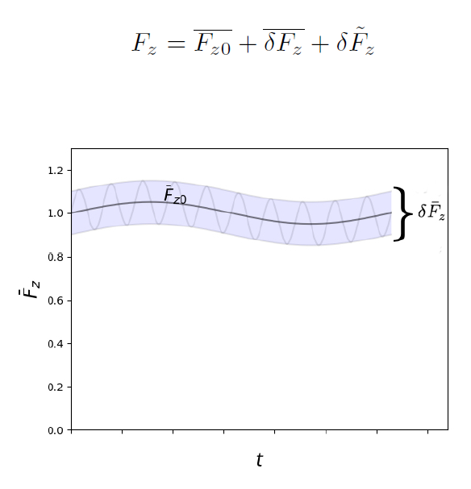
MET legacy
we can decompose the toroidally symmetric distribution function;
$\overline{F_{z0}}$ describe macro- & meso-scales;
micro-scales are accounted by $δ{\overset{‾}{F}}_{z}$;
transitions between neighboring nonlinear equilibria, see Chen and Zonca 2007 ; Falessi and Zonca 2019
nonlinear equilibria, together with zonal field structures, form a zonal state, see Falessi and Zonca $2019.$

Slide 6
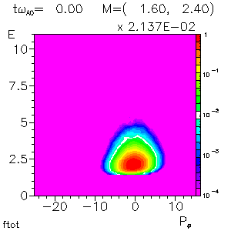
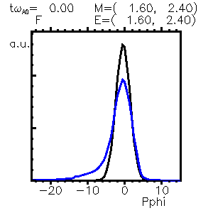
MET legacy
PSZS have been extracted from an HMGC EPM simulation
$$\frac{∂}{∂t}\overline{F_{z0}}+\frac{1}{τ_{b}}{\left[\frac{∂}{∂P_{φ}}\overline{{\left(τ_{b}δ{\overset{˙}{P}}_{φ}δF\right)}_{z}}+\frac{∂}{∂ℰ}\overline{{\left(τ_{b}δ\overset{˙}{ℰ}δF\right)}_{z}}\right]}_{S}=0$$

Slide 7
MET legacy
PSZS have been extracted from an HMGC EPM simulation
$$\frac{∂}{∂t}\overline{F_{z0}}+\frac{1}{τ_{b}}{\left[\frac{∂}{∂P_{φ}}\overline{{\left(τ_{b}δ{\overset{˙}{P}}_{φ}δF\right)}_{z}}+\frac{∂}{∂ℰ}\overline{{\left(τ_{b}δ\overset{˙}{ℰ}δF\right)}_{z}}\right]}_{S}=0$$

Slide 8
MET legacy
Gyrokinetics
Dyson-Schrödinger
Quasilinear

Slide 9
2021 Planning
WP1-D1 Complete transport theory of Phase Space Zonal Structures and Zonal State separating its microscale structures from macro-/meso- scale components
WP1-M1 2D and 3D formulation of Phase Space Zonal Structures transport equations, and definition of Zonal State with corresponding equations for Zonal Field Structures governing equations with separated dependences from nonlinear radial envelope and parallel mode structures

Slide 10
WP1-D1
We have shown how to calculate an evolving equilibrium consistent with the finite level of fluctuations;
we write every moment of the zonal distribution function using their push-forward representation e.g.:
$$\begin{matrix}J_{z}(r)=e & \int{dℰ}dμdαd^{3}XD\left(T^{−1}v\right)δ(X+ρ−r)\left[F_{0}+δF_{z}−\frac{e}{m}{\left\langle δL_{g}\right\rangle }_{z}\frac{∂}{∂ℰ}F_{0}+\right. \\ & \left.−\frac{e}{m}\frac{∂}{∂μ}F_{0}{\left\langle δL_{g}\right\rangle }_{z}\right]+\frac{e^{2}}{m}\int{ }dℰdμdαd^{3}XD\left[\frac{∂}{∂ℰ}F_{0}δφ_{z}+\frac{1}{B_{0}}\frac{∂}{∂μ}F_{0}δL_{z}\right]\end{matrix}$$
we can substitute $F_{z}$ for the PSZS ${\overset{‾}{F}}_{z0}={\left[F_{0}+e^{−iQ_{z}}δ{\overset{‾}{F}}_{Bz}\right]}_{S}$;
we obtain, from a multipole expansion, an equilibrium that is consistent with an anisotropic CGL pressure tensor;

Slide 11
WP1-D1
the current $J_{z}$ and the pressure tensor $P$ satisfy the following force balance equation:
$$σ\frac{J_{z}×B}{c}=∇P_{∥}+(σ−1)∇\left(\frac{B^{2}}{8π}\right)+\frac{B^{2}}{4π}∇_{⊥}σ$$
where $σ=1+\frac{4π}{B^{2}}\left(P_{⊥}−P_{∥}\right)$;
the self-consistent modification of the equilibrium magnetic field due to PSZS can be calculated solving this equation, e.g.
$$Δ^{∗}ψ+∇ln σ⋅∇ψ=−\frac{4πR^{2}}{σ}−\frac{1}{σ^{2}}\frac{∂G}{∂ψ}$$
where $G≡σF^{2}/2$ is a flux function;

Slide 12
Next steps
WP1-M1 related results will be presented in a couple of papers in the next months;
A. Zocco et al. are writing a paper describing the 3D extension of PSZS theory;
all the terms appearing in the PSZS equations will be written using the MSD approach, i.e. separating the dependences from nonlinear radial envelope and parallel mode structures;

Slide 13
Sinergies & Travel
WP2.1/WP3.3/WP3.5 will evaluate PS nonlinear fluxes derived in WP1
WP3.4 RABBIT could be used to solve for the PSZS transport equations
WP3.5 will introduce generalized distribution functions thus describing PSZS
WP3.6 PSZS will be calculated by ORB5 for validation of reduced models
Travel will be of crucial importance to develop these collaborations

Slide 14
Thank you for your attention!

