Slide 1


ATEP kick off meeting – June 09, 2021
ATEP kick off meeting:
CNPS contribution to WP1 & WP2.1
Fulvio Zonca1,2, Yueyan Li1,2,3 and Matteo V. Falessi1,3
1Center for Nonlinear Plasma Science and ENEA C.R. Frascati, 00044 Frascati, Italy
2IFTS and Dept. Physics, Zhejiang University, Hangzhou, 310027 P.R. China
3CREATE Consortium, Via Claudio 21, 80125 Napoli, Italy
*Contributions from Liu Chen^{2,1} and Zhiyong Qiu^{2,1}
Frascati, June 9th 2021

Slide 2

Outline/WP1
WP1: theoretical framework
        Key persons: M. Falessi, Y. Li, A. Zocco, F. Zonca
        Main motivation of WP1
                consolidate and extend the theoretical framework describing EP transport within different levels of reduced dynamics defined and demonstrated by the MET ENR Project
                General framework based on PSZS theory (Matteo) and NLSE for envelope equations (DSM model; FZ joint ATEP-TSVV10 seminar on May 25th)
                Brief reminder here about NLSE/DSM
                Extensions to Stellarators (Alessandro Z, Axel): later in 2022 (not subject of this presentation)

Slide 3
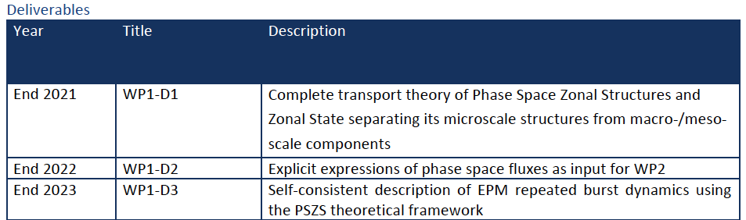
Outline/WP1

Slide 4
Outline/WP2
WP2: Advancing the comprehensive GK framework
        Deeply rooted in MET ENR results & DSM model with multi-level approach
WP2.1: Development of a comprehensive local GK framework for solution of parallel mode structures and dispersion relation
        Key persons: M. Falessi, Ph. Lauber, Y. Li, F. Zonca
        Extension of DAEPS to trapped and circulating particles in general toroidal geometry
        Benchmark DAEPS vs. LIGKA in the local limit (other WP2.X)
        Development of analytic/semi-analytic treatment for kinetic particle response
        Use DAEPS output, including PSZS and ZFS, to calculate the NL fluxes in phase space as input to DSM and phase space transport

Slide 5
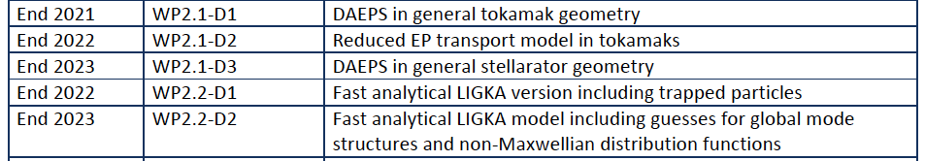
Outline/WP2

Slide 6
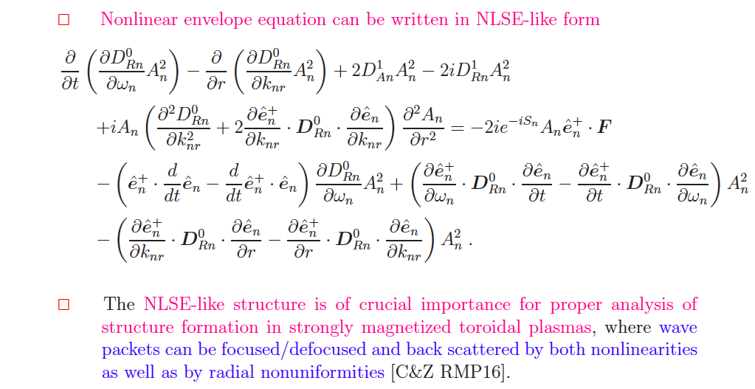
Introduction to DSM: WP1
NLSE: evolution of the radial envelope (FZ seminar 03/25)

Slide 7
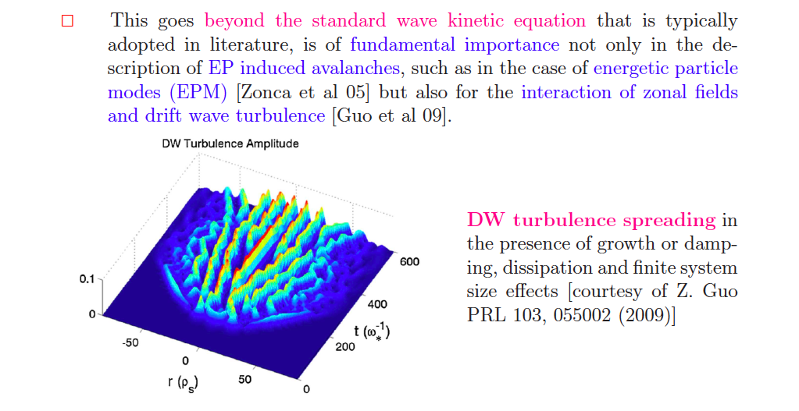
Introduction to DSM: WP1

Slide 8
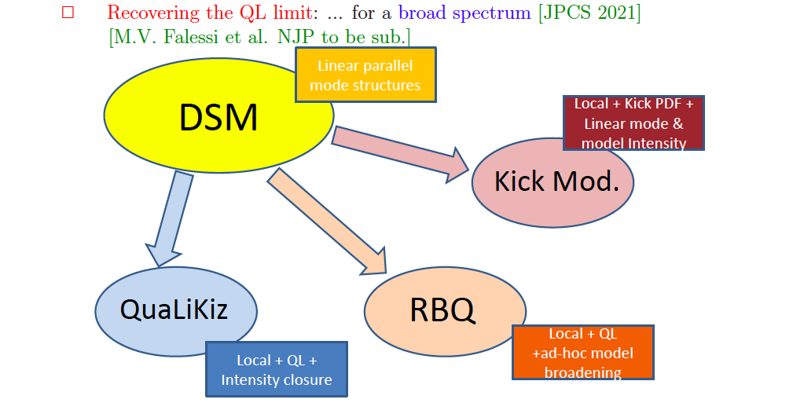
Introduction to DSM: WP1

Slide 9
Introduction to DAEPS: WP2.1
Drift Alfvén Energetic Particle Stability (DAEPS):
        An eigenvalue code using FEM to study physics of low frequency modes, e.g. SAW and DAW, excited by EP in collisionless plasmas [Li2020POP]
        Calculate frequency, growth rate, and the parallel mode structure in the ballooning space as well as the asymptotic behavior in the inertial region
                Connection with GFLDR theoretical framework [Zonca14POP]
                Self-consistent treatment of asymptotic behavior [Falessi2019POP]
                Able to calculate unstable modes, damped modes and continuous spectrum

Slide 10
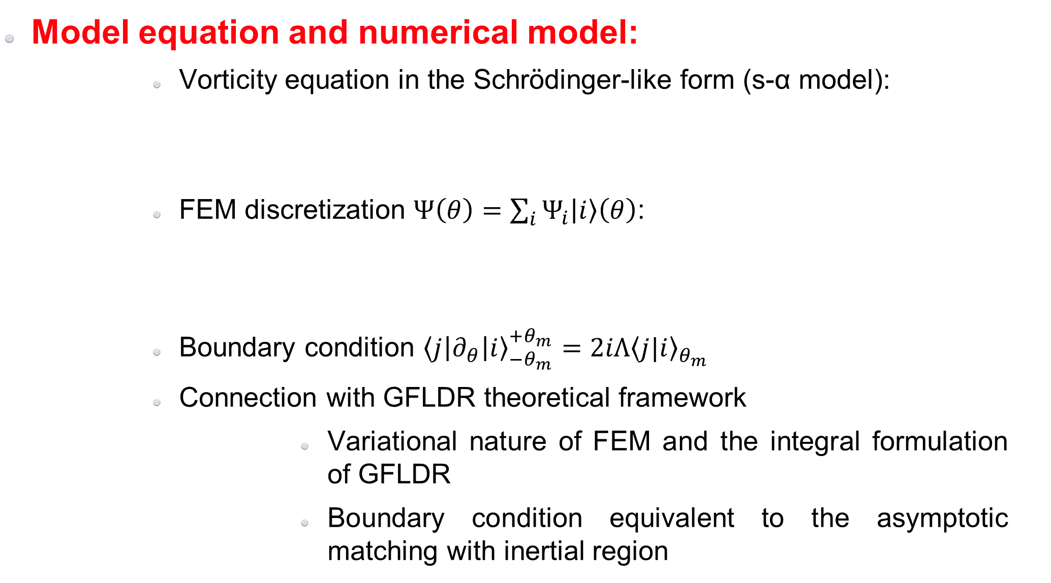
Model equation
Model equation and numerical model:
        Vorticity equation in the Schrödinger-like form (s-α model):
        FEM discretization $Ψ\left(θ\right)=\sum_{i}{Ψ_{i}\left|i\right\rangle \left(θ\right)}$:
        Boundary condition ${\left\langle j\left|∂_{θ}\right|i\right\rangle }_{−θ_{m}}^{+θ_{m}}=2iΛ{\left\langle j|i\right\rangle }_{θ_{m}}$
        Connection with GFLDR theoretical framework
                Variational nature of FEM and the integral formulation of GFLDR
                Boundary condition equivalent to the asymptotic matching with inertial region

Slide 11
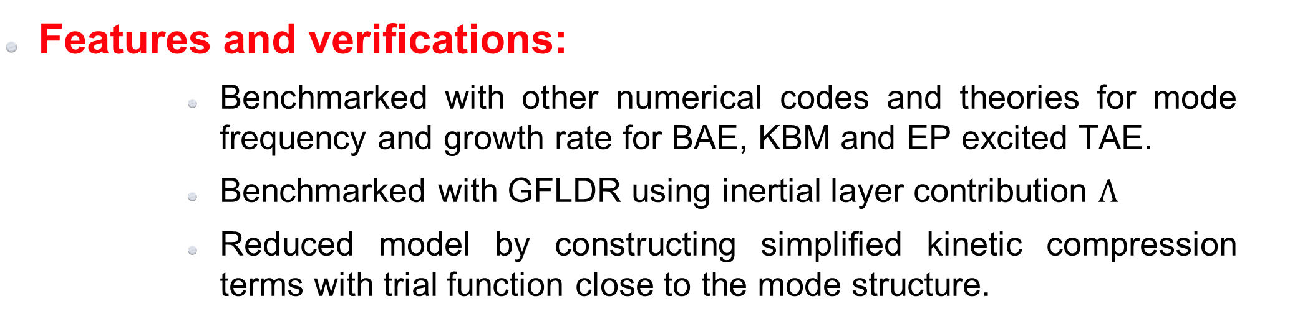
Features and verifications
Features and verifications:
        Benchmarked with other numerical codes and theories for mode frequency and growth rate for BAE, KBM and EP excited TAE.
        Benchmarked with GFLDR using inertial layer contribution $Λ$
        Reduced model by constructing simplified kinetic compression terms with trial function close to the mode structure.
Benchmark on BAE with GFLDR (w/o FLR & FOW)
Benchmark on KBM

Slide 12
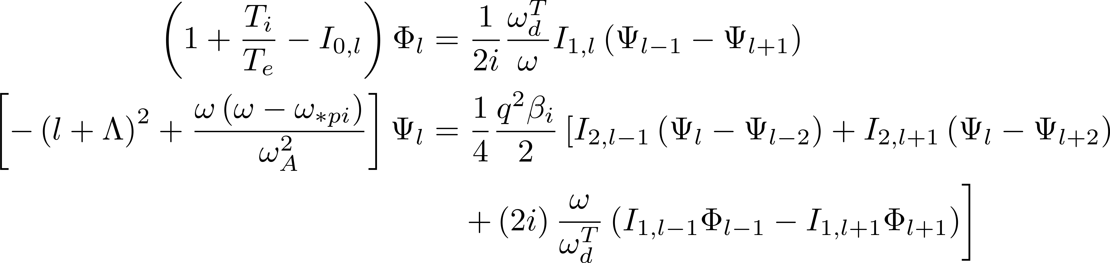
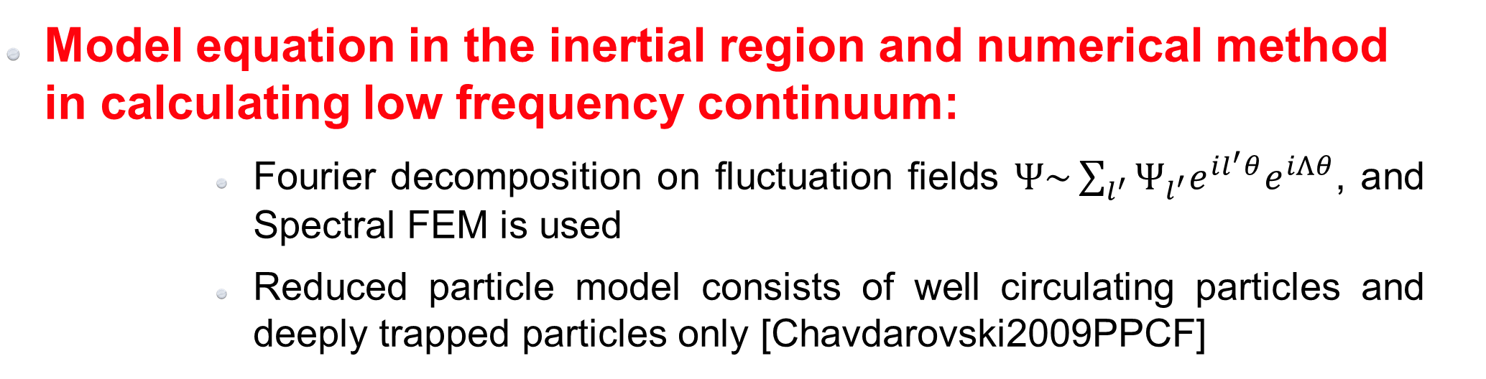
Numerical model in the inertial region
Model equation in the inertial region and numerical method in calculating low frequency continuum:
        Fourier decomposition on fluctuation fields $Ψ\sim \sum_{l^{′}}{Ψ_{l^{′}}e^{il^{′}θ}e^{iΛθ}}$, and Spectral FEM is used
        Reduced particle model consists of well circulating particles and deeply trapped particles only [Chavdarovski2009PPCF]

Slide 13
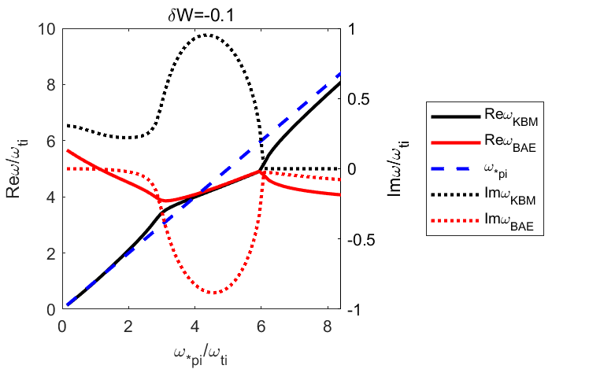
Low frequency continuum
Features and verification:
        The numerical result is benchmarked with theoretical result for LFAW, BAAE and BAE continuous spectrum
        The numerical model in the inertial region can be used to:
                Calculate the low frequency kinetic continuum
                Calculate the inertial layer contribution with kinetic response
Beam instability of BAE and KBM
Benchmark on BAE, BAAE and LFAW continuous spectrum

Slide 14
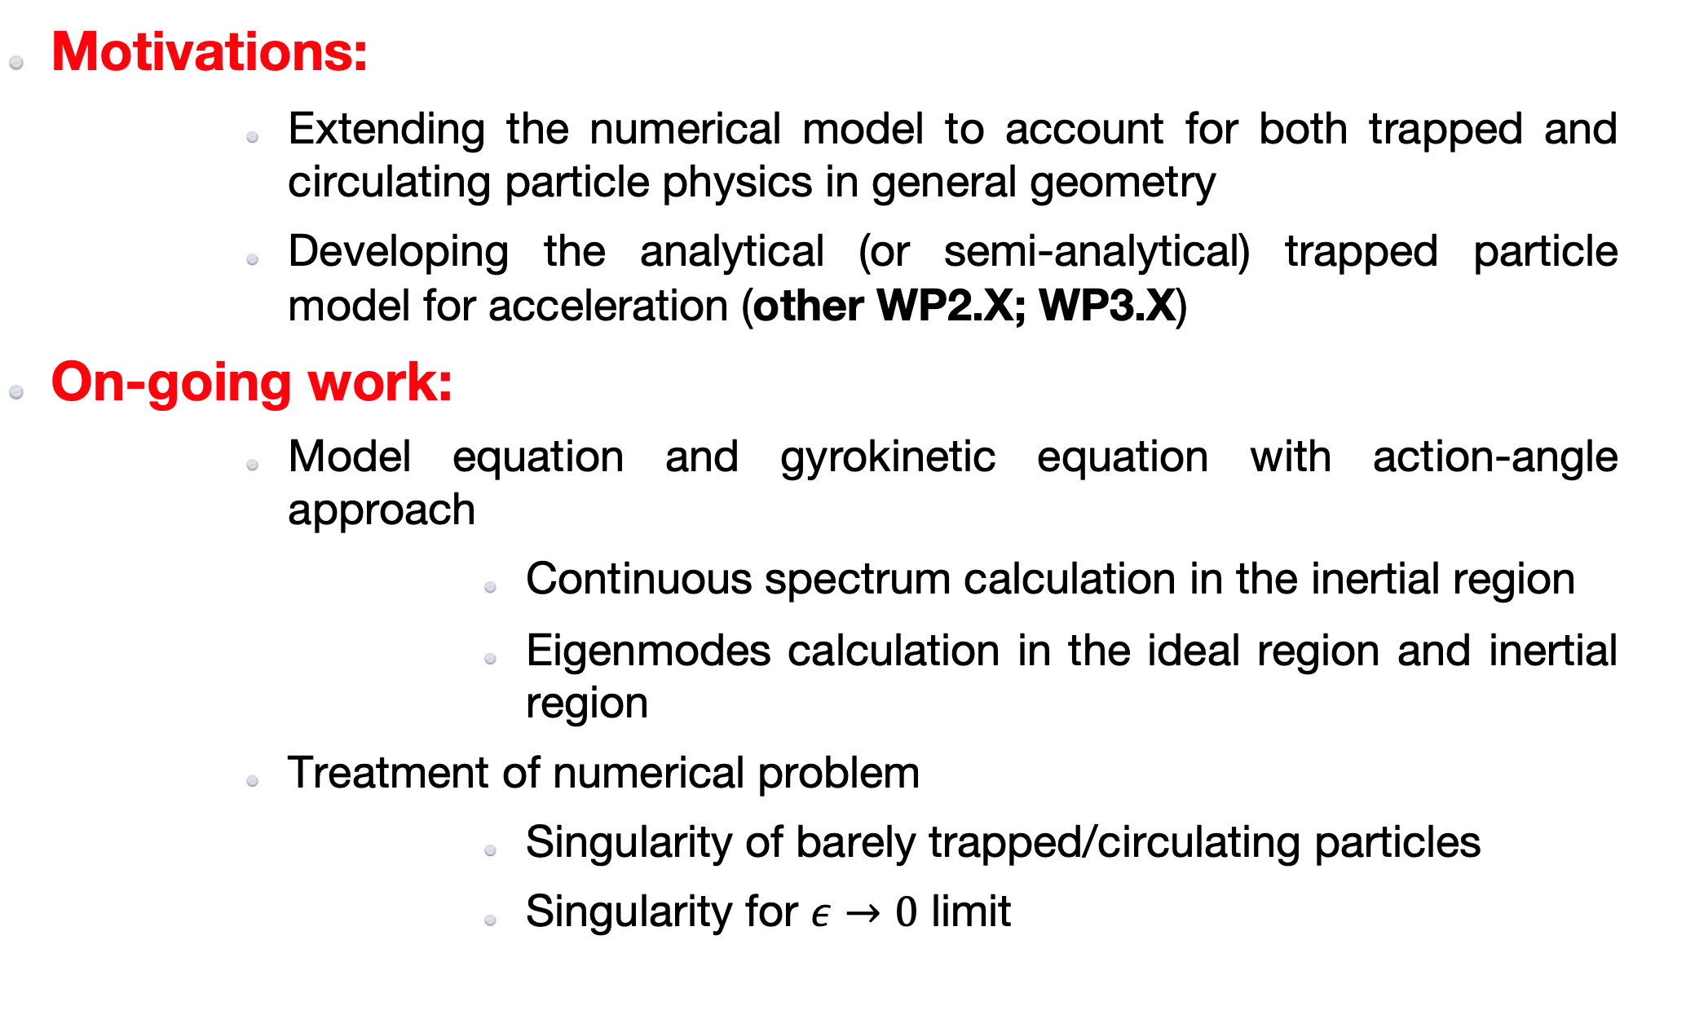
Action-angle approach
Motivations:
        Extending the numerical model to account for both trapped and circulating particle physics in general geometry
        Developing the analytical (or semi-analytical) trapped particle model for acceleration (other WP2.X; WP3.X)
On-going work:
        Model equation and gyrokinetic equation with action-angle approach
                Continuous spectrum calculation in the inertial region
                Eigenmodes calculation in the ideal region and inertial region
        Treatment of numerical problem
                Singularity of barely trapped/circulating particles
                Singularity for $ε→0$ limit

Slide 15
Conclusions
Your questions are welcome:
        WP1 (M. Falessi, Y. Li, A. Zocco, F. Zonca): theoretical framework
        WP2.1 (M. Falessi, Ph. Lauber, Y. Li, F. Zonca): Development of a comprehensive local GK framework for solution of parallel mode structures and dispersion relation

