Slide 1
Advanced Energetic particle transport models (ATEP): WP3.5
Key persons: X. Wang (6pm), V. Fusco (4pm) , G. Vlad (3pm)
0 cost contributers: S. Possanner, F. Holderied
Third party contributers
Guest advisor: S. Briguglio
Acknowlegement: A. Bierwage, J. Gonzalez Martin, other STRUPHY members, Thomas Hayward-Schneider, Z. Lu, other NMPP collaborators

Slide 2
WP3.5 Hybrid kinetic MHD codes for verification and validation
The hybrid-kinetic MHD codes XHMGC [16], HYMAGYK [17], and MEGA [23] will be used to verify and validate the transport models described in the WPs above. Diagnostics for zonal averages leading to the explicit extraction of phase space fluxes have been already successfully tested for an EPM simulation [6]. Building on this first fundamental step, more comparisons for different cases comprising different type of EP-driven modes will be carried out. The distribution function specifications of the codes above will be generalized, in order to connect to other codes and experimental input, together with the implementation, testing and comparison (i.e. XHMGC vs MEGA) of the collision models.
The codes XHMGC, HYMAGYK and MEGA are based on a so-called pressure (XHMGC, HYMAGYK) and current (MEGA) coupling scheme between the MHD equations and the kinetically described (fast) ions. But the need for simulations on transport time scales puts new challenges on the conceptual and numerical implementation of hybrid kinetic-MHD models. STRUPHY is a STRUcture-Preserving HYbrid code (STRUPHY) based on finite element exterior calculus (FEEC) for the MHD part and particle-in-cell (PIC) methods for the kinetic part [24]. STRUPHY combines provable conservation properties (mass, total energy, div B=0), variable-order methods (tensor product B-splines) and implicit time-stepping (Poisson splitting) to achieve numerical stability deep into the nonlinear phase of wave-particle resonance. The current version features a full-orbit Vlasov equation, which will be replaced by a drift-kinetic version within this project, in order to approach simulations on the transport time scale. We will leverage several additional features of STRUPHY such as the use of polar splines around the magnetic axis (singularity effectively removed) and the full 3D capability for stellarator simulations. Based on modern numerical techniques, STRUPHY will provide valuable benchmarks for the other hybrid (XHMGC, HYMAGYK, MEGA) and kinetic (ORB5) codes, especially in the long-time nonlinear stage in order to quantify their numerical reliability.

Slide 3
Milestones
Deliverables

Slide 4
Plan for 2021
Phase space fluxes calculations for different kinds of modes( e.x. frequency-chirping modes, multi-n modes) (A paper is under preparation for frequency chirping modes) (collaborations with WP1, WP3.1, WP3.2, WP4)
Magnetic axis solution for STRUPHY (paper writing)
Genralized distribution functions (RABBIT, or others)
Travel is limited by Covid-19 situations. But travels between ENEA and IPP garching are expected in future.
Meetings: AAPPS, IAEATM, etc.
Seminars: rehearsals, STRUPHY magnetic axis, etc.

Slide 5
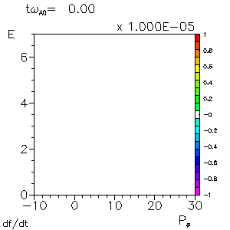
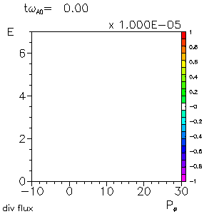
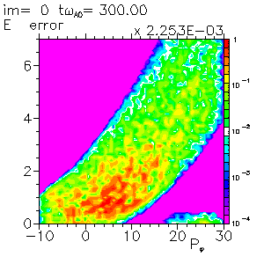
Phase space Fluxes calculations in HMGC simulations
Strong case

Slide 6
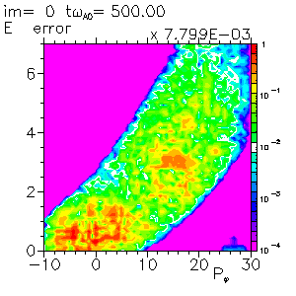
Phase space Fluxes calculations in HMGC simulations
Weak case

Slide 7
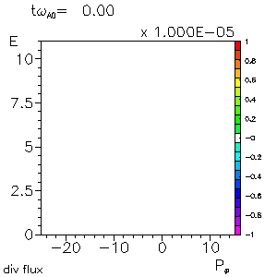
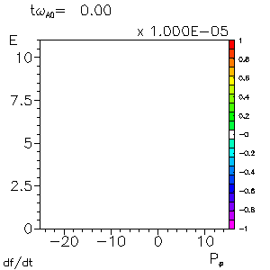
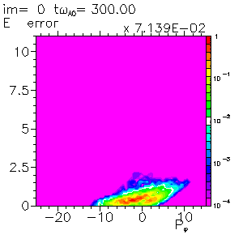
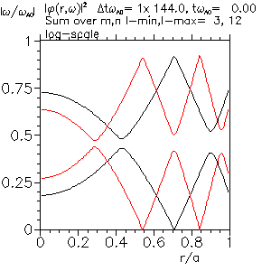
Phase space Fluxes calculations in HMGC simulations
Multi-n

Slide 8
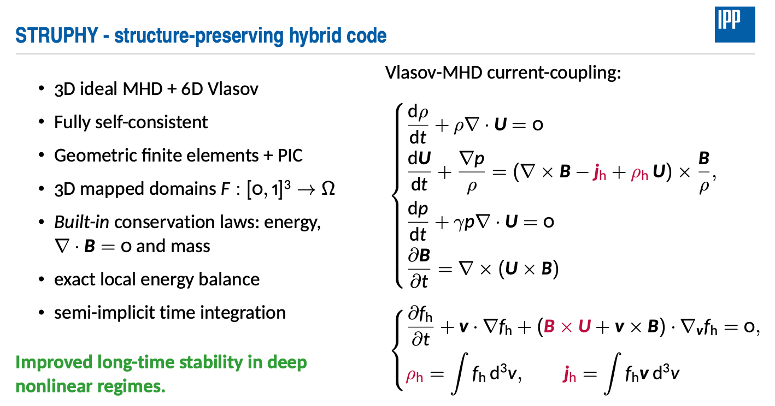

Slide 10
Advanced Energetic particle transport models (ATEP): WP3.5
Key persons: X. Wang (6pm), V. Fusco (4pm) , G. Vlad (3pm)
0 cost contributers: S. Possanner, F. Holderied
Third party contributers
Guest advisor: S. Briguglio
Acknowlegement: A. Bierwage, J. Gonzalez Martin, other STRUPHY members, Thomas Hayward-Schneider, Z. Lu, other NMPP collaborators

