Slide 1


Preparation of ITER Operation, WPPrIO
X. Litaudon (PL), Gloria Falchetto (PSO)

Slide 2
WPPrIO: High level objectives
Contribute to lay the foundation of a coordinated significant EUROfusion participation in the ITER team benefiting from the strength of the EUROfusion programme in operation, technology and simulation
Contribute to integrate EUROfusion activities in line with the Roadmap priorities
Implement some recommendations* on “EUROfusion role in ITER operation and scientific exploitation”
^{*)} EUROFUSION GA (20) 32 - 4.7 - ITER White Paper Report WG1 Issue 1 10-Dec-2020 (Decision).docx and EUROFUSION GA (20) 32 - 4.7 - ITER White Paper Report WG2 Issue 3 7-Dec-2020 (Decision).docx

Slide 3
Introduction in the Grant Proposal
“Whilst integration between work packages is essential for both ITER and DEMO, there are two convening work packages that bring together this breadth: WPPrIO consolidates the preparation for ITER operation, though the contributions to ITER exist in every work package, whilst the DEMO Central Team (supported by WPDES) coheres the design capabilities in each work package, whilst taking advantage of the capabilities and skills developed for ITER”

Slide 4
WG recommendations on ITER operation and scientific exploitation
Divertor and Plasma Facing Components:
  Pursue and develop a comprehensive programme (EUROfusion/F4E)
Nuclear aspects (safety, licensing and neutronics)
  Actions on knowledge management to be elaborated
Neutral Beam Heating and CD system
  Ensure the success of NBTF operation
Diagnostics
  Promote actions to take advantage of the diagnostics provided by F4E
Analysis/operational/simulation tools
  Effort to be focused on scientific priorities
Knowledge Management
  managing proactively the involvement in ITER Operation and Commissioning in view of both developing experienced engineers and transferring knowledge to DEMO design
A. Grosman, J Pamela

Slide 5
Overview priority list and PrIO contributions
Sub-systems | Required involvement for EU implication in ITER operation | Impact level on the EU DEMO design
Divertor & PFCs | *** | ++
Tritium Plant | *** | +++
Breeding Blanket System | *** | +++
H&CD: Neutral Beam | *** (NBTF) | +++
Diagnostics | *** | +++
Control and Analysis/operational/simulation tools | *** | ++ (+++ for some control aspects)
H&CD: Electron Cyclotron | ** | ++
H&CD: Ion Cyclotron | ** (present operation in present facilities) | +
Neutronics, Waste and Radiological Protection | ** | +++
TF & PF Magnets and Cryo-plant | * during full operation (*** in commissioning phase) | ++ (for DEMO design)
Vacuum Vessel | * | +
Remote Handling Equipment | * | +
Vacuum Pumping & fueling | * | +
Building and Electrical Power Supply & Distribution System | * | +++ (for DEMO design)
(+++): Unique, (++) High, (+) Significant
(***) Strong: Organized team with defined commitments, (**) Organized team, (*) Expertise for follow-up

Slide 6
WPrIO : 4 high level objectives
Contribute to the preparation at the EUROfusion level of the initial ITER experimental campaigns
Support knowledge transfer on operational topics and Develop training opportunities
Contribute to the NBTF activities and exploitation of smaller ITER-like ion sources
Improve EUROfusion knowledge on neutronics, instrumentation, nuclear codes, and techniques

Slide 7
Project structure & activities

Slide 8
Project structure as in IMS
SP-1: Project management and coordination
SP-2: Preparation of ITER first experimental campaigns
SP-3: Plasma and sub-systems operation
SP-4: Neutral Beam test Facility and R&D for ITER Neutral Beam
SP-5: Neutronics, Nuclear waste and safety
WP is implementing some elements of the EUROfusion preparation to ITER operation and scientific exploitation
During elaboration of the 2021 tasks unformal contacts have been taken with IO representatives

Slide 9
SP-1: Project management and coordination
Initiate a mapping of the EUROfusion scientific and collaborative activities for ITER with the support of the contact persons for ITER specific activities in the various EU labs
Initiate a mapping of the specific ITER cross-WPs activities performed within the EUROfusion
PL Member of E-TASC Scientific Board and Thrust facilitator on whole device modelling
  Physics Properties of Strongly Shaped Configurations (TSVV#02)
  Validated Frameworks for the Reliable Prediction of Plasma Performance and Operational Limits in Tokamaks (TSVV#11)
  Multi-Fidelity Systems Code for DEMO (TSVV#14)

Slide 10
SP-2: Preparation of ITER first experimental campaigns
Plasma breakdown/burn-through simulation tools and application for ITER operation plasma
  modelling of the variation of the plasma volume during the plasma initiation phase + ECRH absorption
IR synthetic diagnostic and first wall/divertor monitoring system for real time PFC’s protection
  Ray-tracing
  Automatic thermal event detection (AI) – joint EEG with WPW7X
Synthetic diagnostic for the Fiber Optics Current Sensor based on JET experience
EUROfusion databases on disruption, core confinement and pedestal (FP8 resource)
Beyond 2021, this SP should be expanded towards the scenario design for ITER first experimental campaigns (pending extra resources)

Slide 11
SP-3: Plasma and sub-systems operation
EUROfusion Operation Network
  Facilitate stronger connection between the operational groups of European facilities to share operational experience, improve reliability and performance
  Review and support training of operators
  Set up competency based subnetworks (NBI seminars, Wall Conditioning, …)
  Support the EUROfusion preparations for the (integrated) commissioning and operation of ITER
Review the various practices for training EUROfusion staff to operational issues in the different EUROfusion facilities
Knowledge capture of commissioning and operational experience starting with wall conditioning that will directly impact ITER integrated commissioning and initial operation
EEG Training: e.g. Wall conditioning (IO support)
Contribute to ITER FILD diagnostic design – on hold
  review: reciprocating scintillator detector or dedicated IR based solution ?

Slide 12
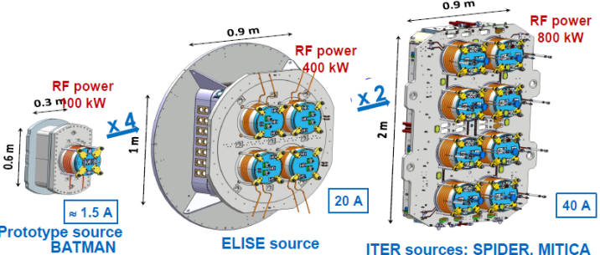
SP-4: Neutral Beam Test Facility and R&D for ITER Neutral Beam
Support EUROfusion experts at NBTF (Consorzio RFX/Padova)
  Participate in the operation of the ITER Neutral Beam Test Facility SPIDER and MITICA
  Up to 14 ppy/y
Support EUROfusion experts at ELISE (IPP/Garching)
  ELISE and BATMAN Upgrade for the demonstration of CW operation in Deuterium or Hydrogen
  Up to 6 ppy/y
Participation in the NBTF Advisory Committee

Slide 13
SP-5: Neutronics, Nuclear Waste and Safety
Assumption: JET operation ends in 2021
2022 and 2023 resources allocated to complete DT analysis
2021 elaboration of EUROfusion activities for ITER
  Neutronics, nuclear instrumentation
  Working group (EUROfusion, IO, F4E) to define the 2022-2025 activities
    Rosaria Villari ENEA Chair
    Yannick Peneliau CEA
    Lee Packer CCFE
    Rafael Jaurez CIEMAT
    Maurizio Angelone ENEA
    Jerzy Mietelski IPPLM
    Luka Snoj JSI
    Dieter Leichtle KIT
    Theodora Vasilopoulou NCSRD
    M. Loughlin, IO and M. Fabbri, F4E

Slide 14
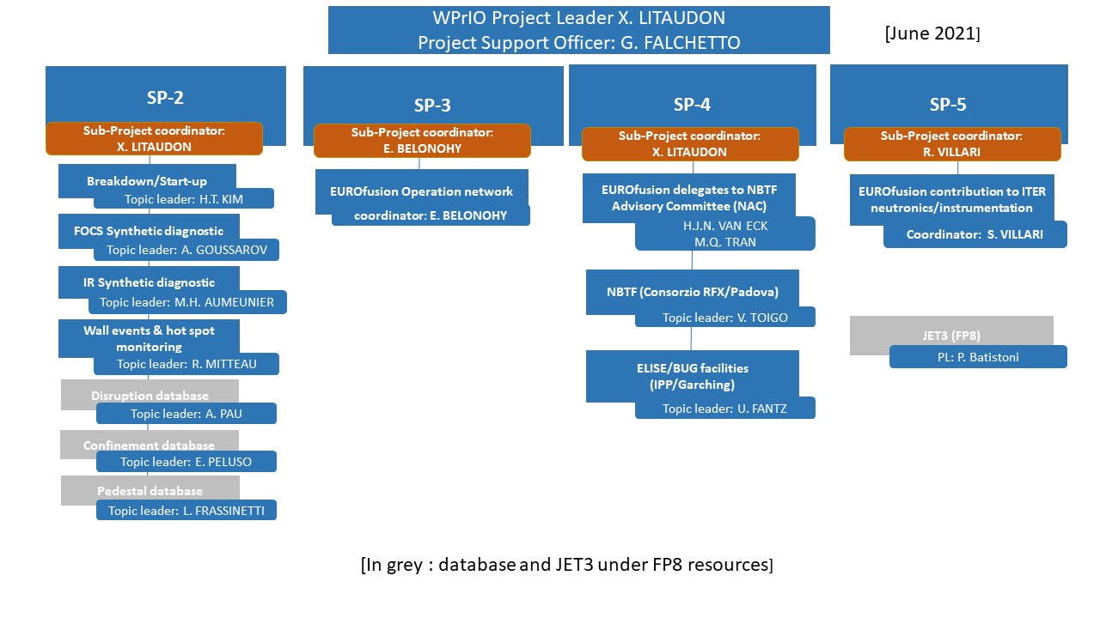
Roles and Responsibilities

Slide 15
Interfaces to other WPs
WPTE
  Specific ITER experiments and validation of the ITER tools
  Plasma breakdown experiments
  Validation of synthetic diagnostics development
  Real time protection of the plasma facing components
  Multi-machines databases
WPPWIE:
  ITER first wall issues
  Wall conditioning topics
WPSA
  Specific ITER experiments and plasma simulator development
  Plasma breakdown experiments
WPAC/E-TASC
  HPC/Gateway
  IMAS support
  EUROfusion databases
  TSVV11 and thrust on whole device modelling
WPW7X
  Real time protection of PFC
WPPRD
  Neutral Beam system.
+ link with the ITPA groups

Slide 16
PLANNING (Gantt chart), milestones, deliverables

Slide 17
2021 Milestones and Grant Deliverables
no. | Milestones | Due Date
PRIO.M.01 | All existing components of the European Plasma Simulator (Python workflow) hosted on the EUROfusion Git (TSVV11) | Dec. 2021
PRIO.M.02 | First release of a user friendly interface for the European Plasma Simulator (Python workflow) (WPAC and TSVV11) | Dec. 2021
PRIO.M.08 | Assessment of the EUROfusion human resources requirements and their implementation for the efficient EUROfusion participation in the NBTF completed | Jun. 2021
PRIO.M.09 | Commission the new CW power supply on ELISE facility completed | Jun. 2021
PRIO.M.10 | Installation and commissioning of CW diagnostic calorimeter on ELISE facility completed | Dec. 2021
PRIO.M.13 | Prioritisation programme for 2022-2025 of activities in support of neutronics and safety for ITER | Dec. 2021
no. | Deliverables | Due Date
PRIO.D.11 | Report on EUROfusion participation in ITER NBTF, ELISE and BUG activities | Dec. 2021

Slide 18
PrIO Baseline timeline - Gantt chart
Coupling of existing breakdown/burn-through models to the European Plasma Simulator
European Plasma Simulator available for full pulse simulation
Validated integrated plasma simulation tools ready for simulation of first ITER plasmas
2021
2022
2023
2024
2025
ITER timeline
construction/assembly phase
Integrated Commissioning
Preparation of ITER first experimental campaigns
TSVV11
Development of analysis/operational tools
Plasma breakdown/start-up simulation tools
Scenario design (FP, PFPO)
Synthetic diagnostics in support of the EU diagnostic procurements
FOCS
Application to ITER FP and initial operation
Wall events & hot spots monitoring
IR
Coordination of EUROfusion multimachine databases
Operation
EUROfusion operation network
Diagnostics
Sub-systems
H&CD
Control
ITER Neutral Beam Test Facility and R&D
ELISE long pulse operation for SPIDER and MITICA optimisation
SPIDER: Ion source operation input to MITICA
Extended SPIDER operation
MITICA: Procurement manufacturing installation and tests
MITICA: From low power short pulses to long pulse op. for ITER NB
Neutronics, Nuclear waste and Safety
Supporting activities in preparation of ITER nuclear phase
JET DT technological exploitation
Neutronics & Safety plan
Neutronics and instrumentation
Nuclear waste and safety
Prioritisation programme for activities in support of neutronics and safety for ITER
Establishment of EUROfusion Operation Network
ITER First Plasma
ITER FILD decision

Slide 19
Risk Identification

Slide 20
Risk Identification | Rating Pre-Mitigation |  |  |  |  |  | Strategy / Mitigation
Risk Title, Category, Owner, Description & Details (a) “As a result of…” (b) “There is the risk that…” (c) “Resulting in…” | Likelihood¹ | Impact² |  |  | Risk Level³ |  | Treatment Strategy & Risk Mitigation Actions (Comments, Details, Due Dates, etc.)
 |  | Tech | Cost | Sched.
Risk Title: European Plasma Simulator not sufficient to provide answers required for ITER Risk Category: Technical Risk Owner: C. Bourdelle Description: As a result of reduced resources there is a risk that European Plasma Simulator and IMAS workflows are not ready for ITER simulations | 3 | 3 | 1 | 3 | 9 | high | Treatment Strategy: escalate/transfer Risk Mitigation Actions: Increase resources for code development and for IMAS support
Risk Title: Lack of EU involvement in the participation in the EUROfusion Operation Network Risk Category: Project Management Risk Owner: E. Belonohy Description: As a result of low resources there is a risk of a lack of involvement and support in the participation in the EUROfusion Operation Network | 2 | 1 | 1 | 1 | 2 | Low | Treatment Strategy: avoid Risk Mitigation Actions: Increase coordination and resources on specific funded tasks. Prioritise activities
Reduced EUROfusion participation in the NBTF and ELISE/ BATMAN Upgrade facilities Risk Category: Project Management Risk Owner: X. Litaudon Description: As a result of lack of EUROFusion interest there is a reduction in the EUROfusion participation in the NBTF and ELISE/ BATMAN Upgrade facilities | 2 | 3 | 1 | 3 | 6 | medium | Treatment Strategy: reduce Risk Mitigation Actions: Promote this R&D activity (e.g. EUROfusion seminars, career development plan with ITER to attract and retain the new generation of engineers) at the EU level
Delay in the achievement of long pulse operation (up to 3600s) extraction on ELISE facility Risk Category: Technical Risk Owner: U. Fantz Description: For technical reasons it is difficult to achieve long pulse operation on ELISE | 2 | 3 | 3 | 3 | 6 | medium | Treatment Strategy: reduce Risk Mitigation Actions: Focus EU effort to understanding (including modelling) the limiting factors and consequences for ITER
JET DT does not provide enough data for neutronics analysis (Reduced performance of the JET DT campaigns and reduced level of 14 MeV neutrons) Risk Category: technical / external Risk Owner: R. Villari Description: For scientific reasons the level of D-T neutrons is lower than expected for neutronics analysis. | 3 | 4 | 3 | 3 | 12 | Very-High | Treatment Strategy: accept Risk Mitigation Actions: Revise the objectives in terms of irradiation of ITER materials and radiation damage. Revise the resources on the related modelling activities.
Low level of coordination between WPPrIO and ITER-IO on common topics (IMAS development, ITER simulation, neutronics, NBTF…) Risk Category: Project management Risk Owner: X. Litaudon Description: As a result of insufficient coordination there is a risk a divergence between the priority actions set within PrIO and the ones requested by ITER-IO or F4E | 2 | 3 | 1 | 1 | 6 | Medium | Treatment Strategy: avoid /escalate Risk Mitigation Actions: Increase the coordination level between WPPrIO and ITER-IO/F4E by setting-up specific coordination meetings. Nominate a new PL.

Slide 21
Risk Identification | Rating Pre-Mitigation |  |  |  |  |  | Strategy / Mitigation
Risk Title, Category, Owner, Description & Details (a) “As a result of…” (b) “There is the risk that…” (c) “Resulting in…” | Likelihood¹ | Impact² |  |  | Risk Level³ |  | Treatment Strategy & Risk Mitigation Actions (Comments, Details, Due Dates, etc.)
 |  | Tech | Cost | Sched.
Delay in the achievement of long pulse operation (up to 3600s) extraction on ELISE facility Risk Category: Technical Risk Owner: U. Fantz Description: For technical reasons it is difficult to achieve long pulse operation on ELISE | 2 | 3 | 3 | 3 | 6 | medium | Treatment Strategy: reduce Risk Mitigation Actions: Focus EU effort to understanding (including modelling) the limiting factors and consequences for ITER
JET DT does not provide enough data for neutronics analysis (Reduced performance of the JET DT campaigns and reduced level of 14 MeV neutrons) Risk Category: technical / external Risk Owner: R. Villari Description: For scientific reasons the level of D-T neutrons is lower than expected for neutronics analysis. | 3 | 4 | 3 | 3 | 12 | Very-High | Treatment Strategy: accept Risk Mitigation Actions: Revise the objectives in terms of irradiation of ITER materials and radiation damage. Revise the resources on the related modelling activities.
Low level of coordination between WPPrIO and ITER-IO on common topics (IMAS development, ITER simulation, neutronics, NBTF…) Risk Category: Project management Risk Owner: X. Litaudon Description: As a result of insufficient coordination there is a risk a divergence between the priority actions set within PrIO and the ones requested by ITER-IO or F4E | 2 | 3 | 1 | 1 | 6 | Medium | Treatment Strategy: avoid /escalate Risk Mitigation Actions: Increase the coordination level between WPPrIO and ITER-IO/F4E by setting-up specific coordination meetings.

Slide 22
International Collaborations

Slide 23
International Collaborations
ID | International Collaboration in WP Activities | Planned period(s) of engagement
IC01 | US: - Collaboration on integrated modelling with SciDac initiatives - Collaboration on neutronics code development and validation with Oak-Ridge National Laboratory and University of Wisconsin | 2021-2025
IC02 | IO: Coordination and support to the participation to the International Tokamak Physics Activity (ITPA), ITER fellow network, ITER operation network and specific ITER Task Forces | 2021-2025
IC03 | IO/F4E: - Scientific collaboration that needs to be developed to ensure that WPPrIO Programme remains focused on the ITER Research Plan -Collaboration on integrated modelling | 2021-2025
IC04 | IO, F4E, India, Japan: Collaboration on the NBTF operation and scientific involvement | 2021-2025

Slide 24
Resources

Slide 25
Resources 2021-2025 per sub-project
Sub-project | PM | Total Resources [k€] | Total Cons. Contr. [k€]
SP-1 | 64,0 | 622,7 | 435,9
SP-2 | 168,5 | 1484,7 | 742,4
SP-3 | 10,0 | 78,6 | 39,3
SP-4 | 1182,0 | 12943,8 | 7560,1
SP-5 | 282,3 | 1773,2 | 743,2
PrIO-NA³ | 199,4 | 1601,8 | 809,6
Sum | 1906,2 | 18504,8 | 10330,5
³PrIO-NA covers all the non-allocated resources (mission, NBTF secondment, human resources)

Slide 26
PM Resource 2021-2025 per sub-project

Slide 27
Resources 2021-2025 per beneficiaries

Slide 28
PM Resources 2021-2025 per beneficiaries

Slide 29
Resources Breakdown for 2021
non-allocated resources: mission, NBTF secondment

Slide 30
Resources Breakdown for 2021

Slide 31
Conclusion

Slide 32
Conclusion and perspectives
2021: foundation year with new activities (limited resources) in addition to the core of the activity on NB R&D and JET DT neutronics
In case JET is extended beyond 2021 with a third DT campaign extra resources to be added on SP-5
Beyond 2021, pending extra resources, activities on operation (e.g. new tasks on Wall Conditioning) and on ITER scenarios simulations for PFPO-1 should be initiated
Beyond 2021, pending conclusions on neutronics WG, new activities on neutronics/intrumentation will be initiated (Non Allocated resources)
Decision should be taken on the EUROfusion involvment in the ITER FILD design (Non Allocated resources)

Slide 33
Project Change Requests (PCRs)

Slide 34
Accompanying Research 2021-2025
80 PM of AR related to IPPLM activities in sub-projects 4 and 5
  8PM in 2021 and 18 PM/year beyond 2021
8PM in 2021
  6PM PrIO-4 : Simulation and physics models describing SPIDER plasma negative ion source in fluid approximation.
  2PM PrIO-5: Radiochemical treatment of materials: preparation and optimization of the method. The main fraction of activity present in activated ITER material are cobalt isotopes and among them the long-lived isotope of Co-60. The use of radiochemical methods aims to remove cobalt.
  Initially it was 8PM under PrIO-5

Slide 35
PCR SP-4
Two calls have been issued to replace one expert at IPP-Garching and two experts at NBTF :
  Mr. Petko Borislavov Krastev (Institute for Nuclear Research and Nuclear Energy Beneficiary (INRNE) has left on the 01 April the NBTF Padua (Italy). It is a Decision from the Bulgarian Scientific Council of INRNE
  Mr Pavel Tomšič University of Ljubljana (Affiliated Entity to the EUROfusion Beneficiary Institut Jozef Stefan (JSI)) will leave the NBFT Padua (Italy) for personal reasons by the end of September.

Slide 36
PCR SP-5
Initial selection PrIO covers JET DT neutronics in Nov. and Dec. 2021.
As consequence of slight delay in DTE2, FP8 JET3 will cover the full 2021 with extra resources:
  no resources in 2021 related to JET DT neutronics activities under WPPrIO.
2021 PRIO resources for the working group:
  ENEA: Indicative resources 3 PM (+ 1.5 PM for SP-5 coordination); revision 1PM (+1.5 PM)
  CEA: Indicative resources 5PM; revision 1PM
  CIEMAT: Indicative resources 6PM; revision 1PM
  JSI: Indicative resources 0PM; revision 1PM
  KIT: Indicative resources 0PM; revision 1PM
  NCSRD: Indicative resources 0PM; revision 1PM
  CCFE and IPPLM (unchanged): Indicative resources 1PM; revision 1PM
The unused resources in 2021 shifted in 2022 as unallocated. Resources will be allocated in 2022 following WG recommendation

Slide 37
Back-up

Slide 38
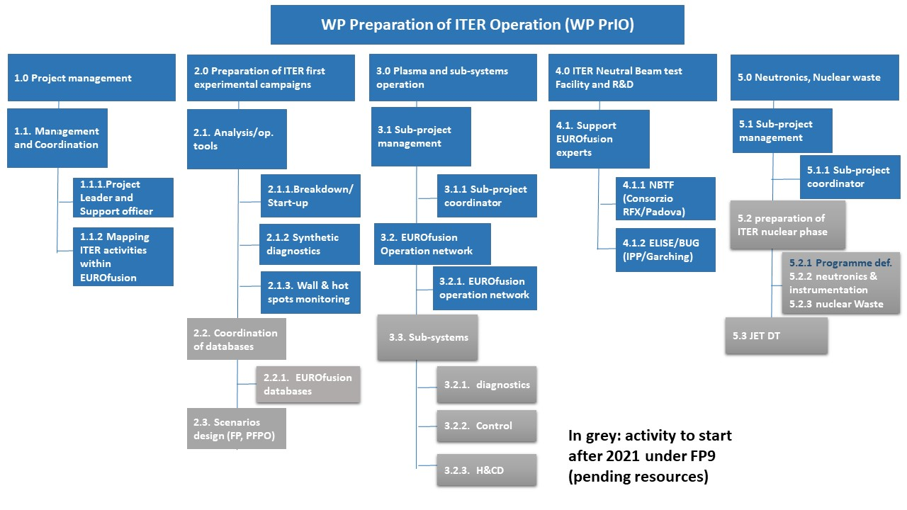
Work Breakdown Structure- 5 Sub-Projects

Slide 39
EUROfusion Operations Network 2021 activities
Set up a EUROfusion Operations Network (EON)
2021 Foundations year: Identify operational areas and their current status and needs
Map out operational roles and available training
Prioritize and establish pilot projects for subnetworks (NBI seminars starting in Autumn 2021, Wall Conditioning workshop in 2022)
Competency-based subnetworks:
Understand the needs of each area, consider regular seminars, (bi)annual workshops, one-off events to share operational experience, discuss opportunities/challenges, provide operator development etc.
  Network and build community – get to know people in the same area of expertise, support for EEG and young/upcoming operators
  Learn – expand knowledge on other facilities and processes
  Consulting – get and provide feedback on current topics
  Be noticed – hiring within Europe and for ITER
  Share – identify opportunities for joint studies in Operations

Slide 40
EON subnetwork pilot – NBI seminar series
WPPrIO area – NBTF – Negative Beam Test Facilities (Padova, Garching)
Proposal developed through discussions with
  WPPrIO (Preparation for ITER Operations): X. Litaudon
  WPHCD (Heating and Current Drive): Q. Tran, J-P. Hogge
  WPSA (Exploitation of JT-60SA): C. Sozzi
  Padova: V. Toigo, G. Serianni
  IPP: U. Fantz (Garching), P. McNeely (Greifswald)
  UKAEA: D. King, D. Ciric
  EUROfusion - International relations: R. Kamendje
  ITER: C. Rotti, P. Veltri
Monthly 2-hour seminar series from September 2021:
Join the positive and negative ion beam communities
Topics: focus mainly on operational topics, although open to other topics as well
Discussion centric: 30-minute talk + 30+ minute discussion, questions during/at the end
Remote: Bottom-up approach in participation, presenting and proposal of topics
Invite IO, QST (JT-60SA collaboration through Broader Approach), NIFS? (waiting for the EU-Japan bilateral agreement to include LHD)

Slide 41
Key assumptions
Prioritization following recommendations of the white paper on the preparation of EUROfusion role in ITER operation
Synthetic diagnostics and data analysis tools
  Focus on a very limited number of activities mainly on the topic on the “Divertor and Plasma Facing Component”
  EUROfusion participation in the design of ITER Fast Ions Lost Detectors diagnostic on hold pending peer review by ITER-IO
  EUROfusion Database coordination under FP8 resources in 2021
ITER scenario design for first plasma & PFPO
  Activity to be initiated in 2022
  TSVV#11 under WPAC
Neutronics
  JET operation ends in 2021. If JET is extended with a third D-T campaign further resources need to be allocated
  2021: JET neutronics funded with FP8 resources (WPJET3)
  2022-2023: WPPrIO cover JET neutronics, materials and waste analyses

Slide 42
SP-4: IPP support to NBTF and ITER NBI
Symmetrisation and reduction of the current of co-extracted electrons with emphasis on deuterium operation
Stable long pulse operation with improved Cs management
  Procurement, commissioning of a cw high voltage power supply
Detailed studies of beam optics

Slide 43
SP-4: SPIDER and MITICA in 2021
SPIDER
MITICA
Experimental campaign up to end of July
  First campaign using caesium in H₂ and D₂
End of July start of long shut down for:
  update of SPIDER Beam source
  Enhancement of vacuum system
  Substitution of RF oscillators with solid state amplifiers
Commissioning of power supply
  integrated tests
    No load tests
    Load tests
    Test simulating grid break downs
High Voltage Holding Tests

Slide 44
Gantt chart

Slide 45
Gantt chart

Slide 46
Gantt chart

