Slide 1
SPB2&B3: IPPLM activities in 2021: microscopy analyses of AUG, WEST, W7-X and reference samples – plans and capabilities
Elżbieta Fortuna-Zaleśna, IPPLM (WUT)

Slide 2
B2 2021 tasks
B2 Material migration in toroidal devices
Task: Microscopy studies of marker samples and other samples from specific plasma experiments (AUG, WEST, W7-X)
D9: SEM, TEM and FIB characterization of selected samples from experiments on AUG, WEST, and W7-X

Slide 3
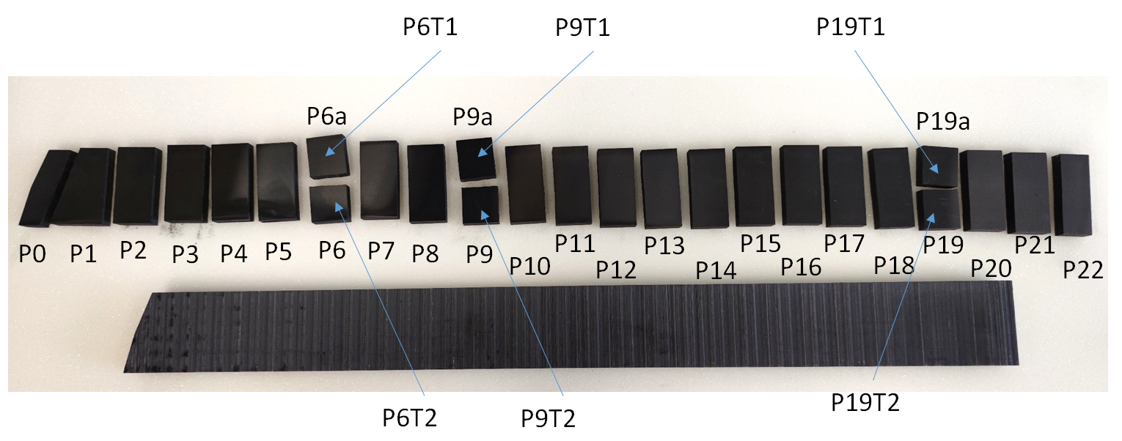
W7-X samples. Work ongoing.
Two target elements
HM19TM400hTE, HM19TM400hTE2, W7X OP1.2b campaign (all together over 50 samples).
HM19TM400hTE1 target element.
Sample size: for samples P2 – P22, 25 x 55 mm, the thickness of the samples of around 10 mm.
The aim of the work: (i) assess surface modification of the material caused by the plasma–wall interactions (erosion/deposition pattern), (ii) study the co-deposits formed and (iii) analyze the dust particles found.
Techniques used: SEM, EDS, TEM and STEM.

Slide 4
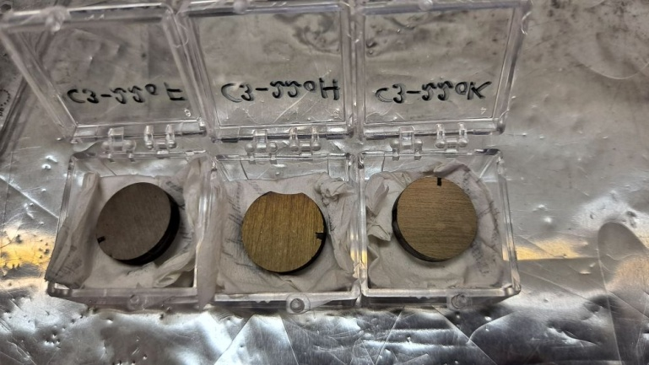
WEST samples. Work ongoing.
3 samples cut from the erosion marker tile 941G142 (outer#22) – C1+C2+C3; designated as C3-22oF, C3-22oH and C3-22oK.

Slide 5
Samples from FTU and AUG
No samples from AUG experiments. What is availability of erosion/migration samples for analyses?
New FTU sample received for analysis this year from Marco De Angeli. Could this work be included into 2021 programme?

Slide 6
B3 2021 tasks
B3 Characterization of plasma-exposed materials
Task: Determine surface changes on selected WEST PFUs and reference coatings from plasma exposures in MAGNUM-PSI, PSI-2, and GyM
D3: SEM, TEM and FIB characterization of selected WEST PFUs and plasma-exposed reference samples

Slide 7
Samples after experiments in MAGNUM-PSI
2 samples from January 2020 exposure:
IU 672-6 W D/(6%N) (high flux) loading
EU2_30-3 W/Ta D/(6%N) (high flux) loading
What is availability of new samples from MAGNUM-PSI, PSI-2?
Should I contact Matteo Passioni/David Dellasega for GyM samples? (We are not any more in the same work package).

