Slide 1
A short update on SMART alloy studies
Within the work packages PWIE SP A 3
18.06.2021| A. Litnovsky

Slide 2
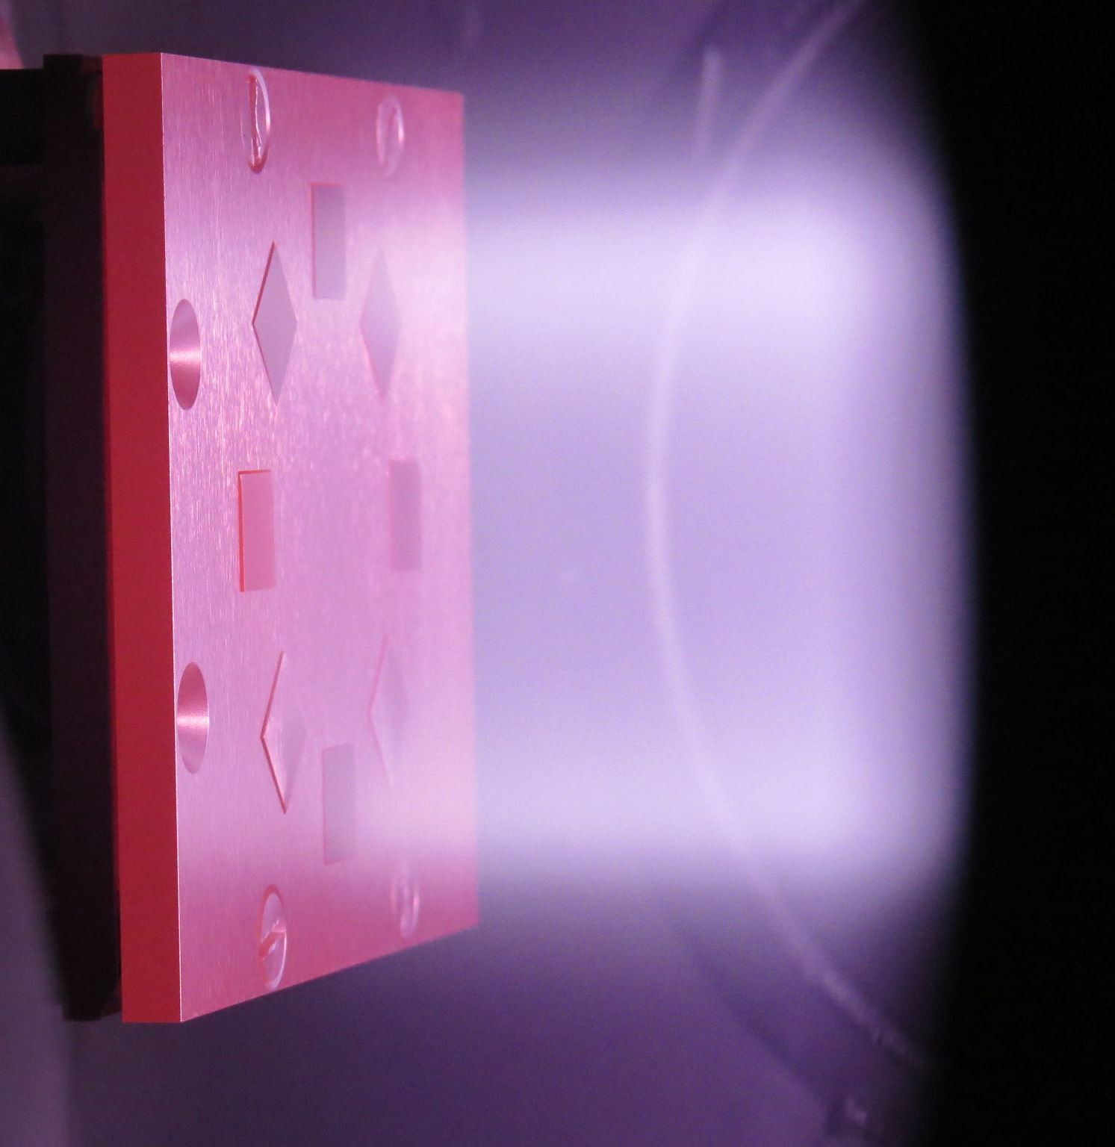
Status and plans of HHF and plasma tests on SMART alloys
Alloy | Plasma tests | HHF tests | Comments
SMART W-Cr-Y | Finished by now PSI 2 and Magnum PSI | Planned for 2022 | We will see depending on modeling whether new tests are required
SMART W-Cr-Zr | 2021-2022* PSI 2 | not yet in plan | Tests depend on availability of samples supplied by HFUT (CN)
Nanostructured alloys | 2021-2022* PSI 2 | not yet in plan | Tests depend on availability of samples supplied by SBU (USA)

Slide 3
Thank you

