Slide 1

WP PWIE - Tasks
PL /DPL /SPL

Slide 2
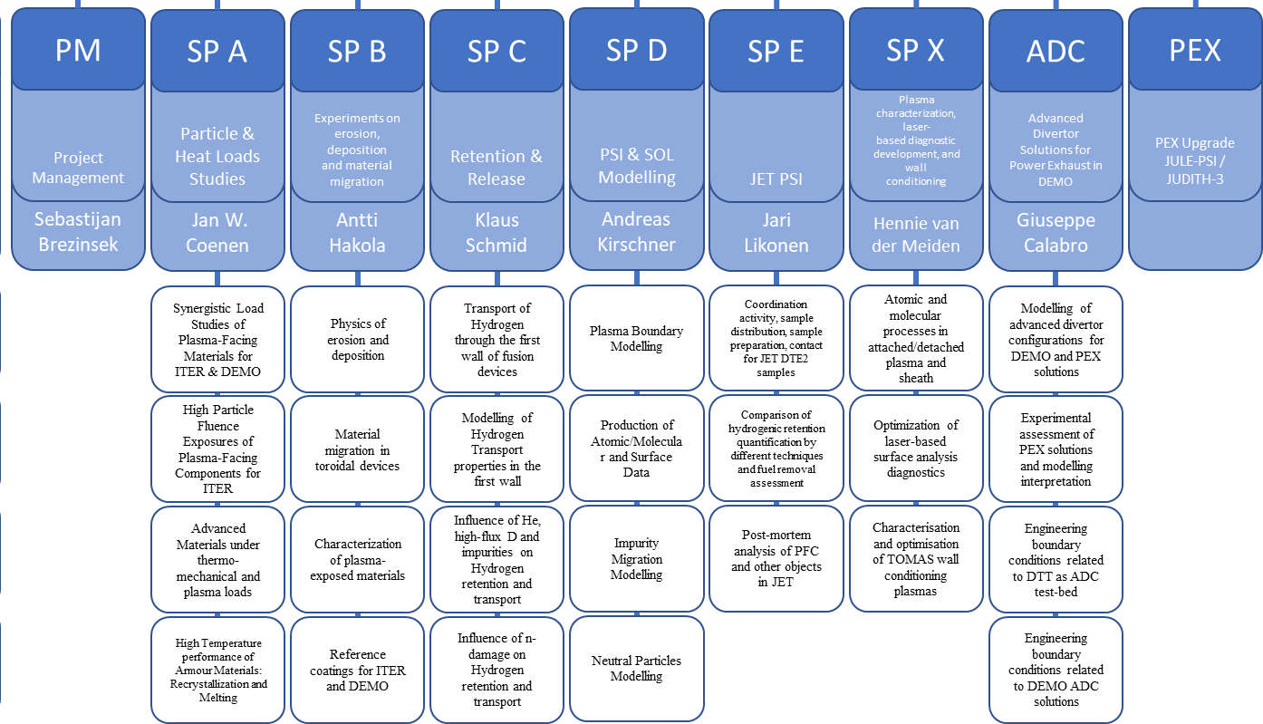
Task Overview

Slide 3
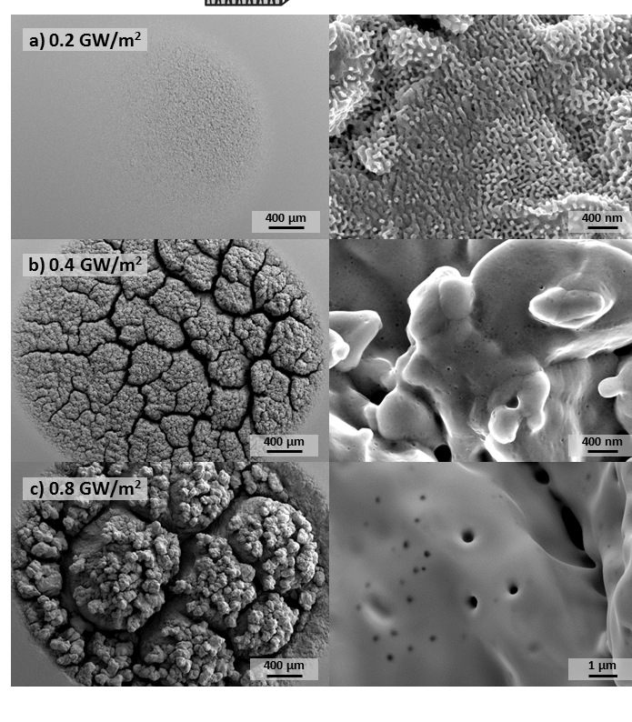
SP A.1: Synergistic Load Studies
Task contributes to the qualification of current baseline materials and beyond
predict the power load capabilities and damage thresholds for materials incurrent and future Fusion Devices.
Task group 1: Establish test matrix for tungsten materials & Study the impact of synergistic loads incl high cycle numbers
Task group 2: Qualify Materials for W7-X
Task group 3: Study Edge Loading on materials in WEST/ HHF Facilities
Plasma Exposure with Transients (PSI-2)
Main Deliverable 1:Damage Thresholds & Understanding of Damage Mechanisms / Predamaged Components Evolution & Analysis
Main Deliverable 2: Qualification of OLMAT as HHF Facility
Main Deliverable 3: Qualification of W Heavy Alloys
Human Resources: total 48.5 PM
Involved: DIFFER,FZJ CIEMAT,MPG,KIPT
Linked WP or TSVV: WP TE, WP MAT, WP DIV
Facilities: PD 18 days, HHF 28 days , Ion beam 0 days
Modelling: N/A

Slide 4
SP A.2: High Particle Fluence Exposures
Study current and future baseline materials under high fluence relevant for ITER & DEMO
Predict the power load capabilities and damage thresholds for materials incurrent and future Fusion Devices.
Task group 1: Recrystallization behavior of DEMO tungsten grades under high flux/fluence plasma loading (DIFFER)
Task group 2: Pre- and post analysis of materials and components (MPG)
Main Deliverable 1:Influence of plasma on Rx under slow transient loading (DIFFER)
Main Deliverable 2: Pre- and post characterization of samples (MPG)
MAGNUM-PSI
Human Resources: total 9.0 PM
Involved: DIFFER,MPG
Linked WP or TSVV: TE, MAT/PRD, DIV
Facilities: PD 7 days, HHF 0 days , Ion beam 0 days
Modelling: N/A
Notes:
Facilties: JUST GIVE the integral numbers for the groups
PD: Plasma devices (MAGNUM, PSI-2, UPP, TOMAS, GyM)
HHF: JUDITH, GLADIS, QSPA, OLMAT
Analysis station: Ion beam
If Facilties, Modelling, Link not applicable, remove the lines. I assume that it is EITHER EXPERIMENT or MODELLING, thus 1 more line for TASKS or Deliveables.

Slide 5
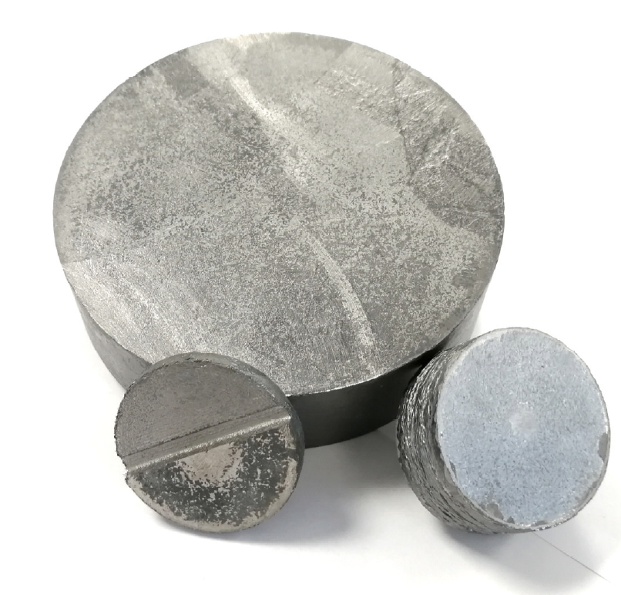
SP A.3: Advanced Materials
Develop qualification methods for advanced materials for ITER & beyond by different thermomechanical test procedures, heat load treatment techniques, and laboratory experiments as well as linear plasma devices.
Task group 1: Plasma qualification of new materials (WPMAT) and components (WP DIV) for DEMO:
Task group 2:Study of basic thermo-mechanical properties for advanced materials for divertor applications
Task group 3: Post-mortem analysis to characterize the induced surface and microstructure modifications
Main Deliverable 1: Analysis& Performance of Advanced Materials under Various HHF conditions
Main Deliverable 2: Results from Small Scale Samples e.g. irradiation incl. W Wire
Main Deliverable 3: Analysis of Microstructural Changes
W-Composites (FZJ)
Human Resources: total 9.0 PM
Involved: FZJ,DIFFER,KIPT,MPG, LPP-ERM/KMS
Linked WP or TSVV: TE, MAT/PRD, DIV
Facilities: PD 15 days, HHF 19 days , Ion beam 010days
Modelling: N/A
Notes:
Facilties: JUST GIVE the integral numbers for the groups
PD: Plasma devices (MAGNUM, PSI-2, UPP, TOMAS, GyM)
HHF: JUDITH, GLADIS, QSPA, OLMAT
Analysis station: Ion beam
If Facilties, Modelling, Link not applicable, remove the lines. I assume that it is EITHER EXPERIMENT or MODELLING, thus 1 more line for TASKS or Deliveables.

Slide 6
SP A.4: High Temperature Performance
Study of Melting and Disruptions and its effect on plasma performance and PFC lifetime
Effects of recrystallisation and material behavior
Task group 1: Study of recrystallisation of tungsten materials under various conditions
Task group 2: Analysis of Melt exposures linked to WP TE and Code development
Task group 3: PFC heat load modelling and simulations of disruption mitigation
Main Deliverable 1: Analysis of recrystallisation mechanisms linked to exposures in SPA.1 & Lab Experiments
Main Deliverable 2: Development and Validation of MEMOS-U
Main Deliverable 3: Code Development examine specific engineering use cases for transient heat flux analysis on ITER and/or DEMO
Melt Layer Modelling with act. cooling
Human Resources: total 9.0 PM
Involved: CEA,DTU,VR,JSI,KIPT,FZJ
Linked WP or TSVV: TE, MAT/PRD, DIV
Facilities: PD TBD days, HHF 5 days , Ion beam 0 days
Modelling: TOKES,MEMOS
Notes:
Facilties: JUST GIVE the integral numbers for the groups
PD: Plasma devices (MAGNUM, PSI-2, UPP, TOMAS, GyM)
HHF: JUDITH, GLADIS, QSPA, OLMAT
Analysis station: Ion beam
If Facilties, Modelling, Link not applicable, remove the lines. I assume that it is EITHER EXPERIMENT or MODELLING, thus 1 more line for TASKS or Deliveables.

