Slide 1
Short status report of the KIT activities in PWIE: PWIE-SP D.4.T001- D001
C. Tantos, S. Varoutis, Y. Igitkhanov, C. Day

Slide 2
Work plan for 2021
The 2021 KIT activities will be focused on the DIVGAS code development and modification in order to include the following physics aspects:
Atomic and molecular processes (i.e volumetric and surface recombination, dissociation, ionization and charge exchange)
Advanced gas-surface interaction models (Cercignani-Lampis-Lord gas-surface interaction kernel)
Magnetic field effects
The code acceleration will be further enhanced using the Graphics Processing Units (GPUs) and implementing a deterministic solver
The benchmarking of the modified code by simulating a DEMO relevant divertor configuration and analyzing how results change - all the needed quantities to be used as DIVGAS incoming boundary conditions should be extracted from a converged plasma simulation

Slide 3
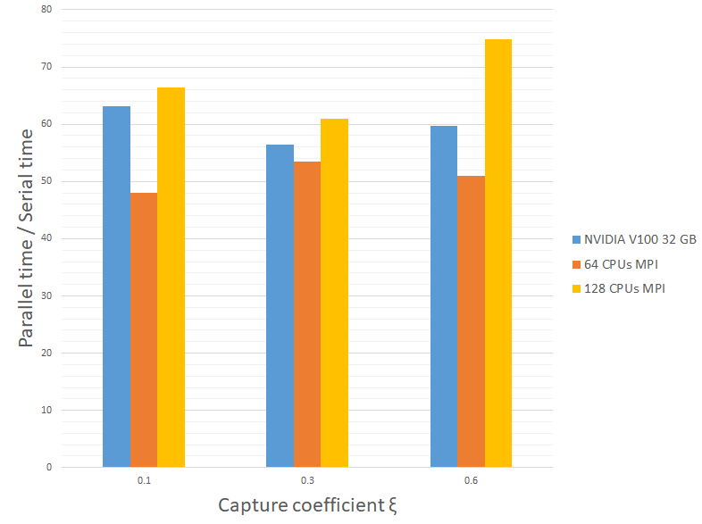
Status of the work
Since the DIVGAS simulations are time consuming, the parallelization optimization had to be done as first step – this task has been completed showing that the hybrid version CPU/GPU of the DIVGAS code can significantly reduce the required computational effort
The GPU simulations have a speed-up of ~60 compared with the serial case
The GPU simulations have a similar speed-up compared with ~96 CPUs
A paper with the findings of this work has been uploaded for consideration and publication in the ´Plasma Physics and Controlled Fusion´ journal.

Slide 4
Status of the work
The implementation of the atomic and molecular processes as well as the implementation of the Cercignani-Lampis-Lord gas-surface interaction kernel are ongoing and are expected to be completed over summer time without delays
The introduction of the magnetic field effects on the DIVGAS modeling (even if simplified) is a more demanding task and it is expected to be completed by autumn 2021
In the period until end of the year, the benchmarking of the above developed code will take place by simulating a DEMO relevant divertor configuration and analyzing how results change, if the new features are switched on
The deliverables for 2021 would be the code verification and a final report for the above described activities
Based on the progress of the work so far no delays are expected

