Slide 1
Overview of the EIRENE versions
Y. Marandet on behalf on the Neutral Gas Module TSVV#5
Kick-off Meeting, June 29th 2021

Slide 2
Outline
1- Introduction – EIRENE
2- Parallelization strategy
3- Status of the OpenMP implementation

Slide 3
Outline
1- Introduction – EIRENE
2- Parallelization strategy
3- Status of the OpenMP implementation

Slide 4
Neutral gas physics
e⁻
D⁺
Ionisation process
e⁻
D
e⁻
From the plasma point of view
- Gain of a D⁺ ion with energy E_{D+} and momentum mv_{D+}
- Gain of an electron with an energy E_{e-}
- Loss of energy of the incident electron
Neutral gas physics provide sources in plasma balance equations
Plasma
B2, EMC3, Soledge3X, …
Neutral gas
EIRENE

Slide 5
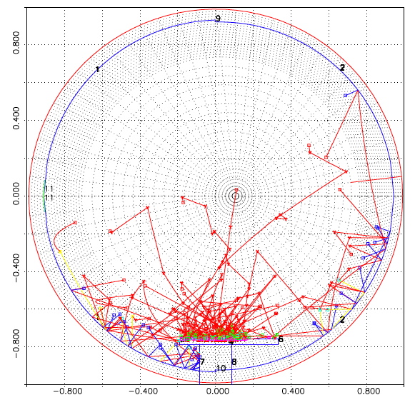
Need for a kinetic description
Neutrals (often) have mean free
paths >> gradient lenghts
No general fluid closure -> kinetic
f(r,v), 6 dimensions in steady state
Monte Carlo approach :
calculation of moments of f
without calculating f explicitely
3D grid « only »
(potentially billions of cells)
But statistical noise

Slide 6
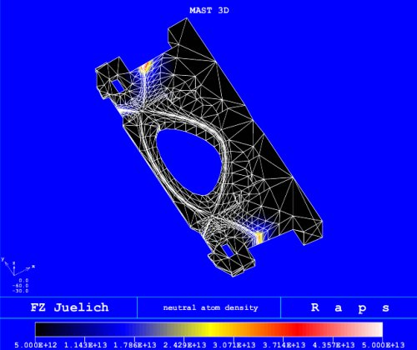
The EIRENE code
~100000 lines
FORTRAN (77 to current)
D. Reiter, P. Börner, et al. FZJ Jülich

Slide 7
Sketch of the MC method for linear transport
Calculation of N trajectories through random sampling
(in the simplest case, represents the physical model)
Trajectories are independant : « straightforward » parallelisation
r
θ
The plasma is discretized on a 1D/2D/3D grid, plasma conditions
as input (model, plasma code in coupled operation)
~ 10+ fields +all derived fields (rate coefficients, …)

Slide 8
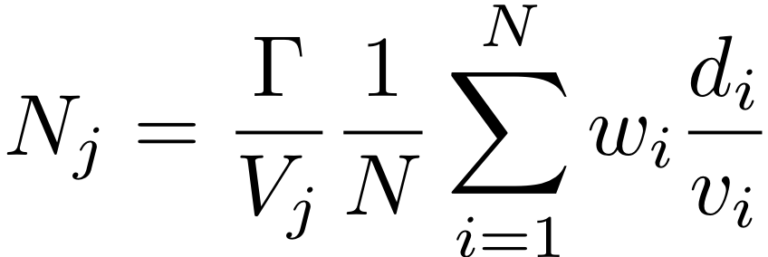
From the trajectories to physical quantities
k trajectories intercepting
Residence time = d_{k}/v_{k}
Cell j (volume V_{j})
Estimator for density in cell j:
Γ: source strengh, N = number of trajectories/histories
~100 of estimators/grid cell (energy density, sources …)
(~100 fields=« tallies » to calculate on the grid)

Slide 9
A word on code versions
Main branches & forks :
MASTER -> Petra
DEVELOP
DEVELOP_openmp (on track for a merge request into DEVELOP) -> Yannick & Huw
JSON input (on track for a merge request into DEVELOP)
FORK/ITER(…) : additional physics relevant for ITER, used in SOLPS ITER (N₂ A&M database, bundled charge states …)
-> Sven/Wouter
We suggest to use the DEVELOP_openmp branch, as a starter, then DEVELOP as soon as the branches have been merged
Also helpful in GPU boost assessment

Slide 10
Outline
1- Introduction – EIRENE
2- Parallelization strategy
3- Status of the OpenMP implementation

Slide 11
Stratified sampling
From a physical point of view, neutrals have different sources : recycling at the wall, recombination of plasma ions (D⁺,T⁺,Be⁺,W⁺,N⁺,Ne⁺, …), gas puffs, …
EIRENE loops over these sources, compute tallies for each sources and then sum them up (variance-noise- reduction)
do istra=1,Nstrata (= sources, 1-100)
do iptsi=1,npts(istra) (= histories, 1-10⁸)
(calls to many subroutines, lots of modules)
enddo
enddo

Slide 12
Already available : two MPI parallelisation strategies
« Embarrasingly parallel »
or ‘fine grained’
‘Historical’ or ‘Coarse grained’
Preprocessing
Preprocessing
N1 part.
Strata 1
N1 part.
Strata 1 Strata 2 … Strata M
Strata 2
N1 part.
N2 part.
NM part.
N2 part.
Strata M
Postprocessing
NM part.
Communications only on both ends of the MC
load balancing requires attention
Postprocessing
More communications,
« natural » load balancing
(input file sets total number of part
Increasing CPU couts –> strong scaling)
(input file sets number of part/core –
Increasing CPU counts -> weak scaling)

Slide 13
MPI parallelization
all input fields and tallies have to be duplicated in memory for each process (> 100 fields), problematic at the level of a node for large 3D grids…
Would benefit from additional optimization of load balancing (cf. previous HLST project)
Shared memory parallelization as a first step to alleviate this issue
E.g. Soledge3X is hybrid MPI/OpenMP, coupling with pure MPI EIRENE wasteful (interface TSVV#3, …)
Ultimately domain decomposition needed (nodes receiving chunks of the grid)

Slide 14
Extension of the parallel zone (2 options)
default
-DUSE EXT OPENMP
!$OMP PARALLEL
…. initialization of random seed for each thread
… initialization of private variables
Do istra=1,Nstrata (= sources, 1-100)
!$OMP DO
do iptsi=1,npts(istra)(= histories, 1-10⁸)
…
enddo
!$END OMP DO
enddo
!$OMP END PARALLEL
In eirene_main.f
!$OMP PARALLEL
call Eirene_Eirene(….)
!$OMP END PARALLEL
Allows being called within a parallel region
of a plasma code (e.g. SOLEDGE3X)

