Slide 1


• CEA contribution to WP PWIE SP D activities
G. Ciraolo, N. Fedorczak, Marandet, M. Raghunathan, S. Di Genova, H. Yang, H. Bufferand

Slide 2
CEA/ FR FCM Contribution
SP D.1 "Plasma boundary modelling“
  Plasma background parameters of WEST for modelling of impurity migration experiments (focus on D and He discharges)
SP D.3 "Impurity Migration Modelling“
  ERO2.0 simulations of tungsten transport in WEST, determination of main tungsten sources in WEST, comparison with spectroscopy

Slide 3
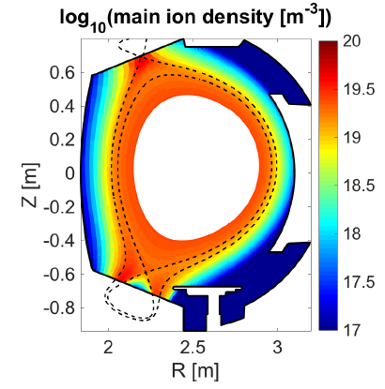
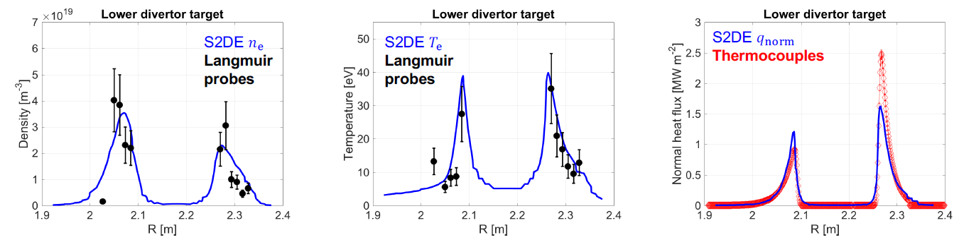
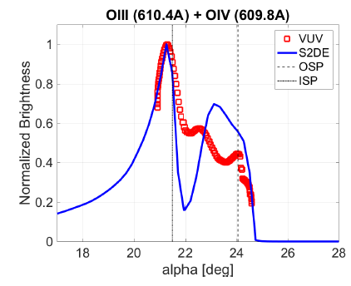

SP D.1: Plasma background parameters of WEST for modelling of impurity migration experiments (focus on D and He discharges)
SOLEDGE modelling in 2D transport mode to help interpretation and preparation of WEST experiments
  Plasma background with and without light impurities (Oxygen) and estimation of the impact of light impurities to W sources from divertor and main chamber PFCs
  Using plasma background for running ERO2.0 code to estimate W transport and contamination of core plasma
  Numerical studies for finding optimal experimental conditions for reducing core contamination
Application to Oxygen transport in the SOL
  [A. Gallo et al., Nuclear Fusion, 2020; G Ciraolo et al, FEC 2020/2021, S Di Genova et al, in preparation]
Exp.: WEST #54067 : $P_{SOL}=2MW (4MW$ LH heating - $2MW$ bulk radiation)
$n_{lid}=4⋅{10}^{19}m^{−2}$ (interferometry)
Simu.: D+O plasma (assumption 2% Oxygen imposed as bc in the core and then transported by soledge)
ad-hoc perpendicular diffusivity: $D=ν=\frac{χ}{2}=1m^{2}s^{−1}$

Slide 4
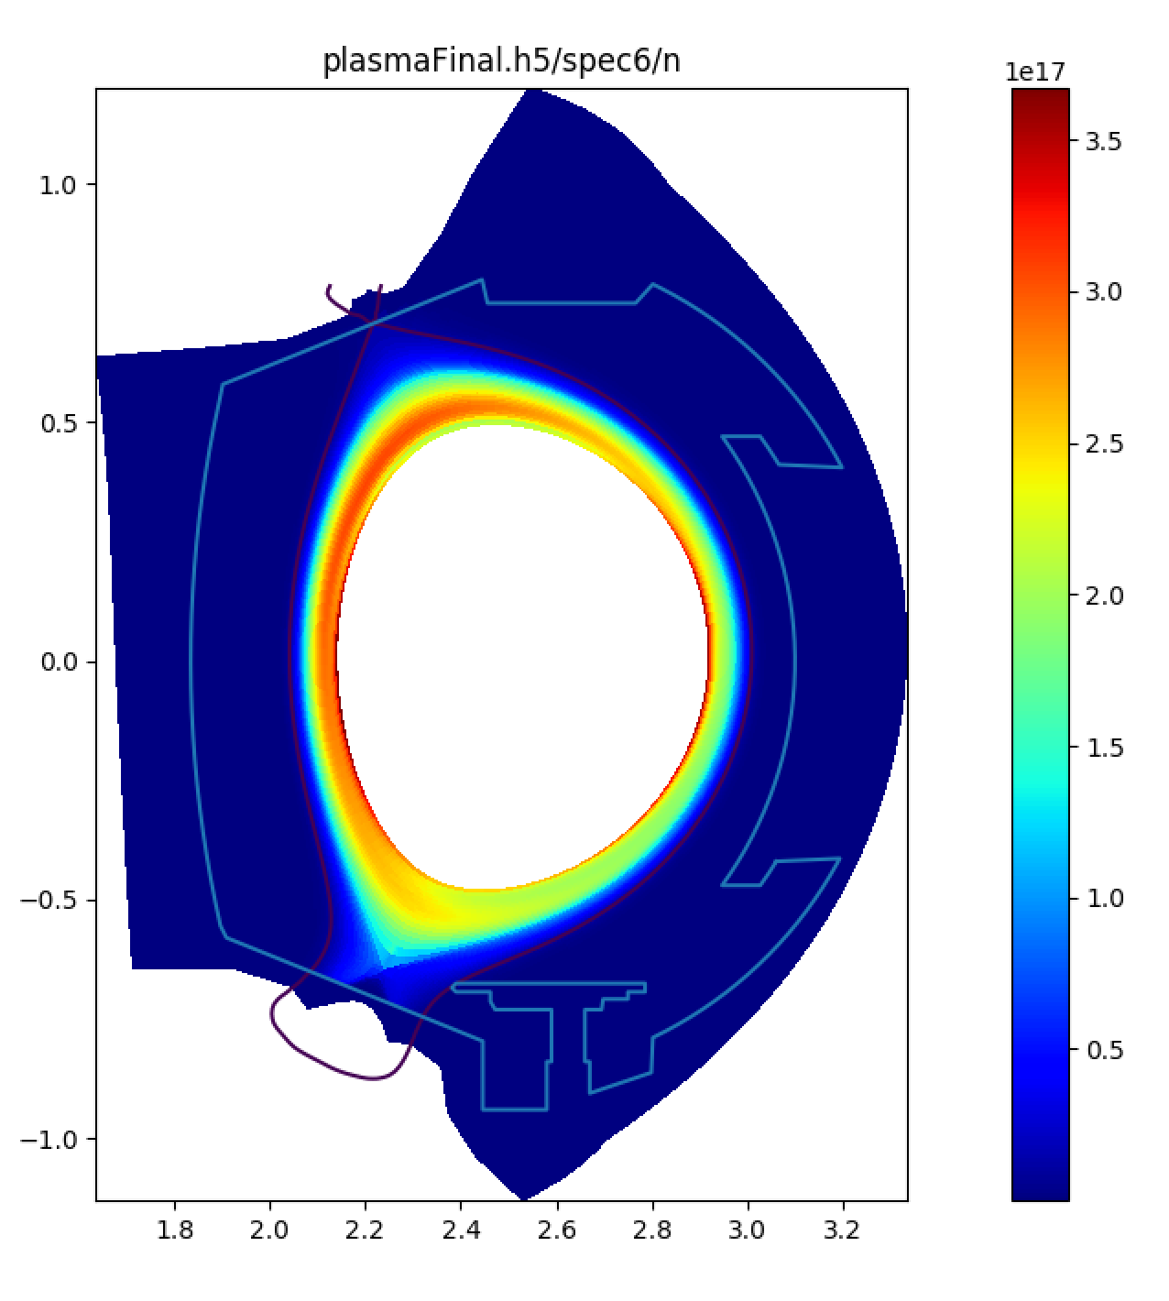
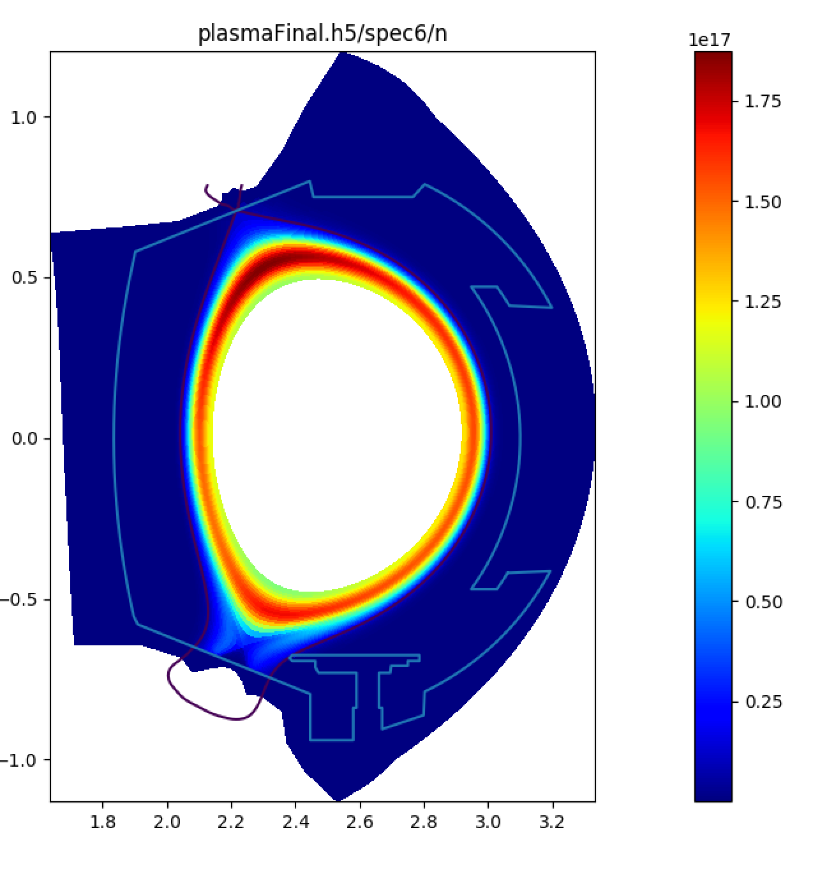
SP D.1: Plasma background parameters of WEST for modelling of impurity migration experiments (focus on D and He discharges)
SOLEDGE modelling in 2D transport mode to help interpretation and preparation of WEST experiments
  Plasma background with and without light impurities (Oxygen) and estimation of the impact of light impurities to W sources from divertor and main chamber PFCs
  C Klepper et al, EPS 2021
Preliminary results of Soledge plasma backgrounds with impurities
with and without drifts (Y. Marandet)
Drifts on
Drifts off

Slide 5
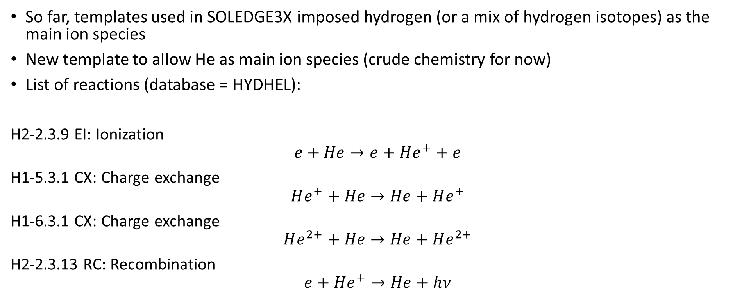
Preparation for He plasma background: New EIRENE template for He plasmas
So far, templates used in SOLEDGE3X imposed hydrogen (or a mix of hydrogen isotopes) as the main ion species
New template to allow He as main ion species (crude chemistry for now)
List of reactions (database = HYDHEL):
H2-2.3.9 EI: Ionization
$$e+He→e+He^{+}+e$$
H1-5.3.1 CX: Charge exchange
$$He^{+}+He→He+He^{+}$$
H1-6.3.1 CX: Charge exchange
$$He^{2+}+He→He+He^{2+}$$
H2-2.3.13 RC: Recombination
$$e+He^{+}→He+hν$$

Slide 6
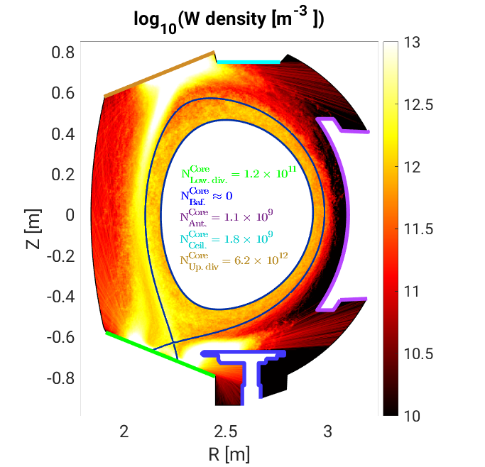
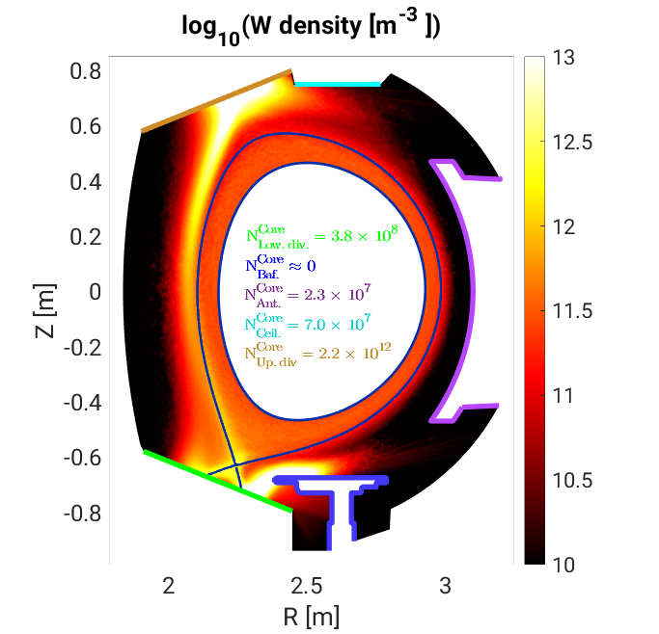
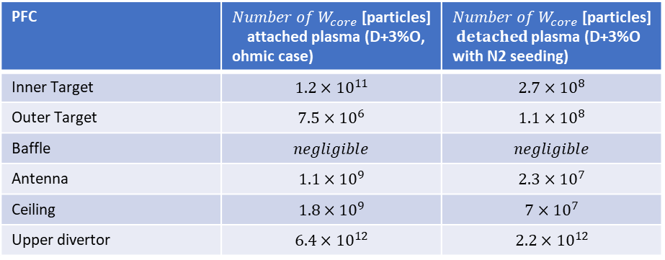
  SP D.3: ERO2.0 simulations of tungsten transport in WEST, determination of main tungsten sources in WEST, comparison with spectroscopy
SOLEDGE modelling in 2D transport mode to help interpretation and preparation of WEST experiments
  Using plasma background for running ERO2.0 code to estimate W transport and contamination of core plasma
  Numerical studies for finding optimal experimental conditions for reducing core contamination
Comparison of W core contamination computed with ERO2.0 using
a) an attached plasma and b) a detached plasma computed with SOLEDGE
G Ciraolo, IAEA contribution
S. Di Genova, in preparation
PFC | $${Number of W}_{core}\text{ [}\text{particles}\text{]}$$ attached plasma (D+3%O, ohmic case) | $${Number of W}_{core}\text{ [}\text{particles}\text{]}$$ $detached$ plasma (D+3%O with N2 seeding)
Inner Target | $$1.2×{10}^{11}$$ | $$2.7×{10}^{8}$$
Outer Target | $$7.5×{10}^{6}$$ | $$1.1×{10}^{8}$$
Baffle | $$negligible$$ | $$negligible$$
Antenna | $$1.1×{10}^{9}$$ | $$2.3×{10}^{7}$$
Ceiling | $$1.8×{10}^{9}$$ | $$7×{10}^{7}$$
Upper divertor | $$6.4×{10}^{12}$$ | $$2.2×{10}^{12}$$

Slide 7
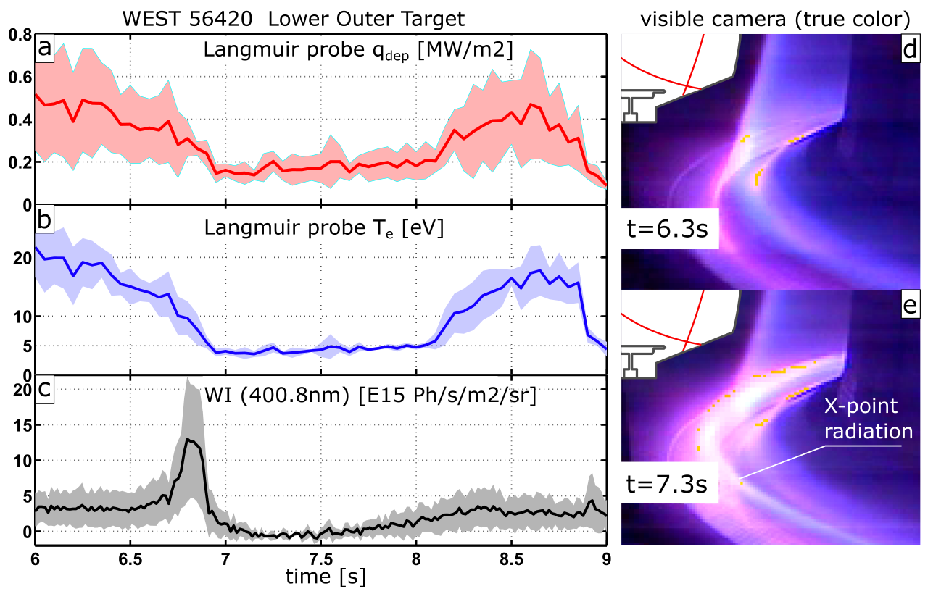
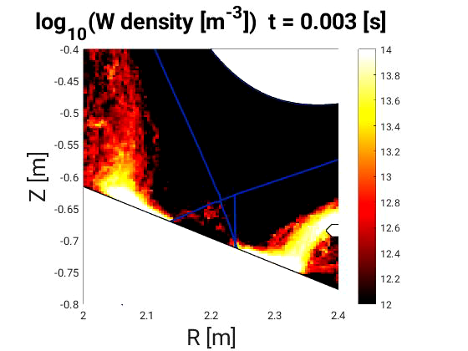
  SP D.3: ERO2.0 simulations of tungsten transport in WEST, determination of main tungsten sources in WEST, comparison with spectroscopy
ERO2.0 simulation on SOLEDGE background
WEST shot #56420. Time traces of deposited heat load (a, Langmuir probe), electron temperature (b, Langmuir probe) and neutral tungsten radiance (c, visible spectroscopy) spatially averaged 5 cm around the outer strike point (colored areas surrounding average curves show the standard deviation in this 5cm band around strike point). Visible camera images of the divertor region are shown for t=6.2s (d) and t=7.3s (e), the later exhibiting a localised emission ring possibly close to the X-point. The pulse features a puff ramp in ohmic, with puff injection stopped at 7.5s.

