Slide 1



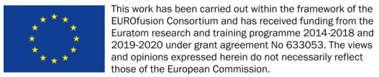
Diploma Thesis
Fusion@ÖAW
Vienna, Austria
PWIE SP-D2 Kickoff Meeting
Proposed Plans for tasks in 2021
Christian Cupak, Martina Fellinger, Paul Szabo and Friedrich Aumayr
TU Wien (Fusion@ÖAW)
SDTrimSP related modelling of erosion including morphology, roughness, fuzz
Kickoff Meeting, June 28th, 2021

Slide 2
Diploma Thesis
Outline
Outline
Fusion@ÖAW
Vienna, Austria
  Eurofusion PWIE SP-D.2 (Production of Atomic/Molecular and Surface Data) 2021/01/01 – 2022/12/31
  Our deliverables:
Erosion information of surfaces including morphology, roughness, fuzz (ÖAW)
This presentation:
Overview on our recent BCA code studies
Current developments
Key goals for this SP-D task

Slide 3
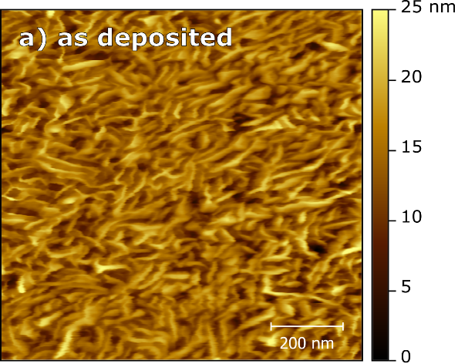
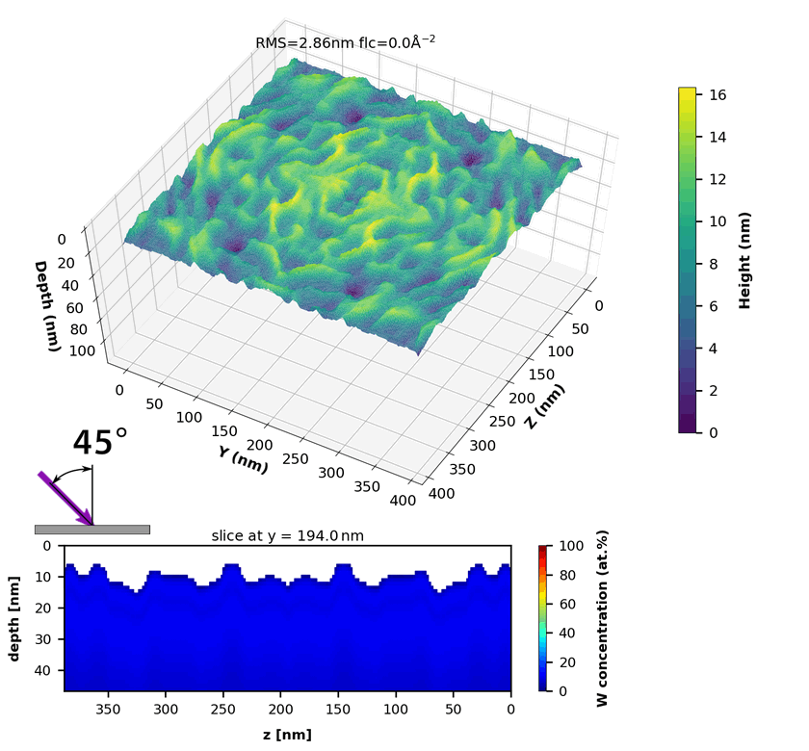
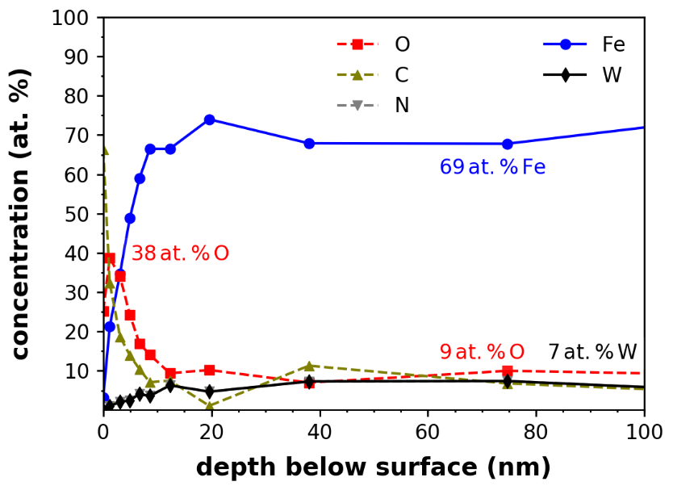
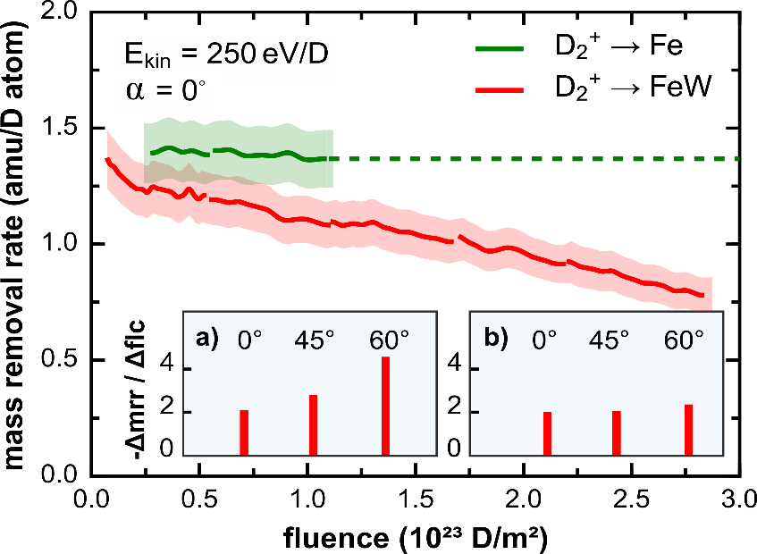
Diploma Thesis
Outline
Recent BCA code studies: D on FeW model films
Fusion@ÖAW
Vienna, Austria
  Key goal: Simulate preferential sputtering of FeW (1.5 at. % W) under 45°, 250eV D bombardment
Experiment:
AFM → surface structure of sample
Sputter-XPS → elemental depth information
QCM → in-situ mass removal rate over fluence
TRI3DYN simulation:
Input: AFM image section (200x200µm²), 2x mirrored
Input: target composition from Sputter-XPS
Dynamic mode, same inc. angle and fluence applied
AFM
Sputter-XPS
QCM
  [R. Stadlmayr et al., Phys. Scripta (2020) doi:10.1088/1402-4896/ab438f]

Slide 4
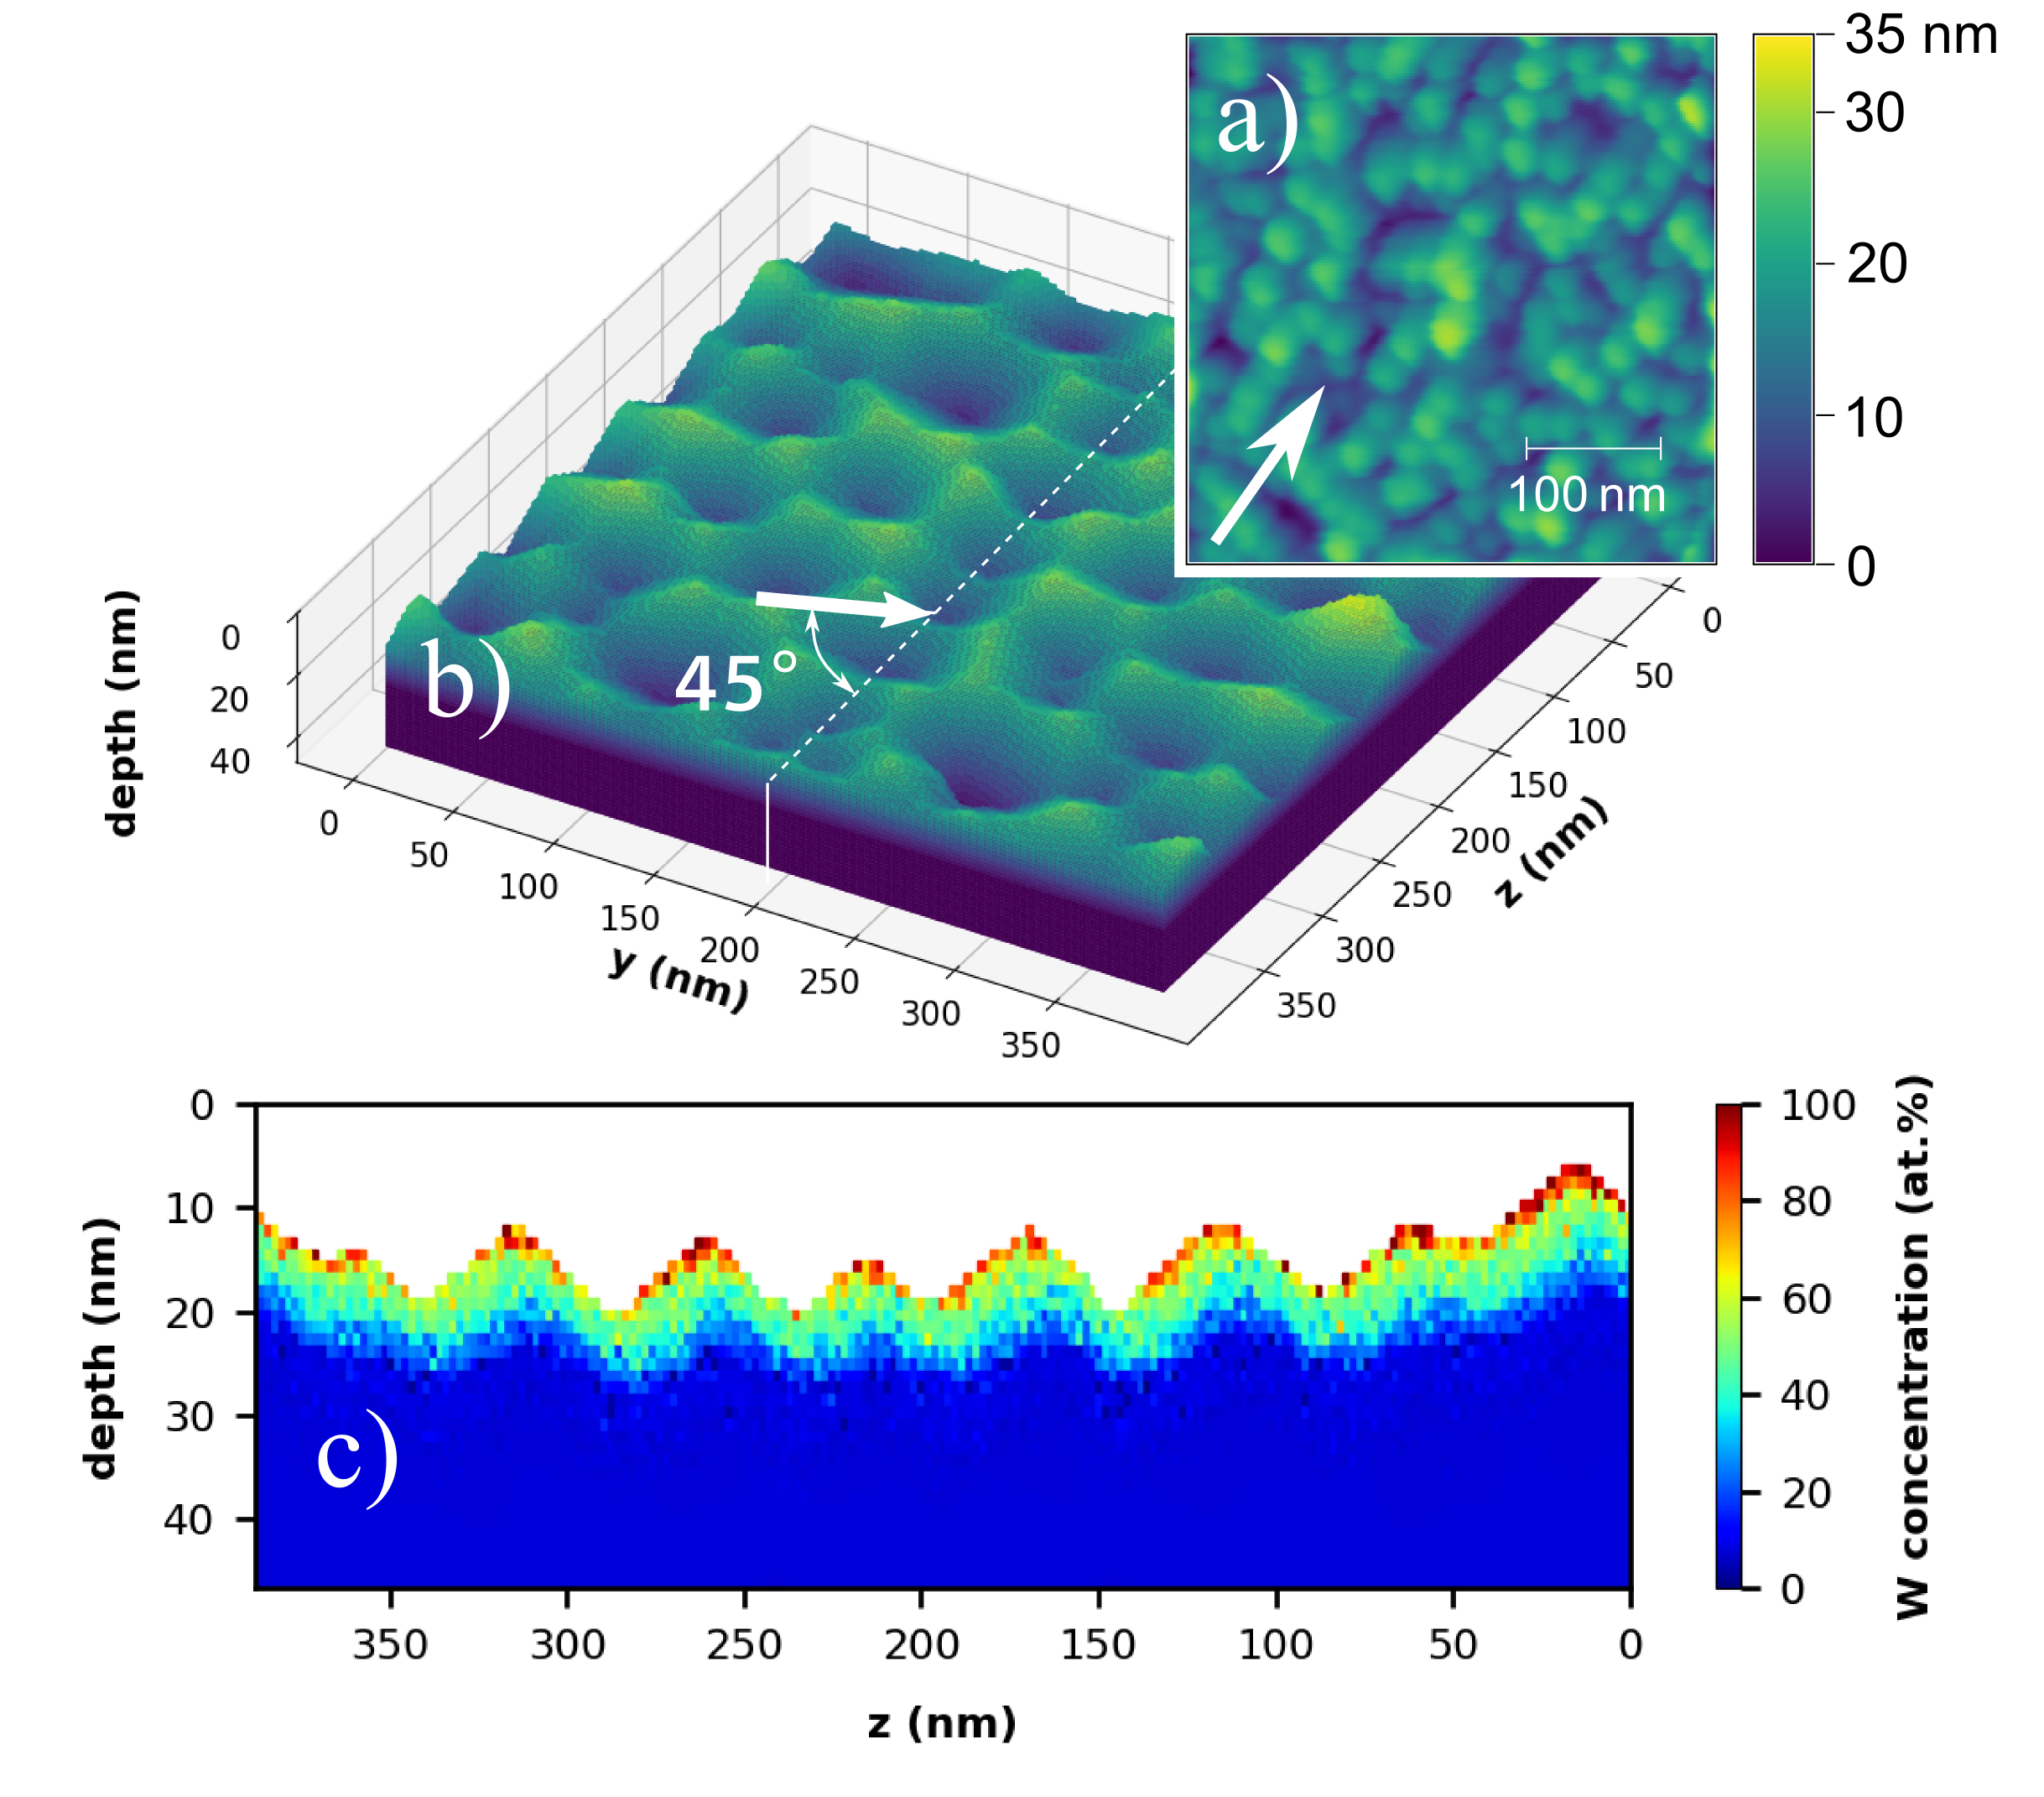
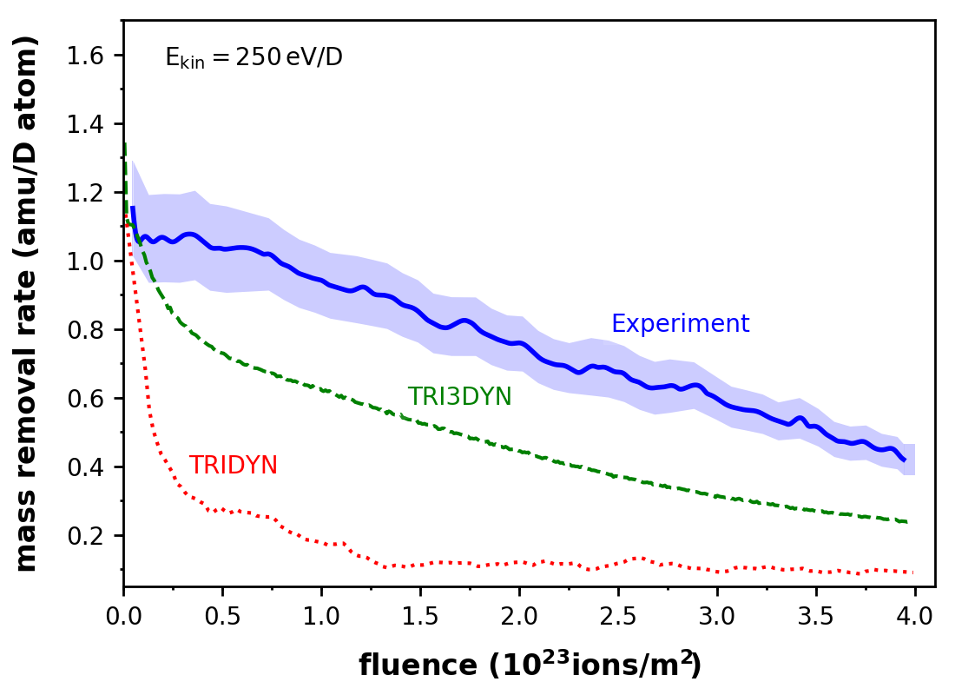
Diploma Thesis
Outline
Recent BCA code studies: D on FeW model films
Fusion@ÖAW
Vienna, Austria
  Outcome:
Surface patterning
W enrichment due to preferential sputtering
Fluence dependency of mass removal rate
  [R. Stadlmayr et al., Phys. Scripta (2020) doi:10.1088/1402-4896/ab438f]

Slide 5
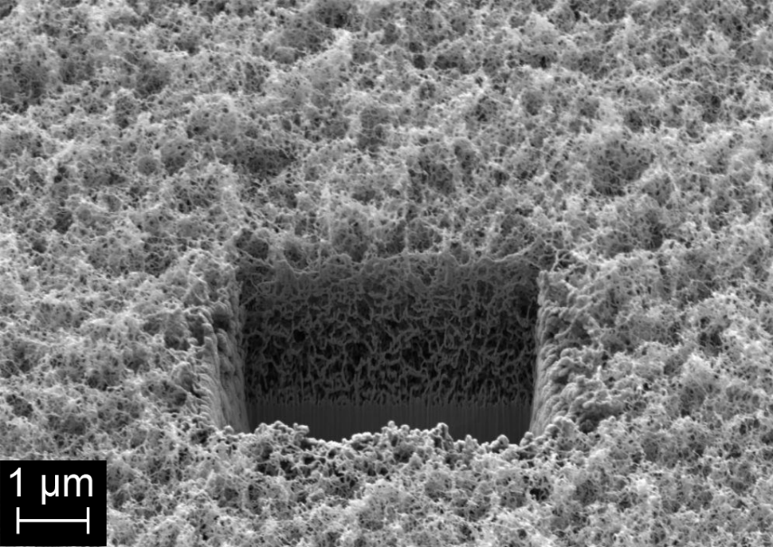
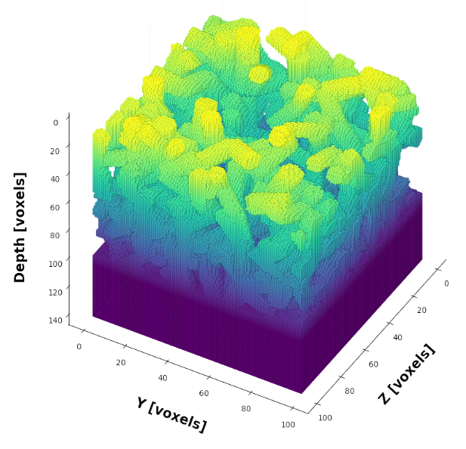
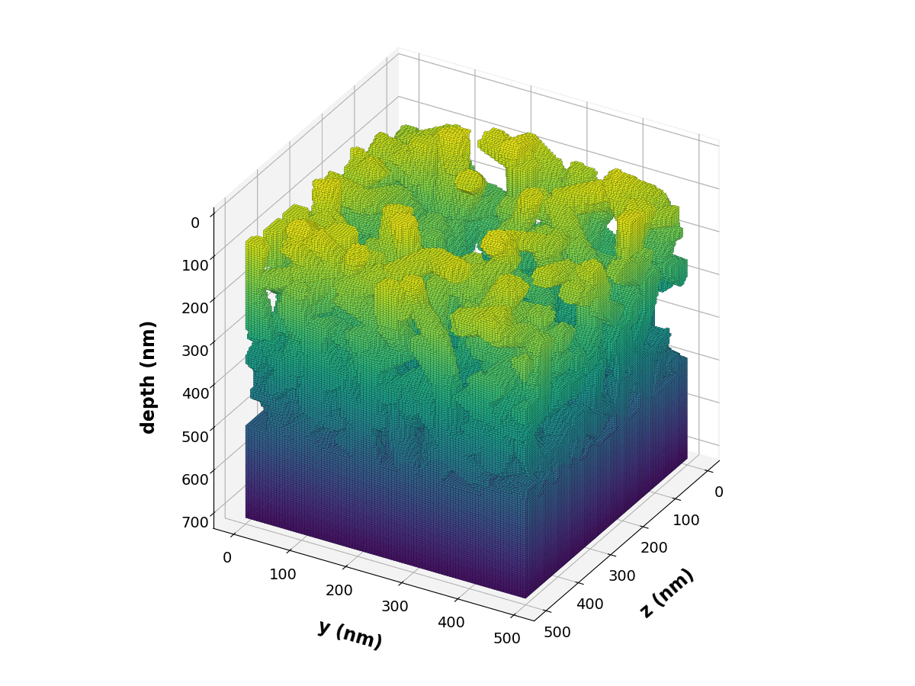
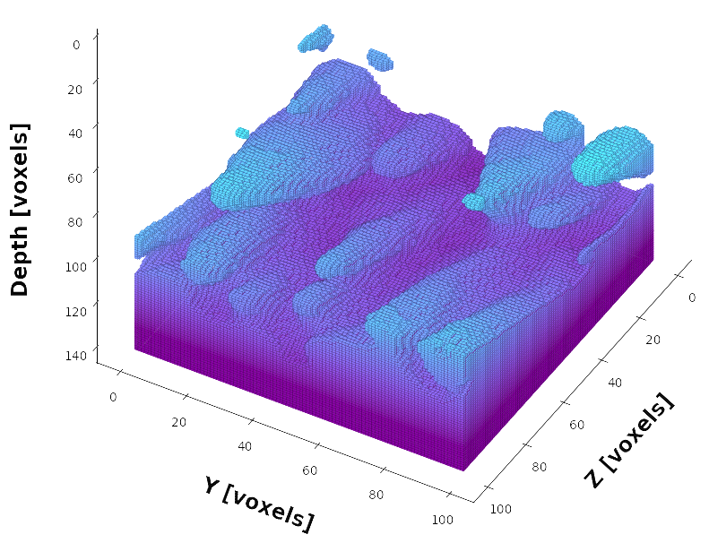
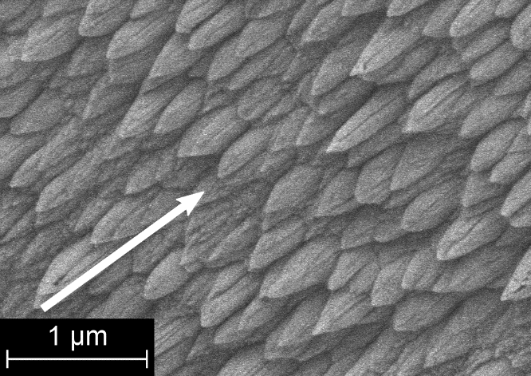
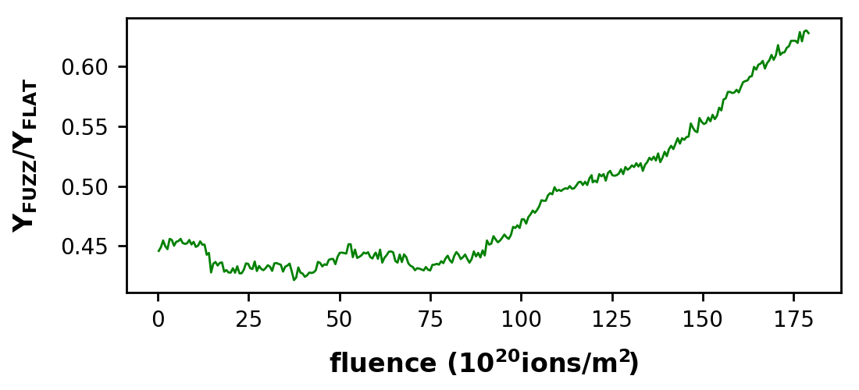
Diploma Thesis
Outline
Recent BCA code studies: W Fuzz
Fusion@ÖAW
Vienna, Austria
  Key goal: Simulate dynamic erosion of W-Fuzz under ion bombardment (2keV Ar¹⁺, 60°)
Simulation:
Fluence 1.7E+22m⁻²
Dynamic
2keV Ar (60°)
SEM image:
Input for TRI3DYN
Ar⁺
60°
  Results:
„Dragonscale“ development found and validated,
pointing towards incoming ion beam direction
Redeposition of sputtered atoms reduces sputter yield
Sputter yield rises with increasing fluence due morphology changes
  [R. Stadlmayr et al., J. Nucl. Mater. (2020) doi:10.1016/j.nme.2019.100722]

Slide 6
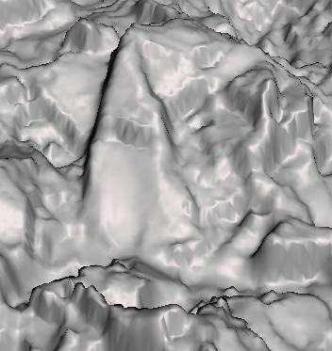
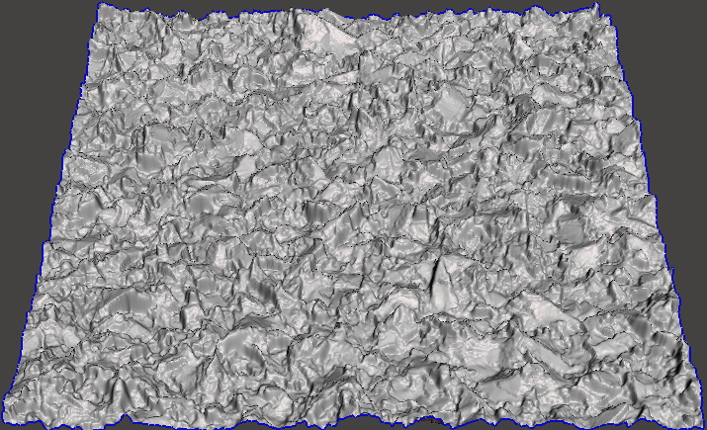
Diploma Thesis
Outline
Current developments + key goals for SP-D
Fusion@ÖAW
Vienna, Austria
  Limitation for 3D BCA codes: surface input limited in size to areas of ≈ 100x100 nm²
  Idea: Use BCA repository data for local ion impact, but raytracing for large scale roughness simulation
  SPRAY = SPuttering simulation via RAYtracing of particles
AFM/SEM/CFM images of surface
Primary ions with random impact point
Local ion incidence -> selection of BCA code (i.e., SDTrimSP) data
→ sputter yields
→ reflection coefficients
→ trajectories of emitted particles/ions
Emission of particles / reflected ions + raytracing
Results:
Calculation of effective sputter yields for large-scale images
Emission distribution of sputtered particles / refl. ions
δ
BCA
Raytracing

Slide 7
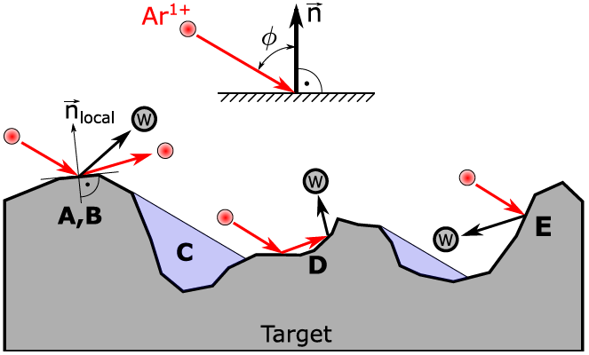
Diploma Thesis
Outline
Current developments + key goals for SP-D
Fusion@ÖAW
Vienna, Austria
  Current features of SPRAY:
  Independent on image size, quick calculations on desktop PCs
  Shadowing (C), sputtering via reflected ions (D) & redeposition (E) considered
  Our key goals for this SP-D task:
  a) Further development and benchmarking of SPRAY
    → application for real W surfaces (AFM)
    → implementation of new features (multicomponent targets,…)
    → modelling the dynamics of systematically increasing roughness on erosion
  b) Connection to our SP-B task (lab experiments):
    Det. sputtering, …, of W model systems with var. morphologies and re-dep. W layers (QCM meas.)
    We have the tools to handle both nano- and microscopic roughness

Slide 8
Diploma Thesis
Outline
Fusion@ÖAW
Vienna, Austria
  Backup slides

Slide 9
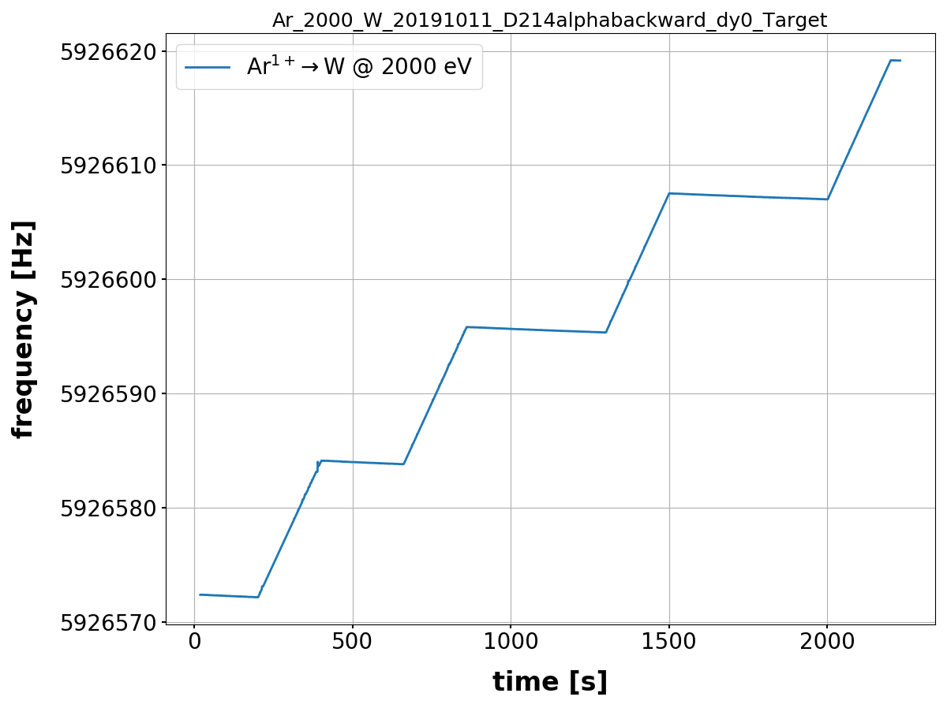
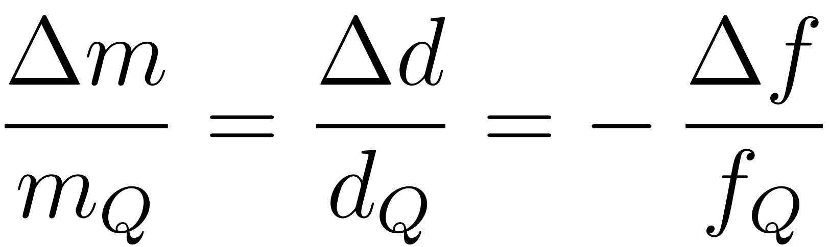
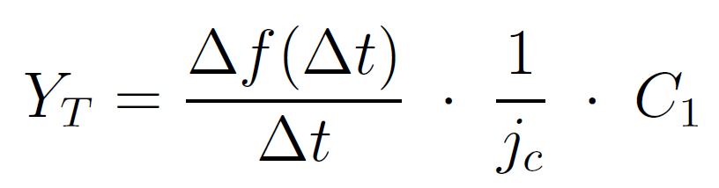
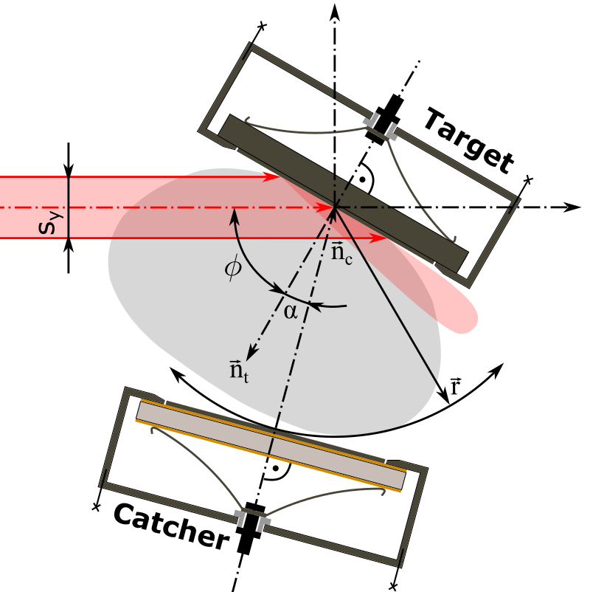
Diploma Thesis
Detailed QCM procedure
Fusion@ÖAW
Vienna, Austria
FC cup measurement before and after experiment
Initial Ar cleaning of target
Record QCM resonance frequency during ion induced mass loss
Via ion flux and frequency -> sputter yield
[6]
Target QCM
Beam on
[6] Sauerbrey G., 1959 (https://doi.org/10.1007/BF01337937)

Slide 10

Diploma Thesis
Details QCM performance
Fusion@ÖAW
Vienna, Austria
QCM electronics -> regulation loop to drive quartz in resonance
Resonance frequency changes due to mass loss in experiments
$$\frac{Δf_{Q}}{f_{Q}}≈{10}^{−9}$$
Sensitivity:
≈ 90 [pg/s] ≈ 3⋅10⁻⁴ [W monolayers/s]
[G. Hayderer et al., Rev. Sci. Instrum., 70 (1999) 3696-3700.]
[K. Dobes, PhD thesis, TU Wien (2014)]

