Slide 1
PWIE SP D2 "Production of atomic/molecular and surface data" Inofficial summarial title of VTT/Univ. Helsinki PWIE work: MD data for Erosion and reflection yields for realistic surface conditions
Kai Nordlund and Fredric Granberg
P. O. Box 43, Department of Physics 00014 University of Helsinki, Finland

Slide 2
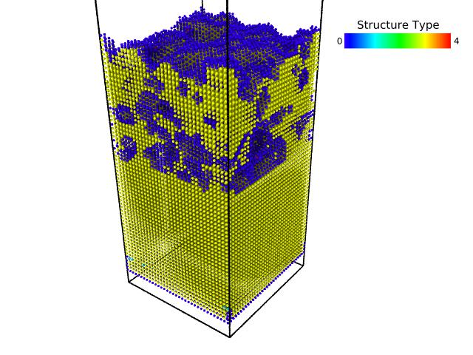
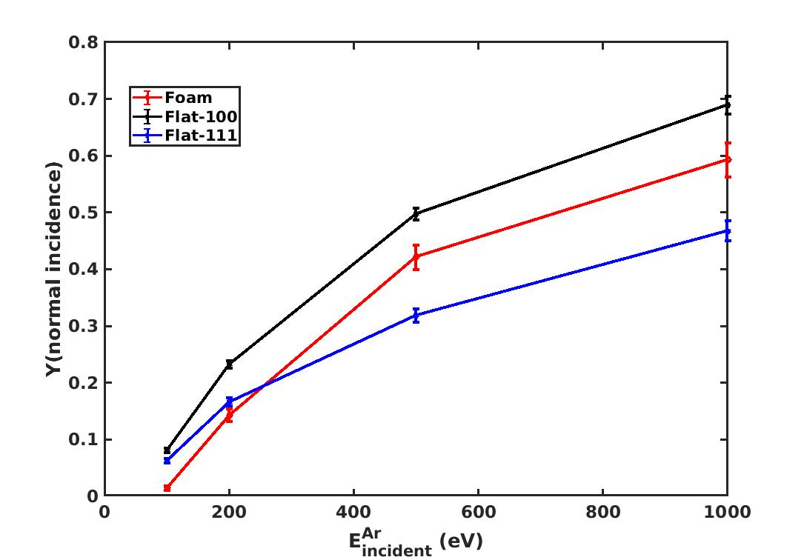
Preliminary work: MD data for foam vs flat surfaces
Foam results somewhat differ from those of flat surfaces
Important to keep in mind tat also difference grain orientations give different results (e.g. 100 vs. 111) here

Slide 3
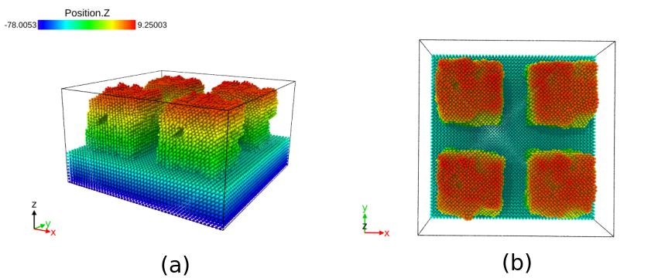
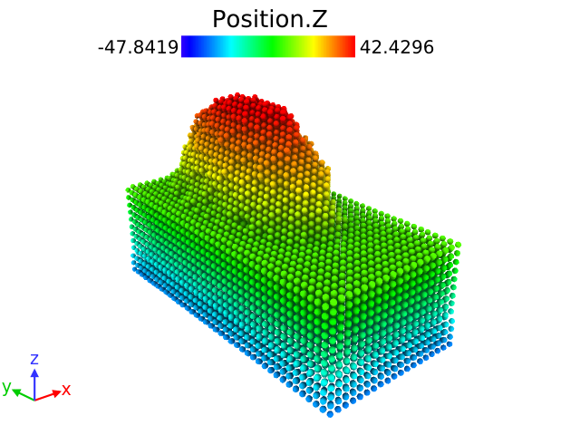
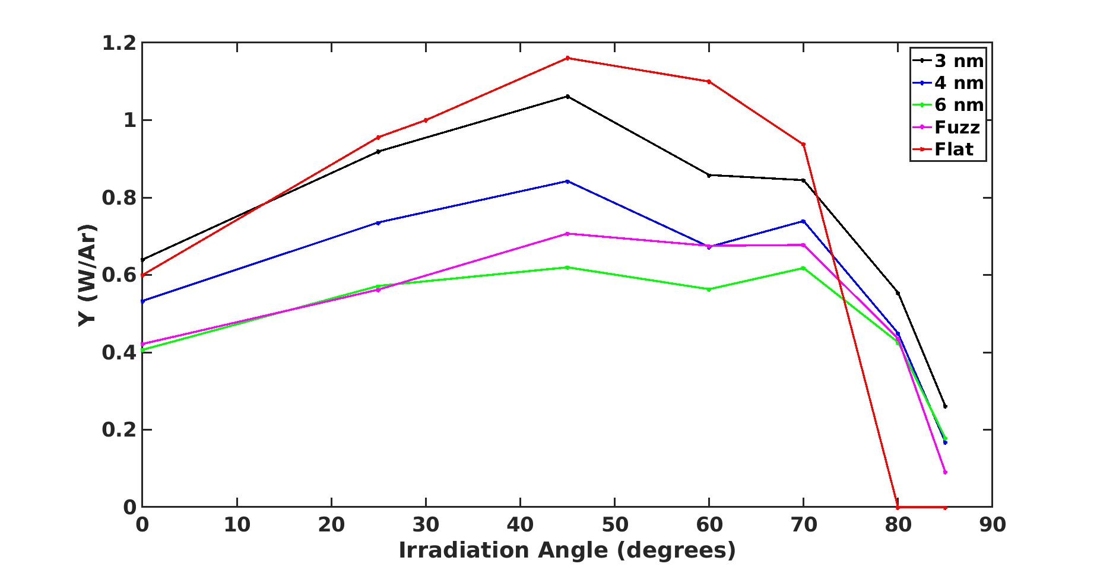
Effect of surface morphology: Hills vs Fuzz vs Flat

Slide 4
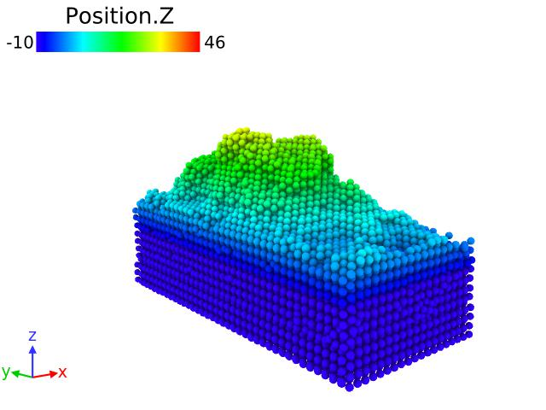
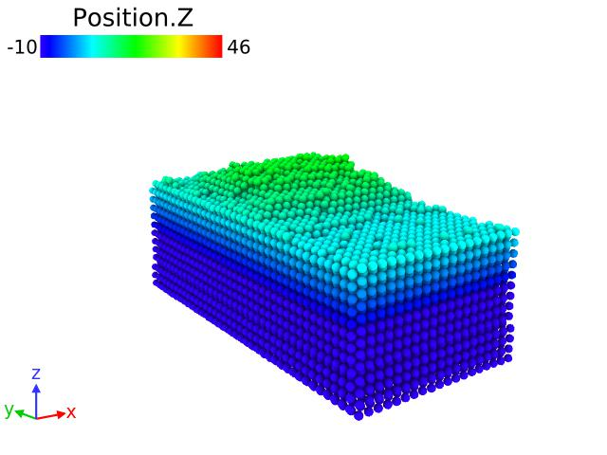
Hills after 5000 impacts
At perpendicular and 80 degree incoming angle

Slide 5
Deductions from preliminary work
Surface morphology affects sputtering and reflection yields
Also, surface morphology itself is not a constant, but the surfaces are dynamically evolving during prolonged irradiation

Slide 6
Workplan
2021-2022:
Production of erosion yields for redeposited W in comparison to bulk W
Production of erosion yields and reflection coefficients for rough W surfaces
2023-2025:
Development of machine learning for interatomic W potentials: Oxygen-W potential
Using this potential to determine sputtering of oxidized W, oxygen layer buildup and erosion during plasma-facing reactor conditions, and chemical erosion of W.

