Slide 1
E-TASC / TSVV Task #13 Stellarator Turbulence Simulation 2nd meeting
J. M. García Regaña

Slide 2
Agenda
# | Title of contribution | Related M or D | Speaker
1 | TSVV13 status: useful info and updates | - | J. M. García Regaña (CIEMAT)
2 | A Fokker-Planck collision model for gyrokinetic simulations in stellarators | M-STELLA-COLL | A. von Boetticher (U. Oxford)
3 | Gyrokinetic simulations in stellarators using different computational domains | D-TURB-DOMAIN | E. Sánchez (CIEMAT)
4 | Discussion | - | All
Regular meetings on second Monday of every month at 15:00 (CET)
Next meeting: 18th of October at 15:00.

Slide 3
Pinboard clearance and rehearsals
The clearance procedure ⇒ uploading the document to the electronic pinboard at least 2 weeks prior the deadline for non-refereed conference paper or abstract, 3 weeks for refereed ones:
https://users.euro-fusion.org/webapps/pinboard/EFDA-JET/index.jsp
Please, upload the documents related to the TSVV activities indicating TSVV/CIEMAT-01 as primary an WPW7X as secondary.
Please, plan in advance the rehearsals of papers and conference contributions at the W7-X Physics Meeting or Topical Group Meetings.

Slide 4
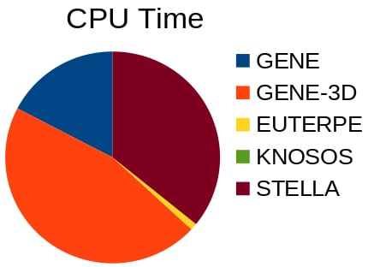
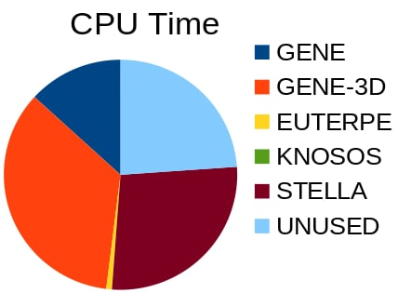
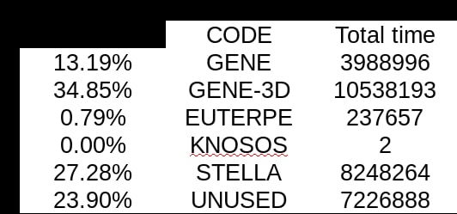
HPC resources
The usage of the TSVV/Marconi: 38 % spent already of the ~60 Mhrs
Prioritize the use of the CPU time of the TSVV Marconi project, in order to guarantee a good resource allocation in the next Marconi cycle.
Courtesy of H. Thienpondt

Slide 5
Agenda
# | Title of contribution | Related M or D | Speaker
1 | TSVV13 status: useful info and updates | - | J. M. García Regaña (CIEMAT)
2 | A Fokker-Planck collision model for gyrokinetic simulations in stellarators | M-STELLA-COLL | A. von Boetticher (U. Oxford)
3 | Gyrokinetic simulations in stellarators using different computational domains | D-TURB-DOMAIN | E. Sánchez (CIEMAT)
4 | Discussion | - | All
Regular meetings on second Monday of every month at 15:00 (CET)
Next meeting: 18th of October at 15:00.

