Slide 1
Kick-of meeting SP X3 Characterization and optimization of TOMAS wall conditioning plasmas
Hennie van der Meiden

Slide 2
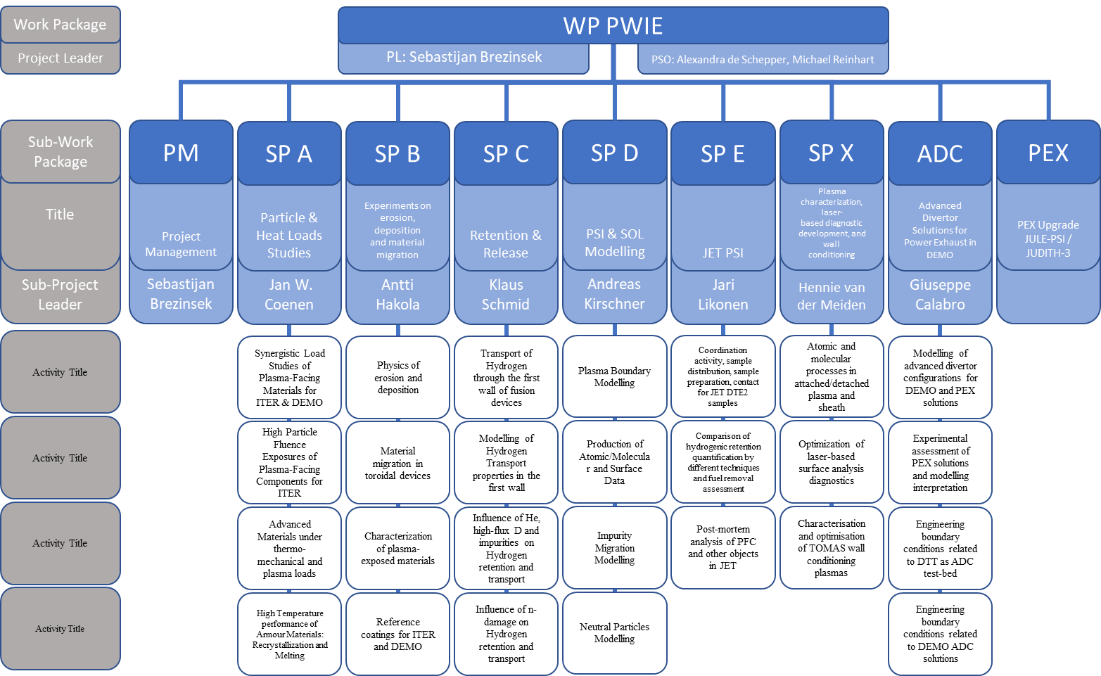
WP PWIE Structure 2021/2022
DPL for ADC: Giuseppe Calabro
Coordination Officer in FSD: David Douai
Not in 2021

Slide 3
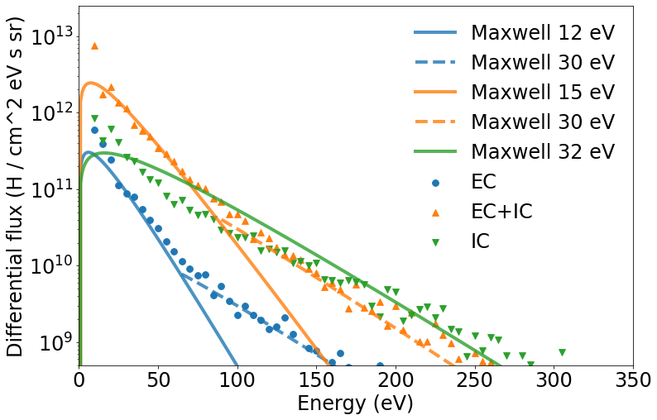
SP X.3: Characterization and optimization of TOMAS wall conditioning plasmas
Investigating effectiveness ICWC, ECWC and RF to “clean” plasma surfaces from impurities and fuel
Study the production and role of energetic neutrals and their impact on wall conditioning
Main Deliverable 1: Report plasma characterization TOMAS: neutral energies, probe and impurity OES data etcetera
Main Deliverable 2: Modeling of wall conditioning RF-based low temperature plasmas
Main Deliverable 3: Characterization of selected reference coatings and plasma-exposed samples
Differential flux ($H^{0}$/ $cm^{2} eV s sr$)
Energy ($eV$)
Moon et al., VR
Main goal of this meeting:
Status and synchronization of the work to be done
Identify possible issues that can cause delays
Notes:
Facilties: JUST GIVE the integral numbers for the groups
PD: Plasma devices (MAGNUM, PSI-2, UPP, TOMAS, GyM)
HHF: JUDITH, GLADIS, QSPA, OLMAT
Analysis station: Ion beam
If Facilties, Modelling, Link not applicable, remove the lines. I assume that it is EITHER EXPERIMENT or MODELLING, thus 1 more line for TASKS or Deliveables.

Slide 4
SP X.3: Detailed describtion tasks and deliverables 2021
Diagnostic upgrade and ECWC, ICWC, RF plasma characterisation in TOMAS
Modelling of TOMAS plasma to describe neutral particle conditions as well optimise efficiency and homogeneity of the plasma
Plasma-facing material cleaning in TOMAS with optimisation of experimental conditions
Pre- and post characterisation of reference samples applied to cleaning attempts
Coordination of TOMAS experiments and relation to ITER conditions as well as other toroidal facilities like W7-X, WEST, AUG
ECWC, ICWC, and GDC plasma characterization in TOMAS (LPP-ERM/KMS, FZJ, VR, KIPT)
Report on fuel/impurity removal studies at reference samples in TOMAS (LPP-ERM/KMS, CIEMAT, FZJ)
Report on a comparison of TOMAS studies with ICWC, ECWC and GDC and comparison with stellarator and tokamak experiments (LPP-ERM/KMS)
Pre- and post-characterization of samples used for cleaning in TOMAS (VR, CIEMAT, FZJ)
Modeling of wall conditioning RF-based plasmas (LPP-ERM/KMS, KIPT)
Notes:
Facilties: JUST GIVE the integral numbers for the groups
PD: Plasma devices (MAGNUM, PSI-2, UPP, TOMAS, GyM)
HHF: JUDITH, GLADIS, QSPA, OLMAT
Analysis station: Ion beam
If Facilties, Modelling, Link not applicable, remove the lines. I assume that it is EITHER EXPERIMENT or MODELLING, thus 1 more line for TASKS or Deliveables.

