Slide 1
ECWC, ICWC, and GDC plasma characterization in TOMAS
Presented by Kovtun Yurii
KIPT– Institute of Plasma Physics of the National Science Center “Kharkov Institute of Physics and Technology”, Kharkiv, Ukraine

Slide 2
 | Deliverable Title:
D001,D005, D008,D010 | ECWC, ICWC, and GDC plasma characterization in TOMAS (LPP-ERM/KMS, FZJ, VR, KIPT)
Deliverable Owner | Beneficiary | PM | Deliverable (Team)
V. Moiseenko | KIPT | 4 | D010, D012 (V. Moiseenko, Y. Kovtun, ...)

Slide 3
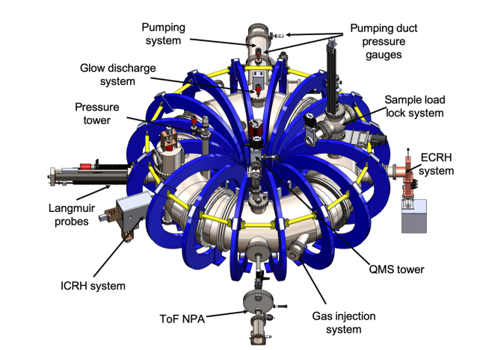
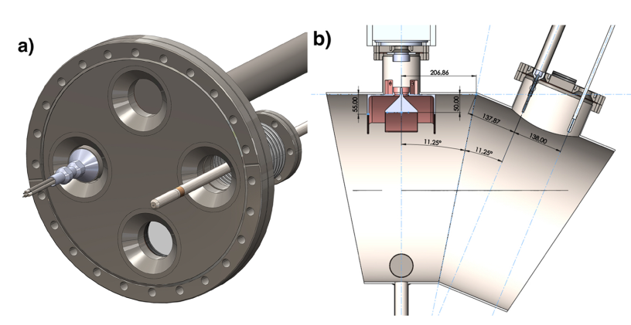
Triple probe in TOMAS
The 3D model of the upgraded TOMAS device.
Two types of movable Langmuir probes have been installed in TOMAS.
One of the probes is a commercial single Langmuir Probe manufactured by Impedans Ltd.
The second movable Langmuir probe is a triple probe. A triple probe head was designed and manufactured by the Institute of Plasma Physics, NSC KIPT.
The 3D model of the Langmuir probes. (a) The probe installation in the horizontal DN200 port. (b) Probe locations and dimensions relative to the ICRF antenna in the equatorial plane
[A. Goriaev at el. Rev. Sci. Instrum. 92, 023506 (2021) ]

Slide 4
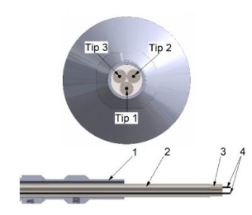
Triple probe
The triple probe technique was proposed in 1965 [Sin Li Chen and T. Sekiguchi // J. Appl. Phys. 36, 2363 (1965)] to diagnostic plasmas with and without a magnetic field.
This method can be used to diagnose both stationary and pulsed plasma.
The operation of the triple probe does not require a voltage or frequency sweep in comparison to other Langmuir probe methods and allows determining instantaneous values of plasma parameters.
Sketch of the triple probe (TOMAS device ). 1 – probe holder,
2 – stainless steel thin pipe, 3 – ceramic cover, 4 – tips of the triple probe.

Slide 5
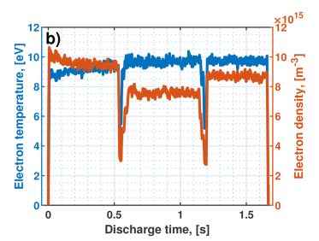
RF discharge
The first TP measurement results are published in A. Goriaev at el. Rev. Sci. Instrum. 92, 023506 (2021)
The discharge has the following parameters: The generator frequency is 24.9 MHz. The RF power is variated stepwise. The duration of each step is 0.5 s. The maximum power of ∼1 kW is achieved at the first step. The second and the third discharge steps have ∼80% and ∼90% of the maximum value of the RF power, respectively. The power between steps is reduced to a minimum value, which is ∼30% of the maximum power level.
The example of the triple Langmuir probe operation: Time evolution of electron temperature Te (blue line) and electron density ne (red line) in RF discharge (hydrogen flow is 35 SCCM, radial probe position is 152 mm relative to the toroidal axis, and B0 = 0.114 T).

Slide 6
Comparison of triple and single probe measurement results
The triple probe was first tested in hydrogen and helium ECR plasma discharges at different parameters. A comparison was made for the plasma parameters measured by a triple probe and a single probe (see table 1) at two radial positions.
Table 1. Comparison of electron temperature and density ECR discharge measurement using single probe (SP) and triple probe (TP).
Initial parameters |  |  |  |  | T_{e}, eV |  | α*, % | N_{e}, 10¹⁶ m⁻³ |  | β*, %
Gas | p₀, Pa | I_{coil}, A | r, cm | P_{ECR}, W | SP | TP |  | SP | TP
H₂ | 7 10⁻² | 1200 | 4.28 | 1000 | 5 | 5.2 | 4 | 1.8 | 3 | 66.7
H₂ | 7 10⁻² | 1425 | 4.28 | 1000 | 1.9 | 1.3 | -31.6 | 2.1 | 2.8 | 33.3
He | 4.3 10⁻² | 1400 | 16 | 804 | 11.9 | 9.1 | -23.5 | 11 | 7.7 | -30
He | 1.04 10⁻¹ | 1400 | 16 | 674 | 9.1 | 9.3 | 2.2 | 7.7 | 6.1 | -20.8
α* = (T_{TP}·100/ T_{SP}) - 100; β* = (N_{TP}·100/ N_{SP}) - 100

Slide 7
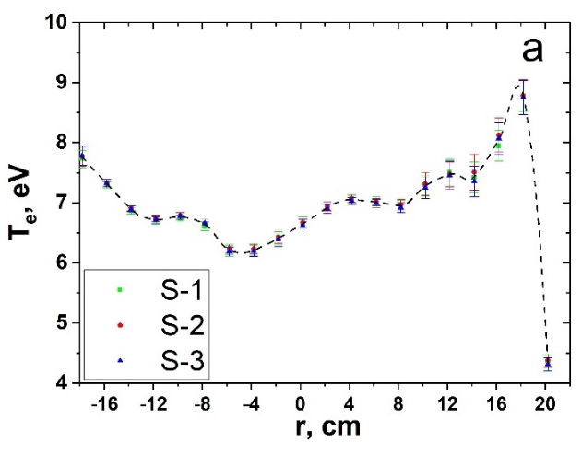
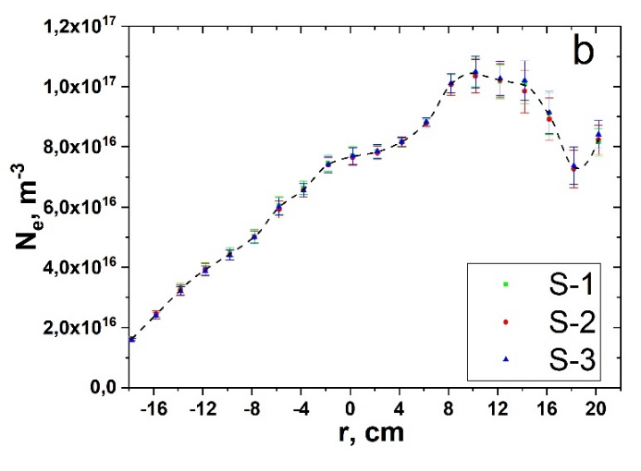
ECR discharge
Radial distribution electron temperature T_{e} (a) and density N_{e} (b) in ECR discharge (S-1, S-2 and S-3 scan number, Pressure p₀ in vacuum 3.8×10⁻² Pa, P_{ECR} =1kW).
The results of measuring the radial distribution of density and temperature in the ECR discharge for three scans (S-1, S-2, S-3) are shown in Fig. All three scans were carried out under practically the same conditions. As can be seen from Fig., a high repeatability of the plasma parameters from pulse to pulse is observed.
The next TP measurement results are paper Y. Kovtun et al. submitted to Plasma Physics and Controlled Fusion.

Slide 8
Tasks 2021
Processing and analysis of experimental data TP for ECWC, ICWC, and GDC discharge.
Making a new measurement module of the triple probe. The new module will implement two measurement circuits. First circuit for measurements N_{e ,}T_{e.} Second circuit for measurements N_{e ,}T_{e} and floating potential.
Installation of the vertical cross-section triple probe is planning.
Participation in the experiments on TOMAS in Forschungszentrum Jülich depends on the COVID-19 situation in Germany and Ukraine.

