Slide 1
CIEMAT contribution to PWIE_SPX3
Tasks:
Diagnostic upgrade and ECWC, ICWC, RF plasma characterisation in TOMAS
· Modelling of TOMAS plasma to describe neutral particle conditions as well optimise efficiency and homogeneity of the plasma
· Plasma-facing material cleaning in TOMAS with optimisation of experimental conditions
· Pre- and post characterisation of reference samples applied to cleaning attempts
· Coordination of TOMAS experiments and relation to ITER conditions as well as other toroidal facilities like W7-X, WEST, AUG
Deliverables:
ECWC, ICWC, and GDC plasma characterization in TOMAS (LPP-ERM/KMS, FZJ, VR, KIPT)
Report on fuel/impurity removal studies at reference samples in TOMAS (LPP-ERM/KMS,
CIEMAT, FZJ)
Report on a comparison of TOMAS studies with ICWC, ECWC and GDC and comparison with stellarator and tokamak experiments (LPP-ERM/KMS)
Pre- and post-characterization of samples used for cleaning in TOMAS (VR, CIEMAT, FZJ)
Modeling of wall conditioning RF-based plasmas (LPP-ERM/KMS, KIPT)

Slide 2
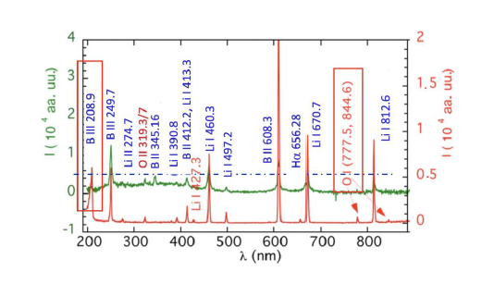
Sample characterization by LIBS
Routine characterization of first wall composition by LIBS in TJ-II
Comparison between a ECRH plasma emission (green ) and the LIBS spectrum (red) of a boronized wall

Slide 3
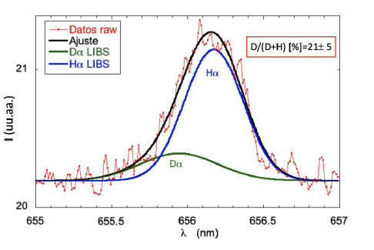
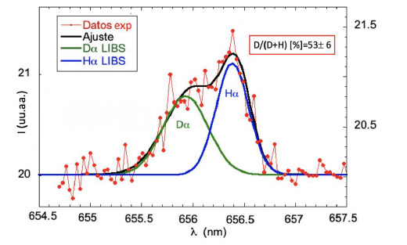
Isotopic Composition
Deconvolution of Hα profile : D/D+H ratio
Also SIMS, XPS, profilometry,SEM…

Slide 4
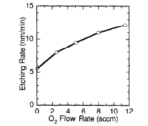
Can we remove the B film?
Conversion of B into volatile species by reactive plasma: To be tested
BF₃
B(CH₃)₃
(a) Removal rate (nm/h) in dependence on temperature (oxygen pressure 0,8.10⁻³ Torr, helium pressure 6.10⁻³ Torr, ethanol pressure 1.10⁻³ Torr, mean ion flux 1.10¹⁶ atoms/sm², sample bias voltage of 200 V).
(b) Removal rate (nm/h) in dependence on ethanol pressure (oxygen pressure 0,4.10⁻³ Torr, helium pressure 2.10⁻³ Torr, temperature 150 ºC, mean ion flux 1.10¹⁶ atoms/cm²s, sample bias voltage of 200 V).
Etching rate of boron film as a function of 0, flow rate for fixed flow rates of CF, (4.8 sccm) and H, (85 sccm).
H. Sugai et al. JNM 200(1993) 403
Airapetov et al.Physics Procedia 71 ( 2015) 58 – 62

