Slide 1
Kick-of meeting SP X1 Atomic and molecular processes in attached/detached plasma and sheath
Hennie van der Meiden

Slide 2
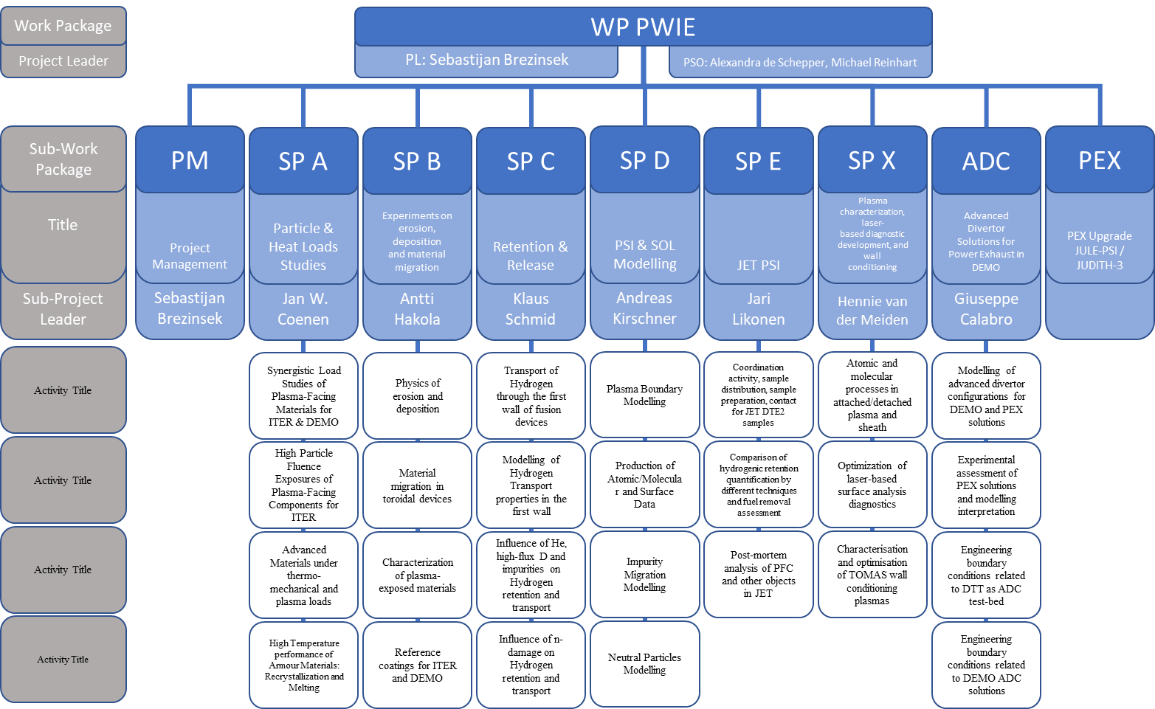
WP PWIE Structure 2021/2022
DPL for ADC: Giuseppe Calabro
Coordination Officer in FSD: David Douai
Not in 2021

Slide 3
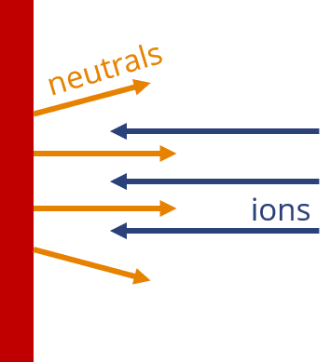
SP X.1: Atomic and molecular processes in attached/detached plasmas and sheath effects ➔ Motivation
Measurement of ro-vibrational distribution and of atomic densities of ground state hydrogen and isotopes. Why?....a few examples
MAR is beneficial for mitigation of plasma power flux/momentum in SOL, but understanding of formation is required. ➔ Ro-vib distribution not known ➔ Reaction rates vary orders of magnitude with ro-vib.
Reaction rates H and isotopes can differ a lot!
Input required for SOL modeling!
H₂(v,r) + H⁺ ➔ H₂⁺ + H(1s)
v=4~1.8eV 13.6 eV ➔ v=0~15.4eV 0 eV
~13.6 eV
Measurement of ion/electron properties in near surface plasma and underlaying processes in the pre-sheath Depending on n_{e} we found energy (20%) and momentum (50%) losses that occur within the last 10 mm of the near surface plasma:
velocity distributions of impinging ions and surface recombined neutrals influence each other ➔ p-n coupling
Notes:
Facilties: JUST GIVE the integral numbers for the groups
PD: Plasma devices (MAGNUM, PSI-2, UPP, TOMAS, GyM)
HHF: JUDITH, GLADIS, QSPA, OLMAT
Analysis station: Ion beam
If Facilties, Modelling, Link not applicable, remove the lines. I assume that it is EITHER EXPERIMENT or MODELLING, thus 1 more line for TASKS or Deliveables.

Slide 4
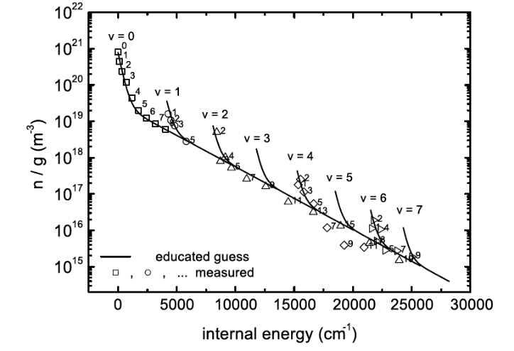
SP X.1: Atomic and molecular processes in attached/detached plasmas and sheath effects
Distribution of ro-vibrationally excited states of H₂ and its isotopes (electronic ground and excited states)
The role of plasma-neutral coupling in energy dissipation and momentum loss
Main deliverable 1: TALIF installed in MAGNUM-PSI, conceptual designs LIF (PSI-2) and VUV-LIF/CARS (MAGNUM-PSI)
Main deliverable 2: Comparison of H₂ ground and excited state population
Main deliverable 3: CTS/TS results ion and electron properties MAGNUM-PSI and UPP: influence p-n coupling
H₂(v,r) ground state population (TU/e)
Main goal of this meeting:
Status and if required synchronization of the work to be done
Identify possible issues that can cause delays
Notes:
Facilties: JUST GIVE the integral numbers for the groups
PD: Plasma devices (MAGNUM, PSI-2, UPP, TOMAS, GyM)
HHF: JUDITH, GLADIS, QSPA, OLMAT
Analysis station: Ion beam
If Facilties, Modelling, Link not applicable, remove the lines. I assume that it is EITHER EXPERIMENT or MODELLING, thus 1 more line for TASKS or Deliveables.

Slide 5
SP X.1: Detailed describtion tasks and deliverables 2021
Measurement of the atomic density of H(1s) and isotopes: installation TALIF in MAGNUM-PSI. Conceptional design CARS/SARS system for ro-vibrational ground state distribution H₂ in MAGNUM (DIFFER)
VUV passive spectroscopy on H/H₂ and isotopes in MAGNUM-PSI (FZJ, DIFFER, CU)
Conceptional design LIF in PSI-2 to measure ro-vibrational ground state distribution (FZJ)
VUV passive spectroscopy on H/H₂ in PSI-2 (FZJ, CU, DIFFER)
Feasibility study multi-photon LIF to measure ro-vib. ground state distri. of H₂ and isotopes (DCU)
Measure ion/electron properties in the proximity of the target surface (Magnum (ion/electron), UPP (electron)) for accurate power load estimations (DIFFER)
D1: TALIF system installed at MAGNUM-PSI and conceptional design CARS/SARS system for ro-vib. ground state distribution H₂ in MAGNUM-PSI ready (DIFFER)
D2: VUV OES results H/H₂ (DIFFER, FZJ, CU)
D3: Conceptional design LIF for H/H₂ measurements in PSI-2 ready (FZJ)
D4: Results feasibility multi-photon LIF for ro-vib. ground state distribution H₂(v,J) (DCU)
D5: v_{plasma} measurements (CTS) near the surface as function of n_{e} (input SP D), and ne/Te measurements in UPP (DIFFER)
Notes:
Facilties: JUST GIVE the integral numbers for the groups
PD: Plasma devices (MAGNUM, PSI-2, UPP, TOMAS, GyM)
HHF: JUDITH, GLADIS, QSPA, OLMAT
Analysis station: Ion beam
If Facilties, Modelling, Link not applicable, remove the lines. I assume that it is EITHER EXPERIMENT or MODELLING, thus 1 more line for TASKS or Deliveables.

