Slide 1
DIFFER contributions to
SP-X1
Ivo Classen, Hennie van der Meiden, Jordy Vernimmen, Jonathan van den Berg

Slide 2
Deliverables
Near target measurements:
  CTS on Magnum: Velocity
  TS on Magnum and UPP: Accurate power loads
Passive VUV spectroscopy on Magnum
TALIF on Magnum
  Diagnostic development
  First step towards VUV-LIF

Slide 3
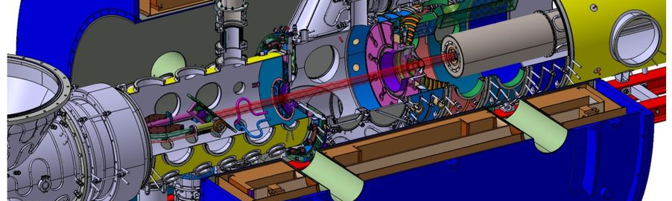
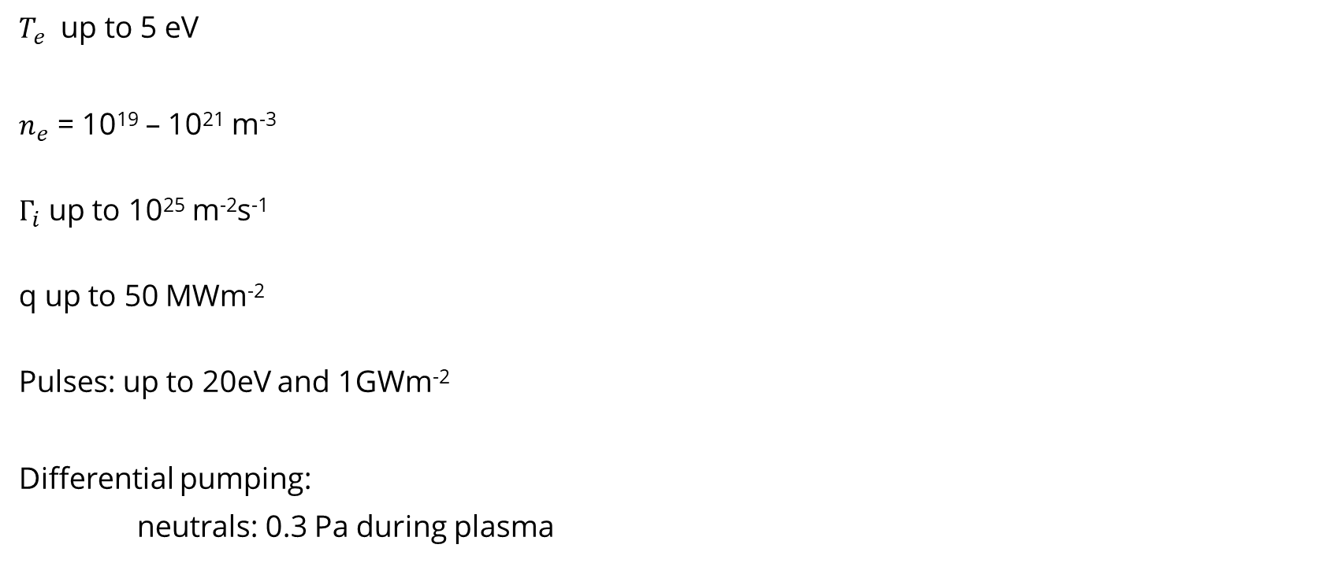
Magnum-PSI
$T_{e}$ up to 5 eV
$n_{e}$ = 10¹⁹ – 10²¹ m⁻³
$Γ_{i}$ up to 10²⁵ m⁻²s⁻¹
q up to 50 MWm⁻²
Pulses: up to 20eV and 1GWm⁻²
Differential pumping:
neutrals: 0.3 Pa during plasma

Slide 4
Section A
Near target ion/electron properties (TS/CTS)
Plasma velocity measurements

Slide 5
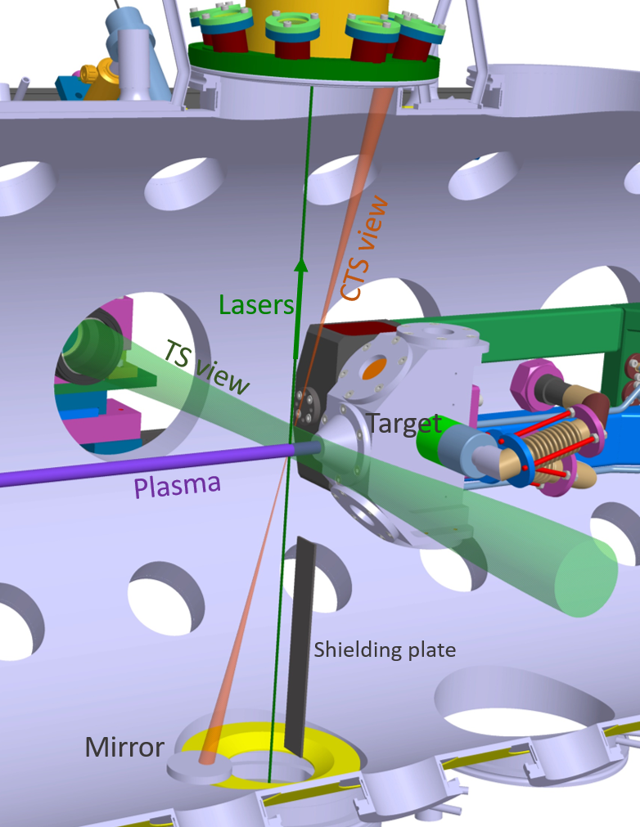
CTS / TS at Magnum-PSI
Simultaneous TS and CTS
Careful stray radiation suppression
Measurements up to 3mm from target

Slide 6
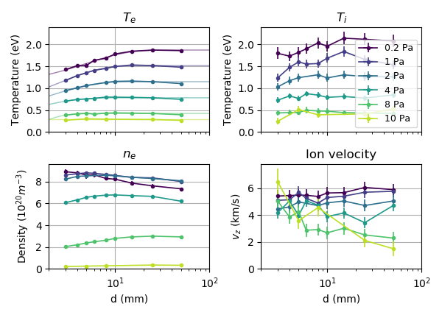
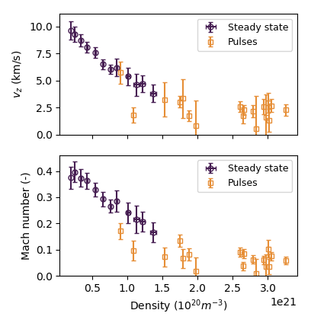

Results so far
At $d_{target−laser}=25 mm$

Slide 7
In 2021:
Measurements under variety of target angles
(90, 60, 45, 30 degrees)

Slide 8
Section B
Passive VUV spectroscopy
Coming soon to a linear device near you!
(collaboration with Comenius Institute)

Slide 9
Section C
Active spectroscopy on Magnum-PSI
Now: TALIF (atoms)
Future: CARS / VUV-LIF (molecules)

Slide 10
Motivation
The ro-vibrational distribution plays a major role:
MAR rate can vary multiple orders of magnitude
Direct measurement difficult, but H₂(r,ν) distribution previously successfully measured in both linear plasmas and tokamaks (no current set-ups)
➔ Build new diagnostic on Magnum-PSI (divertor relevant plasmas) based on proven methods: VUV-LIF and CARS (TU/e, Plexis)
Grant application running at Dutch Scientific Organization (NWO)
From Vankan et al.
10

Slide 11
Active spectroscopy: 3 methods
VUV-LIF based on Stimulated anti-Stokes Raman scattering
(population ν >2,J)
Coherent anti-Stokes Raman spectroscopy (CARS):
(population ν ≤2,J)
Two photon Absorption Laser Induced Fluorescence (TALIF)
(density H atoms in ground state)
11

Slide 12
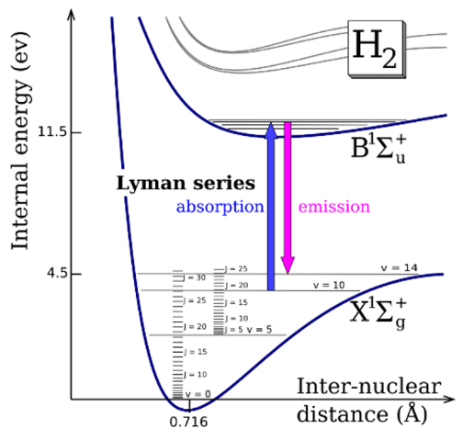
VUV-LIF principle
Excite ground state ro-vib level to electronically excited state
Measure fluorescence signal
Scanning the laser wavelength excites different ro-vib states
110 to 165 nm for ν=0 to ν=14
VUV LIF spectroscopy of H₂ ground state

Slide 13
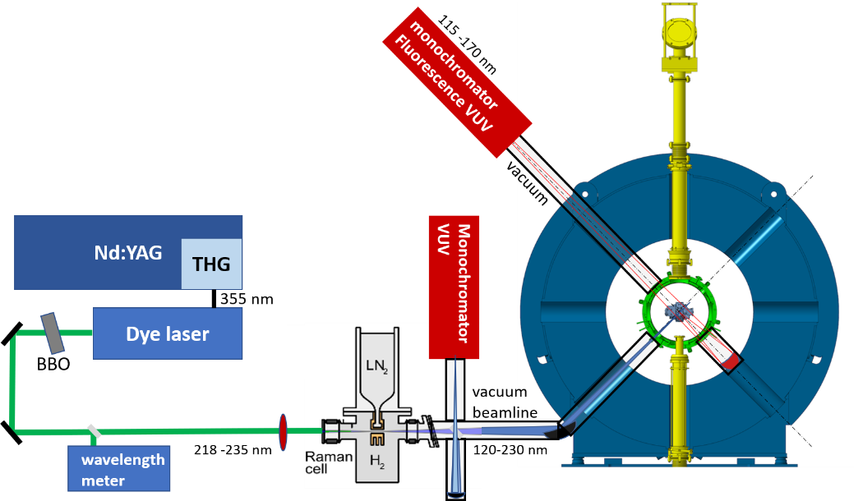
Planned VUV-LIF setup
Laser in VUV range
(down to ~ Ly α)
➔ Raman cell (SARS)
In vacuum
VUV monochromators
Vacuum window transmission (>120 nm) prevents measuring lower vibrational states (ν>2)
13

Slide 14
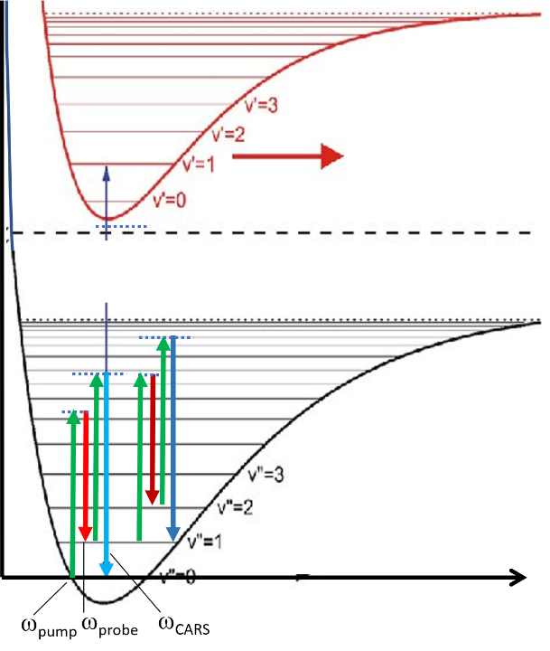
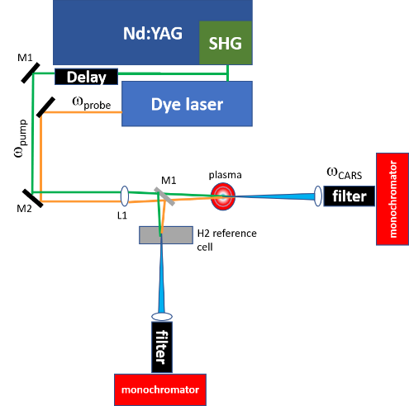
Complementary techniques:
CARS
Lower vibrational states (ν<=2) can be measured with CARS
Same lasers as VUV-LIF
No vacuum needed
CARS:
4-wave mixing process
660-700 nm probe beam
532 nm pump beam
14

Slide 15
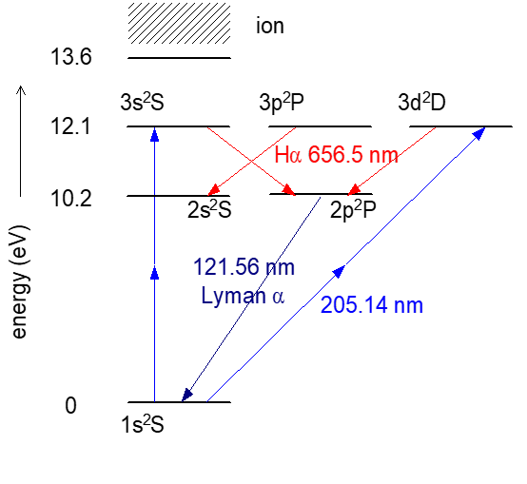
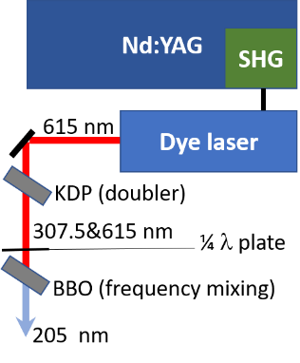
In 2021:
Start with TALIF
TALIF:
  Density of atomic H density
  Also applicable to N
  Excitation: 205.14 nm
  (for Ly β absorption with 2 photons)
  Fluorescence: Hα
Independent of national funding
TU/e student project starting in September
Laser setup before end of 2021
First measurements first half 2022

Slide 16
Thank you for your attention!

