Slide 1
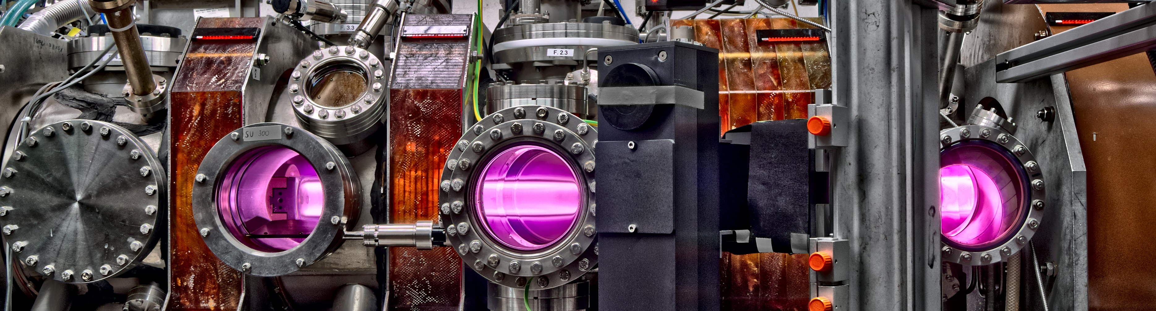
SP X.1: Atomic and molecular processes in attached/detached plasma and sheath
D004: VUV OES results H/H2
D005: Conceptional design LIF for H/H2 measurements in PSI-2 ready
M.Reinhart, S. Ertmer, G. Sergienko, O. Marchuk, S. Brezinsek
WPPWIE SP X.1 Kickoff Meeting
08.07.2021

Slide 2
FZJ Deliverables 1 / 2 : VUV OES results H/H2
Tasks:
Setup a passive spectroscopy system for VUV at PSI 2
Use VUV OES for measurements of H/H2 (and isotopologues) emission lines
Aims:
Diagnostic method for recombining plasmas in PSI-2
Input for modelling activities
Timeline:
Spectrometer is available ✓
PSI-2 back in operation since June 2021 ✓
VUV OES system to be setup at PSI-2
Measurements after system is ready
(not before September 2021 due to PSI-2 fully booked)

Slide 3
FZJ Deliverables 2 / 2 : Conceptional design LIF for H/H2 measurements in PSI-2 ready
Tasks:
Conceptual design for laser induced flourescence of VUV lines in PSI-2
Aims:
Diagnostic method for recombining plasmas in PSI-2
Input for modelling activities
Timeline:
Suitable lasers are already available ✓
Plans for 2021 are only to design the concept, no actual measurements yet
→ Independent from PSI-2 machine availability

