Slide 1
Kick-off meeting SP X2 Optimization of laser-based surface analysis diagnostics
Hennie van der Meiden

Slide 2
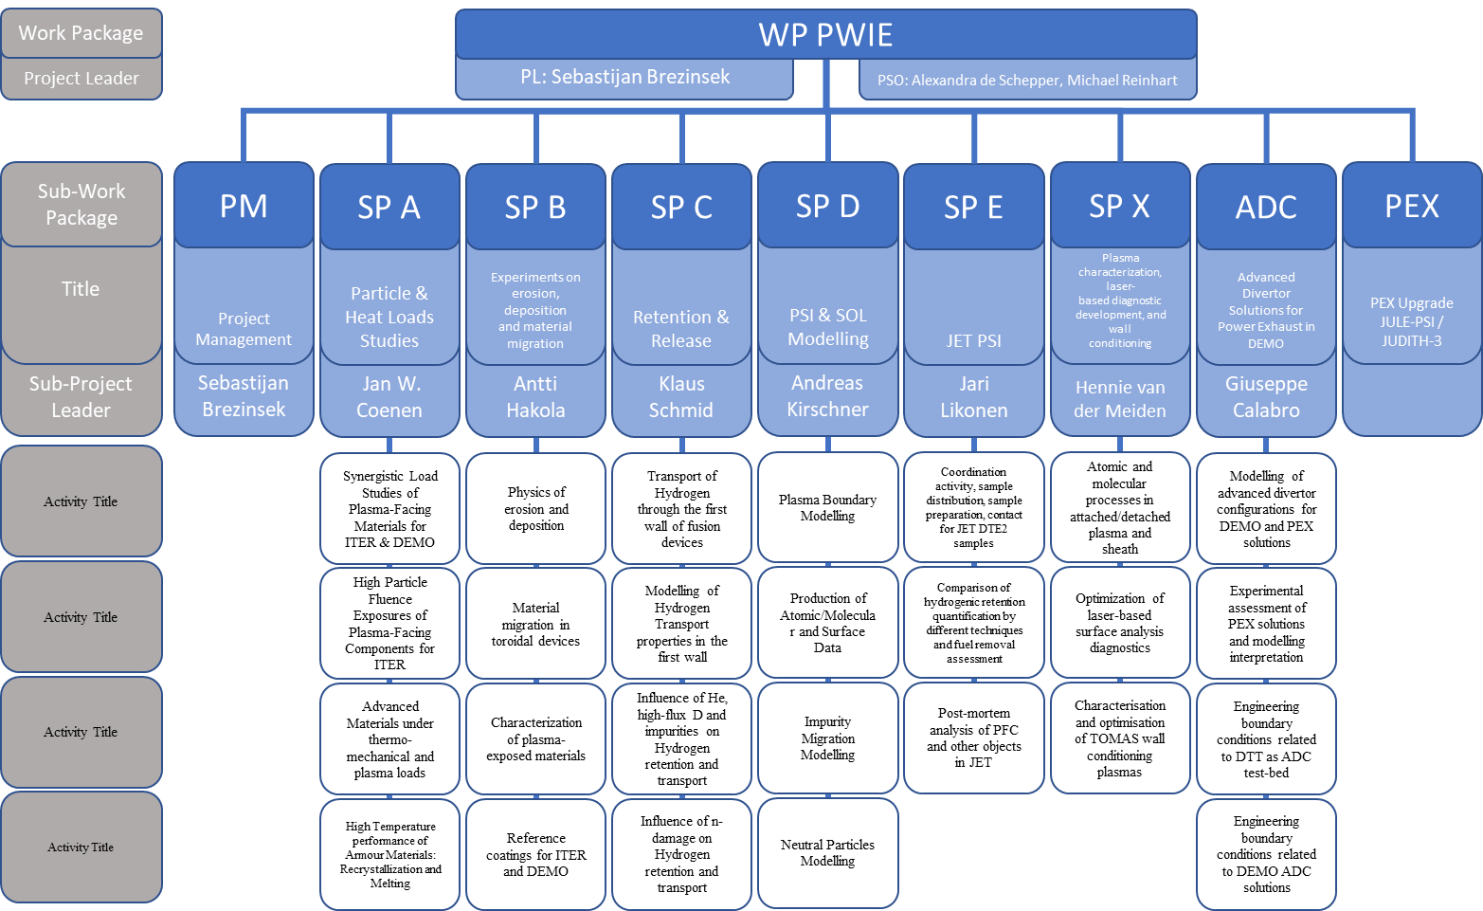
WP PWIE Structure 2021/2022
DPL for ADC: Giuseppe Calabro
Coordination Officer in FSD: David Douai
Not in 2021

Slide 3
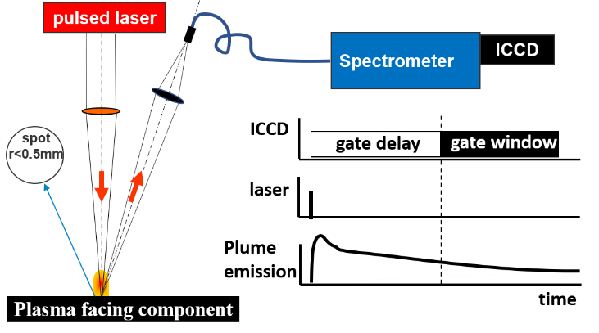
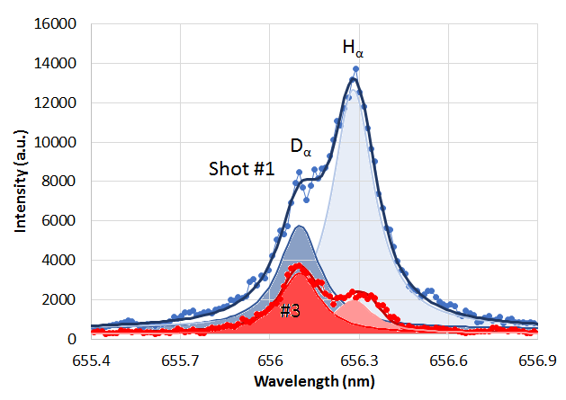
SP X.2: Optimization of laser-based surface analysis diagnostics
Where do we stand with LIBS development?
D-retention monitoring, with CF-LIBS is accurate up to 100 mbar air.
>100 mbar: line distinguishability is difficult. - Better adjustment of detection delay (gate window) is beneficial
- DP-LIBS shows good potential for improving line distinguishability: validation for CF-LIBS required
The dependence of ablation depth on retention and surface roughness needs more research.
AUG
challenge: line separation
Notes:
Facilties: JUST GIVE the integral numbers for the groups
PD: Plasma devices (MAGNUM, PSI-2, UPP, TOMAS, GyM)
HHF: JUDITH, GLADIS, QSPA, OLMAT
Analysis station: Ion beam
If Facilties, Modelling, Link not applicable, remove the lines. I assume that it is EITHER EXPERIMENT or MODELLING, thus 1 more line for TASKS or Deliveables.

Slide 4
SP X.2: Optimization of laser-based surface analysis diagnostics
Announcements
RBS/NRA analysis results 2020 Magnum-LIBS campaign expected this week
Magnum and PSI-2 operational
Overview paper submitted to NF: no news so far
Notes:
Facilties: JUST GIVE the integral numbers for the groups
PD: Plasma devices (MAGNUM, PSI-2, UPP, TOMAS, GyM)
HHF: JUDITH, GLADIS, QSPA, OLMAT
Analysis station: Ion beam
If Facilties, Modelling, Link not applicable, remove the lines. I assume that it is EITHER EXPERIMENT or MODELLING, thus 1 more line for TASKS or Deliveables.

Slide 5
SP X.2: Optimization of laser-based surface analysis diagnostics
Main tasks for this year 2021:
Optimized conditions for LIBS in absolute content and depth resolution at pressures up to 1 bar
Absolute quantification of D and composition in Be-mixed layers (with depth resolution)
Influence of T_{surface} and impurities on absolute fuel retention and outgassing values
Influence of retention and surface roughness on depth resolution ➔ corresponding samples required
Obtain CF-LIBS results for DP-LIBS
Improve analysis (machine learning)
AUG
challenge: line separation
Notes:
Facilties: JUST GIVE the integral numbers for the groups
PD: Plasma devices (MAGNUM, PSI-2, UPP, TOMAS, GyM)
HHF: JUDITH, GLADIS, QSPA, OLMAT
Analysis station: Ion beam
If Facilties, Modelling, Link not applicable, remove the lines. I assume that it is EITHER EXPERIMENT or MODELLING, thus 1 more line for TASKS or Deliveables.

Slide 6
SP X.2: Tasks and deliverables 2021
Comparison ps vs. ns LIBS regarding absolute composition and D content in reference and ITER-relevant coatings which can include impurities (FZJ, CU, UT, ISSPUL, CEA)
Comparison Single Puls vs. Double Puls LIBS (or alternative LIBS signal enhancement methods) regarding absolute material composition and D content in ITER- and DEMO-relevant W including self-damage W and reference coatings. (FZJ, ENEA, CEA)
(CF-) LIBS (ps, ns SP or DP) on samples from different devices (tokamaks or W-7X) (collab. SP B) (ISSP UL, CU, UT, VTT, FZJ, ENEA)
Improve CF LIBS analysis by application of machine learning algorithm (IPPLM)
(CF-)LIBS on Be containing coatings with different type of fuel content (VTT, UT, CU)
CF-LIBS on produced reference samples before and after He loading (FZJ, CU, UT, ENEA)
Investigate erosion/deposition/fuel retention (including He) by in situ (CF)-LIBS and NRA/RBS in MAGNUM, LIBS and LIA-QMS/EDX in PSI-2: outgassing, recycling, and role of impurities (O, N), T_{surface}, and implantation energy (DIFFER, FZJ, UT)
D1: Comparison of ps vs. ns LIBS: abs. content and composition (ISSP UL, CU, UT, VTT, FZJ, NEA) D2: Comparison SP vs. DP LIBS: abs. fuel content in W samples and composition (FZJ, ENEA, CEA) D3: (CF)-LIBS (ps/ns or SP/DP) on samples different toroi. devices: abs. cont. and composition (in depth)
(ISSP UL, CU, UT, VTT, FZJ, ENEA) D4: Report on CF-LIBS analysis by application of machine learning algorithm (IPPLM)
D5: Analysis of Be containing coatings with (CF)-LIBS: absolute content and composition (VTT, UT, CU) D6: (CF)-LIBS results He loaded samples and surface modifications D7: Reference measurements of outgassing, recycling, and retention after D plasma loading: absolute content and composition in W and reference samples (DIFFER, FZJ, UT)
Notes:
Facilties: JUST GIVE the integral numbers for the groups
PD: Plasma devices (MAGNUM, PSI-2, UPP, TOMAS, GyM)
HHF: JUDITH, GLADIS, QSPA, OLMAT
Analysis station: Ion beam
If Facilties, Modelling, Link not applicable, remove the lines. I assume that it is EITHER EXPERIMENT or MODELLING, thus 1 more line for TASKS or Deliveables.

Slide 7
Work Package Milestones in 2021 (part II)
WM11 | Provision of atomic, molecular and surface data necessary to model impurity migration. Main focus is on ionisation, excitation, reflection and sputtering data for W materials including morphology effects and crystal orientation (DEMO+ITER) | 31.12.2021
WM13 | Realization of diagnostics for determination of ro-vibrational distribution of the ground state of H2 and D2 and atomic densities in PSI-2 and MAGNUM-PSI to provide access to neutral particle properties under ITER and DEMO conditions (ITER+DEMO) | 31.12.2021
WM14 | Determination of the role of material composition and surface roughness on the laser-induced ablation rate and its conversion into depth-resolved information about material composition and fuel content in ITER-like materials and surface layers or co-deposits (ITER) | 31.12.2021
WM15 | Quantification of the energetic neutral contribution in Ion and Electron Cyclotron Wall Conditioning in TOMAS and qualification of its impact on fuel removal from W7-X PFCs (DEMO+ITER) | 31.12.2021

