Slide 1
WP PWIE SP X.2 kick-off meeting VTT tasks
Antti Hakola for the VTT contributors

Slide 2
Relevant tasks from the PEP
(CF-) LIBS (ps, ns SP or DP) on samples (if available) from different devices (tokamaks or W-7X) (collab. SP B) (ISSP UL, CU, UT, VTT, FZJ, ENEA)
(CF-)LIBS on Be containing coatings with different type of fuel content (VTT, UT, CU)
Essentially these include
Providing local support for LIBS measurements in the Be- and T-compatible facilities of VTT (once the COVID-19 restrictions are lifted)
Coordinating the production and delivery of reference samples for LIBS measurements (in collaboration with SP B.4)
Carrying out necessary surface analyses (SIMS, NRA, RBS, TOF-ERDA, XPS,…) for the LIBS samples (VTT and University of Helsinki)

Slide 3
Plans for 2021
If COVID-19 restrictions are lifted in the autumn, VTT welcomes any LIBS contributor to pay visits to our labs for the next measurement campaigns with Be samples (TBC)
Several new samples with different properties available since 2019
Sample production a small effort in 2021 since several old samples still exist and results not properly reported; possible new samples, however, could include:
Oxide samples (W/Be)?
Samples with different surface roughness?
Samples from PSI-2, MAGNUM, and GyM experiments?
W re-deposits on bulk W
W samples loaded with He
Since this year, University of Helsinki has been granted additional support for ion-beam analyses (under SP B)
Now also compositional analyses (RBS, NRA, TOF-ERDA, PIXE,…) possible → focus on H
In addition, XPS capabilities will be tested

Slide 4
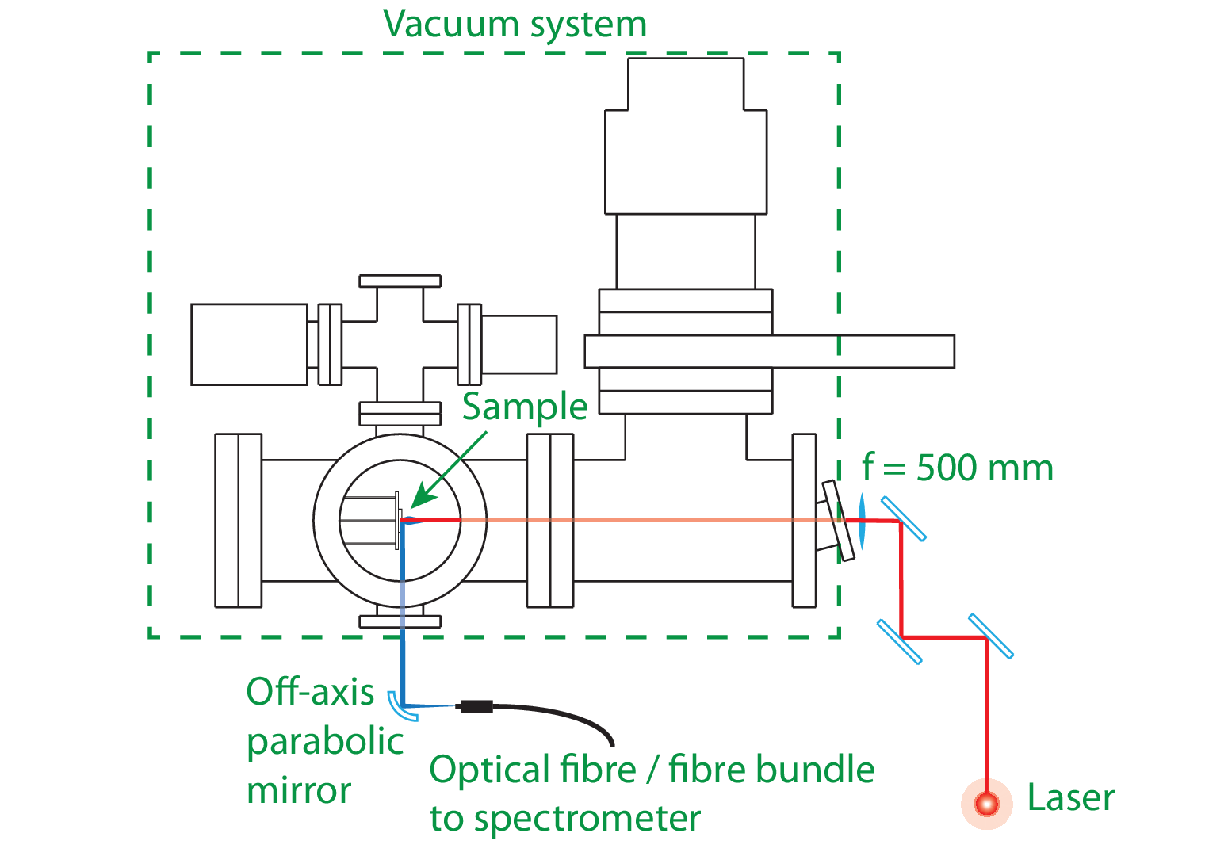
Experimental setup at VTT

