Slide 1

SP-X.2: Optimization of laser-based surface analysis diagnostics
Peeter Paris, Indrek Jõgi
University of Tartu

Slide 2
Tasks and deliverables 2021-2022
1. Comparison of ps vs. ns LIBS regarding absolute composition and D content in reference and ITER-relevant coatings which can include impurities
  Studies with W-Ta(5%)-D(5/10%) and W-N(5%)-D(0/5/10%) (by GDOAS)
  Nd:YAG at 532 nm (7ns), LIBS in Ar at 1, 10 and 100 torr, delay time 300 or 1300 ns
  Czerny-Turner spectrometer + iCCD: 410-430 nm and 645-665 nm
Depth profile
H isotope detection
Saha-Boltzmann plots
Electron density and temperature
D
H
300 ns
100 torr
10 torr, 1300 ns
300 ns
1 torr
D/W ratio by CF-LIBS
Example with W-Ta(5%)-D(5%) coating
collection of spectra
laser
Plans: additional studies in different plume region and with laser at 1064 nm
45°
target

Slide 3
Tasks and deliverables 2021-2022
2. (CF-) LIBS (ns SP) on samples from different devices
  Studies with 3 WEST samples outside from the regions of strong erosion and deposition
  LIBS in Ar at 1 or 10 torr, delay time 300 or 1300 ns, fluences 10-33 J/cm²
  Czerny-Turner spectrometer + iCCD: 645-665 nm and Andor Mechelle spectrometer
Average ablation rate
≈100 nm/shot
Plans: compare samples, check CF-LIBS
3. (CF-)LIBS on Be containing coatings with different type of fuel content
  New measurements not possible in near future due to the COVID-19 restrictions
Plans: recycling the results of previous experiments?
4. CF-LIBS on produced reference samples before and after He loading
  Experiments with various samples doped or loaded by He
  He detectable during first shot at relatively short delay time (100-200 ns) in Ar at 1-2 Torr
Plans: new samples?

Slide 4
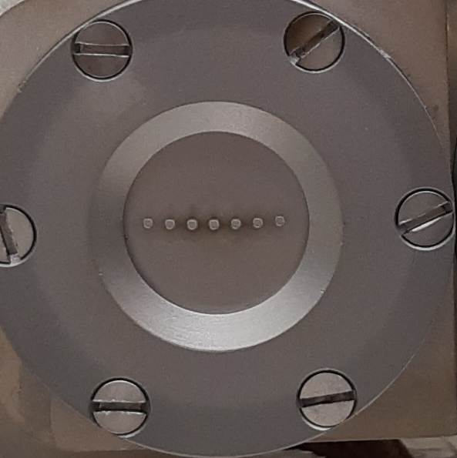
Tasks and deliverables 2021-2022
5. Investigate erosion/deposition/fuel retention (including He) by in situ (CF)-LIBS and NRA/RBS in MAGNUM with subjects of interest: outgassing, recycling, and role of impurities (O, N), T_{surface}, and implantation energy on retention
  Studies with W-Ta(5%) and W-O samples exposed to D₂-N₂ or D₂-N₂-He plasma
  in-situ ns-LIBS with Nd:YAG at 1064 nm (6ns) in Ar at 1, mbar, delay time 1300 ns
W-Ta(5%)
360°C
0 mm
-9 mm
Plans: compare with in-situ NRA results and carry out ex-situ LIBS and/or SIMS?

