Slide 1
SP X2: Optimization of laser-based surface analysis diagnostics - LIBS analysis by application of machine learning algorithm
P. Gąsior, W. Gromelski, P. Wojtowicz, A. Kwaśnik, M. Kastek
IPPLM, Warsaw, Poland

Slide 2
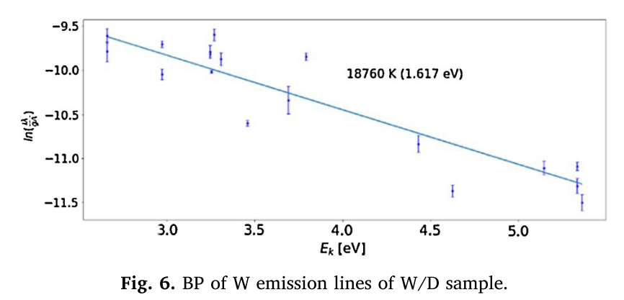
Problems with „standard” LIBS
Calibration methods:
Problems with a sufficient number of calibrated samples with different concentrations of hydrogen isotopes
Matrix effects, especially due to unknown morphology of the deposits in future machines
CF method:
Sensitivity for plasma parameters, especially important when it comes to accuracy
Difficulty with the accurate estimation, especially when Be is present
Common problems:
Operation with tritium and beryllium
Compatibility of results in different set-ups and operational conditions
P.Gasior, et al., KOM SP X2, 15 July, 2021

Slide 3
Advantages of ML approach
A modern and rapidly developing approach with proven successful performance in numerous fields of science, industry and commerce.
Its performance is based on patterns recognition and it depends on the amount of data used for training the system.
The model development may be supported by the use of synthetic data.
Two basic types of system may be used: classification and regression.
A large number of algorithms may be subjected to investigation and optimisation.
There is a number of modern tools which may be effectively used for this goal.
Working with this tools is very attractive for young researchers and gives a lot of fun !
P.Gasior, et al., KOM SP X2, 15 July, 2021

Slide 4
Classification vs Quantification
Classification
The results are separated into a discrete number of concentration levels
Straightforward, but also very powerful supervised models
May be easily combined with dimensionality reduction
Clear and reliable methods of the quality assessment (Statistic parameters, confusion matrix)
Logistic regression, SVM, RF, ANN, kNN
Regression
More challenging approach, but it gives a concentration estimate
Higher computational cost
Linear regression, ANN, kNN
P.Gasior, et al., KOM SP X2, 15 July, 2021

Slide 5
General scheme
Synthetic data processing
Synthetic data
preparation
Preprocessing
Dimensionality
reduction
Data
preparation
Training data
C-V data
ML model development
Model training
Model C-V
Validation
Experimental
data
Absolute
calibration
Preprocessing and formatting
Dimensionality
reduction
Experimental data processing
P.Gasior, et al., KOM SP X2, 15 July, 2021

Slide 6
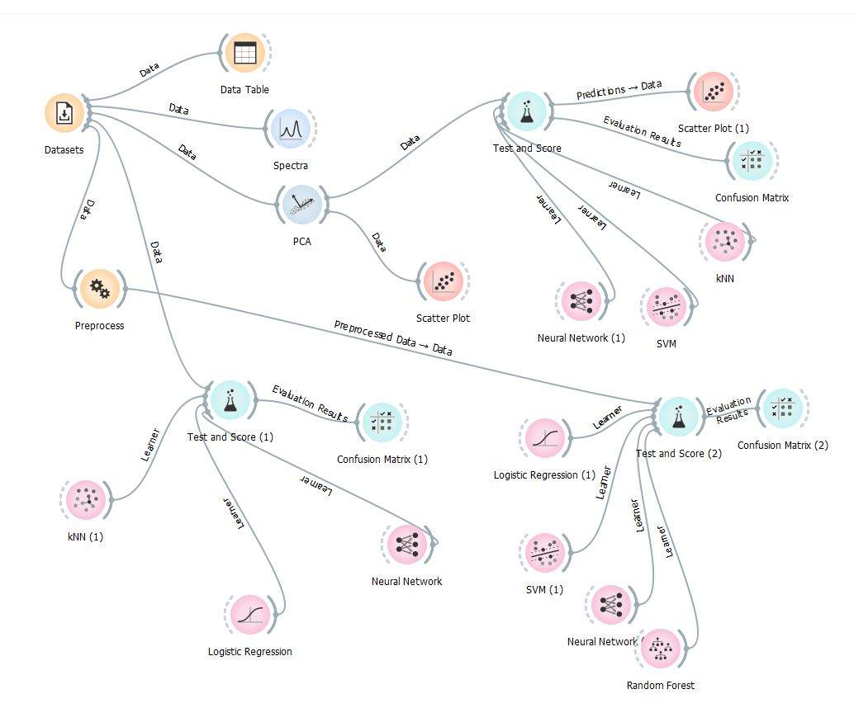
Preliminary implementation (classification)
Intuitive and straightforward
Immediate means for visualisation
Easy tools for comparison and optimistations
Facilitates code development with the use of more sophisticated tools, eg. Scikit-Learn, TensorFlow, PyTorch
P.Gasior, et al., KOM SP X2, 15 July, 2021

Slide 7
Deliverables (2021)
Investigation of the performance of ML models for classification and regression of LIBS data simulated for co-deposit-like materials
Optimisation of the chosen best-performing models for classification and regression
Preliminary validation of the models on experimental data.
P.Gasior, et al., KOM SP X2, 15 July, 2021

Slide 8
Deliverables (2021)
Investigation of the performance of ML models for classification and regression of LIBS data simulated for co-deposit-like materials
Optimisation of the chosen best-performing models for classification and regression
Preliminary validation of the models on experimental data.
P.Gasior, et al., KOM SP X2, 15 July, 2021

