Slide 1
Kick-off meeting WP PWIE SP X2
Salvatore Almaviva, Luisa Caneve, Francesco Colao, Violeta Lazic ENEA, Frascati Research Center, via Enrico Fermi 45, 00044 (Italy)

Slide 2
Deliverables
Comparison SP vs. DP LIBS, or alternative LIBS signal enhancement methods: absolute fuel content in W samples and composition
(CF)-LIBS (ps/ns or SP/DP) on samples from different toroidal devices: absolute content and composition (in depth)
(CF)-LIBS results He loaded samples and surface modifications

Slide 3
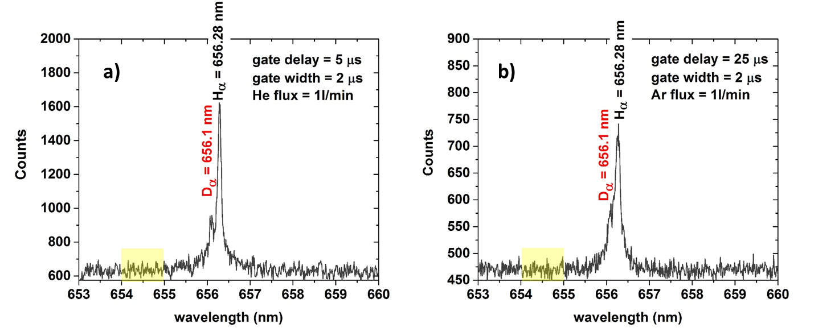
Deliverable 1
Comparison SP vs. DP LIBS, or alternative LIBS signal enhancement methods: absolute fuel content in W samples and composition
The work that will be done this year to obtain this deliverable will include the study of the best interpulse delay in the DP-LIBS and the comparison with the SP-LIBS. Alternative signal amplification methods will involve the study of the LIBS spectrum and intensity under gas flow (in particular He and Ar) in comparison with LIBS in air.
Alternative methods to enhance the depth resolution in ns-DP-LIBS will be investigated
The results obtained in 2020 will be optimized and completed on W reference coatings with different D concentrations (5% - 10 % D atomic concentration)

Slide 4
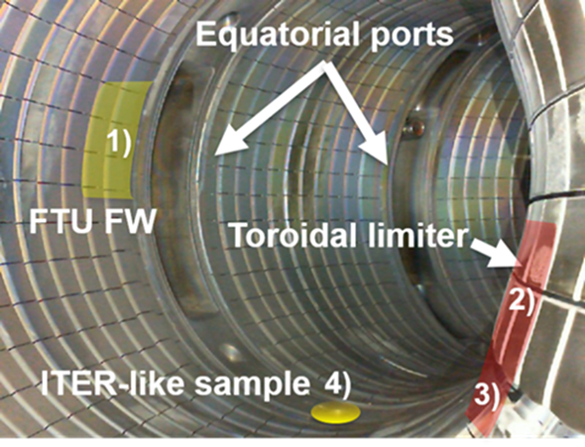
Deliverable 2
(CF)-LIBS (ps/ns or SP/DP) on samples from different toroidal devices: absolute content and composition (in depth)
The work that will be done this year will include the LIBS analysis of the FTU toroidal limiters tiles, if available (TBC. Last update is that they should be available from Oct-2021).
ENEA is also available to analyze and characterize with LIBS samples coming from other devices, not containing Tritium or Beryllium

Slide 5
Deliverable 3
(CF)-LIBS results on He loaded samples and surface modifications
The work that will be done this year will include the LIBS analysis of reference coatings samples under He flux, to identify the best spectral region to detect both He and the materials of the coating. (CF)-LIBS will be considered and discussed.
ENEA is also available to analyze and characterize with LIBS some “ad hoc” He loaded reference samples.

Slide 6
Issues
Availability of the FTU samples within OCT-2021
Availability of He loaded reference samples

