Slide 1
Kick-off Meeting, 15th July 2021
WP PWIE-SPX2
CF-LIBS depth profile quantification and elemental analysis of fusion-relevant samples: ns and ps regimes in VUV-UV-NIR spectral range
COMENIUS UNIVERSITY (CU)
Staff: A. Marín Roldán, M. Veis, J. Kristof, P. Veis
PhD students: V. Dwivedi, M. Pisarcik, S. Atikukke, S. Soni

Slide 2
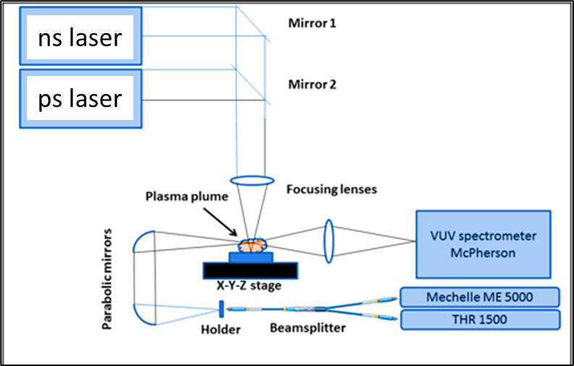
Experimental set-up
Laser:
ns Laser (1064nm, 532nm, 266nm; 5-8ns)
ps Laser (1064 nm, 30ps)
Spectrometer
Echelle spectrometer (Andor, 200-975 nm, λ/Δλ =5000)
VUV spectrometer (McPherson 115 -200 nm)
High resolution spectrometer (THR 1500 Jobin Yvon)
2 iCCD cameras (iStar Andor, for VUV and UV-NIR ranges)
EM CCD camera (Andor)
Pavel Veis et al. | Comenius University | Kick-off Meeting | 15 July 2021 |
2

Slide 3
Comparison ps vs. ns LIBS
CU
regarding absolute composition and D content in reference and ITER-relevant coatings which can include impurities
Calibration-free analysis of a tungsten-based target for diagnostics of relevant fusion materials comparing picosecond and nanosecond LIBS
A. Marín Roldan, P. Veis et al., Spectrochimica Acta Part B: Atomic Spectroscopy 177 (2021) 106055
ns
ps
Emission LIBS spectra of the WCu alloy sample
Planned work:
LIBS comparison and characterization of W and Mo in ps and ns regimes.
(Marin Roldan et al., submitted to FED July 2021)
LIBS study and comparison of ps and ns regimes for W-based samples:
W-Ta+D Coatings of different compositions
W-Zr samples
Pavel Veis et al. | Comenius University | Kick-off Meeting | 15 July 2021 |
3

Slide 4
(CF-) LIBS (ps, ns SP or DP) on samples from different devices (tokamaks or W-7X)
CU, FZJ
Computer programming codes has been developed for more automated CF-LIBS analysis
Planned work:
Single pulse (SP) ns and ps LIBS study of samples in collaboration with FZJ.
Use of Double pulse LIBS using fiber laser for the study of depth profile on real samples
CF-LIBS depth profiling and quantification of the samples using laser excitation and discharge excitation
Pavel Veis et al. | Comenius University | Kick-off Meeting | 15 July 2021 |
4

Slide 5
(CF-) LIBS on Be containing coatings with different type of fuel content
CU,TU, VTT
Already done: Measurements and CF-LIBS depth profile and quantitative analysis of Be-coated samples
(V. Dwivedi et al., NME, 27 (100990), 2021)
LIBS depth profile of Be-O-D/W coating (fluence 4.5 J/cm², ablation rate 230 nm/shot, P = 10 mbar Ar)
Relative elemental composition determined by CF-LIBS for four different Be containing coatings
Measurements of new available samples at VTT premises has been delayed due to COVID pandemic travel restrictions.
Problem: Precision on the quantification of C impurity due to the presence of only one spectral line at 247.8 nm in the classical UV range with the possible interference with Be spectral line. It can be solved by enlarging spectral range to detect C lines at around 190 nm
Planned work:
New measurements (depending upon travel restrictions)
Pavel Veis et al. | Comenius University | Kick-off Meeting | 15 July 2021 |
5

Slide 6
CF-LIBS on produced reference samples before and after He loading
CU
According to NIST LIBS simulation of LTE He spectrum in the classical UV range, spectral lines are not suitable for the CF-LIBS analysis due to less relative intensity.
Spectral lines in VUV range (58 nm) can be used as relative intensity is sufficient enough for this line.
Plan:
VUV (under 100nm) CF-LIBS on reference samples before and after He loading
Pavel Veis et al. | Comenius University | Kick-off Meeting | 15 July 2021 |
6

Slide 7
Investigate erosion/deposition/fuel retention (including He) by in situ (CF)-LIBS in MAGNUM, LIBS in PSI-2
CU, DIFFER
Instalment of VUV spectrometer at MAGNUM PSI has been delayed due to COVID pandemic travel restrictions.
Planned work:
Instalment of VUV spectrometer at MAGNUM PSI
In-situ LIBS investigation of deposition and fuel retention
(plan from 2022)
Pavel Veis et al. | Comenius University | Kick-off Meeting | 15 July 2021 |
7

Slide 8
Tasks 2021
CU
LIBS comparison and characterization of W and Mo in ps and ns regimes.
(Marin Roldan et al., submitted to FED 2021)
LIBS study and comparison of ps and ns regimes for W-based samples:
W-Ta+D Coatings of different compositions
W-Zr samples
Single pulse (SP) ns and ps LIBS study of real samples in collaboration with FZJ.
Use of Double pulse LIBS using fiber laser for the study of depth profile on real samples
CF-LIBS depth profiling and quantification of the samples using laser excitation and discharge excitation
New measurements of Be containing samples
VUV (under 100nm) CF-LIBS on reference samples before and after He loading
Instalment of VUV spectrometer at MAGNUM PSI
In-situ LIBS investigation of deposition and fuel retention (plan from 2022)
Pavel Veis et al. | Comenius University | Kick-off Meeting | 15 July 2021 |
8

