Slide 1

SOLPS-ITER activities within the DEMO Central Team – development needs
S. Wiesen
September 17th 2021

Slide 2
Overview
DEMO Divertor Design studies
Core-edge coupling
Transients & divertor re-attachment
Wall models
ADCs

Slide 3
DEMO divertor design studies

Slide 4
Early assessment for DEMO
SOLPS4.3, Kukushkin
Pacher
2007-2009
D/He/Be +
Ne-seeding
P_{SOL} = 300MW
Density control by
Core + Gas fuelling

Slide 5
Early assessment for DEMO
Full detachment of inner divertor restricts p_{PFR}
Criterion: max T_{e} at inner target falls below certain minimum, i.e. < 5eV
For DEMO: p_{PFR,max} = 18.6 Pa
SOLPS4.3, Kukushkin, Pacher 2007-2009

Slide 6
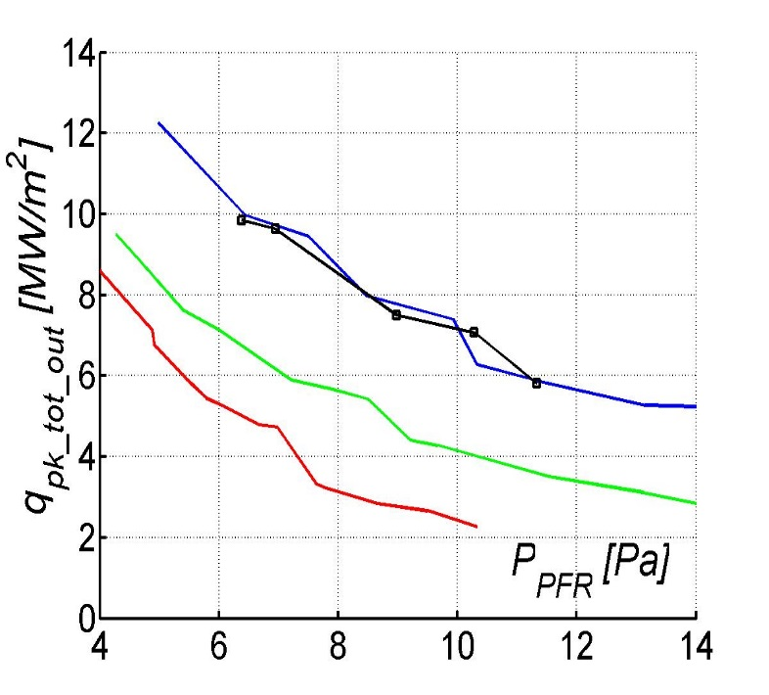
Lessons learned ITER divertor design
SOLPS4.3 has been the main workhorse for the ITER divertor design studies since 20+ years
Physics operating mode for the ITER divertor is to a large extent based on plasma boundary simulations conducted over ~15 years with the SOLPS-4.3 code (B2-Eirene) → mostly C targets!
▬ 1996 (ITER physics basis 1999)
▬ 2003 (neutral-viscosity added)
▬ 2004 (refined molecular collision kinetics added)
▬ 2005 (Lyman radiation trapping)
  A. S. Kukushkin et al. J. Nucl. Mat. 290-293 (2001) 887
  A. S. Kukushkin et al. Nucl. Fusion 42 (2002) 187
  A. S. Kukushkin and H. D. Pacher, PPCF 44 (2002) 931
  H. D. Pacher et al. J. Nucl. Mat. 313-316 (2003) 657
  A. S. Kukushkin et al. Nucl. Fusion 43 (2003) 716
  A. S. Kukushkin et al. Fus. Eng. Design 65 (2003) 355
  A. S. Kukushkin et al. Nucl. Fusion 45 (2005) 608
  A. S. Kukushkin et al. J. Nucl. Mat. 337-339 (2005) 17
  A. S. Kukushkin et al. Nucl. Fusion 47 (2007) 698
  A. S. Kukushkin et al. J. Nucl. Mat. 363-365 (2007) 308
  G. W. Pacher et al. Nucl. Fusion 48 (2008) 105003
  H. D. Pacher et al. J. Nucl. Mat. 390-391 (2009) 259
  A. S. Kukushkin et al. Nucl. Fusion 49 (2009) 075008
  A. S. Kukushkin et al., J. Nucl. Mat. 415 (2011) 2011
  H. D. Pacher et al. J. Nucl. Mat. 415 (2011) S492
  G. W. Pacher et al. Nucl. Fusion 51 (2011) 083004
  A. S. Kukushkin et al. Fus. Eng. Design 86 (2011) 2865
1996
2001
2009

Slide 7
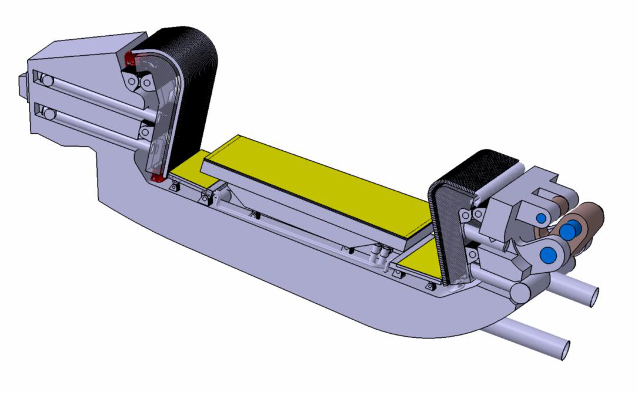
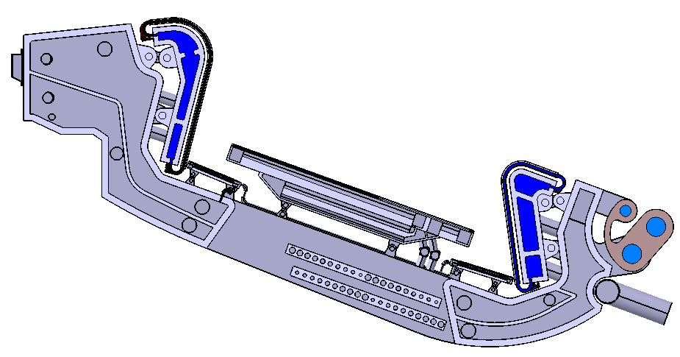
Rationale for inclusion of a DEMO divertor liner
Current design
Introduced to reduce radiative and
neutronic load into the pump duct
Shape and arrangement of the
target / reflector / liner is as such
that it is expected a large quantity of
neutrals and scattered particles impinging
on the almost unprotected parts:
- between the reflectors and the back of liner,
- the liner supply tubes,
- the supports.
Efficiency of pumping potentially reduced (incl. He-ash)
Post-design modelling in preparation with SOLPS-ITER
→ assess load specification, pumping efficiency, etc

Slide 8
Issue of particle balance / explicit (EIRENE sources)-implicit (B2.5) coupling → long convergence times
A. S. Kukushkin et al.
Fus. Eng. Design 86 (2011) 2865
Pumping in ITER (and DEMO) amounts to only about 1% or less of the recycling flux.
→ to resolve the effect of pumping and fuelling on the solution, the accuracy of the particle balance in the code must be much better than 1% → big challenge for a hybrid code such as SOLPS to reach convergence
Numerical noise induced at time-step t+dt → correction factors ~1 required

Slide 9
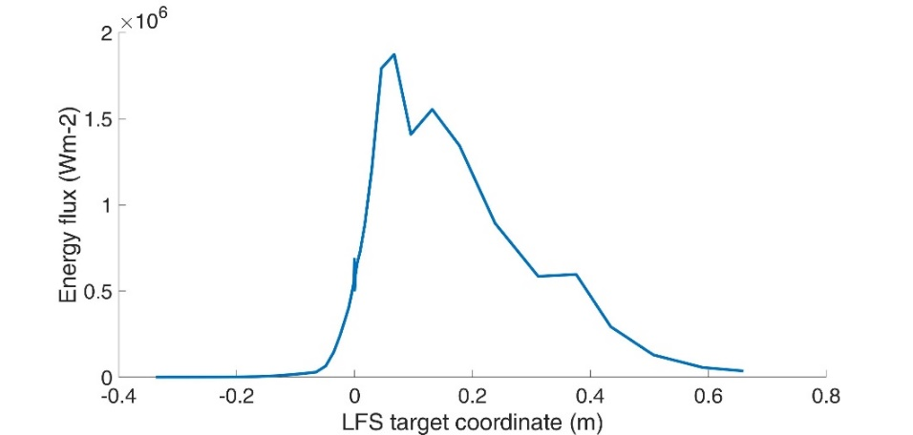
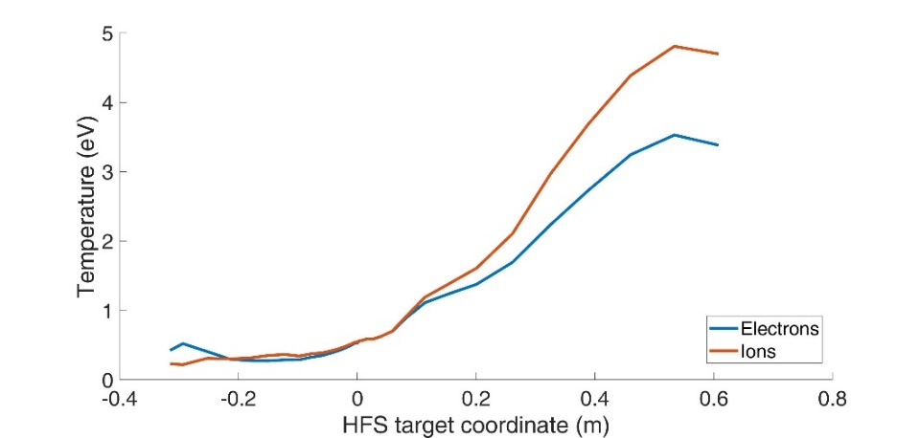
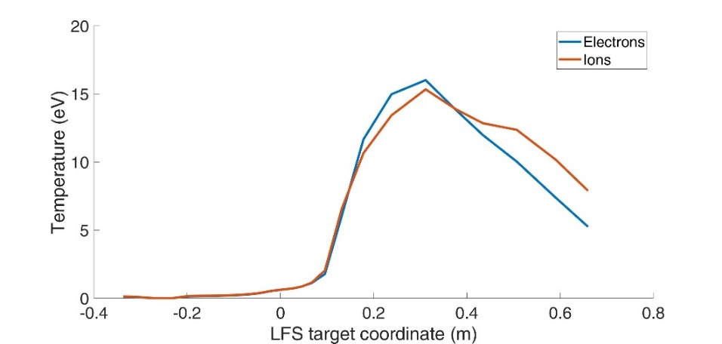
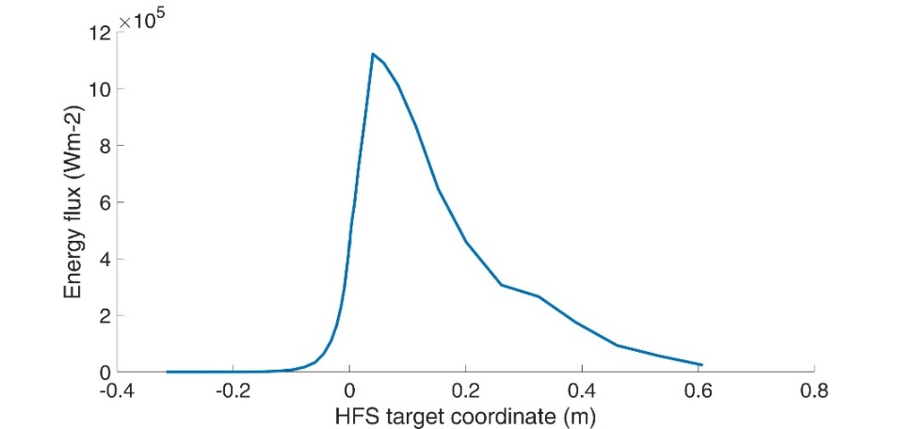
DEMO divertor assessment with new SOLPS-ITER
Work only started in FP8: F. Subba EU-DEMO → WPDES
SOLPS-ITER model parameters (no drifts/currents)
  Input power into edge: 150 MW
  D-puff: 1e23 atoms/s (~ 200 Pa m³ s⁻¹)
  Minor D pellet volumetric source: 7e21 (s⁻¹)
  D+He+Ar plasma
  Ar puff: 1.5e19 atoms/s
HFS deeply detached
Low temperatures; <1eV at max particle flux/density
Negligible heat flux ~ 1MW/m²
LFS partially detached
temperature low @ strike-line < 1.5eV
Heat-flux max 2MW/m²
Zeff ~1.9 in the core
HFS
LFS

Slide 10
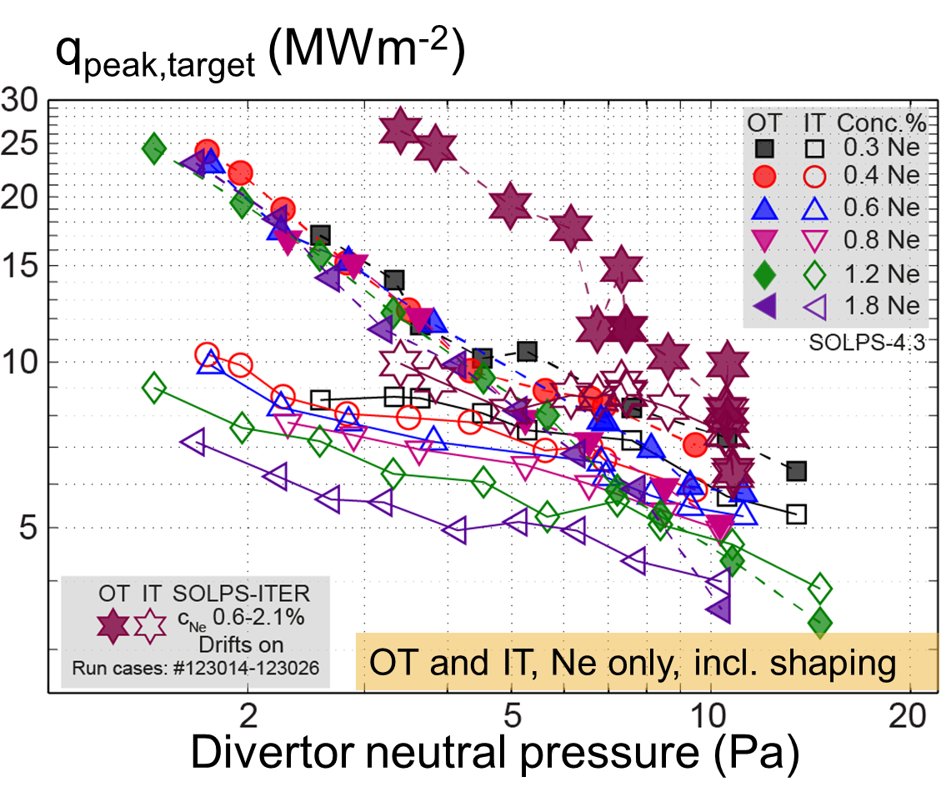
Revised ITER Divertor Design studies: metal wall & SOLPS-ITER
Assessment of several control parameters, together with satisfying a number of constraints (e.g. power loading and core He density or radiation)
→ During FP9, establishment of DEMO operational windows and SOLPS-ITER based scalings (F. Subba, L. Aho-Mantila, WPDES)
Extension towards EU-DEMO design:
assume validity of model first, e.g. through FSD experiments, and scoping (e.g. w. advanced fluid or hybrid models)
Add physics: inclusion of drifts/currents, improved impurity & A&M models, neutral buffering/conductances, Lyman opacity effects, large f_{rad} (e.g. XPR) etc
Add constraints: divertor shape, field geometry, engineering limits, cost
→ towards an optimized DEMO divertor configuration (→ WPDIV, WPTFV)
P_{SOL}=100MW
R.A. Pitts, E. Kaveeva, V. Rozhanski, S. Wiesen, X. Bonnin et al, NME 2019

Slide 11
Core-Edge coupling

Slide 12

Previous DEMO ASTRA/SOLPS4.3 coupling
Core & pedestal:
ASTRA/ICPS model
MMM/Weiland models, shear stabilised; JET/AUG
Edge:
SOLPS4.3 setup as in ITER – but no direct coupling
Provide ASTRA with n_{i}/T_{i,e} DT/He fluxes at spx
Derived scalings for point-of-detachment, i.e.:
$$n_{DT}^{sep}\sim μ^{0.43}$$
H.D. Pacher, G.W. Pacher, A.S. Kukushkin, G. Janeschitz
DEMO conceptual study EFDA TW6-TRP-002

Slide 13
Numerical assessment of integrated DEMO operational space
Review of reduced integrated models: e.g. T. Luda et al: coupling of ASTRA/MISHKA w/ Kallenbach multi-point model of SOL
→ calibration of reduced SOL model (based on SOLPS-ITER, w/ or w/o neutral kinetics – fast models reqd), collaboration with WPTE RT02/RT13
Review ASTRA/SOLPS-ITER coupling: functionality and code-implementation setup of revised EU-DEMO reference scenario
Also: Coupled JETTO-SANCO/SOLPS-ITER simulations: IMAS coupling of core code to SOLPS-ITER foreseen (collaboration w/ IO)
Interface requirements for improved scenario integration:
Assess overlapping computational region between SOLPS-ITER (2D) and ASTRA (1D); identification of an improved scheme to couple: improved pedestal model (i.e. including core radiation), H&CD models etc
DEMO operating window, I=21 MA, Ne seeding feedback
H.D. Pacher, G.W. Pacher, A.S. Kukushkin, G. Janeschitz
DEMO conceptual study EFDA TW6-TRP-002

Slide 14
Transients – Divertor re-attachment

Slide 15


What else can cause a loss of detachment?
Well, many things…
Fluctuations in the separatrix density.
Fluctuations in the separatrix power (e.g. pellet induced transient α-particle heating)
Combinations thereof.
Technical failure (e.g. impurity puff valve).
Control failure.
…others…
$$f_{rad}=40\%$$
$$f_{rad}=60\%$$
Impurity radiation
control required
JETTO-EDGE2D
ITER
[Wiesen, NF 2017]

Slide 16
Fuelling Pellet induced re-attachment
High density
Short bursts of
re-attachment
during pellet ablation
Such simulations
help to predict
and mitigate impact
of unavoidable
transients in HF
→ ITER & DEMO
divertor engineering
and operational design
JETTO-EDGE2D
ITER
[Wiesen, NF 2017]

Slide 17

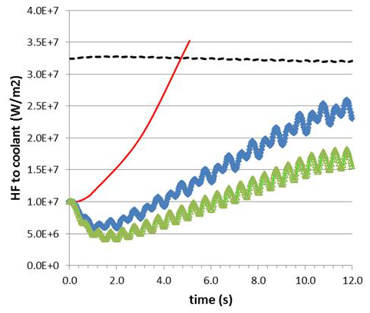
Re-attachment in DEMO
The maximum tolerable steady-state HF on the current DEMO SN divertor plate is 10-20 MW/m².
[J.H. You, G1 review mtg]
This value can be achieved only in detached plasma conditions (with seeded impurities).
In case of accidental divertor reattachment, the divertor reaches burn-out (leading to an in-vessel LOCA) in about 3 sec.
Divertor sweeping (to be activated only in emergency cases) to allow the divertor surviving while the current is ramped down [Maviglia, FED 2016].
Needs the presence of IVC.
RACLETTE:
10s HF ramp 10..70 MW/m²
Siccinio, NF 2019

Slide 18
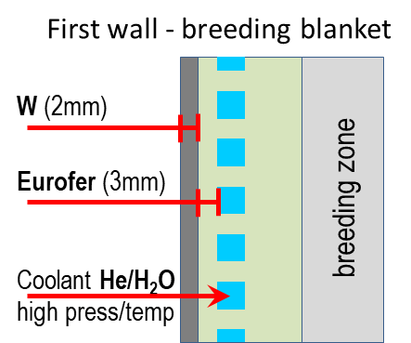
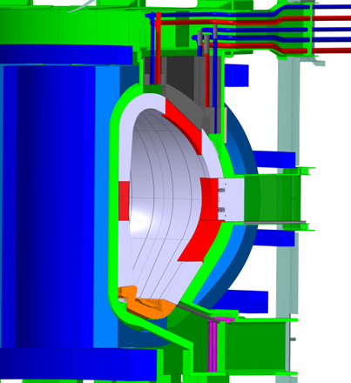
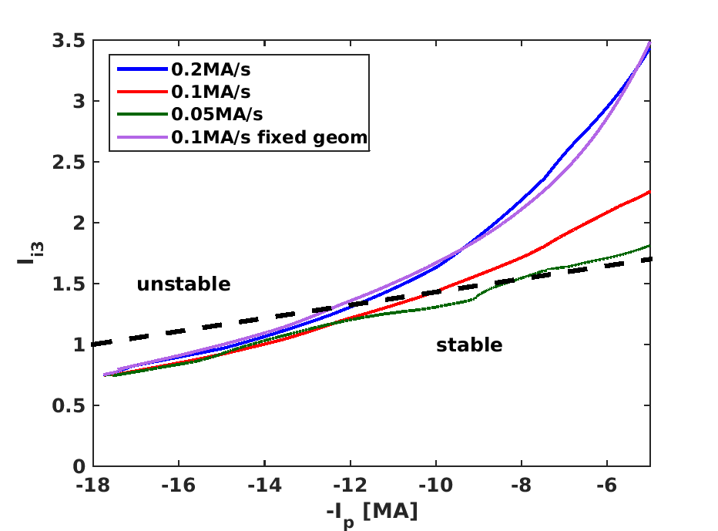
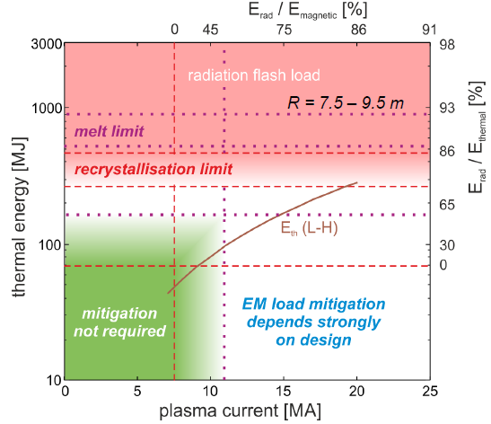
Re-attachment in DEMO
What about “fast termination”?
A fast plasma shutdown (like in ITER) at full current would pose unacceptable risks on the machine integrity [Maviglia, NME 2021],[Lehnen, IAEA 2016].
In parallel, the current cannot be ramped down faster than
~0.2 MA/s without losing vertical stability control.
(the increase of ramp down rate with the use of IVC is presently being investigated)
DEMO
ITER
[Lehnen, IAEA 2016]
[Siccinio, FED 2020]

Slide 19
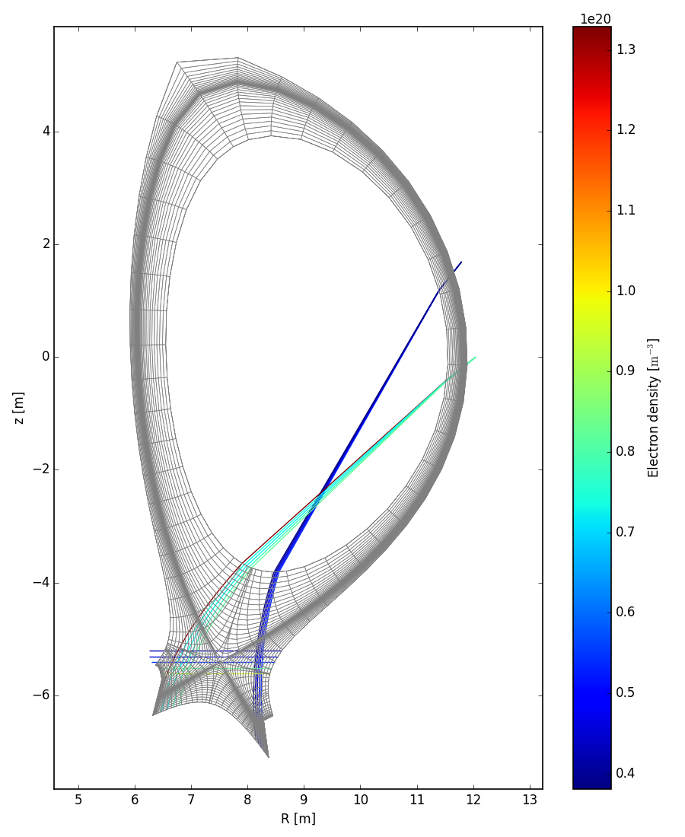
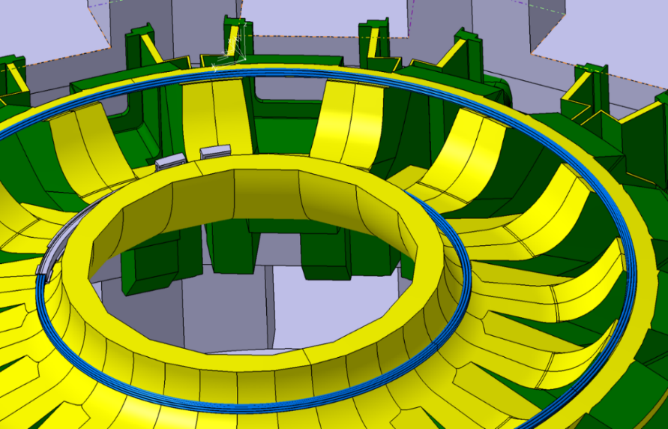
The (provisional) solution
Diagnostics able to detect reattachment before it happens (e.g. spectroscopy following the radiation front) [Biel, FED 2019].
Divertor sweeping (to be activated only in emergency cases) to allow the divertor surviving while the current is ramped down [Maviglia, FED 2016].
Needs the presence of IVC.
10s HF ramp 10..70 MW/m²
[Siccinio, NF 2019]
[Maviglia, NME 2021]

Slide 20
Advanced Fluid Neutral Model application to ITER
TSVV-5
Re-attachment/re-detachment studies; requires input from WPTE expts
Time-dependent option in SOLPS-ITER: issue: explicit-implicit coupling of plasma-fluid and neutral Monte-Carlo
Exploit advanced fluid-models in SOLPS-ITER for time-dependent simulations (without EIRENE); integration with core-codes (e.g. ASTRA)
Interaction related ETASC TSVVs (flight simulators, scenario integration) and ENRs on model reduction (e.g. generative neural-networks) as alternative model

Slide 21
Wall models

Slide 22
CX and photon fluxes on (ITER) first wall components
Breakdown of problem: ITER
Also: photons and radiation loads
possible
Collaborative work WPDC, W. Biel

Slide 23
Erosion vs Deposition on the ITER port-plug faces
V. Kotov NF 2016

Slide 24
CHERAB DEMO First Wall Estimated Loads
Collaboration WPPWIE & TSVV-7
Continuation requires SOLPS-ITER w/extended wall option (not validated yet);
comparison with other models (e.g. SOLEDGE2D)
Development of numerical diagnostics for heat-fluxes in DEMO:
CX and photon fluxes on walls (energy spectra, angular distribution)
Assessment of 2nd Xpoint and PWI in upper plane (SN) (R. Osawa, WPDES)
3D field line tracing codes to estimate charged particle HF (PFCflux – SMARDDA)
Later: kinetic models of 3D structures (e.g. toroidal/poloidal gap analysis, Firdaouss, Gerardin, WPDES)
Long term: Towards numerical optimization of first wall, steady-state & transients (e.g. disruptions/VDEs), impact on wall, W droplets (MEMOS-U, Ratynskaja)
Calculations on TQ mitigated Disruptions (or VDEs)
Assessment of active mitigation techniques
Initial thermal energy W_{th}=1.3GJ:
20% radiated @ pre-TQ at MGI/SPI
→ 1GJ remaining
Analysis including averaging techniques
Some relevant differences observed:
  More uniform load distribution
  Estimated peak load appears smaller by about 33%
  Higher accuracy
P_{rad}=800GW
F. Maviglia, IAEA-TM 2020

Slide 25
ADCs

Slide 26
ADC
Mainly covered by WPPWIE/ADC and WPTE (physics)
Extension of FP8 activities (c.f. F. Militello et al, ADC report 2021, WP-DTT1 and WP-DTT1/ADC) - SOLPS-ITER
Requires speed up and/or validated reduced physics models
Cyclic monitoring of DCT into WPPWIE/WPTE activities: focus on demonstration of ADC being a possibility for DEMO → input gate review 2024
Extension of WPDES activities towards ADC scenarios, e.g. DN, SXN (later on); start with advanced fluid or hybrid neutral model (L. Aho-Mantila, WPDES)
Work with groups who work on advanced fluid models development (i.e. TSVV-5) and numerical divertor optimisation techniques
(e.g. Univ. Leuven, adjoint optimisation techniques)
→ call for combined PWIE-DES EEG, closed & proposals in place
Later: assessments of engineering limits for ADCs: transients and configurations (e.g. sweeping in ADC, seeding, etc)

Slide 27
Overview
DEMO Divertor Design studies
Core-edge coupling
Transients & divertor re-attachment
Wall models
ADCs
All topics would be exploiting the newly developed features in the NGM of TSVV-5

