Slide 1
TSVV3 – ACH EPFL workplan Generic introduction
P. Tamain

Slide 2
ACH support in TSVV3 project
Task | Description | Topic | 2021 | 2022 | 2023
4 | Poisson solver optimization, including porting to GPU | HPC | 0.50 ppy | 0.50 ppy | 0.50 ppy
 | Definition of performance model and application to existing codes | HPC |  | 0.25 ppy | 0.25 ppy
 | Optimization of kinetic neutrals treatment | HPC | 0.1 ppy | 0.50 ppy | 0.50 ppy
 | Code-dependent optimization | HPC | 1 ppy | 1 ppy | 1 ppy
 | TOTAL task 4 |  | 1.6 ppy | 2.25 ppy | 2.25 ppy
8 | Implementation of IMAS compatibility for IO in contributing codes | Integ. Model. | 0.50 ppy
9 | Repository and Continuous Integration environment setup and maintenance | Data Manag. | 0.50 ppy | 0.25 ppy | 0.25 ppy
TOTAL |  |  | 2.6 ppy | 2.5 ppy | 2.5 ppy
EPFL

Slide 3
Performance model definition and application
Targets:
Define performance model (e.g., roof-line model) for evaluation of code performances
Apply it to existing codes to evaluate algorithmic efficiency and guide rationalization of effort beyond 2023
Resources 2021-2022: 3 pm => 0 pm
Task fully postponed to 2023 following resources reduction
priority given to improving codes for early return to WPs

Slide 4
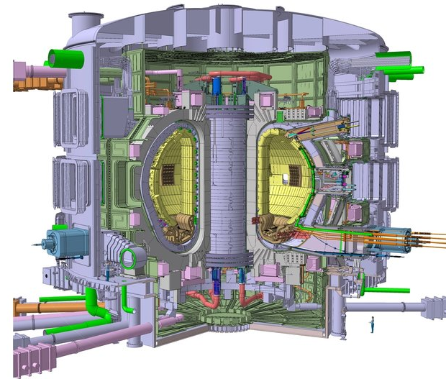
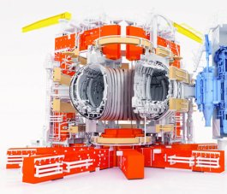
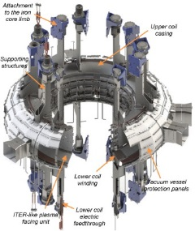
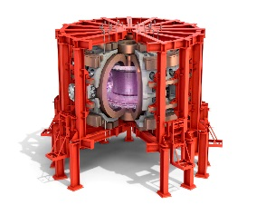
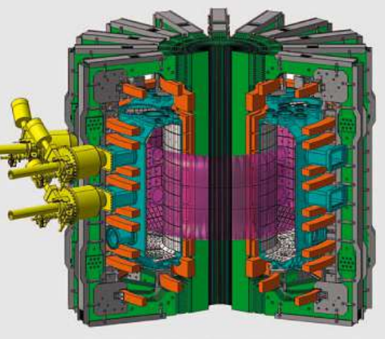
Code-dependent optimization (1)
ITER ~ 800m³
~ x400 in plasma volume
~ x4 in magnetic field amplitude
~ x1600 in resolution
~ x35 in number of ion species (vs pure D)
JET ~ 80m³
WEST ~20m³
AUG ~13m³
TCV ~1.8m³
Current capabilities

Slide 5
Code-dependent optimization (2)
Targets:
optimize codes for running on modern HPC architectures to enable larger scale 3D turbulence simulations (memory & time-to-solution) with ITER as main milestone
Evaluate scaling potential of discretization and implementation options
Resources 2021-2022: 36 pm => 10 pm (with TSVV6 (SOLEDGE3X))
Reduction of ambition in terms of machine size: ITER probably difficult to reach in project span
Exact expected task is code specific (presentations after)

Slide 6
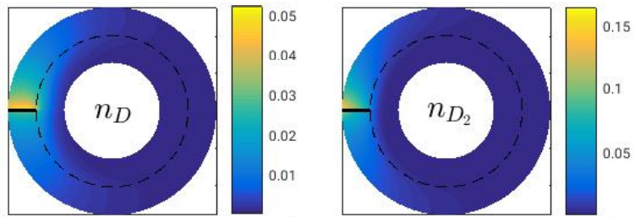
Optimization of kinetic neutrals treatment
Targets:
Optimization of kinetic neutral treatment to limit overhead w/r to simulations without neutrals
2 approaches to be investigated: coupling with EIRENE and method of characteristics
Resources 2021-2022: 7.2 pm => 3 pm
Need discussion on how to adapt the workplan to such reduction
TOKAM3X, coupling to EIRENE
[D.M. Fan, NME 2019]
GBS, method of characteristics
[A. Coroado, submitted to NF]

Slide 7
Poisson solver optimization
Targets:
Reduce bottleneck of elliptic solvers in 3D edge turbulence codes
Share approaches and best practices between codes
Optimize existing solvers and/or propose innovative approaches (GPU…)
Resources 2021-2022: 12 pm => 9 pm
Key point is to make sure progress is beneficial to all or at least several codes
Dedicated discussion at the end of the meeting on best strategy

Slide 9
Poisson solver optimization: discussion
Proposed actions:
Share information about properties and current implementation of elliptic solvers in codes
Document to fill by code developers and share with whole team
Help to identify key differences and similarities between codes
Give relevant resources to ACH team to analyze performances of elliptic solvers
Share source code (via access to common repo?) and/or matrices
On agreed template problem(s), investigate novel approaches (new libraries, GPU…)

