Slide 1
TSVV3 – ACH EPFL workplan SOLEDGE3X workplan
P. Tamain

Slide 2
Overview
SOLEDGE3X concerned by support through 3 of the ACH tasks
Optimization of elliptic solvers => not specific to SOLEDGE3X, generic discussion in this meeting
Optimization of kinetic neutrals treatment via coupling to EIRENE
Code-dependent optimization

Slide 3
Elliptic solvers in SOLEDGE3X
SOLEDGE3X makes use of 2 elliptic implicit solvers:
Parallel heat conduction terms: $∂_{t}E_{α}=\vec{∇}⋅\left(K_{∥}\vec{∇}T_{α}\right)+RHS$
2D thanks to flux-surface aligned grid (1 matrix by flux surface)
Embarrassingly parallel on flux-surfaces
Direct solver quite efficient but scalability questionable and difficulties to exploit parallelization (core pinning) with the libraries we use
Electrostatic potential: $∂_{t}\vec{∇}⋅\left(\frac{N}{B^{2}}\vec{∇}Φ\right)=\vec{∇}⋅\left(\frac{1}{η_{∥}}\vec{∇}Φ\right)+RHS$
3D (strong specificity vs other codes), extremely badly conditioned
Tried many different solvers from direct to AMG
Until recently main bottleneck of code for computing time (>95% for large cases), memory and scalability

Slide 4
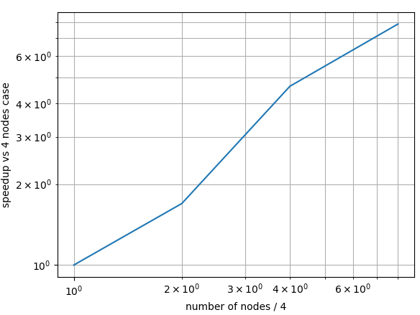
SOLEDGE3X points of interest for elliptic solvers
Strong progress on both aspects through usage of PETSC
Natural scalability recovered for heat conduction solver
Most probably due to better ability to manage core pinning
Huge gain obtained on potential solver which is not any the dominant part of the code
Key aspect = re-use of preconditioner
But usage of PETSC not ideal because of pure MPI parallelization (vs hybrid for rest of code)
Key points of interest on elliptic solvers:
Find a way to exploit hybrid parallelization in elliptic solvers (moving away from PETSC or adding threads somehow)
Strong interest in surveying and testing methods used in other codes
SOLEDGE3X weak strong scaling on TCV case [courtesy H. Bufferand]
Ideal

Slide 5
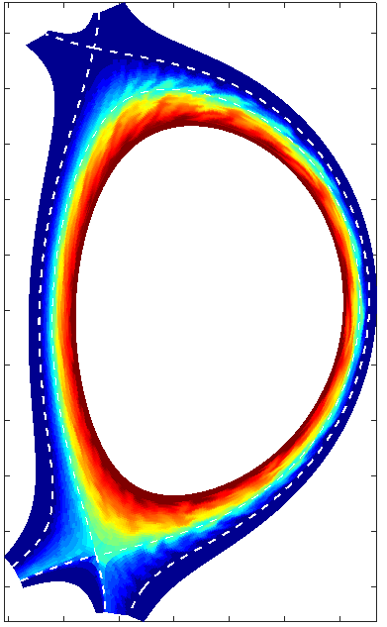
Kinetic neutrals in SOLEDGE3X: status
SOLEDGE3X coupled to EIRENE through STYX interface
Takes care of EIRENE setup and data exchange between plasma solver and EIRENE
Already used in 3D turbulence cases with TOKAM3X [Tamain PSI 2018], currently tested only in 2D in SOLEDGE3X
n_{i}, u_{i},
T_{i}, T_{e}
SOLEDGE3X:
Plasma 3D flux-driven turbulence Plasma up to sheath entrance
EIRENE:
Neutral transport and interactions
© TOKAM3X-EIRENE
S_{n}, S_{E}
© TOKAM3X-EIRENE
Quasi-neutral plasma
STYX
Neutrals
But 2 issues:
STYX has not been optimized nor parallelized properly (initially designed for 2D solver)
Computing and memory bottle neck for large 3D case
STYX not conceived as separate module => for the moment usable only in SOLEDGE3X

Slide 6
Kinetic neutrals in SOLEDGE3X: workplan
ACH support requested to:
Perform first profiling and optimization/parallelization of STYX
Achieve separation (modularization) between SOLEDGE3X and STYX in order to make STYX-EIRENE readily available for any edge code

Slide 7
SOLEDGE3X optimization: workplan
SOLEDGE3X partly written in replacement of TOKAM3X following recommendations of profiling
Strong improvement in terms of computing time evident on test cases
But no exhaustive profiling ever performed since then on SOLEDGE3X, partly because computing time ultra-dominated by elliptic potential solver
Now that this bottleneck has been solved, strong need for:
Exhaustive profiling: algorithmic efficiency, salability (…) of the various parts of the code
Take advantage to setup automatic tools for CI/CD
Identify issues and propose solutions
Implement and test them in the code

