Slide 1
TSVV Task 5: “Neutral Gas Dynamics in the Edge”
News for VC 03.09.2021
D. Borodin et al.

Slide 2
People entering / leaving the task
New postdoc in FZJ will start in October 2021 (improved CRMs incl. for molecular species, detachment in DEMO characterised by spectroscopy)
P.Börner will continue her work (2 days/week) at least till the end of this year.
Bert Mortier is leaving research.
→ Is there a successor?.. Will the KDMC development suffer?..
Very promising contacts with ACH-VTT:
(F. Granberg, J. Åström)
Discussions on parallelisation started
We should also get support with EUDAT
Do we have any issue with PPY support?..

Slide 3
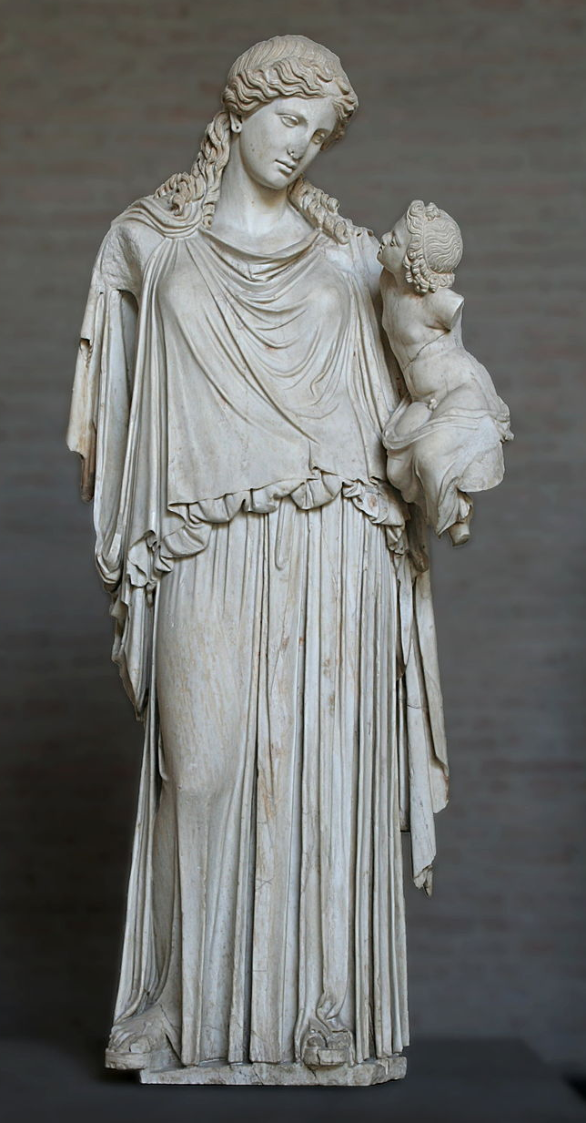
EIRENE-NGM-DEVELOPERS (TSVV-5)
D.V. BORODIN, F. Schluck, S. Wiesen, D. Harting, P.Börner
Forschungszentrum Jülich, Institut für Energie- und Klimaforschung – Plasmaphysik, Germany
W. DEKEYSER, S. CARLI, M. BLOMMAERT, N. HORSTEN, W. VAN UYTVEN, M. BAELMANS
KU Leuven, Department of Mechanical Engineering, Belgium
B. MORTIER, G. SAMAEY
KU Leuven, Department of Computer Science,Belgium
Y. Marandet, P. Genesio
Aix-Marseille Univ., France
H. Bufferand
CEA, IRFM, France
E. WESTERHOF, J.G. MUNOZ
DIFFER - Dutch Institute for Fundamental Energy Research, Eindhoven, the Netherlands
M. GROTH, A. HOLM
Department of Applied Physics, Aalto University, Espoo, Finland
H. LEGGATE ← HLST, ACH-MPG
DCU
??
??
, ??
Very promissing 1st contact with ACH-VTT:
F. Granberg, J. Åström
Eirene with the infant Ploutos

Slide 4
TSVV-5 KOM 16.04.21: planned events in focus groups
Already in (Sep-Oct 2021) code camp for 4-5 days unbroken focused work to start streamlining (segregation of the numeric core) the code
Concepts and parameters of the streamlining were discussed few times already including with ITER
ACH HPC (HLST follow up, H.Legatte) and ACH VTT should join.
Meeting on A&M data and CRMs including ADAS, Yacora etc. with the related external participation (Oct-Nov 2021?..). Handshake with validation at JET ILW and MAGNUM-PSI
We have already had a joint meeting with Yacora team (U.Fanz, D.Wunderlich)
https://indico.euro-fusion.org/event/1107/
To invite: M.O’Mullane (ADAS); D.Tshakhaya (BIT2); J.Tennysson (RMPS for molecules), D.Fursa (CCC for molecules)?..
Reduced model data for outgassing, FEM with applications to Magmum-PSI (Dec 2021?..)
Some cooperation already started within SOLPS-ITER communication (G.Nallo, Turin)
Meeting on selection of DEMO application case(s) (mid 2022?..)
External participation from DEMO-relevant WPs?..
Invite TSVV-6,7 PIs?..

Slide 5
Thrust2 meeting 30.08.2021
https://indico.euro-fusion.org/event/1306/
Action items for TSVV-5:
- W7-X discussion of validation cases (embedded in a fluid code EMC3-EIRENE)
=> Meeting with WP W7X TFL to clarify cases (Borodin/Alonso)
- TE discussion of validation cases (embedded in fluid codes SOLPS-ITER/EMC3-
EIRENE) / clarify situation with KU Leuven activities within WP TE for AUG
=> Meeting with WP TE TFL to clarify cases and scope (Borodin/Hakola)
- Update plan for 2021 and 2022 / potential deviations in plan (shifts) / PI to send table to CO WP AC (Kalupin) and Thrust 2 Facilitator (Brezinsek) by mid of September
Joint meetings proposed:
WP PWIE:
- Meeting to discuss TSVV5 and ADC / TE work activities with EIRENE versions (Brezinsek / Borodin / Harting / Wischmeier / Calabro / Aho Mantiola / Leuven team)
- Joint meeting of TSVV5 and 6 regarding coverage of kinetic ion module in EIRENE (neutrals vs. impurities, D+) in TSVVs (Ciraolo/Harting/Borodin)

Slide 6
EIRENE (“E-”) application portfolio (discussion in progress . . .)
aim/type | ITER/DEMO | JET | WPTE devices | W7-X | Linear devices
 | Slab-ITER (B2-E, FKH, …, usable for most run types) | Slab-JET (B2-E, Edge2D-E, FKH, parallelization) | Slab-AUG (B2-E) | No need for that | No need for that
 | ITER case 2275 (no molec., S.Carli) | FKH-SpH FKH-mMH parallelization | Can be done, of particular value for TSVV-5 | E-EMC3 (D.Harting) | No reason to be separate from validation cases
 | No need for that | E-Edge2D, SOLPS M18-27 L-mode T5 (M.Groth) C30c (S.Wiesen) M18-39 (E.Kaveeva) | ?AUG…Similarity with JET?.. TCV?.. | Need to select one, pending | E-B2 Magnum-PSI (focus on MAR and photon trapping)
 | Future: SOLPS-ITER, baseline with extended grid For starters: reference SOLPS4.3 case (A.Kukushkin) | No need for that | No need for that | No need for that | E-B2 JULE-PSI
Verification
Test on relevant scale
Validation
Predictive modelling and design
Well-established simulation cases for most relevant and representative JET experiments:
1) molecular physics and detachment
2) PSI in divertor in ELMy H-mode with isotopes
3) seeded high-radiative scenario
System: focused selection of Interconnected cases!

Slide 7
Web communication considerations
What should be our Web-communication mechanism?
EUROfusion WIKI?
https://wiki.euro-fusion.org/wiki/TSVV-05
www.Eirene.de?
What actually we wish to have where?
EIRENE-NGM-DEVELOPERs (associated developers, ADs)
EIRENE licence, download link
Developer code of conduct (DCoC)
Publications?..
Developer profiles?..
?..

Slide 8
Thanks for the attention!

Slide 9
EIRENE licencing - User Agreement (UA)
Old UA
acknowledgement of FZJ origin of EIRENE, non-military use, non-commercial use, no cost/liability for FZJ, etc.
New UA
Based on copyleft licence (however GPL3.0 occurs to be not suitable).
Similar declarative statements as in the old UA.
More clear statement about the EIRENE-based publications.
Developers and users are divided into “basic” and “associated” ones (AD).
➔ ADs get more rights on decision-making, direct access to the repository, etc.
ADs must keep to the “Developer Code of Conduct” (see at INDICO).
Current status: we wait for the document version from the FZ Jülich lawyers…

Slide 10
EIRENE-NGM: code streamlining
For details see TSVV-5 FP-9 proposal: D1.a, D1.b, D4.a, D4.c, D4.d
Main ideas:
Segregation of the compact numeric core and starter/interfaces part
The core should be free of any branching (geometry, specific parameters for the application cases etc.) – core input should be minimized to “really need to know”.
The core should be sufficiently flexible for domain decomposition and load balancing schemes; suitable for all variations of the code including FKH.
Parallelization optimisation should be universal, probably with some parameters and clear procedures for their adjustment.
Providing HPC-conform interfaces to the codes from the other TSVVs
CFD-EIRENE from TSVV-3 (B2 as part of SOLPS) are first to go. EMC3 (3D!) is also very important to ensure the variability.
Kinetic ions (tracked on EIRENE side), FKH, etc. may lead to challenges!..
Utilizing new programming/IT technologies
JSON input and HDF5 output (future: parallel writing on HPCs?)
Under discussion: using of OOP (modern Fortran or even C++?)
„Code-camp like“ event is expected in Sep 2021
Details are still under debate…
We need a strategy letting all other development to go in parallel…
Expertise and support from the ACH can be very valuable!

Slide 11
EIRENE applications types - categorisation
aim/type | Aims for this stage | Typical properties
 | Test code functionality and convergence Test performance (including parallelization, new features etc.) | Abstract geometry Flexible and easy defining of input parameters like density gradients.
 | Test impact of real, often 3D, geometry and characteristic parameters on the reasonability of results. Demonstrate availability (sufficient memory, performance, etc.) | Geometry and other input parameters are often simplified Many physical processes can be neglected
 | Simulate results to be compared with experimental observations. Draw conclusions on adequacy and accuracy of the model. | Real existing experiments Synthetic diagnostics Realistic and detailed geometry and other input parameters
 | Use model to investigate realistic parameter rages, and key acting effects for future devices. Provide data and insight for design of the machine, its duty cycle and plasma scenario. | Tests of model scalability, self-consistency and plausibility of results. Parameter scans for answering design, safety and similar issues.
Verification
Test on relevant scale
Validation
Predictive modelling and design

