Slide 1






TSVV Task 5: “Neutral Gas Dynamics in the Edge”
Task status overview for internal discussion inside Thrust 2
D. Borodin et al.

Slide 2
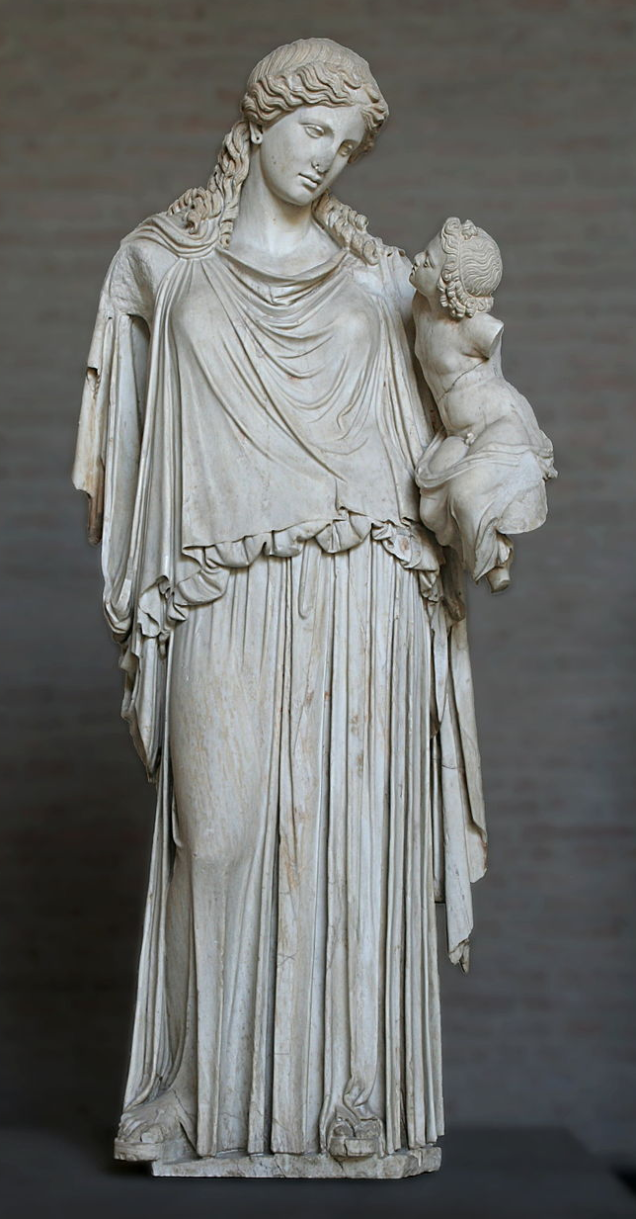
EIRENE-NGM-DEVELOPERS (TSVV-5)
D.V. BORODIN, F. Schluck, S. Wiesen, D. Harting, P.Börner
Forschungszentrum Jülich, Institut für Energie- und Klimaforschung – Plasmaphysik, Germany
W. DEKEYSER, S. CARLI, M. BLOMMAERT, N. HORSTEN, W. VAN UYTVEN, M. BAELMANS
KU Leuven, Department of Mechanical Engineering, Belgium
B. MORTIER, G. SAMAEY
KU Leuven, Department of Computer Science,Belgium
Y. Marandet, P. Genesio
Aix-Marseille Univ., France
H. Bufferand
CEA, IRFM, France
E. WESTERHOF, J.G. MUNOZ
DIFFER - Dutch Institute for Fundamental Energy Research, Eindhoven, the Netherlands
M. GROTH, A. HOLM
Department of Applied Physics, Aalto University, Espoo, Finland
H. LEGGATE ← HLST, ACH-MPG
DCU
Very promissing 1st contact with ACH-VTT:
F. Granberg, J. Åström
Eirene with the infant Ploutos

Slide 3

TSVV-5: Neutral Gas Dynamics in the Edge
Main simulation tool:
EIRENE code (and EIRENE-CFD packages) http://www.eirene.de/
We aim to transform it to IM- and HPC-ready neutral gas module (EIRENE-NGM) suitable for simulations on ITER and DEMO scale with large focus on (semi)detached divertor plasmas
FP-9 deliverables:
Neutral gas code that allows for an efficient use of HPC resources (towards exascale systems and/or HPC booster techniques) through suitable parallelization methods.
Revised and extended physics basis for the neutral gas model. Further development of the underlying collision-radiative model towards the full vibrational resolution for all hydrogen isotopes and specific impurities for seeding.
Improved (in contents and structure) Atomic and Molecular database for volumetric and surface processes. Database access through generalized interfaces to, e.g., atomic, molecular, nuclear and surface (AMNS) physics data.
Interfaces and boundary conditions necessary for future applications; modularization of the neutral gas code to facilitate coupling to computation fluid dynamics (CFD) codes (2D or 3D codes, turbulence codes, time-dependent) and possibly also to gyro-kinetic/gyrofluid plasma codes.
Strategy towards a validated predictive capability for integrated fusion reactor modelling for (semi-)detached divertor plasmas. Liaison with TSVV Tasks 3 and 4.
Neutral gas code that allows for an efficient use of HPC resources (towards exascale systems and/or HPC booster techniques) through suitable parallelization methods.
Revised and extended physics basis for the neutral gas model. Further development of the underlying collision-radiative model towards the full vibrational resolution for all hydrogen isotopes and specific impurities for seeding.
Improved (in contents and structure) Atomic and Molecular database for volumetric and surface processes. Database access through generalized interfaces to, e.g., atomic, molecular, nuclear and surface (AMNS) physics data.
Interfaces and boundary conditions necessary for future applications; modularization of the neutral gas code to facilitate coupling to computation fluid dynamics (CFD) codes (2D or 3D codes, turbulence codes, time-dependent) and possibly also to gyro-kinetic/gyrofluid plasma codes.
Strategy towards a validated predictive capability for integrated fusion reactor modelling for (semi-)detached divertor plasmas. Liaison with TSVV Tasks 3 and 4.
Code performance, parallelization, refactoring, domain decomposition, I/O for HPC, …
Improved physics and features incl. fluid-kinetic hybridisation (FKH) and improved CRMs
Improved AMNS data, both in structure/physics and content
EIRENE as NGM – restructuring, interfaces to other codes, time-dependent runs, kinetic ions
Validation with experiments and test of predictive capabilities for ITER and DEMO

Slide 4
Crude scheme for the TSVV-5 workflow
D4. Coding
FE model for divertor target and FW
Maintenance
Increased code capabilities
KUL
Modulisation
Time-resolved
CEA
A&M Kinetic ions
Adjoint approach
sensitivity analysis and UQ
FZJ
D1. HPC
NGM with interfaces
Domain decomposition
Optimized parallelisation
High performance
DIFFER
D3. AMNS
reduced models for isotopes in FW, outgassing etc.
AMNS data structure and content
Better quality, resolution, isotope effects, more processes
Aalto
Expected outcome
D2. Physics
F-K Hybridisation
High density and collisionality
CRMs for molecules
Physics of detachment
D5. Testing
Magnum-PSI, detachment in transients
Spectroscopy at JET and MAGMUM
ITER scenario with semi-detachement
DEMO scale and parameters

Slide 5
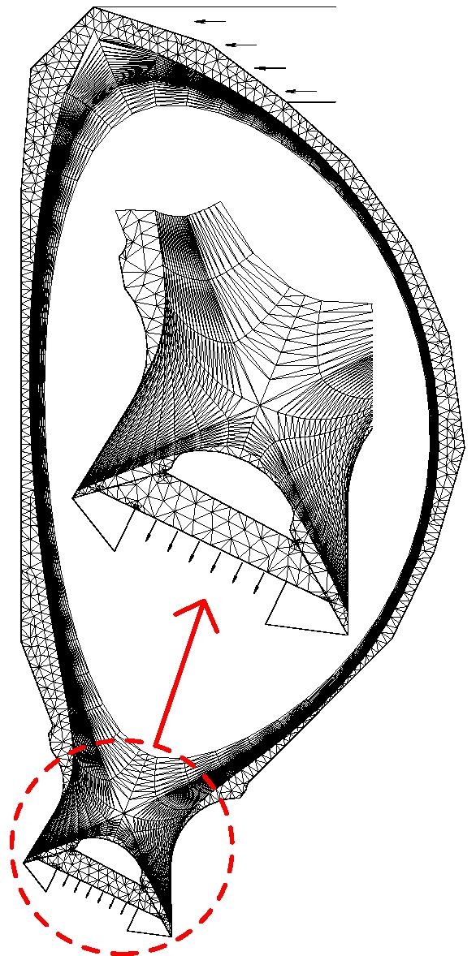
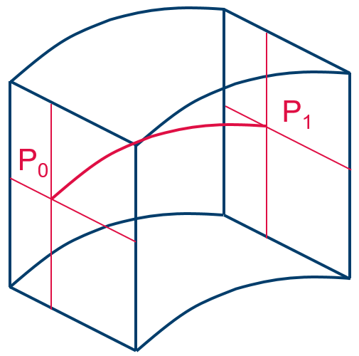
What is EIRENE in a nutshell (e.g. in SOLPS)?..
Macroscopic:
Microscopic:
Plasma flow parameters
EIRENE-NGM: a 3D3v MC multi-species transport code incl. radiation transfer, kinetic
or F-K hybrid.
CFD codes (computational fluid dynamic):
B2, Edge2D, EMC3, SOLEdge3X, etc…
3D EIRENE volume cell
2D or 3D Volume grid (e.g. tetraeder) adopted for current magnetic configuration
Source terms (Particle, Momentum, Energy)
CRMs
(HYDKIN, AMJUEL, ADAS, …)
for atomic and molecular neutrals H,H*,H₂,H₂(v),H₂*,H⁻,H₂⁺,…, impurities
Ionisation, CX, recombination etc.

Slide 6
Fluid-kinetic hybridization (FKH)
Accuracy
Code performance
A hierarchy of neutral models:
D. Borodin et al., FEC-2020, submitted to NF (2021)
Seamless in volume
Fluid,
AFN
Hybrid Fluid-Kinetic approach (FKH)
kinetic,
MC
Asymptotic-Preserving MC (APMC)
Spatial FKH
Micro-macro FKH (mMH)
Cancellation error (can be suppressed by enforcing positivity)
Firm domain allocation
Spatial by source
Micro-macro kinetic diffusion (KDMC)
Bias error (can be suppressed via multi-level)
No coupling with CFD needed
Evapor./condens.
Notes:
BM:
- Added cancellation error and bias inside the boxes
- changed colorscheme of the triangles
- the fact that FKH asymptotically becomes AFN or K and KDMC asymptotically becomes K, are indicated by connecting the blocks
- Added dashed lines to stress that the bottom is a further categorization of the top
- Repeated FKH as a term in the bottom part to show it is the same
- Group the spatial FKH’

Slide 7
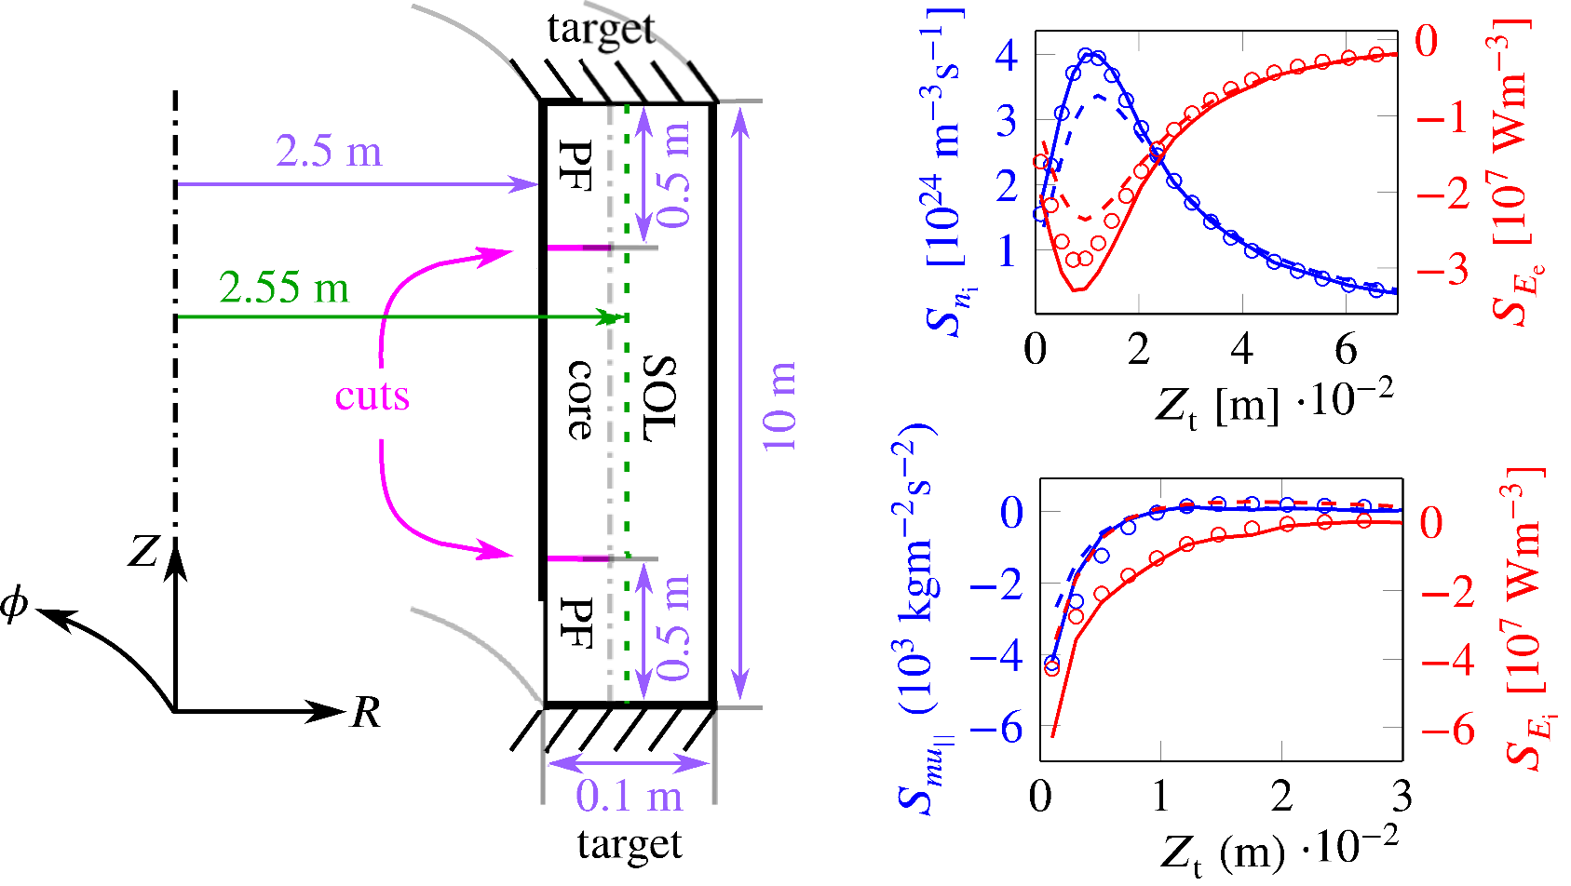
Example: mMH accuracy on ITER slab test case
N.Horsten,
CPP, 2020
SOLPS-ITER
simulations
Hybrid simulations approach full kinetic ones with
5-7 time reduced CPU time

Slide 8
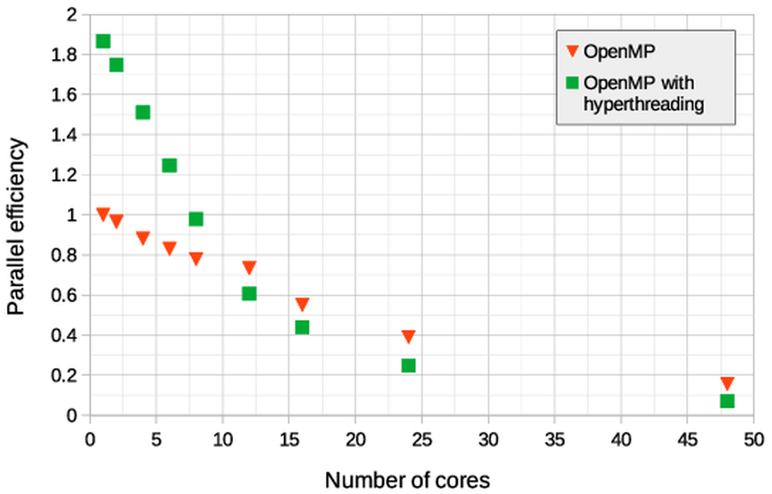
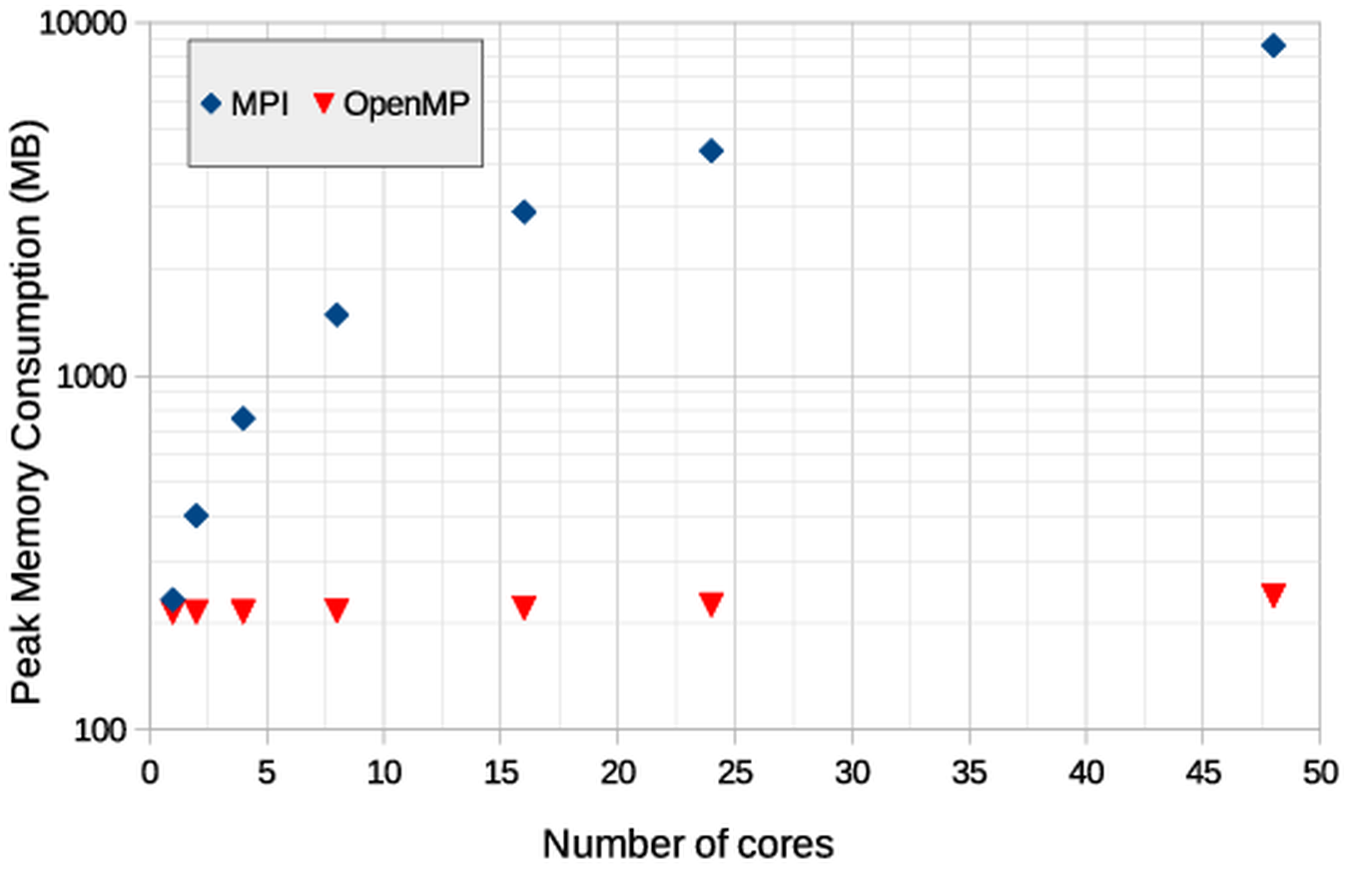
ITER test case: hybrid OpenMP/parallelisation
H. Leggate, HLST support rep., 2021
D. Borodin et al., FEC-2020, submitted to NF (2021)
Acceptable OpenMP efficiency + solution for typical memory limitations in particular in a view of ITER/DEMO scale simulations

Slide 9
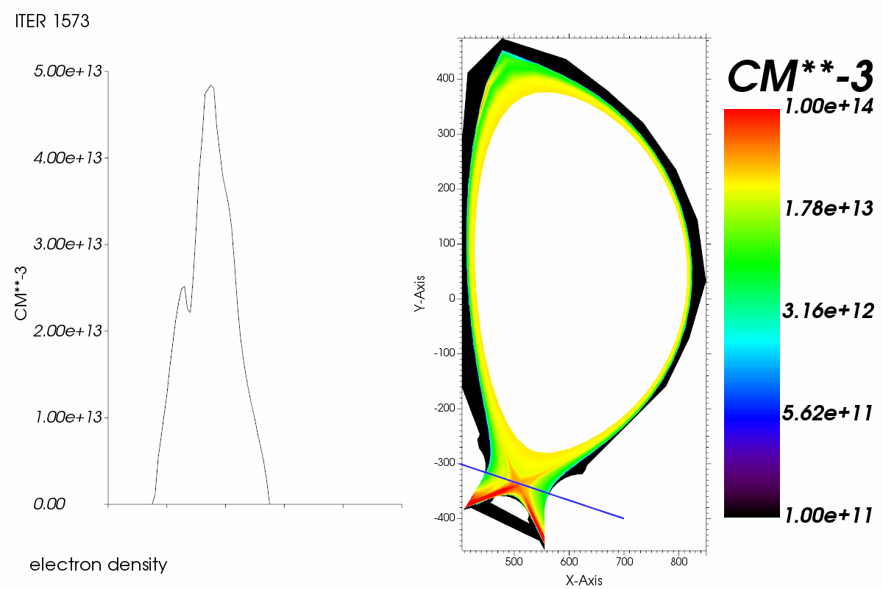
Code visualisation (P.Börner)
„TallyViz“
The python tool for plotting of results of EIRENE calculations has been optimized and developed further to work with all 2D or 3D geometries.
Available features:
Shaded presentation of volume averaged tallies
Lineplot (profile) along an indicator line
Vectorplots
Algebraic calculations with volume averaged tallies
Artificial graphics from line of sight calculations for tetrahedral geometries
➔cooperation with DIFFER: HDF5 implemented

Slide 10
EIRENE (“E-”) application portfolio (discussion in progress . . .)
aim/type | ITER/DEMO | JET | WPTE devices | W7-X | Linear devices
 | Slab-ITER (B2-E, FKH, …, usable for most run types) | Slab-JET (B2-E, Edge2D-E, FKH, parallelization) | Slab-AUG (B2-E) | No need for that | No need for that
 | ITER case 2275 (no molec, S.Carli) | FKH-SpH FKH-mMH parallelization | Can be done, of particular value for TSVV-5 | E-EMC3 (D.Harting) | No reason to be separate from validation cases
 | No need for that | E-Edge2D, SOLPS M18-27 L-mode T5 (M.Groth) C30c (S.Wiesen) M18-39 (E.Kaveeva) | ?AUG…Similarity with JET?.. TCV?.. | Need to select one, pending | E-B2 Magnum-PSI (focus on MAR and photon trapping)
 | Future: SOLPS-ITER, baseline with extended grid For starters: reference SOLPS4.3 case (A.Kukushkin) | No need for that | No need for that | No need for that | E-B2 JULE-PSI
Verification
Test on relevant scale
Validation
Predictive modelling and design
Well-established simulation cases for most relevant and representative JET experiments:
1) molecular physics and detachment
2) PSI in divertor in ELMy H-mode with isotopes
3) seeded high-radiative scenario
System: focused selection of Interconnected cases!

Slide 11
TSVV-5 KOM 16.04.21: planned events in focus groups
Already in (Sep-Oct 2021) code camp for 4-5 days unbroken focused work to start streamlining (segregation of the numeric core) the code
  Concepts and parameters of the streamlining were discussed few times already including with ITER
  ACH HPC (HLST follow up, H.Legatte) and ACH VTT should join.
Meeting on A&M data and CRMs including ADAS, Yacora etc. with the related external participation (Oct-Nov 2021?..). Handshake with validation at JET ILW and MAGNUM-PSI
  We have already had a joint meeting with Yacora team (U.Fanz, D.Wunderlich)
  https://indico.euro-fusion.org/event/1107/
  To invite: M.O’Mullane (ADAS); D.Tshakhaya (BIT2); J.Tennysson (RMPS for molecules), D.Fursa (CCC for molecules)?..
Reduced model data for outgassing, FEM with applications to Magmum-PSI (Dec 2021?..)
  Some cooperation already started within SOLPS-ITER communication (G.Nallo, Turin)
Meeting on selection of DEMO application case(s) (mid 2022?..)
  External participation from DEMO-relevant WPs?..
  Invite TSVV-6,7 PIs?..

Slide 12
Summary: TSVV-5 progress and plans
Physics
  Fluid-kinetic hybridisation (FKH) development successfully continues
  Kinetic ions on the EIRENE side (F.Schluck, D.Harting – TSVV-6)
  Establishing simulation cases (validation, ITER, DEMO) – in progress
  A&M CRM improvement (mostly preparatory work so far…)
Code development
  Parallelisation: OpenMP-MPI hybrid (related code refactoring done; optimisation and restructuring e.g. domain decomposition are necessary)
  Code streamlining (Segregation of the numeric core, etc.) – code camp
  Improved I/O (JSON/HDF5), visualisation, IMASification, etc. – in progress.
Organisational items
  Repository for simulations (EUDAT?.., using JAC catalogue experience) – concept under development, depends on selection of base system.
  New EIRENE license, “infectious open source” (draft discussed with FZJ layers and ITER still in circulation)
  Regular meetings (1 general / 2-3 topical every 2nd week) + focus group events by necessity. Some VC are open outside TSVV-5.
  ➔ Example: 17 Sep. topical meeting on SOLPS (with ITER participation)
Requires communication with other TSVVs
Requires ACH support

Slide 13
Thanks for the attention!

Slide 14
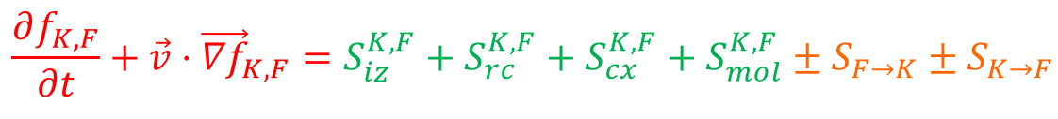
F-K Hybridisation approaches utilized in EIRENE-NGM
A) Full kinetic
B) SpH, mMH
C) APMC: KDMC
Plasma flow parameters
Plasma flow parameters
Mean, covariance
3D
cell
3D
cell
3D
cell
CFD
NGM
CFD
NGM
NGM
diffusive
NGM
kinetic
FKH
Source terms
Source terms
x(t_{n+1}), v(t_{n+1})
f= f_{F} + f_{K}, optionally with
evaporation/condensation:
Kinetic step with constant velocity followed by random walk with appropriate parameters

Slide 15
EIRENE licencing - User Agreement (UA)
Old UA
acknowledgement of FZJ origin of EIRENE, non-military use, non-commercial use, no cost/liability for FZJ, etc.
New UA
Based on copyleft licence (however GPL3.0 occurs to be not suitable).
Similar declarative statements as in the old UA.
More clear statement about the EIRENE-based publications.
Developers and users are divided into “basic” and “associated” ones (AD).
➔ ADs get more rights on decision-making, direct access to the repository, etc.
ADs must keep to the “Developer Code of Conduct” (see at INDICO).
Current status: we wait for the document version from the FZ Jülich lawyers…

Slide 16
From EIRENE to “neutral gas module” in E-TASC
EIRENE
Solid math basis
Well established code
Strong AMNS data collection
EIRENE as NGM inside EUROFusion E-TASC
Suitable for highly radiative divertor, huge amounts of cells, including photon-tracing and other effects
Time-dependent mode
Modernized code well suitable for HPC use. MPI-OpenMP parallelization with good weak scaling (GPU use… may evolve with support from Hub)
Revisited code structure including segregating of a compact core and domain decomposition
Universal interface to other codes (IMAS-based)
Improved A&M database – more data, more parameters, more validation, more systematic, …
Numerical algorithms including FKH
- A&M data and tools:
  AMJUEL,HYDHEL,H2VIBR, . . .
- Manual, visualization, Git repository
- Interfaces to CFD codes:
  B2 (SOLPS), Edge2D, EMC3…
- Improved I/O (pilot TSVV):
  JSON input, HDF5 output
New: portfolio of simulation cases with related catalogued central storage of runs and systematic CI cases
Computational Grid

Slide 17
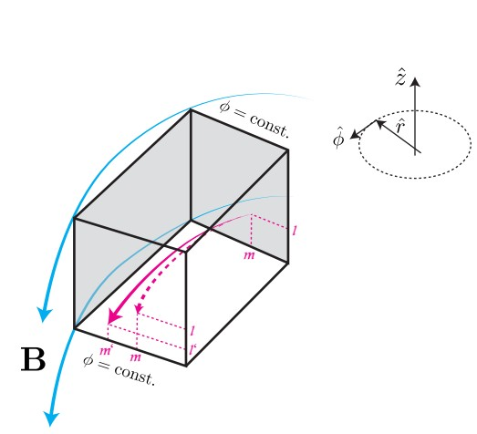
EIRENE: Kinetic Ions (F.Schluck, D.Harting)
EIRENE follows particles only in Cartesian coordinates
Now: tracing $∥$ and $⊥$ to $\overset{⃑}{B}$ needed
  EIRENE coupling to EMC3 provides
  field-line tracing capability
  Field-line defined by m, n
In EMC3 context: trajectory altered by
– Drifts
– Diffusion
Currently: Coulomb collisions handled by simple relaxation time
No E in EMC3, however in many cases (e.g. B2) E-field should be available…
Kinetic Ions followed by guiding centre approximation
${\dot{\overset{⃑}{R}}}_{gc}{=\overset{⃑}{V}}_{gc}=v_{∥}\frac{\overset{⃑}{B}}{B}+\frac{\overset{⃑}{E}×\overset{⃑}{B}}{B^{2}}+\frac{v_{∥}^{2}+v_{⊥}^{2}/2}{q_{i}B/m_{i}} \frac{\overset{⃑}{B}×\overset{⃑}{∇}B}{B^{2}}+anom.transp.$
$${\dot{ v}}_{∥}=\frac{q_{i}}{m_{i}}\frac{\overset{⃑}{E}⋅\overset{⃑}{B}}{B}−\frac{v_{⊥}^{2}}{2}\frac{∇_{∥}B}{B}+coulomb collisions$$
$${\dot{v}}_{⊥}=\frac{v_{∥}v_{⊥}}{2}\frac{∇_{∥}B}{B}+coulomb collisions$$
Currently no electric field in EMC3
Guiding centre transport by stochastic process
$$∆{\overset{⃑}{R}}_{gc}={\overset{⃑}{V}}_{gc}∆t+\sqrt{D_{⊥}∆t} {\overset{⃑}{ζ}}_{⊥}$$

Slide 18
EIRENE-NGM: code dtreamlining
For details see TSVV-5 FP-9 proposal: D1.a, D1.b, D4.a, D4.c, D4.d
Main ideas:
Segregation of the compact numeric core and starter/interfaces part
  The core should be free of any branching (geometry, specific parameters for the application cases etc.) – core input should be minimized to “really need to know”.
  The core should be sufficiently flexible for domain decomposition and load balancing schemes; suitable for all variations of the code including FKH.
  Parallelization optimisation should be universal, probably with some parameters and clear procedures for their adjustment.
Providing HPC-conform interfaces to the codes from the other TSVVs
  CFD-EIRENE from TSVV-3 (B2 as part of SOLPS) are first to go. EMC3 (3D!) is also very important to ensure the variability.
  Kinetic ions (tracked on EIRENE side), FKH, etc. may lead to challenges!..
Utilizing new programming/IT technologies
  JSON input and HDF5 output (future: parallel writing on HPCs?)
  Under discussion: using of OOP (modern Fortran or even C++?)
„Code-camp like“ event is expected in Sep 2021
Details are still under debate…
We need a strategy letting all other development to go in parallel…
Expertise and support from the ACH can be very valuable!

Slide 19
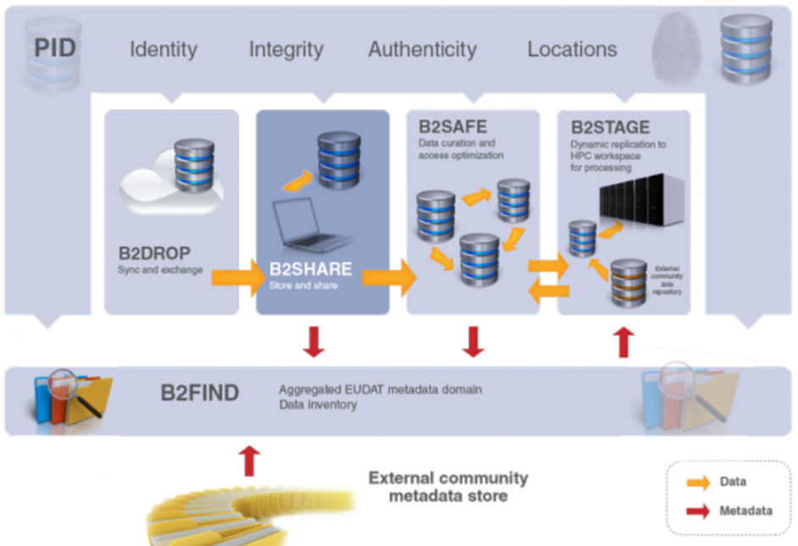
EUDAT for saving EIRENE/NGM runs
https://www.eudat.eu/
Flexible, World-wide access “B2ACCESS“ based on certificate (e.g. FZJ), google ID or EUDAT ID
→ One can define groups of users e.g. “NGM
developers”
B2DROP cloud (20Gb per user!) – sufficient?!.
Free and easy to get for any of TSVV participants
B2SAFE – unlimited additional volumes of data in full agreement with organization policies.
B2STAGE: extension of the iRODS system with a GridFTP interface
Consider using SimDB as backbone for organization of folders/catalogs at B2SAFE
We can get support for installing/maintaining the system from Juelich Supercomputing Centre (JSC)
We need to have seamless data transfer with HPC, so our option is “B2STAGE”, however we can also use “B2SHARE” (plus “OOath2” access, versioning) for some of the metadata e.g. instead of SCIEBO
→ B2Drop “NF_NGM” requested, next step is testing . . .

Slide 20
EIRENE applications types - categorisation
aim/type | Aims for this stage | Typical properties
 | Test code functionality and convergence Test performance (including parallelization, new features etc.) | Abstract geometry Flexible and easy defining of input parameters like density gradients.
 | Test impact of real, often 3D, geometry and characteristic parameters on the reasonability of results. Demonstrate availability (sufficient memory, performance, etc.) | Geometry and other input parameters are often simplified Many physical processes can be neglected
 | Simulate results to be compared with experimental observations. Draw conclusions on adequacy and accuracy of the model. | Real existing experiments Synthetic diagnostics Realistic and detailed geometry and other input parameters
 | Use model to investigate realistic parameter rages, and key acting effects for future devices. Provide data and insight for design of the machine, its duty cycle and plasma scenario. | Tests of model scalability, self-consistency and plausibility of results. Parameter scans for answering design, safety and similar issues.
Verification
Test on relevant scale
Validation
Predictive modelling and design

