Slide 1
WP TE contribution to Thrust 2
Antti Hakola
On behalf of the WP TE TFL team

Slide 2
Interaction of WP TE with Thrust 2 TSVVs
All WPTE research topics have a direct relation with at least one TSVV (see WPTE wiki)
Research topics have a set of objectives and their modelling deliverables have often a clear connection to those of the TSVVs
Scientific coordinators have been informed about the relation of their Research Topics with the relevant TSVVs
It is part of their duties to establish the necessary interactions with the relevant Pis
TFLs will help in managing these relations but we strongly encourage organizing meetings at the working level
WP TE TFLs expect working meetings to take place between the SCs and PIs to define / identify:
Specific model/code requests that the Research Topics have towards the TSVVs
People involved in this work on both sides at the working level + gaps if any
The validation actions required for the models/codes developed such as database, data mining, targeted experiments, etc.

Slide 3
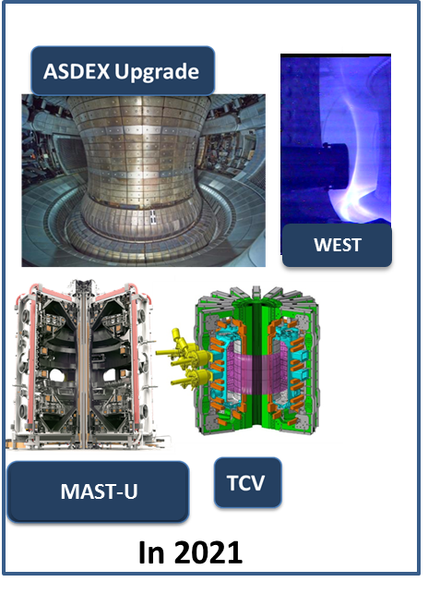
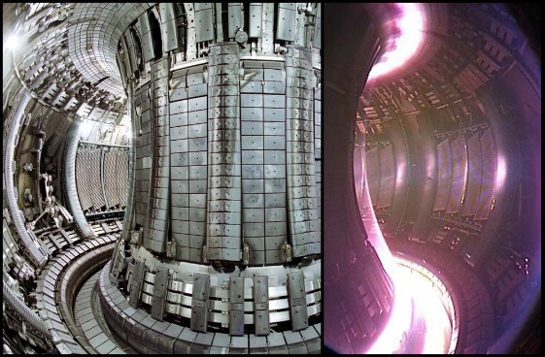
WP TE programme in the EUROfusion devices
Participation of 4 devices in 2021: ASDEX Upgrade, MAST-U, TCV and WEST
The operational budget allocated to WP TE to all 4 devices is pre-defined by EUROfusion until 2025
WP TE aims at using at best the allocated budget on each device for achieving the overarching scientific objectives using the devices capabilities
JET integrated end of 2021 with a pre-defined programme and participation

Slide 4
Overview of WP TE structure
 | TFLs | Title | SC | SC | SC
RT1 | EJ/BL | IBL scenarios towards low collisinality and detachment | O. Sauter, | T. Puetterich | L. Piron
RT2 | NV/BL | H-mode entry and pedestal dependence with impurities and isotopes | M. Dunne, | L. Frassinetti
RT3 | EJ/BL | RF-assisted breakdown and current ramp-up optimization | D. Ricci, | T Wauters
RT4 | EJ/MW | Disruption avoidance and control for ITER and DEMO | F. Felici, | M. Maraschek | O. Kudlacek
RT5 | EJ/AH | Run-away electron generation and mitigation | U. Sheikh, | C. Reux, | O. Ficker
RT6 | NV/AH | ELM mitigation and suppression in ITER/DEMO relevant condition | W. Suttrop | D. Ryan
RT7 | NV/BL | Negative triangularity scenarios as an alternative for DEMO | T. Bolzonella
RT8 | NV/BL | QH-mode and I-mode assessment in view of DEMO | E. Viezzer | A.Merle
RT9 | MW/BL | Extension of EDA and QCE performance towards DEMO | M. Faitsch | L. Gil
RT10 | ET/AH | Fast-ion physics with dominant ICRF heating | Y. Kazakov | R.Bilato
RT11 | NV/BL | Impact of MHD activity on fast ion losses and transport | M. Vallar | M. Garcia-Munoz
RT12 | EJ/NV | Development of the steady state scenario | S. Coda, | C. Piron
RT13 | MW/AH | X-point radiation and control | M. Bernert | S. Wiesen
RT14 | MW/ET | Physics of plasma detachment / impurity mix/ heat load patterns | O. Février | S. Henderson | A. Jarvinen
RT15 | NV/ET | Extrapolation of SOL transport to ITER and DEMO | D. Brida | G. Harrer
RT16 | ET/AH | PFC damage evolution under tokamak conditions | Y. Corre | K. Krieger
RT17 | ET/AH | Material migration and fuel retention mechanisms in tokamaks | T. Loarer | J. Likonen
RT18 | MW/EJ | Alternative divertor configurations | A. Thornton | C. Theiler

Slide 5
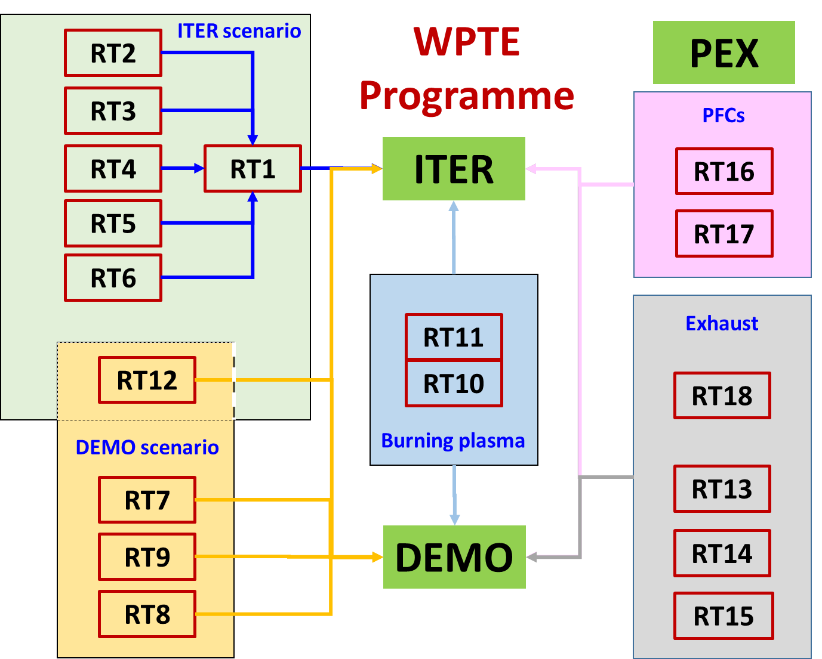
WP TE programme in a nutshell
TSVVs

Slide 6
Linking WP TE RTs and TSVVs
TSVV / Research topic No | 1 | 2 | 3 | 4 | 5 | 6 | 7 | 8 | 9 | 10 | 11 | 12 | 13 | 14 | 15 | 16 | 17 | 18
TSVV 01 Physics of the L-H Transition and Pedestals
TSVV 03 Plasma Particle/Heat Exhaust: Fluid/Gyrofluid Edge Codes
TSVV 04 Plasma Particle/Heat Exhaust: Gyrokinetic/Kinetic Edge Codes
TSVV 05 Neutral Gas Dynamics in the Edge
TSVV 06 Impurity Sources, Transport, and Screening
TSVV 07 Plasma-Wall Interaction in DEMO
TSVV 08 Integrated Modelling of Transient MHD Events
TSVV 09 Dynamics of Runaway Electrons in Tokamak Disruptions
TSVV 10 Physics of Burning Plasmas
TSVV 02 Physics Properties of Strongly Shaped Configurations
TSVV 11 Validated Frameworks for the Reliable Prediction of Plasma Performance and Operational Limits in Tokamaks
TSVV 14 Multi-Fidelity Systems Code for DEMO

Slide 7
WP TE priorities for Thrust 2
NB! List is not – and not even meant to be – exhaustive or complete
Identify the stability of X-point radiator using available analytical models and numerical methods in conjunction with experimental data (RT13) | TSVV5, TSVV6
Assess whether the parameter dependences related to detachment scale the same between (reduced) SOL models and experiment and determine the impact of divertor geometries (e.g. baffled vs. non-baffled and compact vs. conventional) on these trends (RT14) | TSVV5, TSVV6
Determine filament dynamics dependence on separatrix and divertor condition (n_e,sep, collisionality, shearing, alpha_t, recycling state) and how it impacts the near and far SOL transport (RT15) | TSVV5
Determine the role of plasma parameters and thermionic emission in melt dynamics on metallic plasma-facing components in view of ITER operation (RT16) | TSVV7
Quantify material migration pathways in the SOL and in the confined plasma in L and H-mode plasmas in multiple machines (RT17) | TSVV6, TSVV7
Document fuel retention and ammonia formation in long-pulse conditions (RT17) | TSVV7
Quantify the effect of total flux expansion on detachment onset, radiative stability and SOL dissipative capability, comparing MAST-U and TCV through both experiment and modelling (RT18) | TSVV5, TSVV6
Assess the core transport properties of IBL scenarios with dominant electron heating (low nu*, low rotation) and He seeding (RT01) | TSVV6
Improve predictive capabilities of pedestal performance with coupled SOL/pedestal integrated modelling (RT02) | TSVV6

