Slide 1
Thrust#5 Whole-Device Modelling
Facilitator : Xavier Litaudon
WPAC 2022 scientific goals

Slide 2
Thrust 5 team Whole-Device Modeling
Facilitator: X. Litaudon [WPPrIO]
TSVV Task Leader: J. Ball, C. Bourdelle, J. Morris [TSVV 2, 11, 14]
A. Dinklage; S. Brezinsek [WPW7X, WPPWIE]
B. Labit, E. Joffrin [WPTE]
P. Strand; A. Kirschner [E-TASC SB]
Mattia Siccinio, Matti Coleman [FST/DEMO]

Slide 3
Thrust#5: meeting and remarks
2021-04-23: ETASC Kick-off
2021-09-28: to prepare the E-TASC scientific board meeting on the 29/09
Initially a report from the thrust was requested at the E-TASC scientific board meeting on the 29/09 ?
The 3 tasks are quite disconnected
TSVV2 Negative triangularity and plasma shaping (DEMO)
TSVV11 Validated frameworks for the Reliable Prediction of Plasma Performance and Operational Limits in Tokamaks
TSVV14 Multi-fidelity systems code for EU-DEMO
TSVV deliverables are in the WP creating some issues since PL is not monitoring the activity within WPAC (eg TSVV11 deliverables/milestones are in PRIO !)
No IMAS support from ACH to the WPs delaying critical deliverables for TSSVs
E.g. porting to IMAS the EUROfusion databases and breakdown simulators

Slide 4
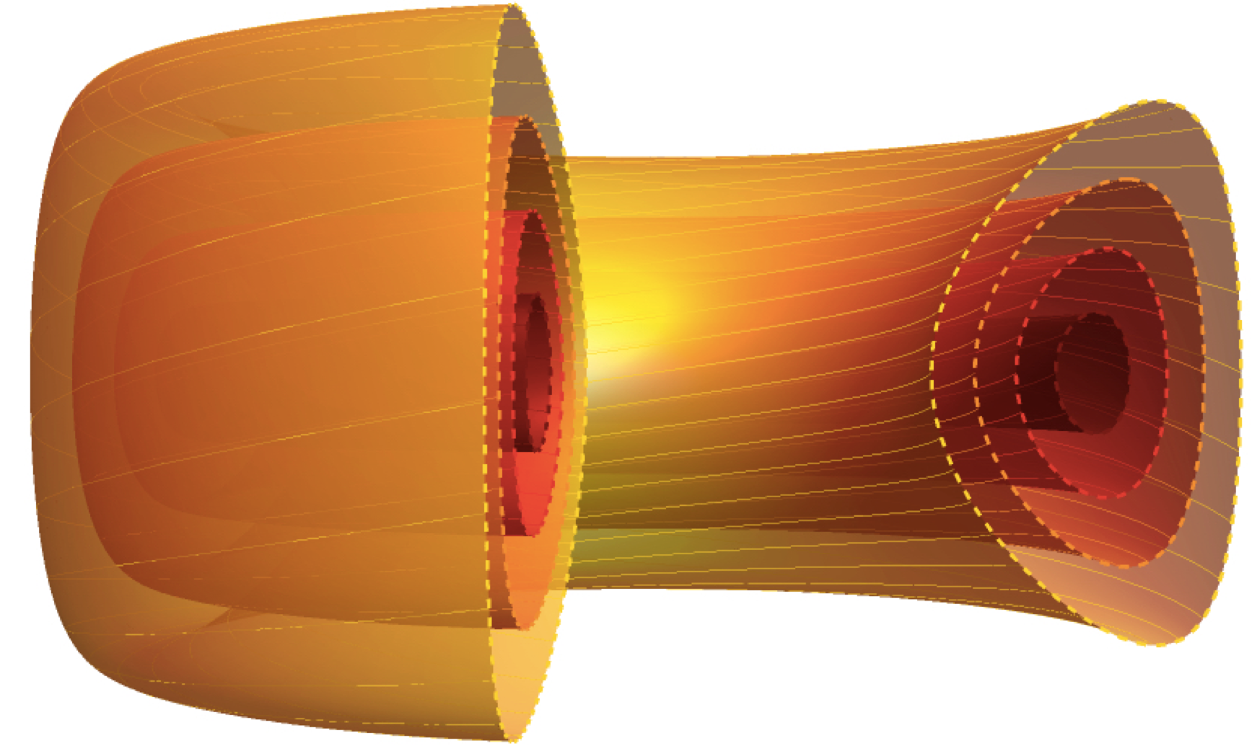
TSVV 2 on negative triangularity - administration
TSVV 2 is on schedule and unaffected by the delays/cuts to the advanced computing hubs
Obtained sufficient computational resources for the planned work
Planned activities and schedule for 2022 still look good
Links with WPTE RT07 experimental project on negative triangularity have been established in the form of monthly shared topical group meetings
Experimental time for WPTE RT07 would be helpful
J. Ball

Slide 5
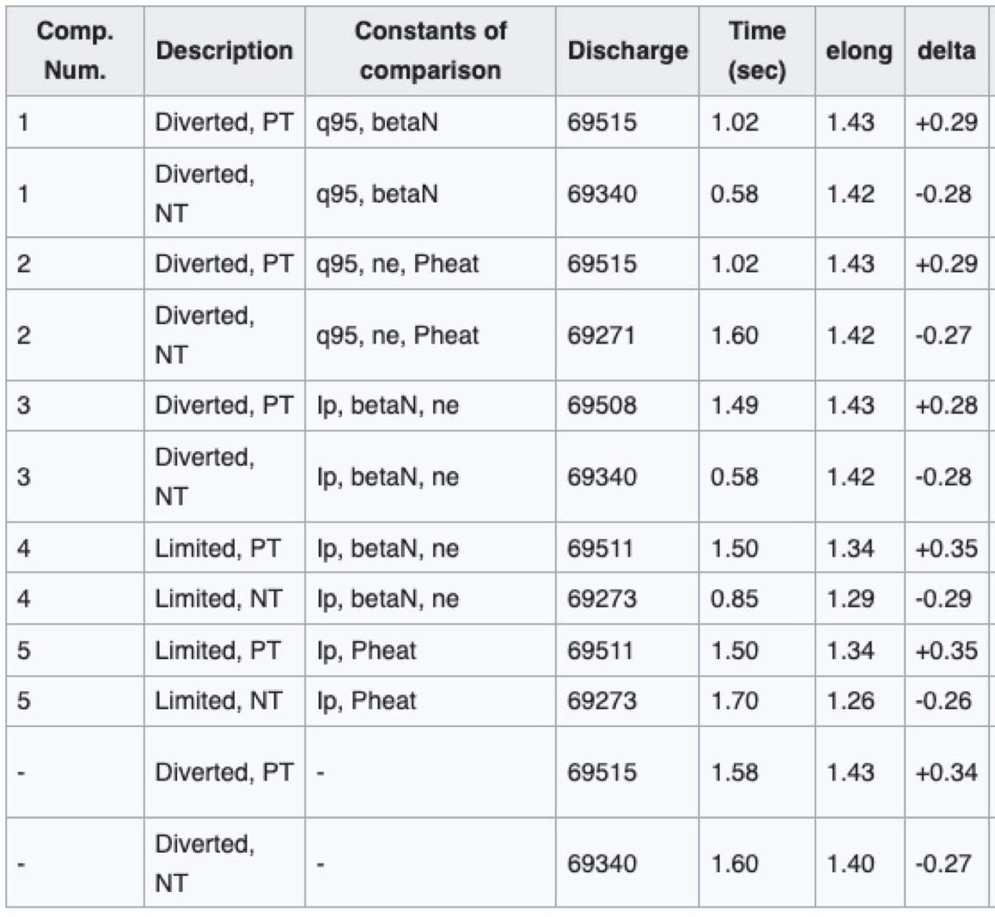
TSVV 2 on negative triangularity - science
TCV shots have been performed in order to hold particular quantities (e.g. heating power, density, beta) fixed between positive and negative triangularity
From these discharges, a common set of twelve TCV equilibria have been established and distributed to the team (see wiki)
Already one paper has been submitted (a study of zonal flow saturation in view of developing reduced models for negative triangularity) and a conference contribution has been made (a gyrokinetic investigation identifying the important geometrical properties of negative triangularity)
J. Ball

Slide 6
TSVV11-Project structure has been set-up
WP1: HFPSeu Workflow orchestration and module coupling framework (coordinator: F.J. Casson, 2.5 ppy incl. 1.5 ACH)
WP2: HFPSeu key physics modules validation (3.5 ppy incl. 1 from ACH)
WP2-D1 Turbulent transport reduced models targeted validation (coordinator: Y. Camenen)
WP2-D2 Core-edge-SOL coupling targeted validation (coordinator : C. Bourdelle)
WP2-D3: Impurity transport, development of reduced models, verification and targeted validation (coordinator: C. Angioni)
WP2-D4: MHD modules targeted validation (coordinator: P. Maget)
WP2-D5: Plasma initiation (Breakdown and burn-through and MHD equilibrium) integration and validation (coordinator: J-F Artaud)
WP3-HFPSeu full pulse modelling capability demonstration (coordinator: E. Fable, 2 ppy)
WP4-HFPSeu systematic validation (coordinator: A. Ho, 1ppy incl. 0.5 from ACH)
WP5- HFPSeu initial ITER phase modelling (coordinator: J. Citrin, total effort 0.5 ppy)
[C. Bourdelle et al. ]

Slide 7
TSVV11- Project status
TSVV11 activities have started well despite an imposed late start in 2021.
Communication using both our wikipages to archive meeting’s minutes and a slack channel for daily technical discussions.
HFPSeu Workflow orchestration and module coupling framework:
the coordination is now built with the ACH in Poznan with names on both TSVV11 and ACH sides on each subtasks for 2021 and 2022
The containerization of the HFPS (JINTRAC-IMAS) is on-going, this is a key step to make it available on the Gateway
HFPSeu key physics modules validation activities are also very active
gathered expertises under the TSVV11 umbrella is actively discussed in order to make choices on the short term on the HFPSeu development (pedestal models, SOL models etc).
HFPSeu systematic validation has started, the interaction with the VTT ACH as well.
It is foreseen to deploy a simulation database on the Gateway.
[C. Bourdelle et al. ]

Slide 8
Key risks and issues
Gateway Project Implementation Agreement does not cover ENEA/CINECA support to some project requests: installation of software or setup/maintenance of svn/git /storage on Gateway
Issue to be raised at the HPC Programme Committee ?
TSVV11 request for the gateway easy-to-access storage of 5TB has been made: Urgently needed for the simulation database; status of these requests ?
TSVV11 progress will also rely on the development of reduced models in the other TSVVs
Cross coordination on reduced model development required
Lack of support/resource for reduced model development on transport and ICRH
Meeting in persons is very important for the team building within the TSVV and with ACH
What is the mission budget allowed ? no feedback
Definition of the EUROfusion code standards has been proposed by the ACH in Poznan, what is its status?
If approved could it be officially circulated to all TSVV and ACH PI.
[C. Bourdelle et al. ]

Slide 9
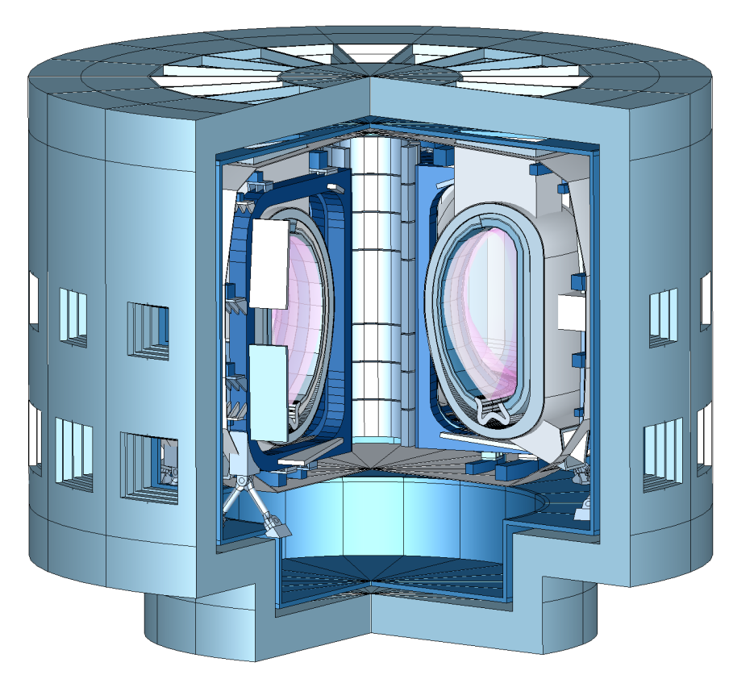
TSVV-14 Objectives
Multi-fidelity System Codes for EU-DEMO
Create open-source reactor design tool and framework
Merge BLUEPRINT (UKAEA) and MIRA (KIT) codes as foundation of project
Project runs 2021-2025
[J. Morris, M. Coleman, J. Cook, F. Franza, I. Maione, K. Maijeh, D. Short]

Slide 10
TSVV-14 Progress: Current Status
Merge of BLUEPRINT and MIRA has begun
Some issues have slowed down progress
Balance between long-term solutions vs. maintaining functionality in short-term
Migrating userbase over to new codebase imminent
Heavy underspend in 2021 due to a number of factors
Beginning work in May
Resource availability at KIT and UKAEA (primarily due to late start)
ACH meetings to discuss work with hub set up for Sept 2021
On course for open-source release in December
[J. Morris, M. Coleman, J. Cook, F. Franza, I. Maione, K. Maijeh, D. Short]

Slide 11
TSVV-14 Outlook 2022
Tasks for 2022 still appropriate
Some neutronics tasks might need to be reshuffled given reason below
Potential issue with resources due to author of MIRA code leaving KIT at end of 2021 (F. Franza)
KIT to organise replacement, but still likely to have an impact on delivery
Aim is to begin building community around BLUEMIRA after open-source release in December 2021
[J. Morris, M. Coleman, J. Cook, F. Franza, I. Maione, K. Maijeh, D. Short]

Slide 12
Back up

Slide 13
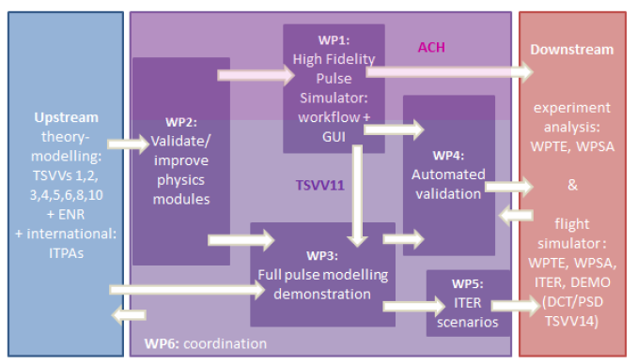
TSVV11
[C. Bourdelle et al. ]

