Slide 1

WP Plasma-Wall Interactions and Exhaust
Status 2021 / Plans 2022
Sebastijan Brezinsek
J.W. Coenen, A. Hakola, K. Schmid, A. Kirschner,
H. v. d. Meiden, J. Likonen, G. Calabro, M. Reinhart

Slide 2
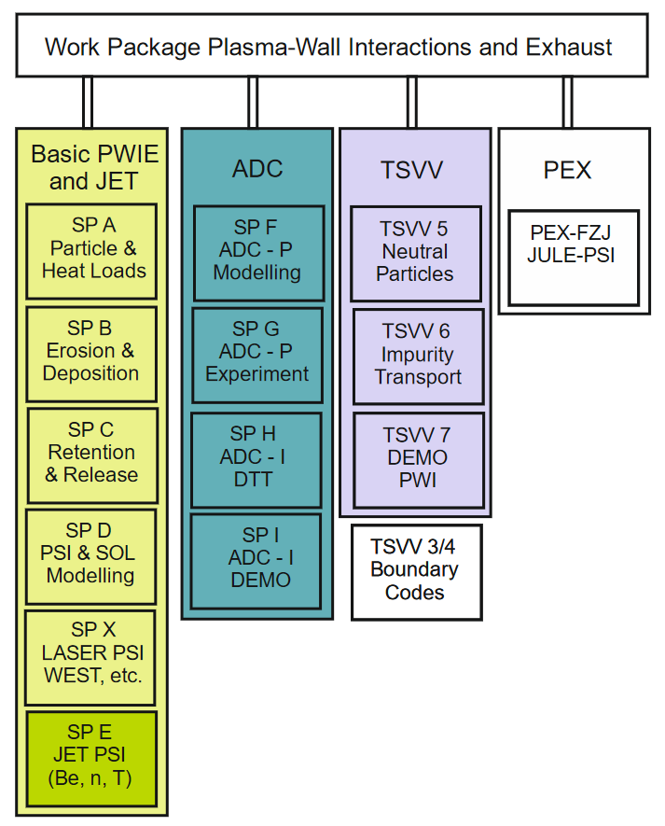
Boundary conditions
WP PWIE covers
  WP PFC activities (at reduced budget/y w.r.t. FP8)
  DTT-ADC physics activities (budget only for 2021/22)
  JET-2 activities (half FP8 budget/y limited to 2022/23)
TSVV related to PWIE (budget located in WP AC)
PEX-FZJ upgrade (budget located in WP PWIE)
WEST operation in TE (budget located in WP TE)
Slow start in 2021 with the organisation and funding
  New EUROfusion consortium / new grant / new structure
  Budget constraints
  Start of project in June (Project Board 22.06.21)
Slow start in 2021 with physics due to COVID 19
  Closure of labs in spring / reduced capabilities
  Completion of work from FP8 in spring 2021
  Tasks and budget defined May 2021
Most tasks within PWIE are defined for 2021 & 2022 to cope
with complex situation => RISK of shift of work if laboratories
can’t claim work in 2nd half of 2021 due to absence of grant
TSVV: Theory, Simulation, Verifcation and Validation tasks
PEX: Power EXhaust tasks

Slide 3
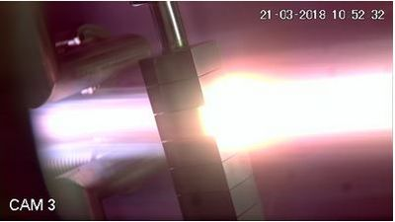
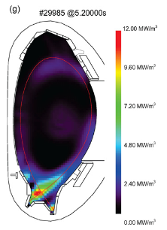
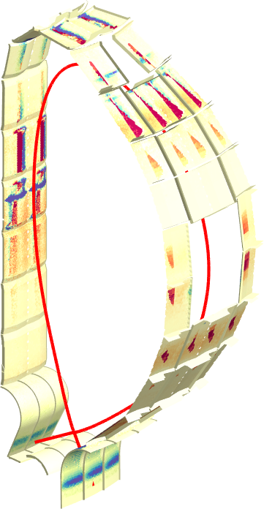
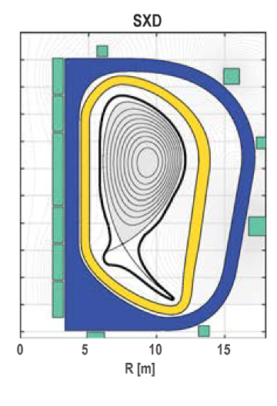
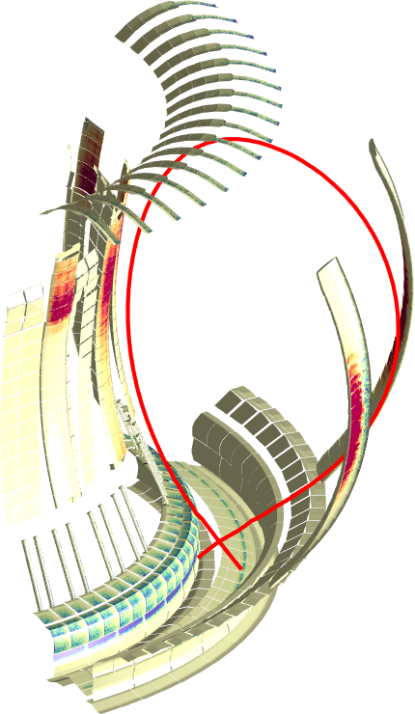
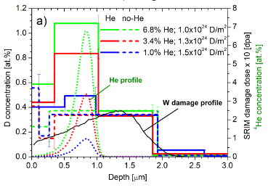
Plasma-Wall Interactions and Exhaust
Focus on ITER and DEMO materials, H and isotopes, He, seeding gases, and impurities
Particle and heat flux
Tungsten + Deuterium
Radiative divertor
Tungsten +
seed gas (Kr/N₂)
Advanced Divertor Solutions
Tungsten
Goal: steady-state operation
MAGNUM
AUG
DEMO
[T. Morgan]
JET
ITER
[M. Bernert]
[F. Militello]
[J. Romazanov]
[S. Markelj]
3D erosion & deposition modelling
Beryllium
Fuel (Tritium) retention
Tungsten + Deuterium/Helium

Slide 4
Role of WP PWIE in EUROfusion
Works hand in hand with FTD (DCT) in the area of DEMO exhaust solutions, PWI, and safety
Supports WP DIV in DTT divertor selection (modelling) and PFC qualification on plasma (DEMO, W7-X, etc.)
TSVV
Fusion Technology Department
Neutral Gas Dynamics
in the Edge
TSVV
WP MAT
WP DIV
WP DES
WP SAE
Plasma Exhaust:
Fluid/Gyrofluid Edge Codes
Impurity Sources,
Transport, and Screening
WP PWIE
Plasma Exhaust:
Gyrokinetic/Kinetic Edge Codes
Plasma-Wall Interaction
in DEMO
WP PrIO
WP TE
WP W7X
WP SA
Fusion Science Department
(Thrust 1)
(Thrust 2)
Works hand in hand with WP TE and WP W7X in the areas of PWI and PFC-compatible exhaust solutions
Executes post-mortem analysis of PFCs (WEST, AUG, W7-X, JET etc.) and associated interpretation

Slide 5
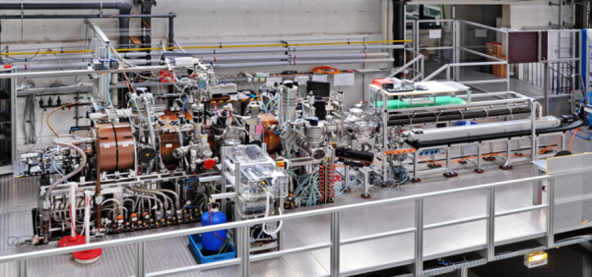
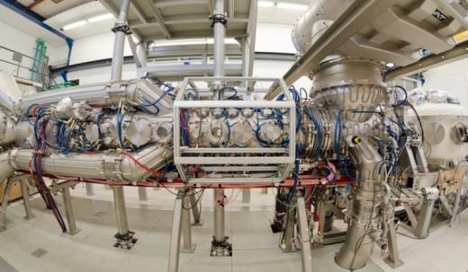
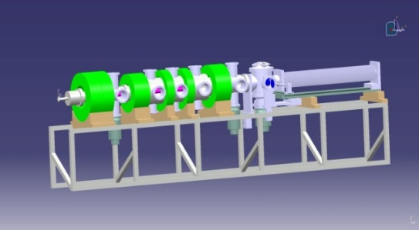
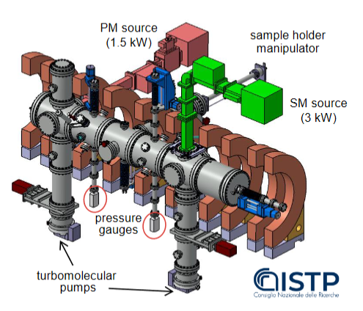
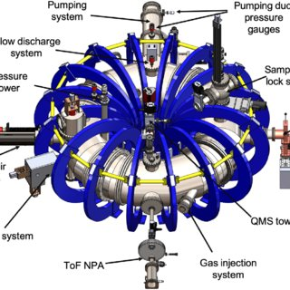
Plasma facilities within WP PWIE
PSI-2:
Medium flux and fluence
MAGNUM-PSI
and UPP:
High flux and
fluence
GyM:
Low flux and fluence
JULE-PSI:
Medium flux and fluence
[Be and T]
PEX 2023
TOMAS:
Wall conditioning and fuel removal

Slide 6
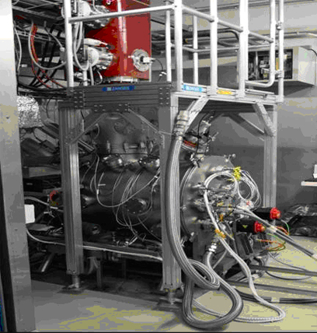
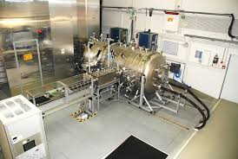
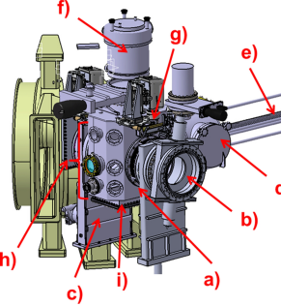
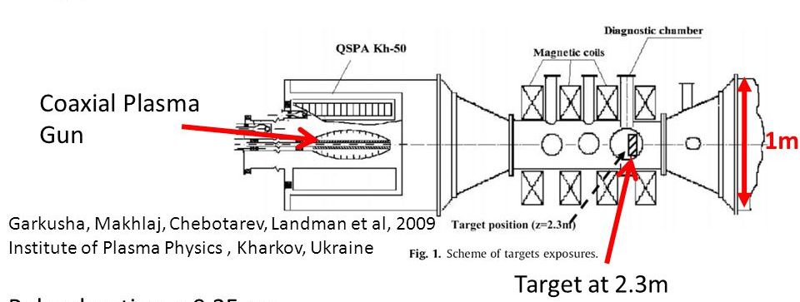
High heat flux facilities
JUDTIH 2 / 3 (PEX: Be & n)
E-beam:
Steady-state and transient loads
GLADIS
(Neutral Beam):
Steady-state load
QSPA / QSPA-m
Plasma Gun:
Transient loads
MAGNUM and PSI-2:
pulsed or laser for transients
OLMAT (at TJ-II)
(Neutral Beam):
Transient loads

Slide 7
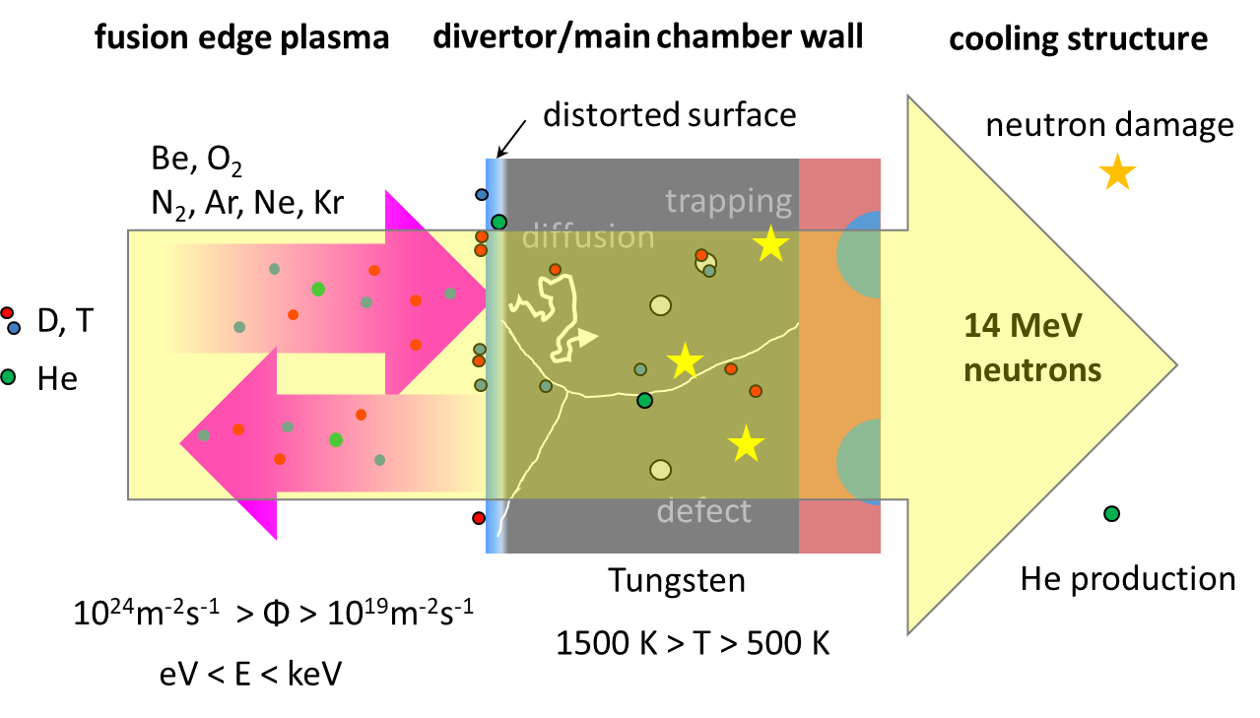
Basic physics studies
Re-crystallisation and morphology changes by plasma & heat load
Properties of re-deposited W and role of impurities
Effective sputtering yields and associated 3D effects
General dust studies and dust release mechanisms
Hydrogen in metals: impact of He and neutron/ion damage
Supersaturation and fuel exchange of hydrogen isotopes on metals
Atomic, molecular & surface processes relevant for/in detachment
Material mixing and segregation modelling
[T. Schwarz-Selinger]
In-situ ion-beam / laser-based analysis techniques in linear devices
In-vacuo material characterization (retention / material composition)
Feeds into predicitions for ITER and DEMO!
Priority list regularly adapted in annual work plans …

Slide 8
Contributions to ITER
WP PWIE supports ITER with experimental studies and modelling related to Roadmap Mission 2
Identification of topics according to ITER Research Plan, ITPA DivSOL, and direct interaction with IO
Reference program in grant application, but flexible to adapt urgent high priority items
WP PWIE supports ITER with experimental studies and modelling related to EUROfusion Mission 2
Identification of topics according to ITER Research Plan, ITPA DivSOL, and direct interaction with IO
Reference program in FP9 grant, but flexible to adapt urgent high priority items (e.g. limiter start-up )
Support ITER in lifetime estimations for the W divertor and Be first wall components [budget approach]
  Plasma (He, D) and high heat flux exposure of reference / pre-damaged / recrystallised materials
  High fluence experiments (MAGNUM-PSI, WEST) / repetitive loads / fatigue of W PFCs
Support ITER in fuel retention estimations and fuel recovery schemes [housekeeping approach]
  Tritium monitor diagnostic: retention location identification and quantification (LID-QMS and LIBS)
  Assessment of ITER tool box: baking, ICWC and ECWC, GDC including laboratory experiments (e.g. TOMAS)
Support ITER in material migration and dust production estimations
  Modelling of global material migration and transport to remote areas and ducts
  Layer stability assessment under consideration of intrinsic and extrinsic impurities

Slide 9
Contributions to DEMO
WP PWIE works hand in hand with the DEMO Central Team in the area of PWI and Exhaust
WP MAT provides plasma-facing materials and WP DIV provides plasma-facing components
Joint exploration and assessment of PEX solutions for DEMO with WP DES
Supports DEMO baseline scenario via WP DES: vital input to the conceptual design
  PSI modelling regarding first wall erosion under steady-state conditions and transients
  Re-deposited W layer stability and corresponding dust conversion factors
  Fuel inventory predictions based on implantation and neutron damage in W-based PFCs
Recommends alternative DEMO-compatible plasma exhaust solutions:
  Physics basis for alternative power exhaust solutions (highly radiative LSN divertor as reference / WP DES)
  Predictive plasma edge modelling for alternative divertor solutions and their exploitation (PEX)
  Technical realisation within the DEMO boundary conditions (together with WP DES)

Slide 10
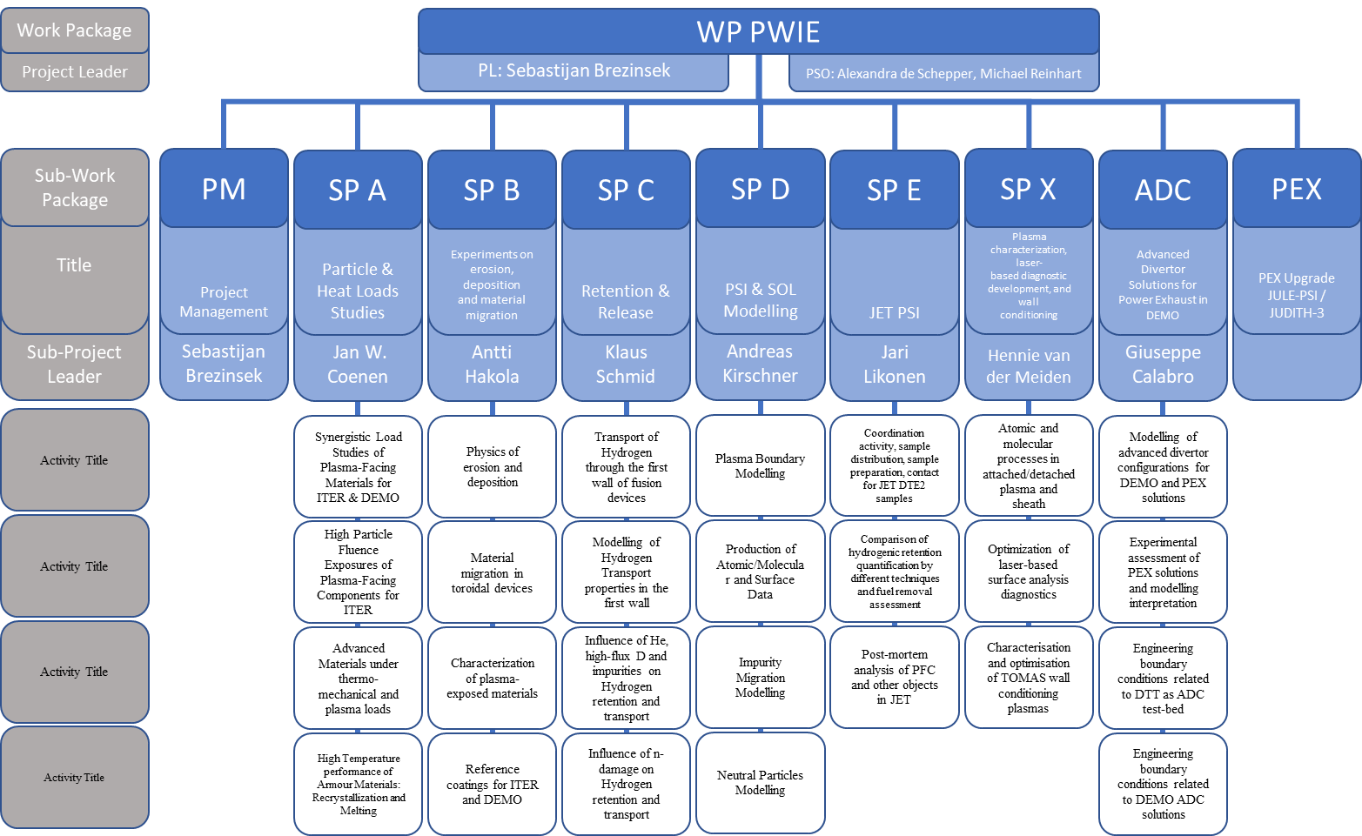
WP PWIE Structure 2021/2022
DPL for ADC: Giuseppe Calabro
Modelling of standard
and advanced divertor
configurations for DTT
New in 2022

Slide 11
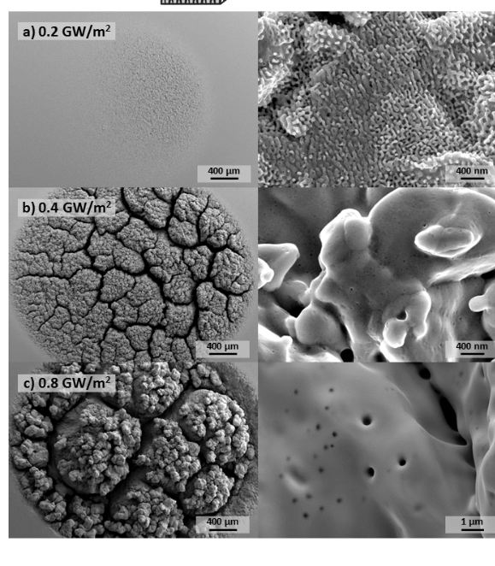
SP A.1: Synergistic particle and power load studies
Support qualification of baseline tungsten-based materials and materials beyond
Predict the power load capabilities and damage thresholds for materials in current and future fusion facilities
Task group 1: Establish test matrix for tungsten materials & study the impact of synergistic loads (incl. high cycling)
Task group 2: Qualify W materials for W7-X etc. on plasma
Task group 3: Study damage on edges of W MB in WEST / HHF facilities / Test of OLMAT
PSI-2 plasma exposure combined with transients.
FZJ
Completion of damage matrix and
additional materials/components in 2022!
Decision on OLMAT as test facility!
Main Deliverable 1: Document damage thresholds & understanding of damage mechanisms
Main Deliverable 2: Qualification of W heavy alloys / W VPS
Main Deliverable 3: Evolution of pre-damaged W material in WEST / HHF facilities
Human Resources: 48.5 PM
RU: DIFFER, FZJ, CIEMAT, MPG, KIPT
Link: WP TE, WP MAT, WP DIV
Facilities: PD 18 days, HHF 28 days, Ion beam 0 days

Slide 12
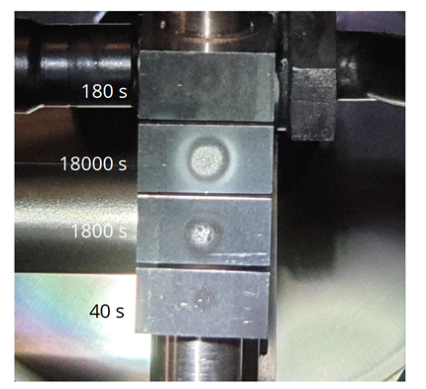
SP A.2: High particle fluence exposures
Study current baseline W material under high fluence and ELMy loading relevant for ITER
Study current and future baseline W materials under high fluence conditions relevant for DEMO
2/2021
Task group 1: Pre- and post analysis and DEMO MB exposure below damage conditions in MAGNUM-PSI
Task group 2: Pre- and post analysis of ITER MB exposure at damage conditions in MAGNUM-PSI
Additional exposure conditions for ITER-like MBs and additional DEMO materials in 2022!
Main Deliverable 1: Pre- and post characterization of DEMO-like MBs
Main Deliverable 2: Pre- and post characterization of ITER-like MBs
T_{surf}=2000K
Exposed in MAGNUM-PSI, DIFFER
Human Resources: 9 PM
RU: DIFFER, MPG
Link: WP TE, WP MAT/PRD, WP DIV
Facilities: PD 7 days, HHF 0 days, Ion beam 0 days
Notes:
Facilties: JUST GIVE the integral numbers for the groups
PD: Plasma devices (MAGNUM, PSI-2, UPP, TOMAS, GyM)
HHF: JUDITH, GLADIS, QSPA, OLMAT
Analysis station: Ion beam
If Facilties, Modelling, Link not applicable, remove the lines. I assume that it is EITHER EXPERIMENT or MODELLING, thus 1 more line for TASKS or Deliveables.

Slide 13
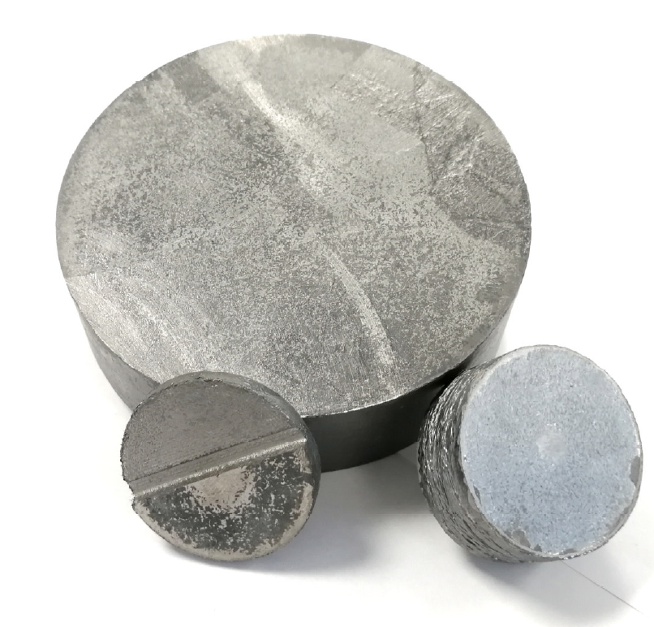
SP A.3: Qualification of advanced W materials
Develop qualification methods for advanced materials for ITER & beyond by different thermomechanical test procedures, heat load treatment techniques, and laboratory experiments as well as linear plasma exposure
Task group 1: Plasma qualification of new materials (WP MAT) and components (WP DIV) for DEMO
Task group 2: Study of basic thermo-mechanical properties for advanced materials for divertor applications
Task group 3: Post-mortem analysis to characterize the induced surface and microstructure modifications
Additional qualifications and testing of PRD and MAT materials in 2022!
Preparation of exposure of samples/PFCs in toroidal plasma facilities!
Main Deliverable 1: Analysis& Performance of Advanced Materials under Various HHF conditions
Main Deliverable 2: Characterization of medium size samples e.g. irradiation incl. W Wire
Main Deliverable 3: Analysis of Microstructural Changes
W-Composites (FZJ)
Human Resources: 9 PM
RU: FZJ, DIFFER, KIPT, MPG, ERM/KMS
Link: WP TE, WP MAT/PRD, WP DIV
Facilities: PD 15 days, HHF 19 days, Ion beam 10 days
Notes:
Facilties: JUST GIVE the integral numbers for the groups
PD: Plasma devices (MAGNUM, PSI-2, UPP, TOMAS, GyM)
HHF: JUDITH, GLADIS, QSPA, OLMAT
Analysis station: Ion beam
If Facilties, Modelling, Link not applicable, remove the lines. I assume that it is EITHER EXPERIMENT or MODELLING, thus 1 more line for TASKS or Deliveables.

Slide 14
SP A.4: Performance of PFCs under high temperature
Study of disruptions and melting and its effect on plasma performance and lifetime of Be and W PFCs
Effect of W re-crystallisation on material properties in view of ITER and DEMO application
Task group 1: Study of re-crystallisation of W materials under various exposure conditions
Task group 2: Analysis of melt exposures linked to WP TE experiments and code qualification (WEST / AUG)
Task group 3: PFC heat load modelling and simulations of disruption mitigation
Continuation of re-crystalisation studies in 2022!
Modelling of new WP TE experiments with MEMOS-U?
TOKES refactoring transferred to EEG grant
Main Deliverable 1: Analysis of recrystallisation mechanisms linked to exposures in SPA.1 & Laboratory experiments
Main Deliverable 2: Validation of MEMOS-U code
Main Deliverable 3: Validation of models for high heat flux (transient) induced damages in ITER and DEMO
Melt Layer Modelling with act. cooling
Human Resources: 9 PM
RU: CEA, DTU,VR, JSI, KIPT, FZJ
Link: WP TE, WP MAT/PRD, WP DIV
Facilities: PD 0 days, HHF 5 days, Ion beam 0 days
Modelling: TOKES, MEMOS
Notes:
Facilties: JUST GIVE the integral numbers for the groups
PD: Plasma devices (MAGNUM, PSI-2, UPP, TOMAS, GyM)
HHF: JUDITH, GLADIS, QSPA, OLMAT
Analysis station: Ion beam
If Facilties, Modelling, Link not applicable, remove the lines. I assume that it is EITHER EXPERIMENT or MODELLING, thus 1 more line for TASKS or Deliveables.

Slide 15
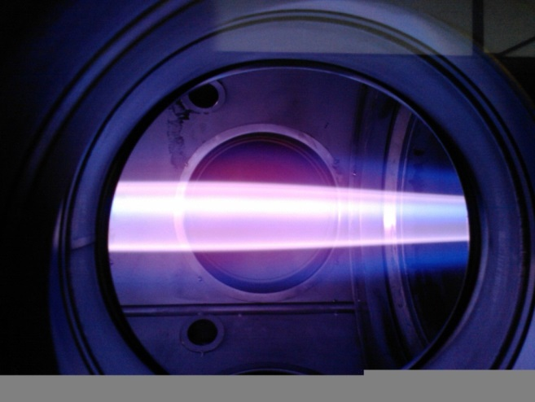
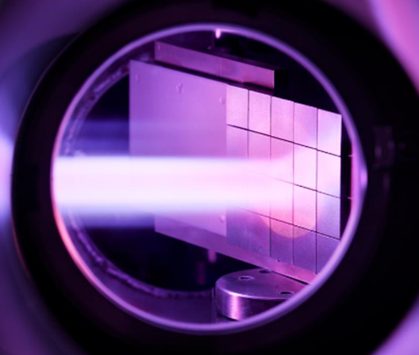
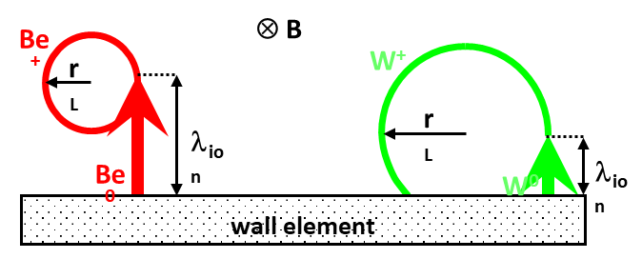
SP B.1: Physics of erosion and deposition
Provide insights into the physics mechanisms behind erosion and re-deposition in fusion reactors
Information obtained from experiments in linear devices and via laboratory studies
PSI-2
MAGNUM-PSI
Task group 1: Influence of plasma parameters and surface morphology on erosion: MAGNUM-PSI, PSI-2, and GyM
Task group 2: Sputtering properties of W model systems with different morphologies and of W re-deposits: lab experiments
Task group 3: Surface erosion by dust impacts and formation of dust during air and water leaks
Continuation in 2022 with additional sample and plasma conditions!
Input for SP D modelling!
Main Deliverable 1: Sputtering yield of W model systems and structure of re-deposited layers, data from linear devices
Main Deliverable 2: Effective sputtering yield of W model systems and W re-deposits following exposure to ion beams
Main Deliverable 3: Composition of Be and W dust formed during air and water leaks
Human Resources: 25 PM
RU: DIFFER, ENEA, FZJ, IAP, ÖAW, VR
Link: WP TE, WP MAT, WP DIV, TSVV 7
Facilities: PD 34 days, HHF 0 days, Ion beam 11 days
Notes:
Facilties: JUST GIVE the integral numbers for the groups
PD: Plasma devices (MAGNUM, PSI-2, UPP, TOMAS, GyM)
HHF: JUDITH, GLADIS, QSPA, OLMAT
Analysis station: Ion beam
If Facilties, Modelling, Link not applicable, remove the lines. I assume that it is EITHER EXPERIMENT or MODELLING, thus 1 more line for TASKS or Deliveables.

Slide 16
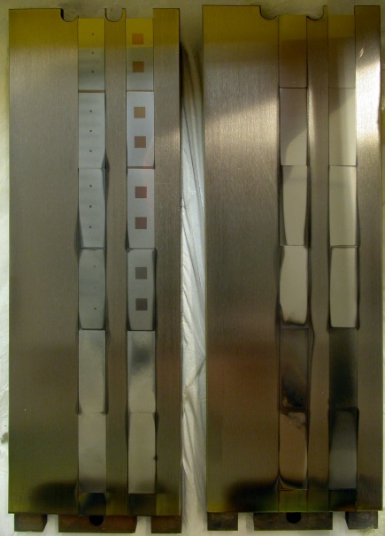
SP B.2: Material migration in toroidal devices
Determine erosion, re-deposition and material migration in toroidal devices (AUG, WEST, W7-X)
Information obtained from post-exposure analyses of tiles or samples removed from the devices
Task group 1: Balance between gross and net erosion and the influence of surface roughness on erosion and re-deposition
Task group 2: Erosion and (re-)deposition pattern on WEST plasma-facing units during He campaign
Task group 3: Erosion of wall components and migration of tracer impurities during OP 1.2b of W7-X
Continuation in 2022 for single condition experiments (e.g. W-7X W samples! )
WEST He samples delayed!
Input for SP D modelling!
Main Deliverable 1: Erosion and re-deposition patterns on selected WEST PFUs after He campaign
Main Deliverable 2: Balance between gross and net erosion of W in L- and H-mode plasma experiments on AUG
Main Deliverable 3: Characterization of marker samples and coatings from plasma experiments on AUG, WEST, and W7-X
AUG
Human Resources: 22 PM
RU: CEA, FZJ, IPPLM, JSI, MPG, RBI, VR, VTT
Link: WP TE, WP W7X, TSVV 7
Facilities: PD 0 days, HHF 0 days, Ion beam 28 days
Notes:
Facilties: JUST GIVE the integral numbers for the groups
PD: Plasma devices (MAGNUM, PSI-2, UPP, TOMAS, GyM)
HHF: JUDITH, GLADIS, QSPA, OLMAT
Analysis station: Ion beam
If Facilties, Modelling, Link not applicable, remove the lines. I assume that it is EITHER EXPERIMENT or MODELLING, thus 1 more line for TASKS or Deliveables.

Slide 17
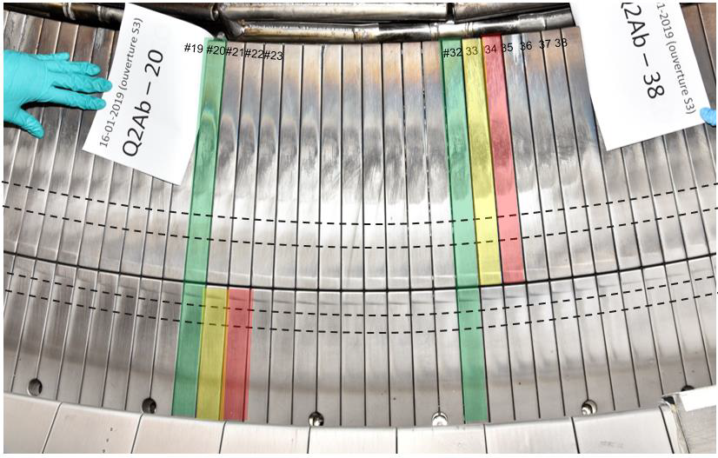
SP B.3: Characterization of plasma-exposed materials
As SP B.2, deals with analyses of PFC tiles from toroidal devices, but focus on steady-state operation
Clarify formation of deposits, retention of plasma fuel, and surface modifications of PFCs (mainly W)
Task group 1: Post-exposure analyses of PFUs from WEST Phase 1 and pre-characterization of PFUs for Phase 2
Task group 2: Surface changes as well as erosion/deposition and fuel retention profiles on AUG and W7-X tiles
Task group 3: Surface changes and formation of re-deposits on reference samples, following exposure in linear devices
Continuation in 2022 - campaign integrated conditions!
Input for SP D modelling!
Main Deliverable 1: Database on ageing, erosion, and fuel-retention behavior of selected WEST PFUs (ripple effect)
Main Deliverable 2: Surface analyses of selected AUG and W7-X divertor and first wall tiles
Main Deliverable 3: Characterization of selected reference coatings and plasma-exposed samples
WEST (marker tiles)
Human Resources: 20 PM
RU: CEA, FZJ, IPPLM, IST, JSI, MPG, NCSRD, VTT
Link: WP TE, WP W7X
Facilities: PD 0 days, HHF 0 days, Ion beam 20 days
Notes:
Facilties: JUST GIVE the integral numbers for the groups
PD: Plasma devices (MAGNUM, PSI-2, UPP, TOMAS, GyM)
HHF: JUDITH, GLADIS, QSPA, OLMAT
Analysis station: Ion beam
If Facilties, Modelling, Link not applicable, remove the lines. I assume that it is EITHER EXPERIMENT or MODELLING, thus 1 more line for TASKS or Deliveables.

Slide 18
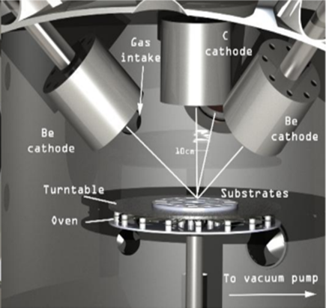
SP B.4: Reference layers (to mimic ITER and DEMO)
Production and characterization of reference layers simulating (re-)deposits predicted for ITER and DEMO
Included also production of marker layers for WP TE experiments and studies in other SPs
Task group 1: Production and characterization of W reference coatings and proxies for re-deposited layers
Task group 2: Production and characterization of Be reference coatings with varying properties
Task group 3: Identifying fuel-retention properties of the produced layers (fuel removal strategy for ITER)
Continuation of 2021 work in 2022
– mimic JET-like deposits and damaged W with high D content for LIBS/LID-QMS!
Input SP X experiments and SP D modelling!
Main Deliverable 1: W-based coatings with pre-defined properties produced for analyses and plasma experiments
Main Deliverable 2: Be-based coatings with pre-defined properties produced for analyses and plasma experiments
Main Deliverable 3: Fuel-retention characteristics of the produced layers
Production of Be layers
Human Resources: 25 PM
RU: CEA, CIEMAT, ENEA, IAP, IST, JSI, RBI, VTT
Link: N/A
Facilities: PD 0 days, HHF 0 days, Ion beam 11 days
Notes:
Facilties: JUST GIVE the integral numbers for the groups
PD: Plasma devices (MAGNUM, PSI-2, UPP, TOMAS, GyM)
HHF: JUDITH, GLADIS, QSPA, OLMAT
Analysis station: Ion beam
If Facilties, Modelling, Link not applicable, remove the lines. I assume that it is EITHER EXPERIMENT or MODELLING, thus 1 more line for TASKS or Deliveables.

Slide 19
SP C.1: Transport of Hydrogen through the first wall of fusion devices
Understand transport of hydrogen across surfaces and inter-material interfaces
Information obtained from experiments in linear devices and via laboratory studies
Task group 1: Dynamic Hydrogen inventory and influence of transients on retention
Task group 2: Permeation across material interfaces for relevant materials (W/Cu/EUROFER)
Task group 3: Release of Hydrogen into water compared to gas phase
A. Houben FZJ
Continuation of 2021 work in 2022!
T release into water shifted into 2022
=> CEA T laboratory costs!
Main Deliverable 1: Loading of W by Hydrogen plasma under ELM-like heat loads
Main Deliverable 2: Permeability variation in presence of material interfaces
Main Deliverable 3: Recombination / Dissociation parameters for water compared to gas phase.
Human Resources: total 46 PM
RU: CEA, DIFFER, FZJ, MPG, JSI, IPPLM, ÖAW, VR
Link: WP TE, WP MAT, WP SAE, TSVV 7
Facilities: PD 9 days, HHF 0 days, Ion beam 25 days
Modeling: TESSIM-X, MHIMS
Notes:
Facilties: JUST GIVE the integral numbers for the groups
PD: Plasma devices (MAGNUM, PSI-2, UPP, TOMAS, GyM)
HHF: JUDITH, GLADIS, QSPA, OLMAT
Analysis station: Ion beam
If Facilties, Modelling, Link not applicable, remove the lines. I assume that it is EITHER EXPERIMENT or MODELLING, thus 1 more line for TASKS or Deliveables.

Slide 20
SP C.2: Modelling of Hydrogen Transport properties in the first wall
Determine activation energies for transport across interfaces and surfaces
Explain effect of enhanced defect creation in the presence of Hydrogen
Task group 1: DFT calculation of Hydrogen on W-oxide surfaces
Task group 2: DFT calculation of Hydrogen in W in the presence of radiation defects
Task group 3: DFT calculation of Hydrogen W/Cu material interfaces
Continuation of 2021 work in 2022!
Main Deliverable 1: Activation energies for Hydrogen transport across W-oxide
Main Deliverable 2: Stress and strain as function of defect concentration and H amount
Main Deliverable 3: Energy landscape of H at a W/Cu material interface
AUG
Y. Ferro CEA
Human Resources: 15 PM
RU: CEA, UKAEA
Link: TSVV 7
Facilities: PD 0 days, HHF 0 days, Ion beam 0 days
Notes:
Facilties: JUST GIVE the integral numbers for the groups
PD: Plasma devices (MAGNUM, PSI-2, UPP, TOMAS, GyM)
HHF: JUDITH, GLADIS, QSPA, OLMAT
Analysis station: Ion beam
If Facilties, Modelling, Link not applicable, remove the lines. I assume that it is EITHER EXPERIMENT or MODELLING, thus 1 more line for TASKS or Deliveables.

Slide 21
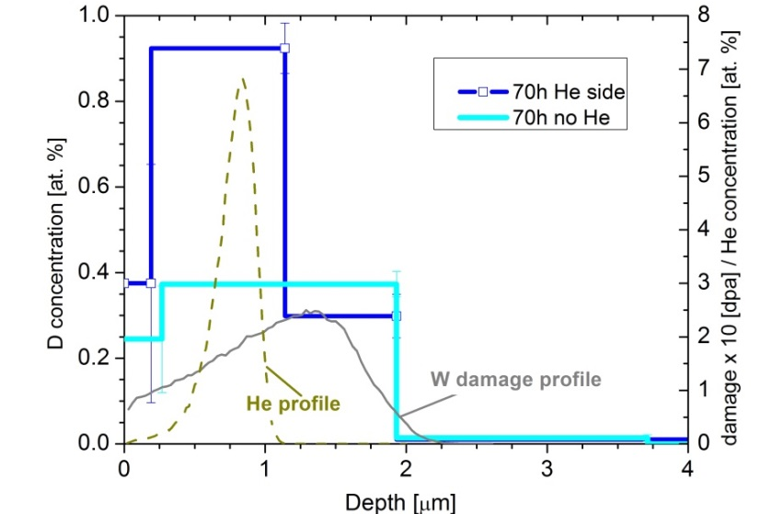
SP C.3: Influence of He, high-flux D and impurities on H retention & transport
Understand the influence of typical impurity layers (C, O) on Hydrogen uptake and release
Investigate the influence of He on retention and release for W or steels
Task group 1: Influence defects on He retention in Tungsten
Task group 2: Influence of retained He in W on Hydrogen retention
Task group 3: Influence of surface state on Hydrogen uptake from gas phase, atom-beam or plasma.
S. Markelj, JSI
Continuation of 2021 work in 2022 and inclusion of seed impurities!
Main Deliverable 1: Difference in He retention in defect free and e-beam damaged W
Main Deliverable 2: Influence of near surface He implantation on D release
Main Deliverable 3: Uptake of D through oxide films as function of temperature and thickness
Human Resources: 23 PM
RU: MPG, JSI, ENEA
Link: WP TE, WP MAT, TSVV 7
Facilities: PD 0 days, HHF 0 days, Ion beam 33 days
Notes:
Facilties: JUST GIVE the integral numbers for the groups
PD: Plasma devices (MAGNUM, PSI-2, UPP, TOMAS, GyM)
HHF: JUDITH, GLADIS, QSPA, OLMAT
Analysis station: Ion beam
If Facilties, Modelling, Link not applicable, remove the lines. I assume that it is EITHER EXPERIMENT or MODELLING, thus 1 more line for TASKS or Deliveables.

Slide 22
SP D.1: Plasma boundary modelling
Production of background plasma parameters to be used for migration modelling
Covering specific experiments as well as predictive modelling e.g. for ITER, DEMO or JULE-PSI
Task group 1: Modelling of background plasmas for toroidal devices (WEST, AUG, JET-ILW, W7-X)
Task group 2: Modelling of background plasmas for linear devices (MAGNUM-PSI, GyM, PSI-2)
Task group 3: Modelling of near-surface plasma parameters (characterisation of the sheath)
SOLEDGE2D modelling for WEST (CEA)
Continuation of 2021 activities in 2022 with
plasma backgrounds for dedicated PWI experiments (He, tracer, roughness etc)!
Main deliverable 1: Background plasma parameters for toroidal devices
Main deliverable 2: Background plasma parameters for linear devices
Main deliverable 3: Sheath-related parameters
Human Resources: 22 PM
RU: CEA, DIFFER, ENEA. FZJ, IPP.CR, VR, VTT
Link: WP TE, WP W7X, WP JET, TSVV 5-7
Modelling: SOLEDGE3X-EIRENE, SOLPS, EMC3-EIRENE, PIC-based codes, …
Notes:
Facilties: JUST GIVE the integral numbers for the groups
PD: Plasma devices (MAGNUM, PSI-2, UPP, TOMAS, GyM)
HHF: JUDITH, GLADIS, QSPA, OLMAT
Analysis station: Ion beam
If Facilties, Modelling, Link not applicable, remove the lines. I assume that it is EITHER EXPERIMENT or MODELLING, thus 1 more line for TASKS or Deliveables.

Slide 23
SP D.2: Production of atomic/molecular & surface data
Generation of ionization, dissociation, recombination and excitation data
Production of erosion yields and reflection coefficients
Task group 1: Calculation of erosion and reflection data considering redeposited material and morphology effects. Focus on tungsten
Task group 2: Development of dust formation models, including molten metal and droplet ejection
Task group 3: Calculation of rate coefficients, in particular for detached conditions
Setup of fuzz-like structure for MD (VTT)
Continuation of 2021 activities in 2022 with
update of data at low energies!
Main deliverable 1: Erosion and reflection database. considering morphology, roughness, fuzz and redeposits
Main deliverable 2: Dust formation models for fusion needs
Main deliverable 3: Updated atomic/ molecular database
Human Resources: 24 PM
RU: CEA, FZJ, ÖAW, VR, VTT, MPG
Link: WP TE, WP JET, TSVV 5-7
Modelling: MD-based codes, BCA-based codes (SDTrimSP, …)
Notes:
Facilties: JUST GIVE the integral numbers for the groups
PD: Plasma devices (MAGNUM, PSI-2, UPP, TOMAS, GyM)
HHF: JUDITH, GLADIS, QSPA, OLMAT
Analysis station: Ion beam
If Facilties, Modelling, Link not applicable, remove the lines. I assume that it is EITHER EXPERIMENT or MODELLING, thus 1 more line for TASKS or Deliveables.

Slide 24
SP D.3: Impurity migration modelling
Global and local impurity migration modelling in existing experiments and predictions e.g. for ITER
Dynamics of morphology in the context of impurity migration
Task group 1: Modelling of impurity migration (W, Be, C, N) in fusion-relevant devices (WEST, AUG, JET-ILW, W7-X, GyM, …) to PWI experiments and predictions to ITER
Task group 2: Modelling of morphology dynamics due to erosion/deposition in comparison to experimental results
ERO2.0 simulation for full-W ITER (FZJ)
Continuation of 2021 activities in 2022 with
interpretative and predictive migration modelling for various experiments: e.g. WEST, W-7X (tungsten) and ITER!
Main deliverable 1: Erosion/deposition pattern for dedicated experiments, predictive data for ITER. Spectroscopic information in comparison to experiments
Main deliverable 2: Morphology dynamics as result of plasma-wall interaction and comparison with experiments
Human Resources: 29 PM
RU: CEA, ENEA, FZJ, MPG, VTT
Link: WP TE, WP W7X, WP JET, TSVV 5-7
Modelling: WallDYN, ERO2.0
Notes:
Facilties: JUST GIVE the integral numbers for the groups
PD: Plasma devices (MAGNUM, PSI-2, UPP, TOMAS, GyM)
HHF: JUDITH, GLADIS, QSPA, OLMAT
Analysis station: Ion beam
If Facilties, Modelling, Link not applicable, remove the lines. I assume that it is EITHER EXPERIMENT or MODELLING, thus 1 more line for TASKS or Deliveables.

Slide 25
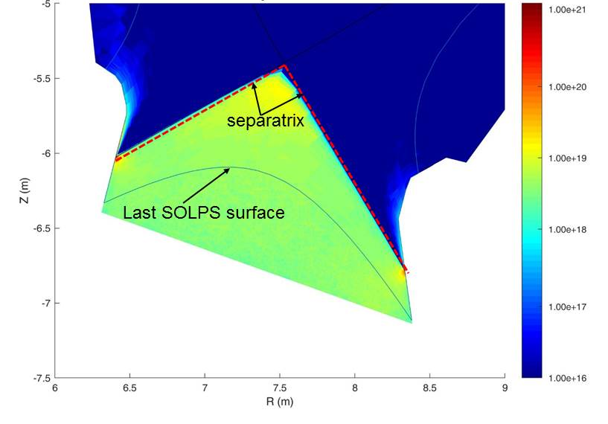
SP D.4: Neutral particles modelling
Modelling of neutrals to improve efficiency of pumping systems of fusion devices
Calculation of neutral fluxes along the first wall of fusion devices
Task group 1: Code development and modelling of gas dynamics and exhaust for DEMO.
Task group 2: Post-processing of plasma results to get neutral fluxes along the wall.
  SOLPS
DIVGAS optimisation
for DEMO
ADC
application (KIT)
Continuation of 2021 activities in 2022 with focus to complete DIVGAS update for DEMO ADC application!
EIRENE post-processing for JET first wall neutral flux distribution for SP E!
Main deliverable 1: Updated version of DIVGAS code. DIVGAS modelling for DEMO SN and ADC divertor.
Main deliverable 2: Atomic and ion fluxes to the first wall:
3D angular and energy distribution of atoms e.g. for JET
  DIVGAS
Human Resources: 11 PM
RU: KIT, VTT
Link: WP TE, WP DES, WP JET, TSVV 5-7
Modelling: DIVGAS, SOLPS-ITER, EIRENE, OSM-EIRENE
Notes:
Facilties: JUST GIVE the integral numbers for the groups
PD: Plasma devices (MAGNUM, PSI-2, UPP, TOMAS, GyM)
HHF: JUDITH, GLADIS, QSPA, OLMAT
Analysis station: Ion beam
If Facilties, Modelling, Link not applicable, remove the lines. I assume that it is EITHER EXPERIMENT or MODELLING, thus 1 more line for TASKS or Deliveables.

Slide 26
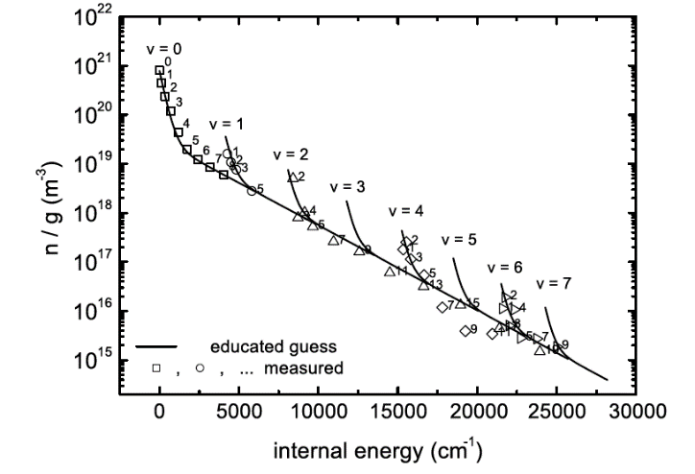
SP X.1: Atomic and molecular processes in attached/detached plasmas and sheath effects
Distribution of ro-vibrationally excited states of H₂ and its isotopes (electronic ground and excited states)
The role of plasma-neutral coupling in energy dissipation and momentum loss
Task group 1: Installation TALIF for measurement H-density
and isotopes. Concept design VUV-LIF/CARS in Magnum
and LIF in PSI-2 both for H₂ ro-vib. ground state distribution
Task group 2: VUV passive spectroscopy in PSI-2 and Magnum for ro-vib. H₂ ground state distribution
Task group 3: Ion/electron properties close to target at
ITER/DEMO-like plasmas for accurate power load estimations.
H₂(v) ground state population (TU/e)
Start of project partially delayed in 2021
=> Focus to produce best reference cases for EIRENE refactoring in 2022+ for TSVV 5
Main Deliverable 1: TALIF installed in MAGNUM-PSI, concep-tual designs LIF (PSI-2) and VUV-LIF/CARS (MAGNUM-PSI)
Main Deliverable 2: Comparison of H₂ ground and excited state population
Main Deliverable 3: CTS/TS results ion and electron properties MAGNUM-PSI and UPP: influence p-n coupling
Human Resources: 8 PM
RU: DIFFER, FZJ, CU
Link: TSVV 5, WP DES
Facilities: PD 13 days, HHF 0 days, Ion beam 0 days
Notes:
Facilties: JUST GIVE the integral numbers for the groups
PD: Plasma devices (MAGNUM, PSI-2, UPP, TOMAS, GyM)
HHF: JUDITH, GLADIS, QSPA, OLMAT
Analysis station: Ion beam
If Facilties, Modelling, Link not applicable, remove the lines. I assume that it is EITHER EXPERIMENT or MODELLING, thus 1 more line for TASKS or Deliveables.

Slide 27
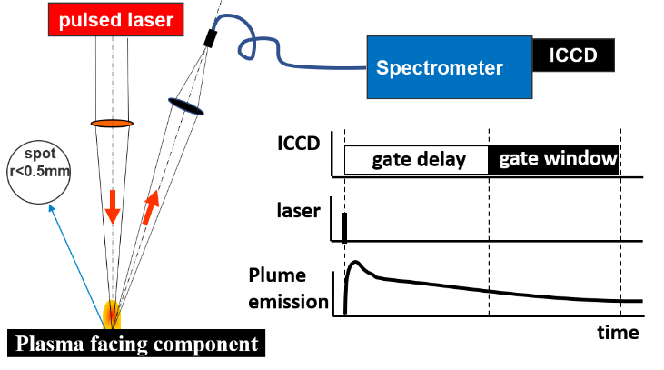
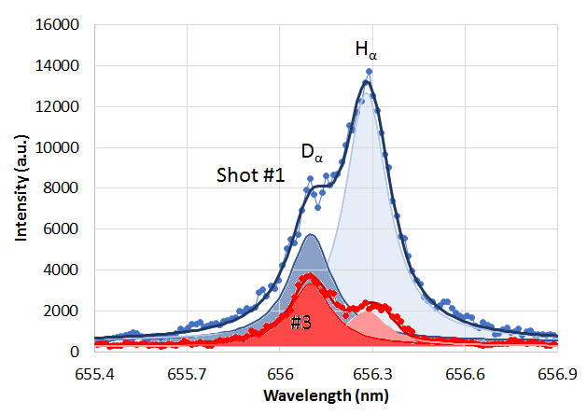
SP X.2: Optimization of laser-based surface analysis diagnostics
Optimization of laser techniques for the quantification of fuel content and material composition of PFCs
Qualification of laser techniques for operation in ITER (Be & W) and DEMO (W)
Task group 1: Comparison ps- vs. ns-LIBS and SP-LIBS vs. DP-LIBS regarding composition and D content sensitivity
Task group 2: In situ LIBS (+ NRA/RBS) in MAGNUM-PSI and LIBS (+LIA-QMS/EDX) in PSI-2 during/between plasma ops.
Task group 3: LID-QMS and CF-LIBS on Be-mixed coatings/layers with different percentage of fuel content
Continuation in 2022 with focus on
a) sensitivity enhancement of LIBS for D in W
b) in-operando qualification
No funding for LIBS on remote handling arm!
JET decision regarding exploitation of LID-QMS (construction) and LIBS (plans) pending => UKAEA?
Main Deliverable 1: Optimized conditions for LIBS in absolute content and depth resolution at pressures up to 1 bar
Main Deliverable 2: Influence of T_{surface} and impurities on absolute fuel retention and outgassing values
Main Deliverable 3: Absolute quantification of D and composition in Be-mixed layers (with depth resolution)
AUG
challenge: line separation
Human Resources: 39 PM
RU: CEA, DIFFER, ENEA, FZJ, IPPLM, CU, UT, ISSP UL
Link: WP JET-4 (LID-QMS) / T monitor
Facilities: PD 19 days, HHF 0 days, Ion beam 4 days
Notes:
Facilties: JUST GIVE the integral numbers for the groups
PD: Plasma devices (MAGNUM, PSI-2, UPP, TOMAS, GyM)
HHF: JUDITH, GLADIS, QSPA, OLMAT
Analysis station: Ion beam
If Facilties, Modelling, Link not applicable, remove the lines. I assume that it is EITHER EXPERIMENT or MODELLING, thus 1 more line for TASKS or Deliveables.

Slide 28
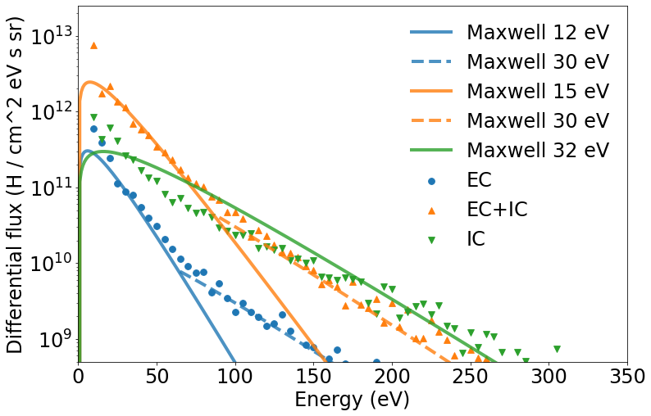


SP X.3: Characterization and optimization of TOMAS wall conditioning plasmas
Investigating effectiveness ICWC, ECWC and RF to “clean” plasma surfaces from impurities and fuel
Study the production and role of energetic neutrals and their impact on wall conditioning
Task group 1: Diagnostic upgrade and ECWC, ICWC, RF plasma characterisation in TOMAS
Task group 2: Modelling TOMAS plasma to describe neutral particle conditions and optimise plasma efficiency/homogeneity
Task group 3: ECWC, ICWC, and GDC optimization for PFC cleaning in TOMAS using pre- and post characterised samples
Continuation of the work in 2022+ with focus on impurity removal (B layers) as well as link to laser diagnostics as tool to demonstrate efficiency!
Issue manpower! Link to ERG Goriaev!
Differential flux ($H^{0}$/ $cm^{2} eV s sr$)
Main Deliverable 1: Report plasma characterization TOMAS: neutral energies, probe and impurity OES data etcetera
Main Deliverable 2: Modeling of wall conditioning RF-based low temperature plasmas
Main Deliverable 3: Characterization of selected reference coatings and plasma-exposed samples
Energy ($eV$)
Moon et al., VR
Human Resources: 18 PM
RU: LPP-ERM/KMS, CIEMAT, FZJ, VR, KIPT
Link: WP TE, WP W7X
Facilities: PD 15 days, HHF 0 days, Ion beam 8 days
Modelling: Wall conditioning plasma modelling
Notes:
Facilties: JUST GIVE the integral numbers for the groups
PD: Plasma devices (MAGNUM, PSI-2, UPP, TOMAS, GyM)
HHF: JUDITH, GLADIS, QSPA, OLMAT
Analysis station: Ion beam
If Facilties, Modelling, Link not applicable, remove the lines. I assume that it is EITHER EXPERIMENT or MODELLING, thus 1 more line for TASKS or Deliveables.

Slide 29
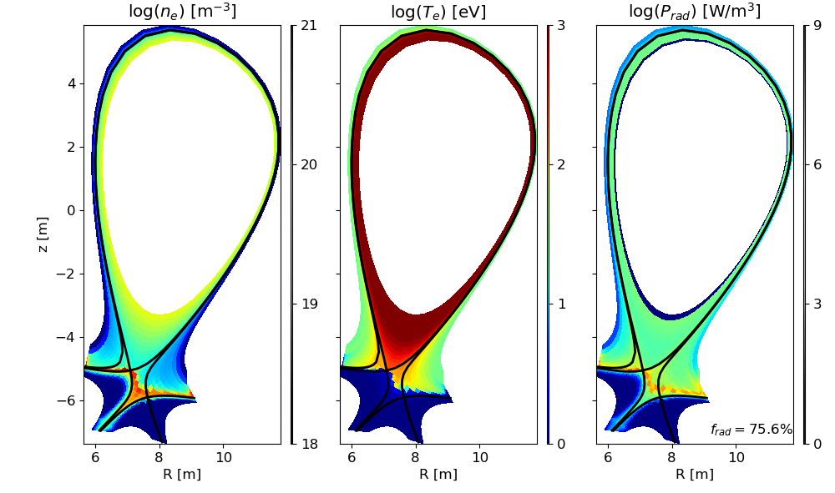
SP-ADC.F: Modelling of ADCs
Verify/increase credibility of the predicted benefits of the various ADCs for DEMO
Identify geometrical design choices, which can facilitate power exhaust in DEMO
Task group 1: Improvement of the neutral model used for XD and SX: Spatial hybrid / adv. fluid neutral / kinetic Eirene
Task group 2: Increased physics description for specific configurations: Drifts (XD, DN) and pedestal radiators (DN)
Task group 3: Completion of matrix scans for SF-
Task group 4: Start searching for optimal design choices:
e.g. leg dimensions in SX, Δrsep in SF-
All ADC acitivites for 2021-2022 fixed!
Main Deliverable 1: Understand driving mechanisms for in-out asymmetry in XD
Main Deliverable 2: Search for benefits of DN with pedestal radiation and drifts
Main Deliverable 3: Role of outer divertor leg width in SX
Main Deliverable 4: Identify operating space in SF-
Simplified DEMO simulations suggested benefits of XD and SX (less seeding)
EMC3-EIRENE
2021 modelling
L. Aho-Mantila, Ou et al., VTT, MPG
Human Resources: 26 PM
RU: ENEA, MPG, EPFL, VTT, IPPLM, LPP-ERM/KMS
Link: WP DES / DCT
Modelling: SOLPS-ITER
Notes:
Facilties: JUST GIVE the integral numbers for the groups
PD: Plasma devices (MAGNUM, PSI-2, UPP, TOMAS, GyM)
HHF: JUDITH, GLADIS, QSPA, OLMAT
Analysis station: Ion beam
If Facilties, Modelling, Link not applicable, remove the lines. I assume that it is EITHER EXPERIMENT or MODELLING, thus 1 more line for TASKS or Deliveables.

Slide 30
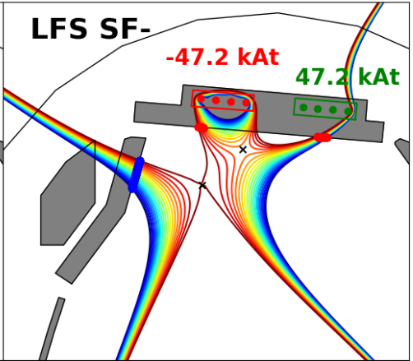
SP-ADC.G: Experimental assessment of PEX solutions and modelling interpretation
Improve the modelling accuracy, reliability and predictive capability for ADCs in particular in view of the high heat flux AUG PEX upgrade of DivIIo by testing codes against existing experiments
Task group 1: Validate/test EMC3-EIRENE against recent AUG experiments including XPR and ‘small divertor’ discharges
Task group 2: Validate/test EMC3-EIRENE & SOLPS against TCV SF configurations with an XPR (X Point Radiator)
All ADC acitivites for 2021-2022 fixed!
Main Deliverable 1: Comparison of experimental results and experimentally validated detachment models with simulations
Main Deliverable 2: Initial reduced model from experimental ADC edge simulations in 3D and experimental data to scaling laws applicable to DEMO size machine
T. Lund et al., MPG
Human Resources:10 pm
RU: CEA,IPP, EFPL
Link: WP TE (RT18)
Modelling: EMC3-EIRENE, SOLPS
Notes:
Facilties: JUST GIVE the integral numbers for the groups
PD: Plasma devices (MAGNUM, PSI-2, UPP, TOMAS, GyM)
HHF: JUDITH, GLADIS, QSPA, OLMAT
Analysis station: Ion beam
If Facilties, Modelling, Link not applicable, remove the lines. I assume that it is EITHER EXPERIMENT or MODELLING, thus 1 more line for TASKS or Deliveables.

Slide 31
SP-ADC.H: Engineering boundary conditions related to DTT as ADC test-bed
Electromagnetic modelling of alternative configurations for DTT
Controllability analysis of the alternative configurations
Double Null
Snowflake
Electromagnetic modelling
Support to the DTT physic activities under WPWIE in terms of definition of additional DTT plasma configurations
Magnetic control
Design of the preliminary shape and VS controllers for SN and alternative configurations for the analysis of disturbances and transients (LH and HL).
VDE and Disruptions
Analysis of the effects of VDE and MD of the plasma facing components
All ADC acitivites for 2021-2022 fixed!
X-divertor
Negative Triang
Resources:15 pm
RU: ENEA
Link: WP DIV / WP DES
Modelling: CREATE-NL, CREATE-L, MAXFREA, FIXFREE
Notes:
Facilties: JUST GIVE the integral numbers for the groups
PD: Plasma devices (MAGNUM, PSI-2, UPP, TOMAS, GyM)
HHF: JUDITH, GLADIS, QSPA, OLMAT
Analysis station: Ion beam
If Facilties, Modelling, Link not applicable, remove the lines. I assume that it is EITHER EXPERIMENT or MODELLING, thus 1 more line for TASKS or Deliveables.

Slide 32
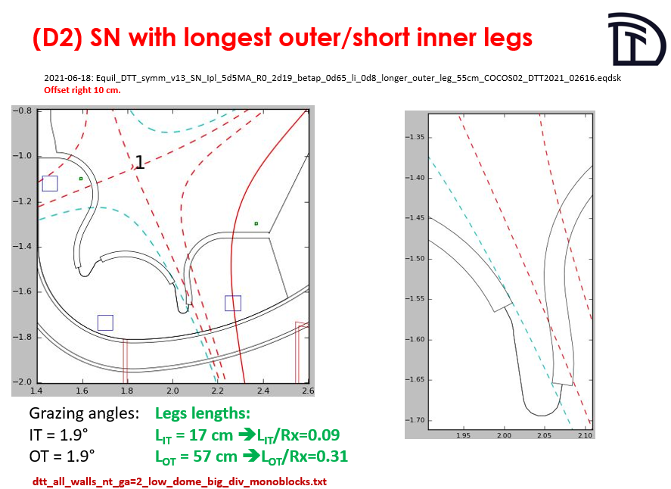
SP-ADC.J: Modelling in support of DTT divertor solution selection
Explore advanced divertor solutions for DTT by predictive modelling
Physics input to identify best compromise solution for lower divertor in DTT
Technological assumptions:
The reference case must allow DEMO standard SN
Divertor shape should be compatible with as much as possible divertor configurations
Divertor configurations must be compatible with DTT in terms of:
  Field coils available on DTT
  Divertor cassette maximum size
  Vessel size
  Foreseen pumping
  Actively cooled w mono-blocks constructions fixed
SHORT TERM ARRANGEMENT between
WP DIV and PWIE ..
P. Innocente et al.
Resources:24 pm
RU: ENEA
Link: WP DIV / WP DES
Modelling: SOLPS-ITER, SOLEDGE-EIRENE
Notes:
Facilties: JUST GIVE the integral numbers for the groups
PD: Plasma devices (MAGNUM, PSI-2, UPP, TOMAS, GyM)
HHF: JUDITH, GLADIS, QSPA, OLMAT
Analysis station: Ion beam
If Facilties, Modelling, Link not applicable, remove the lines. I assume that it is EITHER EXPERIMENT or MODELLING, thus 1 more line for TASKS or Deliveables.

Slide 33
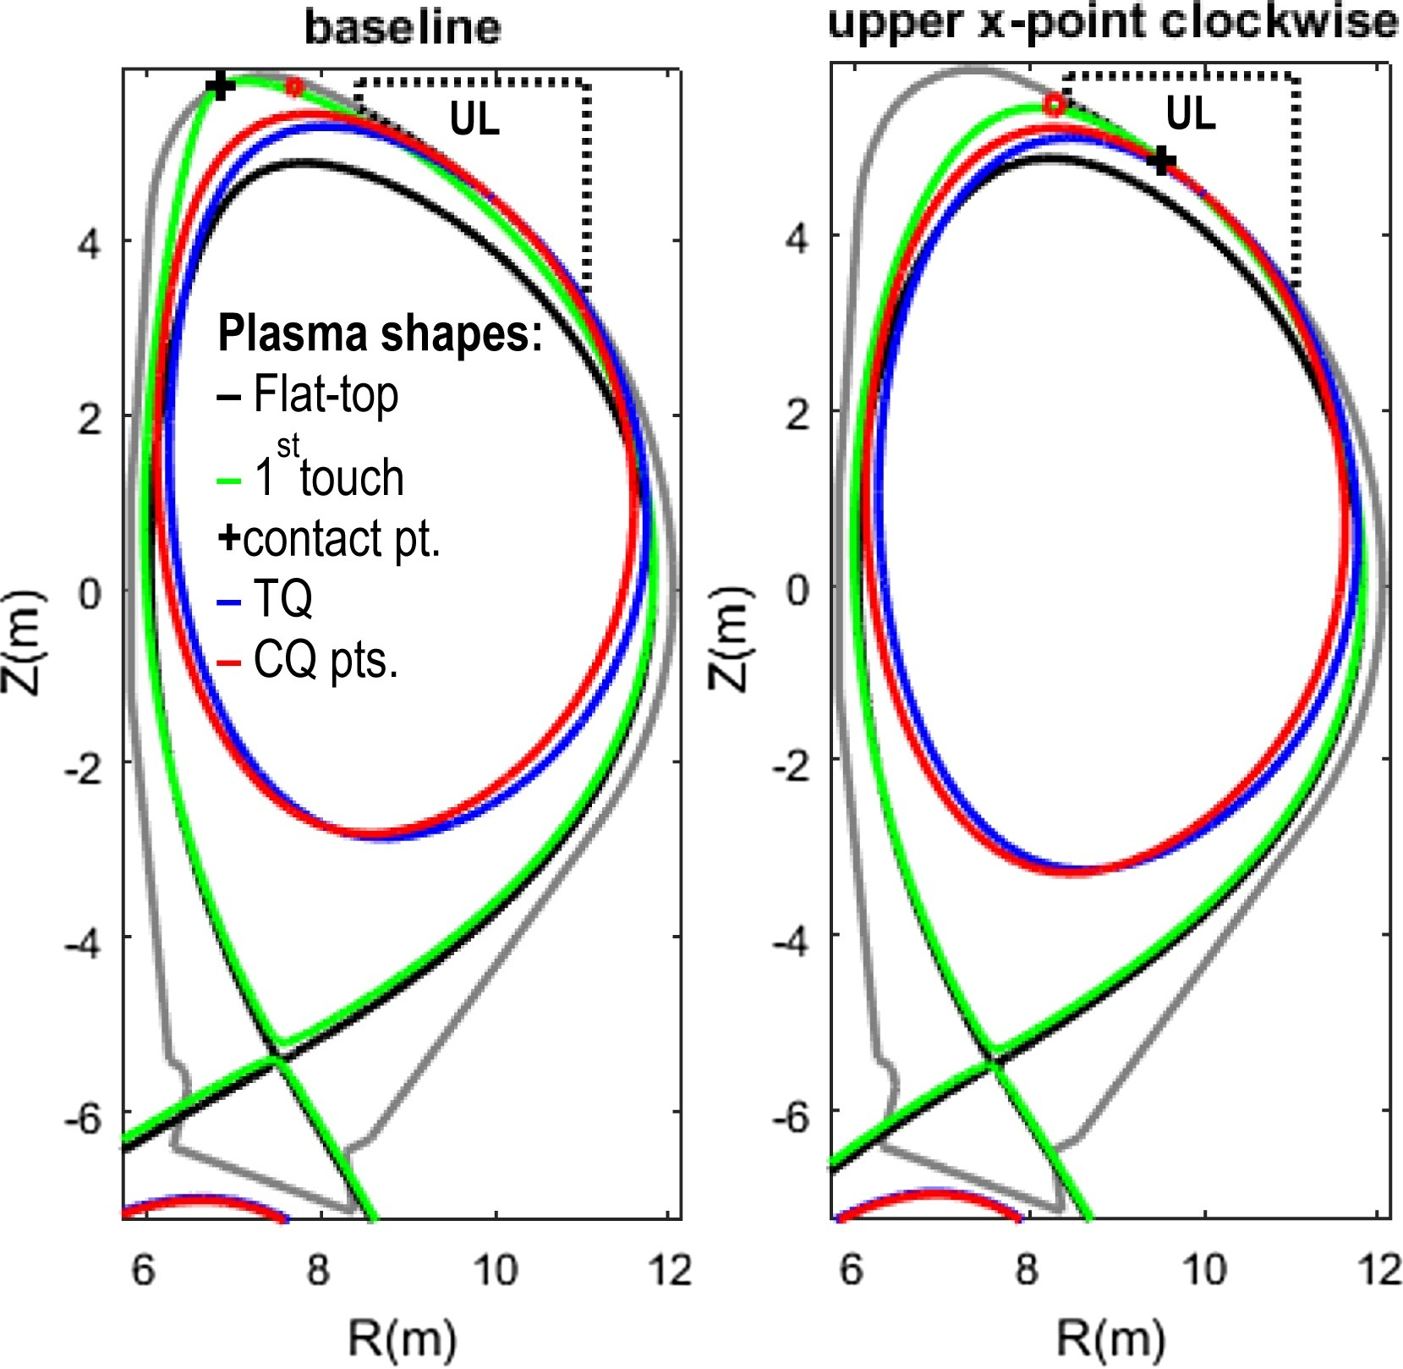
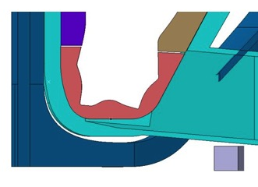
SP ADC.I: Engineering boundary conditions related to DEMO ADC solutions
The engineering part focus on the compatibility with DEMO constraints in view of configurations, stability, and thermomechanical and electromagnetic loads - the work is coordinated with the FTD
Engineering boundary conditions related to ADC solutions
Task group 1: Exploit engineering DEMO compatibility for most favourable ADC solutions configurations in terms of plasma-wall contact points during disruptions
Task group 2: Initial definition of the required size and configuration of the divertor including baffle.
All ADC acitivites for 2021-2022 fixed!
Main Deliverable 1: Plasma-Wall contact points during disruptions and initial evaluation of ADC transients for the heat flux impact point of view
Main Deliverable 2: Initial definition of required size and configuration of ADCs divertor including the baffle
D001
D002
Human Resources:10 PM
RU: ENEA
Link: WP DES DCT
Modelling: MAXFEA, ANSYS
Notes:
Facilties: JUST GIVE the integral numbers for the groups
PD: Plasma devices (MAGNUM, PSI-2, UPP, TOMAS, GyM)
HHF: JUDITH, GLADIS, QSPA, OLMAT
Analysis station: Ion beam
If Facilties, Modelling, Link not applicable, remove the lines. I assume that it is EITHER EXPERIMENT or MODELLING, thus 1 more line for TASKS or Deliveables.

Slide 34
SP E.1: Coordination activity, sample distribution, sample preparation, contact for JET DTE2 samples
Coordination of sample preparation and distribution for remaining JET ILW3 samples
SPE activities will start in 2022
Task group 1: Sample preparation
Task group 2: Coordination of sample distribution
Main Deliverable 1: Cutting of divertor tiles
Main Deliverable 2: Sampling of wall probes (wall inserts, rotating collectors, louvre clips, mirrors and cassettes)
Main Deliverable 3: Distribution of samples to beneficiaries
Human Resources: 6 PM
RU: IAP, VTT
Facilities: Hot cells at IAP and VTT
Notes:
Figure shows coring of a divertor tile at VTT

Slide 35
SP E.2: Comparison of hydrogenic retention quantification by different techniques and fuel removal assessment
Compare hydrogenic retention quantification by different techniques and assess fuel removal
Information obtained from post-mortem analyses of JET PFCs
Task group 1: Post-exposure analysis of JET divertor tiles exposed for multiple campaigns
Task group 2: Assessment of fuel removal efficiency by simulating the baking cycle in JET C39
Main Deliverable 1: Surface analyses of selected samples from JET divertor tiles for fuel retention
Main Deliverable 2: Laboratory experiments for simulating baking cycle in C39 for T removal (ITER scheme)
Main Deliverable 3: Microstructural characterisation of selected divertor samples
Baking cylce, Heinola et al. NF, 2017
Human Resources: 27 PM
RU: CU, FZJ, IAP, IPP_LM, ISSP_UL, IST, MPG, NCSRD, VR, VTT
Link: WP TE
Facilities: Ion beams
Notes:
Facilties: Has the number of days been decided for SPE?

Slide 36
SP E.3: Post-mortem analysis of PFC and other objects in JET
Investigation of material migration from the limiters and the main wall towards the divertor
Clarify migration mechanisms, thermo-mechanical properties and formation of deposits
Task group 1: Post-exposure surface analysis of JET wall and diagnostics components
Task group 2: Investigation of microstructural changes due to long-term plasma exposure
Main Deliverable 1: Annealing of metallic components using LID-QMS, TDS and FC
Main Deliverable 2: Metallography of metallic components
Main Deliverable 3: Surface analysis of metallic components
Louvre clips, Mizohata VTT
Human Resources: 62 PM
RU: CU, FZJ, IAP, IPP_LM, ISSP_UL, IST, MPG, NCSRD, VR, VTT
Link: WP TE
Facilities: Ion beams
Modelling: EIRENE, ERO
Notes:
Facilties: Has the number of days been decided for SPE?

Slide 37
Grant Deliverables 2021 and 2022
PWIE.D.01 | Post-mortem analysis of plasma-facing components exposed in W7-X (graphite) and WEST (ITER-like tungsten PFUs) in FP8. Reports on campaign integrated material migration pattern and modelling in both devices. | FZJ | 12/2021
PWIE.D.02 | Diffusion and trapping modelling in W PFCs under combined D+He impact and ion-induced self-damage for ITER / DEMO-like conditions. Report on underlying physics and fuel recovery strategies. | FZJ | 12/2021
PWIE.D.03 | Optimization of laser-based diagnostics for ITER and other long-pulse devices regarding material composition and fuel retention quantification. Selection of most suitable approaches. | FZJ | 12/2022
PWIE.D.04 | Interpretative PSI modelling of material migration and fuel retention in WEST, JET, ASDEX Upgrade and initial predictive PSI modelling for W7-X with full-W PFCs. | FZJ | 12/2022
PWIE.D.05 | Initial assessment on the impact of material damage (pre-irradiation) on fuel retention in W. | FZJ | 12/2022
Grant deliverables for 2021 will be fulfilled
Grant delierables for 2022 can be reached

Slide 38
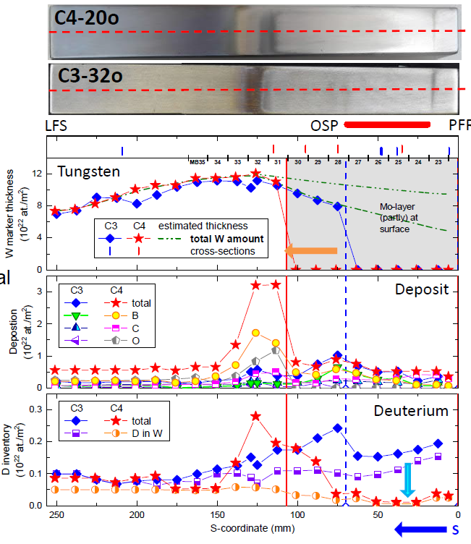
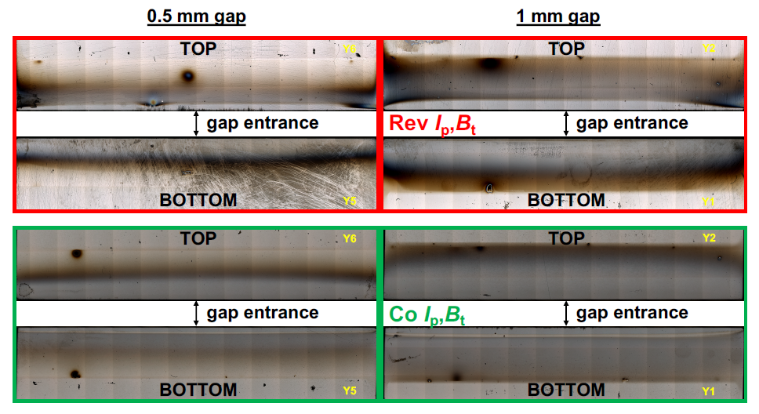
Example: SP B which feeds into PWIE.D.01 / PWIE.M.01
First Ion-Beam Analysis and SEM investigations completed on WEST marker tiles originating from the C4 campaign (right)
  No drastic differences, erosion and deposition patterns more prominent after C4
Direct evidence on the Larmor flux of hot ELM-related ions reaching shadowed gap side faces (toroidal orientation) on AUG (below)
  Erosion/deposition pattern switches sides if the B-field is reversed
  Depth of erosion zone corresponds to sputtering by keV D-ions with a Larmor radius of ~1 mm
K. Krieger et al.
PFMC 2021, M. Balden et al.

Slide 39
Grant Milestones
PWIE.M.01 | Initial tile analysis of WEST PFUs and W7-X TDU PFCs completed | 12/2021 | Report available
PWIE.M.02 | Comparative modelling of first set of revised advanced divertor solutions executed. | 12/2021 | Report available
PWIE.M.03 | Modelling of fuel retention in W under combined D+He exposure and self-damaged W by diffusion and trapping executed. | 12/2021 | Report available
PWIE.M.04 | High fluence experiments in deuterium (L-mode) discharges on ITER-like PFUs in WEST executed. | 06/2022 | Data available
PWIE.M.05 | Incorporation of turbulence in multi-fluid calculations using physics-based diffusion coefficients (with TSVVs). | 06/2022 | Software available
PWIE.M.06 | Comparative experiments of different LASER-based techniques on W and other reference samples executed. | 12/2022 | Data available
PWIE.M.07 | Interpretative modelling of W migration and D retention in WEST high fluence discharges completed. | 12/2022 | Report available
Likely not reachable!
All grant milestones for 2021 will be reached!
Grant milestones for 2021 will be achieved
Grant milestones for 2022 can be reached (apart from WEST long pulse (with TE)!

Slide 40
Summary
Basic PWIE activities:
- balanced program within limits in resources and machine time
- insufficient money for T laboratories (CEA, ISPPUL)
- insufficient money for JET (existing) sample analysis
=> resources taken from other experiment analysis (TE and W7X)
- delays in fuel removal strategy for ITER due to overall JET DT
and clean-up delay and available resources
- post DT JET sample anlaysis has no funding
- Laser-based techniques at JET (or elsewhere) have no funding
(UKAEA+FZJ own interest for LID-QMS and risk in the moment)
Former DTT-ADC physics activities scope:
- further down selection by 2022: XD, SN, long leg …
- ADC tests in AUG in 2024 after end of task (!)
Start of WP PWIE is challenging
  COVID situation
  EUROfusion II: overall grant and funding situation
  Procedure and communication issues within EUROfusion
Excellent work between PLs and TFLs on daily basis
  Better coordination among projects in view of limited funding
  Improved cooperation between FSD and FTD

Slide 41
ANNEX

Slide 42
Team
Surname | First Name | Role (in WP) | Beneficiary | Email | Office Phone
Brezinsek | Sebastijan | Project Leader | FZJ | s.brezinsek@fz-juelich.de
Coenen | Jan Willem | Sub-Project Leader SP A | FZJ | j.w.coenen@fz-juelich.de
Hakola | Antti | Sub-Project Leader SP B | VTT | antti.hakola@vtt.fi
Schmid | Klaus | Sub-Project Leader SP C | MPG | Klaus.Schmid@ipp.mpg.de
Kirschner | Andreas | Sub-Project Leader SP D | FZJ | a.kirschner@fz-juelich.de
Likonen | Jari | Sub-Project Leader SP E | VTT | jari.likonen@vtt.fi
Van der Meiden | Hennie | Sub-Project Leader SP X | DIFFER | h.j.vandermeiden@differ.nl
Calabro | Giuseppe | Deputy Project Leader SP ADC | ENEA | giuseppe.calabro@unitus.it
De Schepper | Alexandra | Project Support Office | FZJ | a.de.schepper@fz-juelich.de
Reinhart | Michael | Project Support Office | FZJ | m.reinhart@fz-juelich.de
Douai | David | EUROfusion Coordination officer | CEA | David.DOUAI@cea.fr

Slide 43
Risks and counter actions (I)
Selected high heat flux facilities are not available due to technical issues (SP A) | Delay activities or transfer to other facilities not selected in the first place
Selected linear plasma devices are not available due to technical issues (SP A, B, C, X) | Delay activities or transfer to other linear plasma devices in the WP PWIE portfolio
Selected accelerator facilities are not available due to technical issues (SP A, B, C, X, E) | Delay activities or transfer to other Accelerator facilities in the WP PWIE portfolio
Selected TE or W7-X campaigns and attached PFC components for analysis / modelling delayed | Delay activities or redistribute resources to other toroidal facilities, linear plasma devices and laboratory experiments
Start of JULE-PSI operation delayed (SP C) | Compensate with PSI-2 operation as much as feasible and delay activities with Be an neutron damage to a later period
Funding for LIBS on a remote handling arm in JET not available or test not compatible with JET program (SP X, SP E) | Focus on LIBS on a remote handling arm in WEST (AIA) under WP TE as technical demonstration in a full W device (no Be and no T possible). Compensate with experience in JULE-PSI
Funding for LID-QMS in JET not available or test not compatible with JET program (SP X, SP E) | Transfer studies to FREDIS and JULE-PSI with residual JET-ILW samples. Reduce scope of this task.

Slide 44
Risks and counter actions (II)
No decision about the ADC solution for DEMO and DTT possible in given two years framework possible (SP ADC) | Coordination between involved EUROfusion partner in FTD and FSD on possible paths towards a timely ADC solution for DEMO. Assessment of consequences for a test in I-DTT. Increase of ADC resources will be required if more time is needed to conclude physics solutions.
Access to the CEA Tritium lab not granted or not covered by the available resources (SP C) | Reduce scope and focus on activities every other year with resources combined over 2 years. Check for alternatives at UKAEA or ISPPUL
Access to the LPP-ERM-KMS hot cell for material characterisation not granted or not covered by the available resources (SP A) | Reduce scope and focus on activities every other year with resources combined over 2 years. Check for alternatives at FZJ hot material laboratory.
Access to JET material samples from FP8 not accessible due to BREXIT restrictions (SP E) | Adaption of scope of SP E to the available samples from JET-ILE 1-3 available in European laboratories
Additional JET samples after DTE2 available and ready for analysis (SP E) | Prolongation of SP E with additional funding for the remaining time of FP9 in order to be able to wait for the reduction of neutron activation. Redistribution of samples to laboratories with T, Be and activation permission. Analysis done at start of PWIE.
EUROfusion contract signature delayed => no work of partners and small Rus in 2021 possible | Shift to 2021 if possible

Slide 45
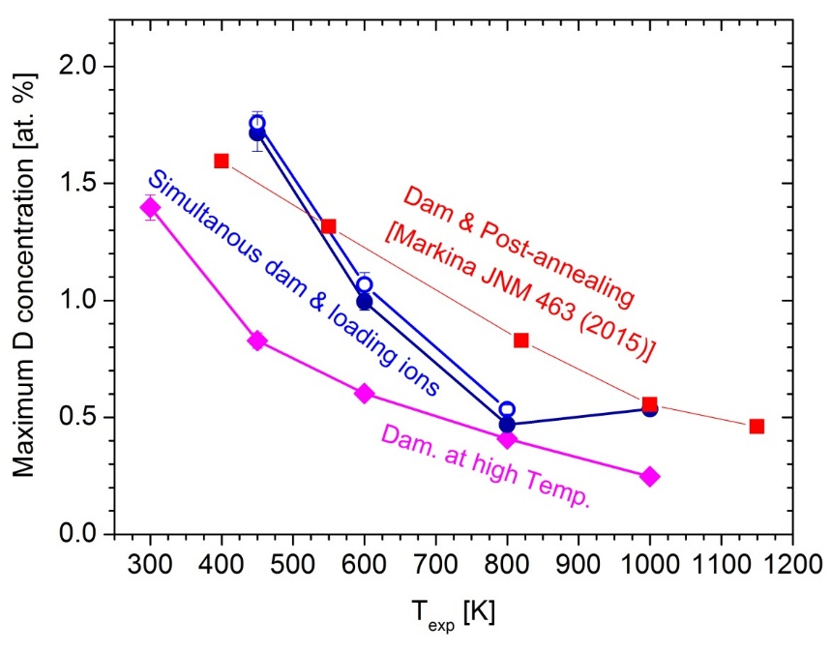
SP C.4: Influence of n-damage on H retention & transport
Investigate damage created by n-irradiation in W and steels.
Information obtained from experiments in accelerators, n-sources and via laboratory studies
Task group 1: Impact of irradiation damage on hydrogen permeation and combined hydrogen and helium retention
S. Markelj, JSI
Main Deliverable 1: Influence of transmutation products produced by 30MeV p-irradiation on retention in W
Samples on hold in 2022 to “cool” down and
prepare for JULE-PSI!
Human Resources: 3 PM
RU: FZJ
Link: TSVV 7
Facilities: PD 5 days, HHF 0 days, Ion beam 11 days
Notes:
Facilties: JUST GIVE the integral numbers for the groups
PD: Plasma devices (MAGNUM, PSI-2, UPP, TOMAS, GyM)
HHF: JUDITH, GLADIS, QSPA, OLMAT
Analysis station: Ion beam
If Facilties, Modelling, Link not applicable, remove the lines. I assume that it is EITHER EXPERIMENT or MODELLING, thus 1 more line for TASKS or Deliveables.

Slide 46
Work Package Milestones in 2021 (part I)
ID | Title | Due Date
WM01 | Development analysis methods to determine of underlying mechanisms for recrystallization which impacts the lifetime of tungsten-based PFCs from e.g. WPMAT (ITER+DEMO) | 31.12.2021
WM02 | Assessment of W-heavy alloy PFCs for use in current and future fusion devices with a focus on high heat flux treatment and high fluence plasma exposure (DEMO+ITER) | 31.12.2021
WM03 | Exposure of DEMO baseline divertor PFC mono-blocks (from WPDIV) in MAGNUM-PSI in D and D+Ne conditions to high fluence (DEMO) | 31.12.2021
WM04 | Experimental determination of effective tungsten sputtering yields on different types of rough surfaces in pure and mixed plasmas and comparison with laboratory experiments (ITER+DEMO) | 31.12.2021
WM05 | Provision of the gross and net erosion balance of W PFCs in L. and H-mode plasmas in tokamaks with the aid of marker probes (ITER) | 31.12.2021
WM06 | Completion of W marker tiles surface analysis exposed in the deuterium campaign C3. First assessment of the erosion/deposition on W PFUs in WEST after the He campaign C4 (ITER+DEMO) | 31.12.2021
WM07 | Documentation of the impact of oxygen layers on the uptake and release of hydrogen from W (ITER+DEMO) | 31.12.2021
WM08 | Assessment of the role of W layers on the hydrogen isotope permeation through steels (DEMO) | 31.12.2021
WM09 | Determination of the H permeation through ITER W PFC to the underlying Cu heatsink (ITER) | 31.12.2021
WM10 | Provision of plasma backgrounds for a set of JET-ILW H-mode D plasmas (EDGE2D-EIRENE), WEST He plasmas (SOLEDGE-EIRENE), and W7-X H plasmas (EMC3-EIRENE) used for interprettative impurity migration modelling (ITER) | 31.12.2021

Slide 47
Work Package Milestones in 2021 (part II)
WM11 | Provision of atomic, molecular and surface data necessary to model impurity migration. Main focus is on ionisation, excitation, reflection and sputtering data for W materials including morphology effects and crystal orientation (DEMO+ITER) | 31.12.2021
WM12 | Benchmark the quantify the predictive modelling capabilities of erosion sources, impurity migration and resulting deposition in JET, WEST, W7-X, and ITER (ERO, WallDYN) (ITER) | 31.12.2021
WM13 | Realization of diagnostics for determination of ro-vibrational distribution of the ground state of H2 and D2 and atomic densities in PSI-2 and MAGNUM-PSI to provide access to neutral particle properties under ITER and DEMO conditions (ITER+DEMO) | 31.12.2021
WM14 | Determination of the role of material composition and surface roughness on the laser-induced ablation rate and its conversion into depth-resolved information about material composition and fuel content in ITER-like materials and surface layers or co-deposits (ITER) | 31.12.2021
WM15 | Quantification of the energetic neutral contribution in Ion and Electron Cyclotron Wall Conditioning in TOMAS and qualification of its impact on fuel removal from W7-X PFCs (DEMO+ITER) | 31.12.2021
WM16 | Improvement of detached regimes in ADCs, including the effects of kinetic neutrals and sensitivity studies for the most uncertain input parameters regarding e.g. plasma transport (DEMO+ITER) | 31.12.2021
WM17 | Development of a reduced model from ADC experiments/simulations to scaling laws applicable for DEMO size and comparison with scaling laws extracted from existing DEMO scale simulations (DEMO) | 31.12.2021
WM18 | Engineering compatibility assessment of potential best promising DEMO ADC solutions with the DTT facility (DEMO) | 31.12.2021
WM19 | Engineering DEMO evaluation of most favourable ADC solutions in terms of VDE and disruption events compatibility (DEMO) | 31.12.2021
WM20 | Portfolio selection of key application (validation, verification, realistic scale) cases and set-up of most of them including full-scale ITER and DEMO cases with the aim to demonstrate the advantages of the restructuring into the Neutral Gas Model (NGM) and improved EIRENE | 31.12.2021
WM21 | Start with modulation of EIRENE by segregating the numeric core, incorporate ADAS “MDF” formats allowing refinement of CRMs, and reactivate time-dependent simulations (ITER+DEMO | 31.12.2021
WM22 | First test run of SOLEDGE-EIRENE with a 3D wall in a WEST geometry (ITER) | 31.12.2021
WM23 | Implementation of EIRENE Kinetic Ion Trace module in EMC3-EIRENE for low Z impurities (ITER+DEMO) | 31.12.2021
WM24 | Adaption of available ITER plasma backgrounds to DEMO. First scoping PIC, dust transport and ERO2.0 simulations with these backgrounds (ITER + DEMO) | 31.12.2021
WM25 | Implementation and validation of thermo-migration and material interface models in hydrogen retention codes (TESSIM-X and FESTIM) with identified common test cases (DEMO) | 31.12.2021

