Slide 1
ITER Research Plan priorities for WP PWIE in 2022
R. A. Pitts
On behalf of the Science Division
Science, Controls and Operation Department
ITER Organization, Route de Vinon-sur-Verdon, CS 90 046, 13067 St. Paul Lez Durance Cedex, France
The views and opinions expressed herein do not necessarily reflect those of the ITER Organization.

Slide 2
Supporting R&D for the ITER Research Plan
Presented in draft form to all ITPA Topical Groups in 2019 and released as ITER Technical Report in 2020
3 priority categories identified:
  Outcome of R&D can have major impact on system design or on the IRP (e.g. modifying overall experimental strategy in each phase or the objectives of the phases themselves)
  Outcome of R&D expected to have medium impact on system design or on the IRP (e.g. modifying significant details of experimental strategy to achieve objectives in each phase)
  Outcome of R&D expected to optimize details of IRP experimental strategy to achieve objectives in each phase by providing relevant experience
ITR-20-008
  https://www.iter.org/technical-reports

Slide 3
Workbook example: R&D for design completion
  R&D for design completion:
  Class A
  IRP implementation: Class B
  Examples of Class A

Slide 4
R&D topics
  R&D for design completion (DMS, Diagnostics, etc.)
  Disruption characterization, prediction and avoidance
  Stationary H-mode plasmas, ELMs, ELM control and impact on H-mode and power fluxes
  Characterization and control of stationary power fluxes
  Plasma material/component interactions and consequences for ITER operation
  Start-up, ohmic and L-mode scenario development
  Conditioning, fuel inventory control
  Basic scenario control and commissioning of control systems
  Transient phases of scenarios and control
  Complex scenario control during stationary phases
  Validation of scenario modelling and analysis tools
  Heating and Current Drive and fast particle physics
  Long pulse/enhanced confinement scenario issues

Slide 5
R&D topics
  R&D for design completion (DMS, Diagnostics, etc.)
  Disruption characterization, prediction and avoidance
  Stationary H-mode plasmas, ELMs, ELM control and impact on H-mode and power fluxes
  Characterization and control of stationary power fluxes
  Plasma material/component interactions and consequences for ITER operation
  Start-up, ohmic and L-mode scenario development
  Conditioning, fuel inventory control
  Basic scenario control and commissioning of control systems
  Transient phases of scenarios and control
  Complex scenario control during stationary phases
  Validation of scenario modelling and analysis tools
  Heating and Current Drive and fast particle physics
  Long pulse/enhanced confinement scenario issues
  Areas where WPPWIE should be involved

Slide 6
R&D topics
  Following slides give full list of IRP workbook topics in which WP PWIE may contribute either directly (as lead) or in association with other WP’s (mostly WP TE)
  The list is for the record and will not be discussed in detail → most important for ~2022 period highlighted

Slide 7
Specific areas with WP PWIE contributions (1)
A. Design completion
  A.7: Laser Induced Desorption for in-situ T retention measurement: C1
  A.9: Laser Induced Breakdown: C1
  A.12: Ammonia formation: for Tokamak Exhaust Processing design: C1
  A.14: IR measurement with reflections in a metallic environment: C1
B.1: Disruption characterization, prediction and avoidance
  B.1.1: Disruption/VDE thermal load characterization: C2
  B.1.3: Runaway electron load characterization: C2
Red: IRP priority areas Red (bold): specific WP PWIE areas for 2022 (see dedicated slides later)
C1,2,3: Category in IRP Workbook

Slide 8
Specific areas with WP PWIE contributions (2)
B.2. Stationary H-mode plasmas, ELMs, ELM control and impact on H-mode and power fluxes
  B.2.1: He H-mode operation with W PFCs and ELM control: C1/2
  B.2.13: Control of ELM divertor power flux by mitigation: C2
  B.2.20: First wall ELM power fluxes by mitigation: C3

Slide 9
Specific areas with WP PWIE contributions (3)
B.3: Characterization and control of stationary power fluxes
  B.3.1: Divertor power flux deposition width in ITER H-mode plasmas: C2
  B.3.2: Effect of plasma response on divertor power fluxes with 3-D fields for ELM control and 3-D field optimization: C2
  B.3.3: Radiative H-modes with Ne and N and mixed impurities and impact on H-mode performance: C2
  B.3.5: Effect of 3-D fields for ELM control on divertor power fluxes in radiative H-modes: C2
  B.3.6: Wall power/particle fluxes in ITER H-mode plasmas: C3
  B.3.7: Radiative divertor operation in He H-modes: C3

Slide 10
Specific areas with WP PWIE contributions (4)
B.4: Plasma-material/component interactions and consequences for ITER operation (1 of 2)
  B.4.1: Be wall erosion in He plasmas: C2
  B.4.2: He plasma modification of W mechanical properties at high fluences: C2
  B.4.3: Formation of fuzz by He/W interaction and critical fuzz thickness: C2
  B.4.4: Power fluxes to castellated PFCs: C2
  B.4.5: Tolerable W damage on surface and macro-brush edges for tokamak operation: C2
  B.4.6: W operation above recrystallization and implications for tokamak operation: C2
  B.4.7: W surface modification by high plasma fluence exposure and implications for tokamak operation: C2

Slide 11
Specific areas with WP PWIE contributions (5)
B.4: Plasma-material/component interactions and consequences for ITER operation (2 of 2)
  B.4.8: Splashing of Be and W under transients: C2
  B.4.9: Melt damage and impact on operation: C2
  B.4.10: Dust production: C2
  B.4.11: Impact of vapour shielding on power flux in ITER transients: C2
  B.4.12: W divertor erosion under controlled ELMs: C2
  B.4.13: Be wall erosion under controlled ELMs: C3

Slide 12
Specific areas with WP PWIE contributions (6)
B.6: Conditioning, fuel inventory control*
  B.6.1: ECWC conditioning: C2
  B.6.2: Operation at low wall temperatures and ITER-like baking cycles: C2
  B.6.3: Removal of hydrogen by baking and GDC: C3
  B.6.4: Efficiency of T removal by plasma operation from Be co-deposits in routinely unexposed areas: C3
  B.6.5: ICWC fuel removal from Be co-deposits: C3
  B.6.6: Start of operation by baking without GDC: C3
*Probably mostly done in WPTE (?), but strong WP PWIE interaction?

Slide 13
ITPA DivSOL R&D contributions: VII
B.7: Basic scenario control and commissioning of control systems
  B.7.6: Develop real time divertor power flux measurement and control loop: C3
B.9: Complex scenario control during stationary phases
  B.9.2: Integrated control of radiative Ne/N H-mode in ITER-like conditions: C3

Slide 14
More details on specific points for 2022

Slide 15
LID-QMS/LIBS
LID-QMS
  Now receiving a lot of attention at IO following a period of reduced effort
  A Preliminary Design Review (PDR) for the ITER system in early 2022 → focus on space/services in port plugs/Diagnostic Building
  Second PDR in 2023 for more detailed technical aspects of the system
  Highest IO priority remains a tokamak scale test (JET) → obviously depends on extension of JET beyond 2021/funding.
LIBS
  An important possible long term option for ITER
  However key potential issue is use of LIBS in air → need more R&D → but cannot at this stage state that this is an urgent priority.

Slide 16
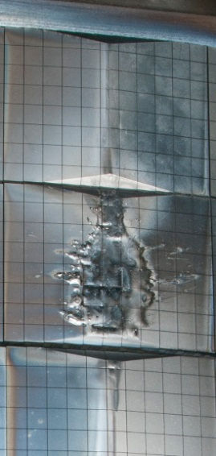
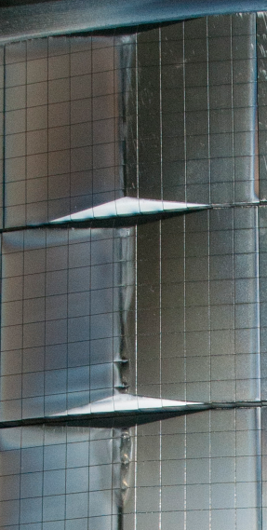
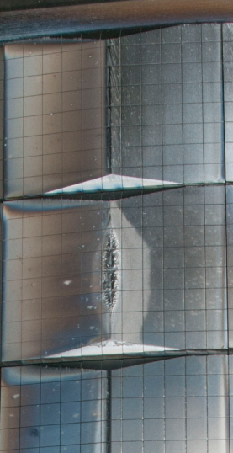
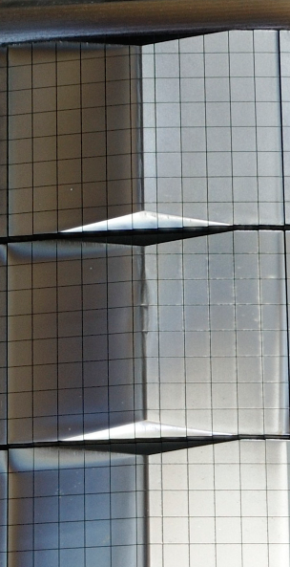
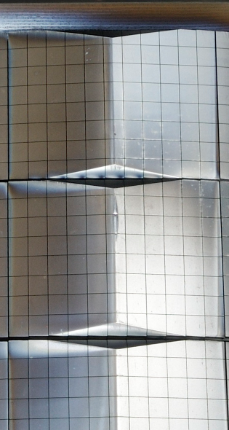
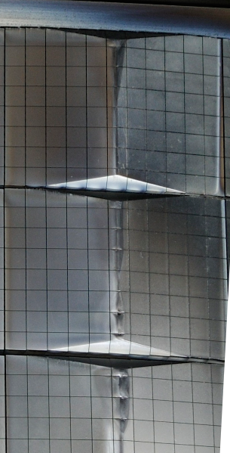
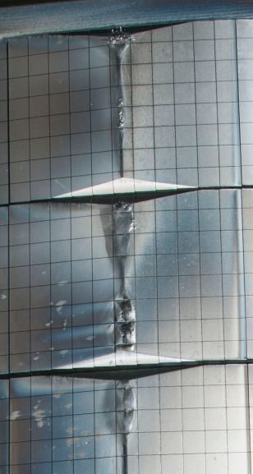

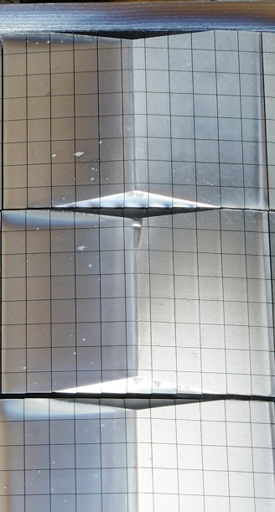
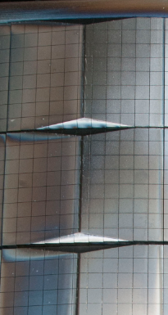
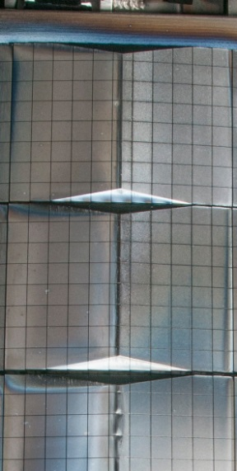
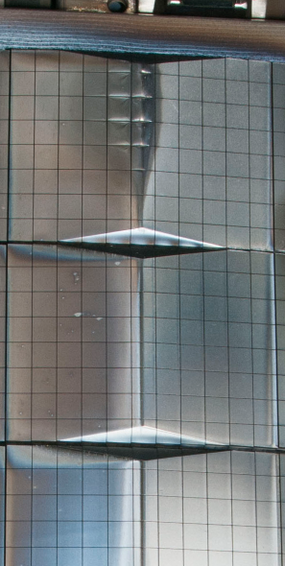
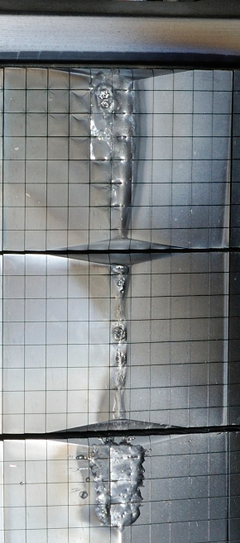

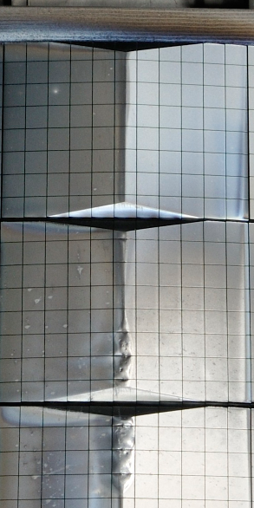
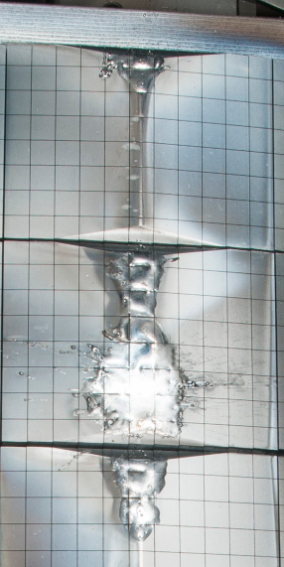
Runaway electron load characterization
At IO we have been carefully studying the RE deposition event seen on the JET Be FW
  With the SMITER-GEANT4-MEMOS-U workflow
  To benchmark the simulations to improve confidence in ITER predictions
Single RE event in JET (#86801 )
Octant 1
Octant 2
Octant 3
Octant 4
Octant 5
Octant 6
Octant 7
Octant 8
G. F. Matthews et al., PFMC 2015

Slide 17
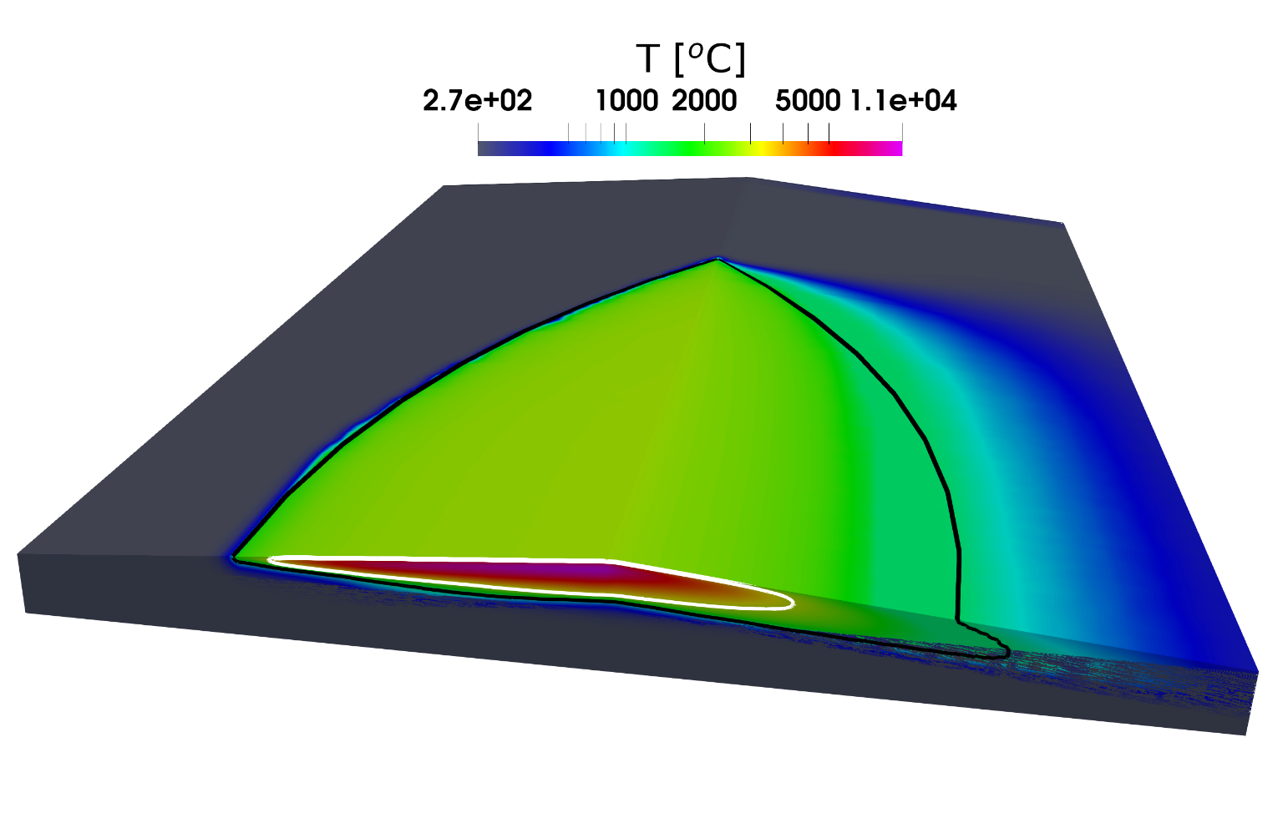
Runaway electron load characterization
At IO we have been carefully studying the RE deposition event seen on the JET Be FW
  With the SMITER-GEANT4-MEMOS-U workflow
  To benchmark the simulations to improve confidence in ITER predictions
  Can match quite well the observed surface melt regions
melt
boiling
60 mm
RE beam width = 1.5 mm
RE beam energy = 80 kJ
L. Chen, JET T17-13 meeting, 30/6/2021

Slide 18
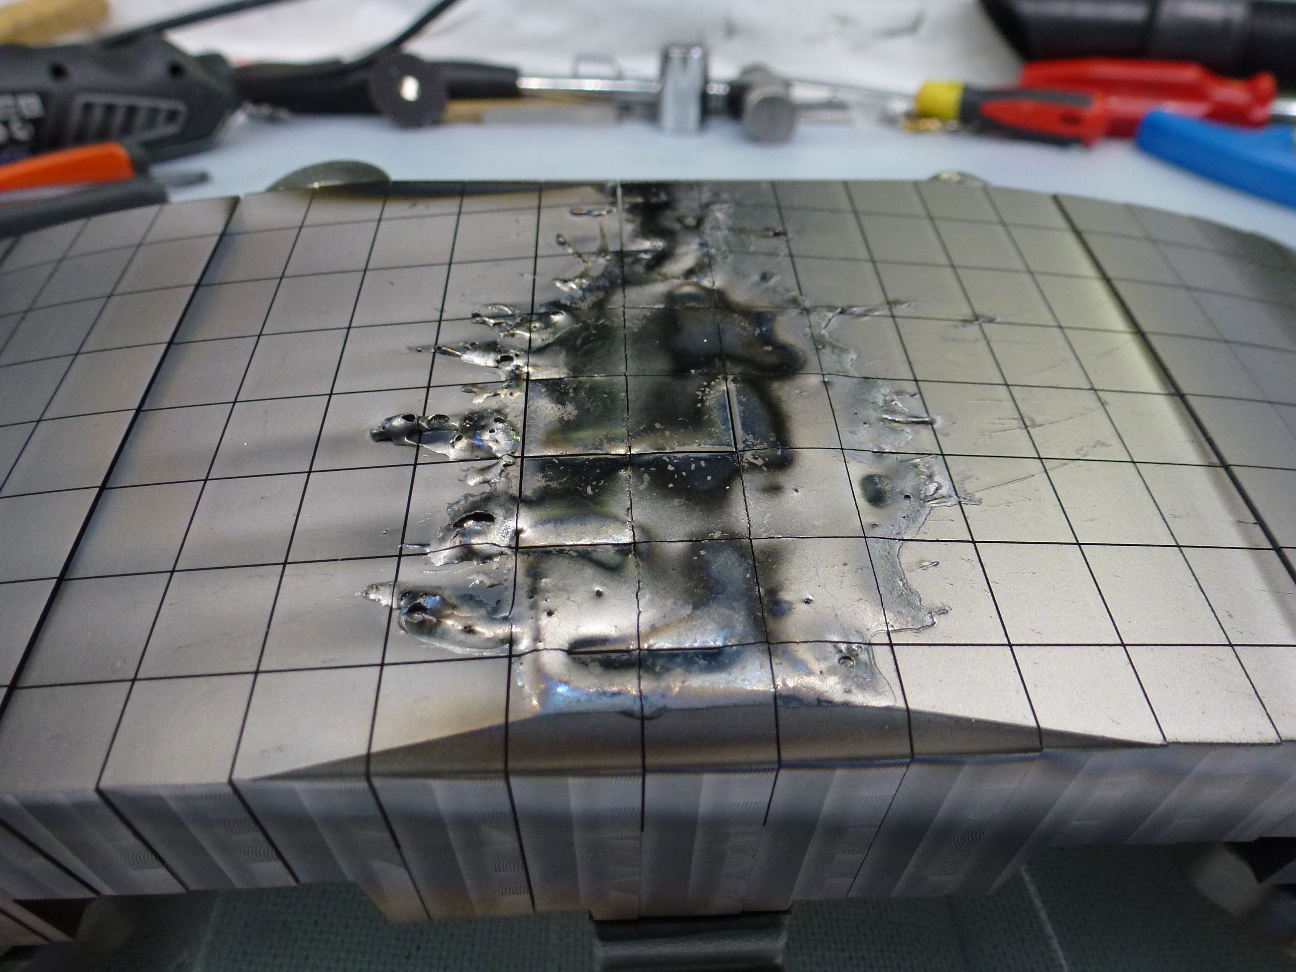
Runaway electron load characterization
An inner wall tile with RE damage similar to the one we have been modelling has been removed from JET
  IO would be very interested to have this tile sectioned → the only way to decide if our estimations of volumetric boiling are correct → last step in the benchmark with JET
  If this could be performed inside WP PWIE (e.g. in SP E) would be much appreciated
Courtesy A. Widdowson, UKAEA

Slide 19
Experiments at JET beyond 2021 (1)
From IO point of view important to establish if He H-mode operation is an appropriate option for the ITER Research Plan with regard to scenario development and from the point of view of PWI
  If not, gives important additional input to strengthen the case for ECRH power upgrade for PFPO-1
  From WP PWIE point of view the key issue is to properly characterize impact of increased FW erosion (cf. H, D) – B.4.1 - and subsequent migration
  JET not best suited to other PWI aspects of He operation (e.g. long term effects on W mechanical properties)

Slide 20
Experiments at JET beyond 2021 (2)
Hugely important experiment is the fuel removal exercise to be performed after DTE2 (M21-18)
  Possibly one of the most important outcomes of the JET DT experiments for ITER
  Important follow-up to the recent hydrogen isotope removal experiment – M18-30 (T. Wauters et al., PFMC 2021)
  Strongly support efforts to ensure longer term extraction of samples after DT.
  IO will make T. Wauters (co-SC of M21-18) fully available for participation/analysis if required by WP TE/PWIE
  Would like to emphasize also the importance of the systematic investigation of TDS spectra already existing JET samples from Be co-deposition → trap distributions and testing against new scalings which are now emerging, as well as input to migration modelling

Slide 21
TOKES refactoring
IO strongly supports award of EEG21-19 if possible
  Initial proposal was from IO and we thank WP PWIE/EUROfusion for the effort to include this option in the programme
  High priority for 2022 given the importance of TOKES to ITER (DEMO also) and the potential imminent loss of code knowledge base

