Slide 1
ITER Priorities for JT-60SA
Alberto Loarte
On behalf of the Science Division
Science, Controls and Operation Department

Slide 2
Outline of talk
R&D priorities to support ITER Research Plan
Background information on IO-QST-F4E(EUROfusion) collaboration
Priorities for JT-60SA IO-QST-F4E(Eurofusion) collaboration
JT-60SA priorities for 2021/2022
@2021 ITER Organization
WPSA EUROfusion planning meeting - 8th September 2021

Slide 3
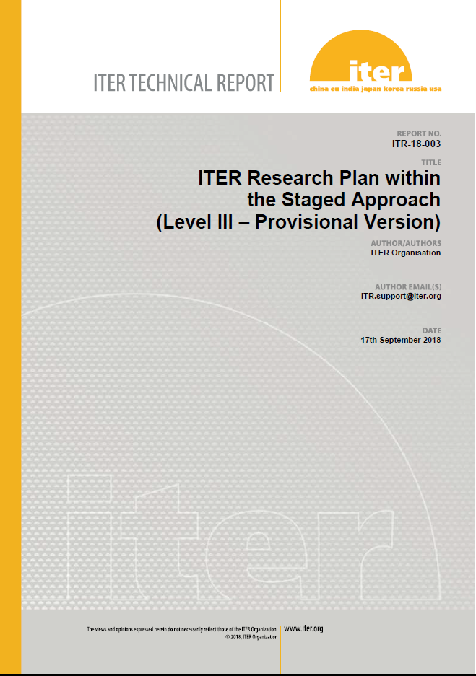
ITER Research Plan and Supporting R&D
Elaboration of IRP was supported by experts from ITER Members’ fusion R&D institutions and Domestic Agencies (available as ITER Technical Report (ITR-18-003)
IRP informs fusion community on details of experimental plans to achieve project’s goals and defines supporting R&D (ITR-20-008)

Slide 4
R&D Topics for IRP
  R&D for design completion (DMS, Diagnostics, etc.)
  Disruption characterization, prediction and avoidance
  Stationary H-mode plasmas, ELMs, ELM control and impact on H-mode and power fluxes
  Characterization and control of stationary power fluxes
  Plasma material/component interactions and consequences for ITER operation
  Start-up, ohmic and L-mode scenario development
  Conditioning, fuel inventory control
  Basic scenario control and commissioning of control systems
  Transient phases of scenarios and control
  Complex scenario control during stationary phases
  Validation of scenario modelling and analysis tools
  Heating and Current Drive and fast particle physics
  Long pulse/enhanced confinement scenario issues

Slide 5
Categories for IRP R&D issues
Categories
  1 → Outcome of R&D can have major impact on system design or on the ITER Research Plan (e.g. modifying overall experimental strategy in each phase or the objectives of the phases themselves)
  2 → Outcome of R&D expected to have medium impact on system design or on the ITER Research Plan (e.g. modifying significant details of experimental strategy to achieve objectives in each phase)
  3 → Outcome of R&D expected to optimize details of ITER Research Plan experimental strategy to achieve objectives in each phase by providing relevant experience

Slide 6
High Priority Cat. 1 and Cat. 2 R&D Topics (next ~3 years)
Support of DMS baseline design (Shattered Pellet Injection, SPI)
Resolution of diagnostic design issues
He H-mode operation and/or H+10% He operation for Pre-Fusion Power Operation
3rd harmonic ECH heating validation for 1.8 T operation in PFPO
Low <n_{e}> ECH heated H-modes for operation in PFPO-1
Electron Cyclotron Wall Conditioning (ECWC) for use in PFPO-1
ECH-assisted and ohmic start-up for First Plasma (FP) and PFPO-1
Disruption loads characterization in PFPO
Strategy for ELM control
n = 1 and n = 2 error fields and correction
Divertor lifetime appropriateness to allow operation until well into the Fusion Power Operation (FPO) phase with the first tungsten divertor
3-D field ELM suppressed H-mode as integrated scenario for ITER high Q scenarios
Specific issues for Q = 5 steady-state scenarios in ITER with NBI + ECH

Slide 7
IO-QST-F4E collaboration
IO signed a cooperation arrangement with QST and F4E to collaborate on Broader Approach activities of joint interest in November 2019
Two specific implementing arrangements signed to formalize cooperation
  JT-60SA – November 2020
  IFERC (REC – CSC – DEMO R&D) - June 2021
Arrangements specify overall topics of cooperation with detailed activities formulated in yearly programmes

Slide 8
JT-60SA topics of collaboration (JT-60SA → ITER) - I
Plasma start-up at low loop voltage with and without EC assistance
Alignment of the first wall with the magnetic field
Wall conditioning (ECWC) and gas analysis
Hydrogen H mode, ELM control, 10% He to reduce H-mode threshold
Plasma magnetic control and equilibrium reconstruction
Magnetic diagnostics validation and MHD analysis
Validation of NB shine-through calculations
Validation of third harmonic ECH
Adopting or adapting to IMAS (Integrated Modelling Analysis Suite)
Protocol for error field measurement
Disruption analysis mitigation with SPI
Scenario design and development

Slide 9
JT-60SA topics of collaboration (JT-60SA → ITER) - II
Commissioning and operation of the magnets
Cryo-plant commissioning
Integrated Commissioning
Cleaning of the vacuum vessel/Vacuum preparation practice/initial Wall conditioning
Other topics: Camera (EDICAM) and image analysis

Slide 10
JT-60SA topics of collaboration (ITER → JT-60SA)
Application of Modelling and Analysis Tools
Improvement of NB Heating System Capability
Application of alternative magnetic diagnostics (Hall probes) developed by ITER for long pulse
In-situ calibration technique of plasma diagnostics developed in ITER
Preparation and implementation of plasma operation with Tungsten divertor

Slide 11
Previously proposed work programme 2020/2021 - I
Lessons learnt by the assembly in JT-60SA (complete)
Integrated Commissioning Planning/Execution and sharing of experience (on-going)
Initial Wall conditioning, ECWC and gas analysis
Preparation and demonstration of First Plasma
Disruption and disruption mitigation studies
  Measurements of disruptions forces, particularly during asymmetric VDEs
  Study contributions of JT-60SA to ITER disruption mitigation R&D based on the present 2-MGI system and of a potential 2-SPI system
Study of Hall sensor possible location and installation feasibility

Slide 12
Proposed work programme 2020/2021 - II
Test of ITER ECH stray radiation detectors: feasibility study of locations
Discussions for possible further topics
  Installation and application of IMAS in JT-60SA
  In-situ calibration of diagnostics
Priorities and topics remain the same for 2022/2023 assuming 5 months operation as for the original 2020/2021

Slide 13
Conclusions
Well established cooperation among IO-F4E (EUROfusion)/QST for JT-60SA
Information interchanged effectively between teams (assembly + integrated commissioning)
Most foreseen activities have not made much progress given issues in JT-60SA integrated commissioning → No major changes for plans for 2022/2023 proposed from IO side

