Slide 1
WPW7X 2021 Progress Report
A. Alonso, A. Dinklage and I. Calvo.

Slide 2
Bringing stellarators to maturity
Coils for HELIAS can be built precisely ✓ ^{[1]}
Bootstrap currents are small and controllable ✓ ^{[2]}
Optimization reduces NC thermal transport ✓ ^{[3]}
Viable detachment scenarios demonstrated ✓ ^{[4]}
Stable high-beta operation □
Good fast-ion confinement □
Improved confinement regimes* □
Integrated SOL/core high-performance* □
* new insights
Same with metallic-wall operation □
provision of an alternative line to fusion electricity (Mission 8)
FP8
FP9
mid-term Roadmap
[1] Sunn-Pedersen et al. Nature Comm. (2015) [3] Beidler et al. Nature (2021)
[2] Dinklage et al. Nature Phys. (2018) [4] Jakubowski et al., Feng et al. Nucl. Fusion (2021)

Slide 3
CWP: Deliverables and Milestones 2021
 | Description | Due date | Type | Dissemination
W7X.D.01 | Report on conducted scenario & campaign preparation (focus: opimization studies, wall conditioning procedures) | Dec. 2021 | Report | Public
W7X.M.01 | 1.5MW gyrotron infrastructure completed | Dec. 2021 | Demon-stration | Public
The Milestones are expected to be achieved. Wall conditioning activity manager left –meeting held and reorganisation of work conducted.

Slide 4
AWP: Objectives 2021
WPW7X-2021.O1 | Continue the development of heating and fueling system upgrades and prepare their installation on the device.
WPW7X-2021.O2 | Initiate TSVV-12 on stellarator optimisation and lay out plans for the project with the goal of producing highly optimised designs by 2025.
WPW7X-2021.O3 | In the framework of TSVV-13, enhance the capabilities of microturbulence modelling in W7-X via development of the currently available gyrokinetic codes, their verification and their application to specific transport problems.
WPW7X-2021.O4 | Prepare safe long-pulse, high-power operation by implementing safety interlocks and developing strategies for wall conditioning.
WPW7X-2021.O5 | Continue to develop and implement diagnostic systems and upgrades in support of the scientific objectives of Mission 8 in OP2.
WPW7X-2021.O6 | Advance the analysis of OP1 experimental data, develop and validate physics models and codes to (a) prepare OP2 experimental scenarios and (b) continue to construct the physics basis and the design and simulation tools for next-step devices.
WPW7X-2021.O7 | Prepare longer-term upgrades of the W7-X divertor and plasma facing components in collaboration with other EUROfusion work packages (WPPWIE, WPDIV).
WPW7X-2021.O8 | Support the preparation of the HELIAS physics basis, ITER first plasmas, ensure information exchange with the EUROfusion FTD and continue international collaborations in support of the Mission 8 objectives.

Slide 5
AWP: Objectives 2021
WPW7X-2021.O1 | Heating and fueling upgrades.
WPW7X-2021.O2 | TSVV-12 : Stellarator optimisation.
WPW7X-2021.O3 | TSVV-13 : Stellarator turbulence simulation.
WPW7X-2021.O4 | Safe long pulse operation.
WPW7X-2021.O5 | Diagnostic systems and enhancements.
WPW7X-2021.O6 | Analysis of OP1 data.
WPW7X-2021.O7 | Transition to a W divertor in W7-X.
WPW7X-2021.O8 | Interfaces: Fusion Technology Department, ITER and INCO.

Slide 6
Heating and fueling upgrades
WPW7X-2021.O1 | Continue the development of heating and fueling system upgrades and prepare their installation on the device.
Background information
In the last campaign W7-X was equiped with 8.5MW ECRH and 3.4MW NBI. (Largest input power was 7.8MW (ECRH)).
A pellet gun was installed which allowed to achieve high performance regimes.
Higher heating and a continious pellet injector are instrumental to achieve important mission goals (assess optmization in high-beta, low-collisionality, reactor-like operation)

Slide 7
Heating and fueling upgrades

Slide 8
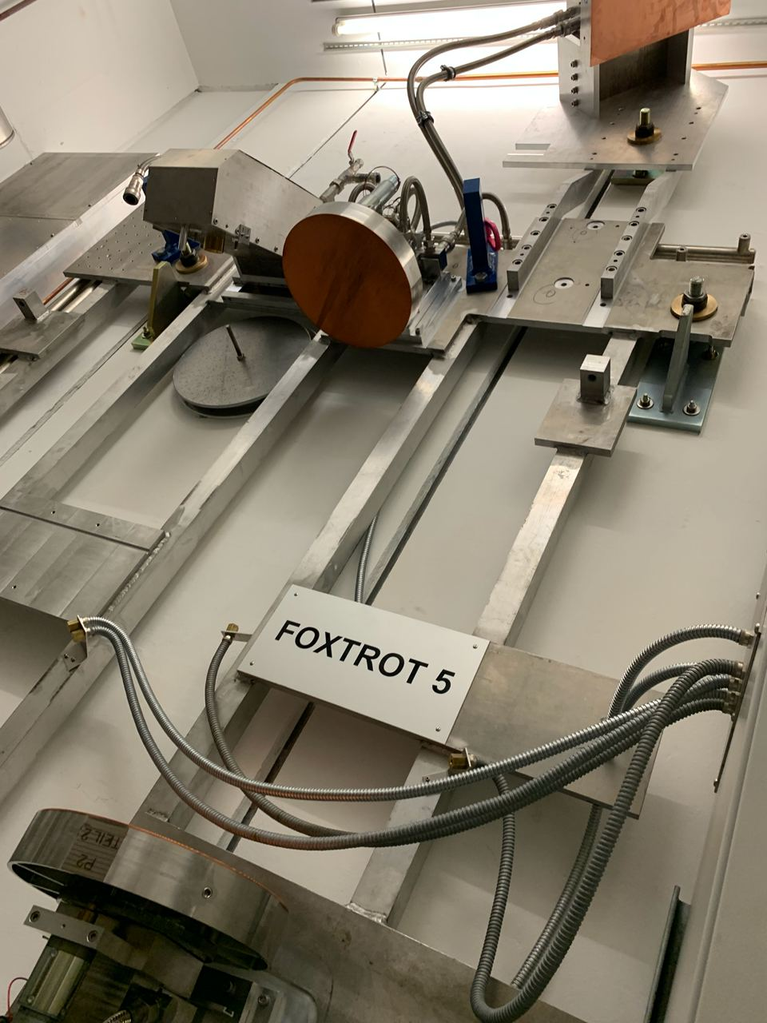
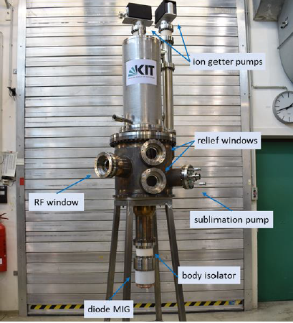
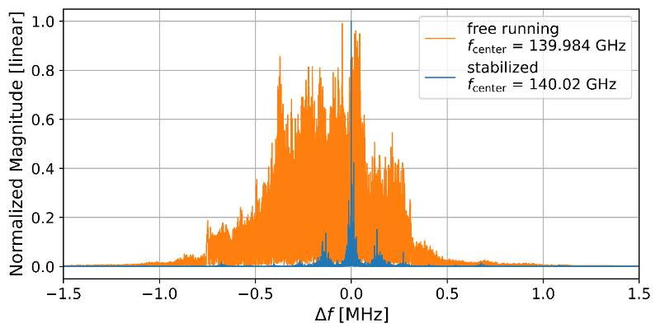
Heating and fueling upgrades
WPW7X-2021.O1 | Continue the development of heating and fueling system upgrades and prepare their installation on the device.
Installation of 1.5 MW ECRH Gyrotron
Gyrotron infrastructure at W7-X ready or on track.
  Transmission line, mirrors, in-vessel reflection tiles, HV connection, water cooling, PLC system…
Gyrotron magnet undergoing final acceptance test.
Delivery to IPP in November.
Frequency stabilisation
Z. Ioannidis et al (2021), Generation of 1.5MW-140GHz pulses with the modular pre-prototype gyrotron for W7-X.

Slide 9
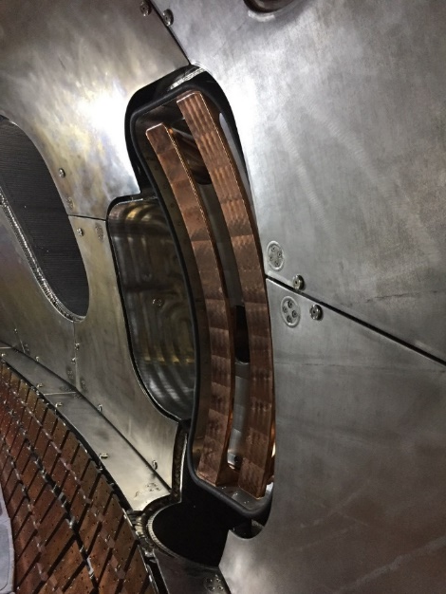
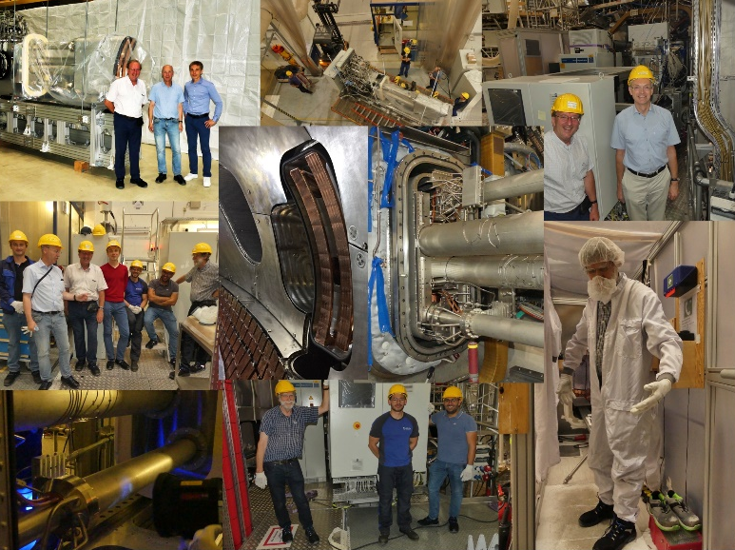
Heating and fueling upgrades
WPW7X-2021.O1 | Continue the development of heating and fueling system upgrades and prepare their installation on the device.
ICHR antenna installed on W7-X in mid-August!!
Extensive testing done at FZJ with a port mockup.
Generators and lines still to be shiped.
First experiments in OP2 (test gas puffing and movement with plasma).
Others
Second NBI beam box on track.
Continuous pellet system will be shiped from the US on Feb 22. Expected in OP2.

Slide 10
Safe long-pulse operation.
WPW7X-2021.O4 | Prepare safe long-pulse, high-power operation by implementing safety interlocks and developing strategies for wall conditioning.
Background information
W7-X high-heat flux (HHF) divertor is being installed (water-cooled)
The W7-X (mid-term) project goal is to reach 18 GJ energy input (30 min, 10 MW).
In OP2.1 (2022) and OP2.2 we aim at 1 and 2 GJ respect.
This makes hardening and active cooling necessary…
and increases the importance of wall conditioning, in particular with B-field (SC device).

Slide 11
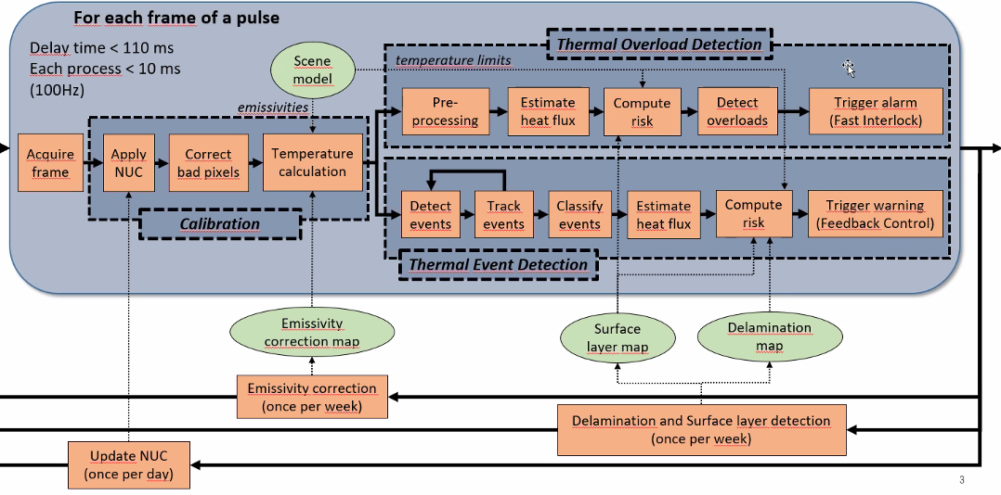
Safe long-pulse operation.
WPW7X-2021.O4 | Prepare safe long-pulse, high-power operation by implementing safety interlocks and developing strategies for wall conditioning.
IR surveillance: thermal overload (fast interlock, essential for OP2.1) and thermal event (feedback control) detection
Adaptation of computer vision, NN, deep learning techniques for several tasks (e.g. estimation of heat flux, Surface layer detection, strike-line characterization…)
Entry point for University groups.
Vision: an EU imaging software suite
Scheme by A. Puig

Slide 12
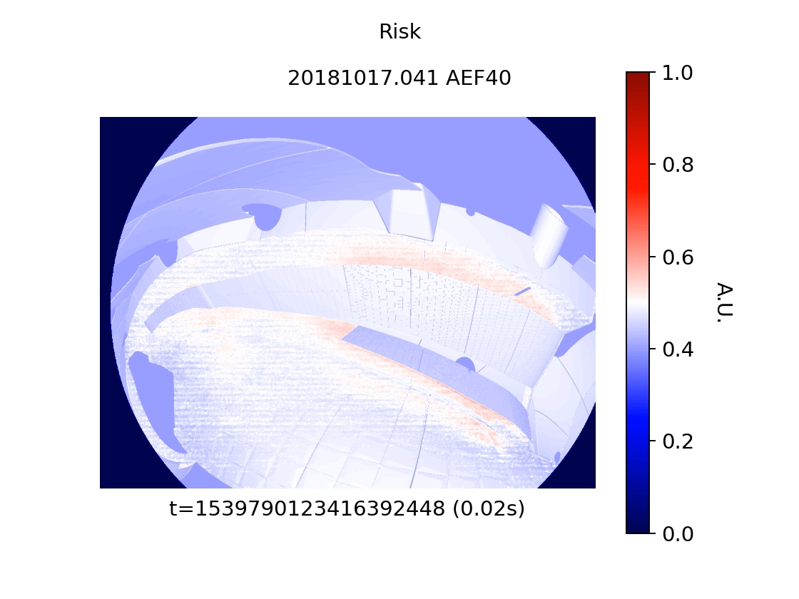
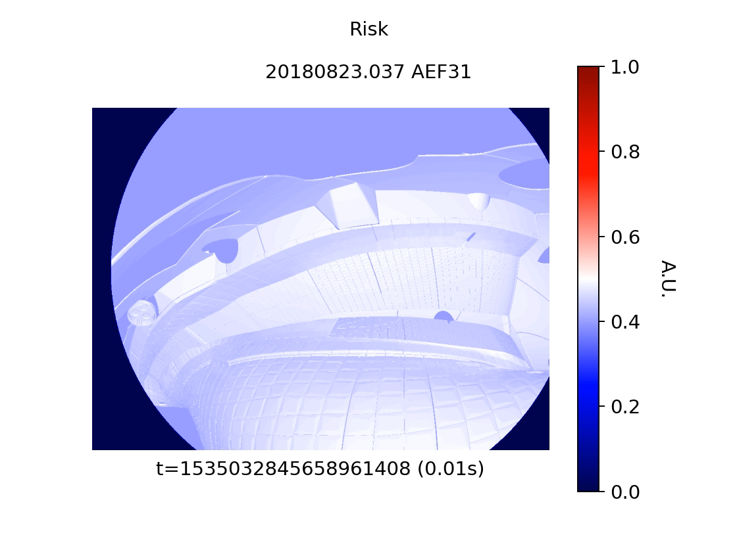
Safe long-pulse operation.
WPW7X-2021.O4 | Prepare safe long-pulse, high-power operation by implementing safety interlocks and developing strategies for wall conditioning.
Divertor overload
Baffle overload

Slide 13
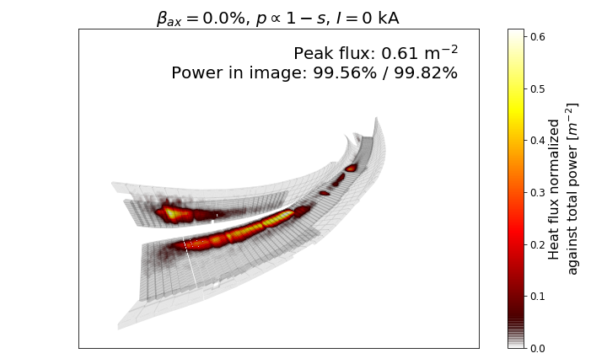
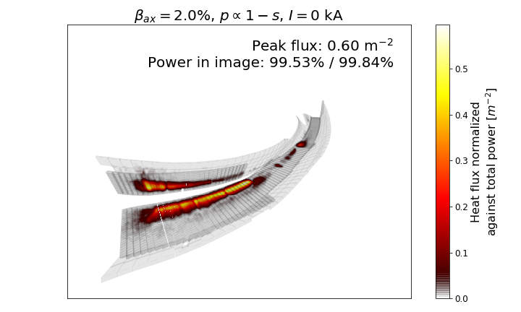
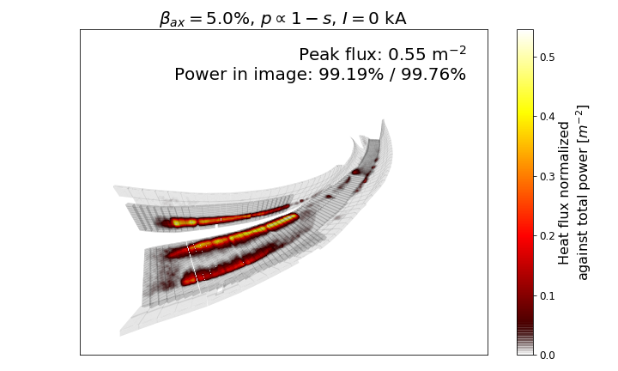
Safe long-pulse operation.
WPW7X-2021.O4 | Prepare safe long-pulse, high-power operation by implementing safety interlocks and developing strategies for wall conditioning.
Plasma-beta effects on the island divertor of Wendelstein 7-X.
Equilibrium magnetic fields were calculated with HINT.
Heat-loads estimated with anisotropic diffusion method.
  Standard configuration mostly stable (some edge stochastization)
  High-iota configuration shows full stochastization of the edge islands
  Low-iota configuration shows vanishing magnetic islands in equilibrium.
Secondary strike line at high beta
Knieps et al, EPS 2021

Slide 14
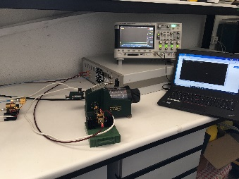
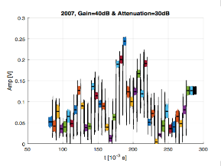
Diagnostic systems and enhancements.
WPW7X-2021.O5 | Continue to develop and implement diagnostic systems and upgrades in support of the scientific objectives of Mission 8 in OP2.
E-band Doppler reflectometer
  Comercial hardware procured (reflectometer and E-band waveguide components).
  Testing at TJ-II in Oct-Nov 2021
Divertor endoscopes (4 units w/ spectroscopy, IR camera, bolometers)
  Control and DAQ
CO monitor
  Integration in W7-X light-impurity monitor (C,O, B, N) and adjustment of the optical axis

Slide 15
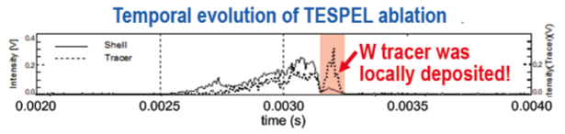
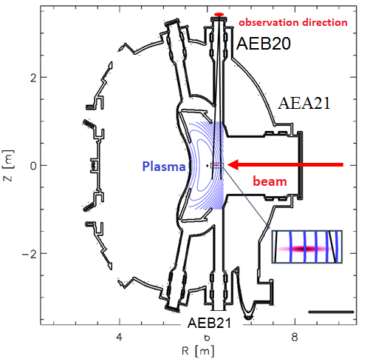
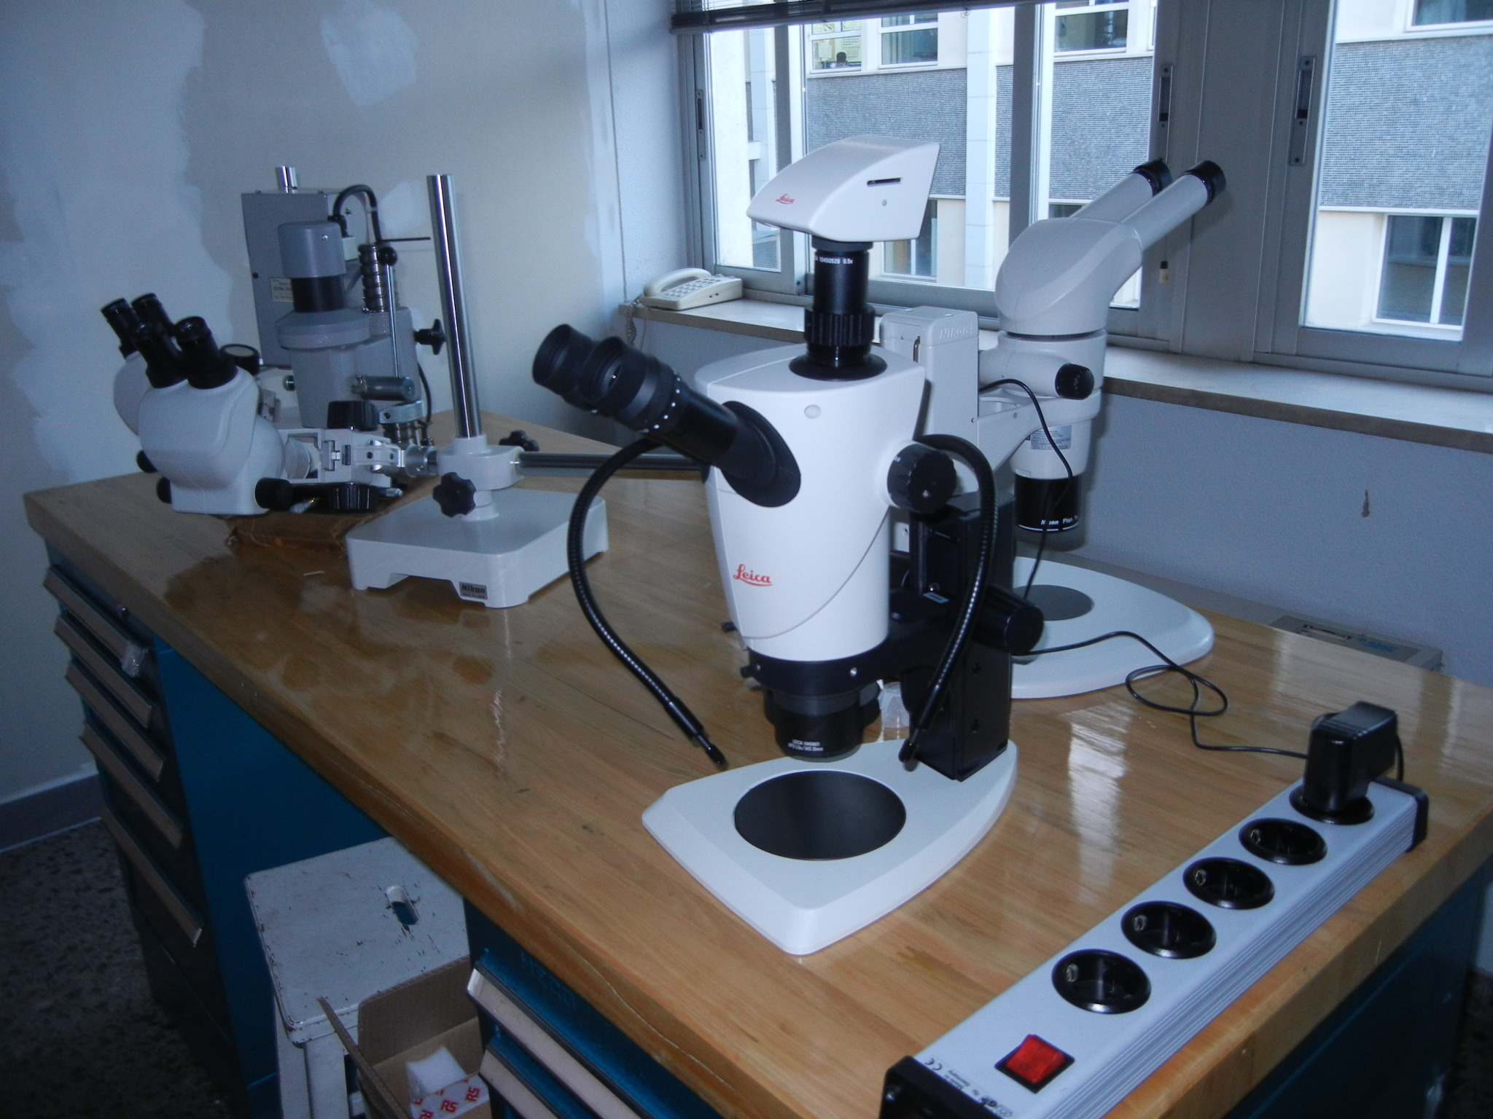
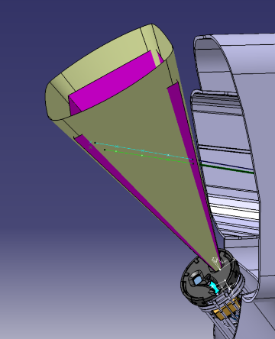
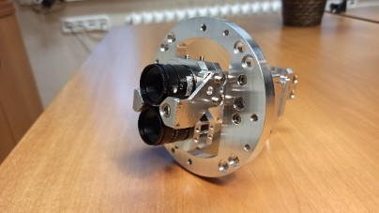
Diagnostic systems and enhancements.
WPW7X-2021.O5 | Continue to develop and implement diagnostic systems and upgrades in support of the scientific objectives of Mission 8 in OP2.
Preparations and improvements in …
TESPEL lab
Pulse Height Analyser
  Protect against ICRH radiation
Colletive Thomson Scattering
  Upgrade to 174 GHz, notch filter
Alkali BES
  Fast beam deflection.
Visible camera system
  EDICAM Control
  Filament and TESPEL obs.
Multi-purpose manipulator
Dual-laser Thomson Scattering
LHD
View „cone”
TESPEL and LBO
injection lines
AEF41 Hα diagnostics

Slide 16
Analysis of OP1 data.
WPW7X-2021.O6 | Advance the analysis of OP1 experimental data, develop and validate physics models and codes to (a) prepare OP2 experimental scenarios and (b) continue to construct the physics basis and the design and simulation tools for next-step devices.

Slide 17
Analysis of OP1 data.
EMC3-EIRENE successfully explain several experimental observations during detachment in W7-X.
Homogeneous unloading of divertor plates.
Reduction of recycling flux to the target at high radiation fraction (without signs of volume recombination).
Further increases of radiation fraction cause a degradation of confinement (radiation front protrudes beyond LCFS).
Increase of divertor neutral pressure with decreasing recycling flux.
Feng et al, Understanding detachment of the W7-X island divertor (submitted).

Slide 18
Analysis of OP1 data.
Progress in turbulence-suppressed high-performance discharges
Post-pellet HP discharges demonstrate the optimization of NC transport [Beidler et al, Nature 2021].
Clear link established between HP and turbulence reduction.
Limited Ti in ECRH discharges thought to be due to poor coupling + strong turbulence activity.
Analysis of NBI-dominated scenarios shows experimental strategies to increase ion temperature.
Carralero et al, Nucl. Fusion (accepted)
Beurskens et al, Nucl. Fusion (accepted)
Ford et al, EPS 2021

Slide 19
TSVV-13: Stellarator turbulence simulation.
WPW7X-2021.O3 | In the framework of TSVV-13, enhance the capabilities of microturbulence modelling in W7-X via development of the currently available gyrokinetic codes, their verification and their application to specific transport problems.
  Verification and benchmarking activities involving codes that employ different simulation domains (EUTERPE, GENE-3D, GENE and stella).
  Implementation of the full linearized collision operator in stella and first applications.
  Development of a full-flux-surface version of stella.
  Development of an electromagnetic version of GENE-3D.
  Self-consistent simulations of turbulent impurity transport in W7-X.
García-Regaña et al. Turbulent transport of impurities in 3D devices, NF (accepted)

Slide 20
Prepare the transition to a W divertor in W7-X.
WPW7X-2021.O7 | Prepare longer-term upgrades of the W7-X divertor and plasma facing components in collaboration with other EUROfusion work packages (WPPWIE, WPDIV).
Background information
The 3rd W7-X operational phase OP3 is meant to feature a tungsten New-HHF divertor (around 2030).
Long-term, multi-FP activity.
Important for the W7-X mission (long-pulse, first stellarator to work with a reactor-type divertor).
In OP2 a number of wall tiles will be W-coated for in-situ and post-mortem analysis.

Slide 21
Prepare the transition to a W divertor in W7-X.
WPW7X-2021.O7 | Prepare longer-term upgrades of the W7-X divertor and plasma facing components in collaboration with other EUROfusion work packages (WPPWIE, WPDIV).
Heat shield (200 tiles in modules 1 and 5, incl. reflector tiles for safe X2 and O2 operation) –ready
  Tiles with marker layers (18) –ready
Baffle area (40 tiles W/W alloy) design aided by EMC3-EIRENE –in work

Slide 22
Interfaces: Fusion Technology Department, ITER and INCO.
WPW7X-2021.O8 | Support the preparation of the HELIAS physics basis, ITER first plasmas, ensure information exchange with the EUROfusion FTD and continue international collaborations in support of the Mission 8 objectives.
Meeting with PRD held on requirements for the W7-X experimental program (Action: Felix Warmer presented priorities at the W7-X Topical Group Scenarios).
ITER-relevant activities related to ECRH heating (calculation of stray radiation power density) and long pulse operation (LaB6 neutral pressure gauges).
Participation in LHD campaign preparation with 19 experimental proposals presented at the LHD research forum. XP schedulling (Oct.21-Feb.22) ongoing.
  2022-2023 will be LHD‘s last campaign.

Slide 23
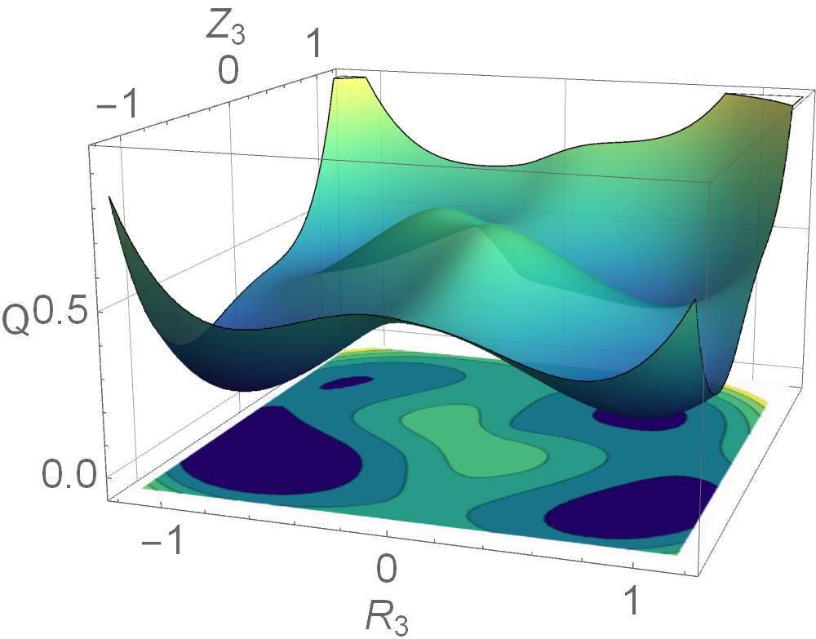
TSVV-12 : Stellarator optimisation.
WPW7X-2021.O2 | Initiate TSVV-12 on stellarator optimisation and lay out plans for the project with the goal of producing highly optimised designs by 2025.
  Development of a gyrokinetic instability model (for integration into optimisers).
  Exploitation of the code SPEC to evaluate MHD stability of stellarator equilibria.
  Improved optimization approach to reduce the number of local minima in the landscape.
  Interface to equip the stellarator optimization code ROSE with new algorithms.
Schematic optimisation landscape
P. Helander, Thrust 4 meeting.

Slide 24
Conclusion
Progress is as needed for OP2.1
  ECRH infrastructure completed.
  ICRH antenna installed.
  Pellet injector (DoE) delayed – EU support (infrastructure/modelling) as planned
  Diagnostics and FP8-enhancement support is progressing as planned.
  Preparatory analyses progress as planned: new insights.
  Scientific preparation of OP2 underway (W7-X OP2 TFLs recently appointed).
Difficulties from the overall planning status
  Specific diffculties in tasks potentially unrevealed.
  Planning for 2022 under time constraints giving rise to different risks.

