Slide 1
ITER Priorities for W-7X
Alberto Loarte
On behalf of the Science Division
Science, Controls and Operation Department

Slide 2
Outline of talk
R&D priorities to support ITER Research Plan
Priorities for W-7X
Conclusions
@2021 ITER Organization
WPSA EUROfusion planning meeting - 8th September 2021

Slide 3
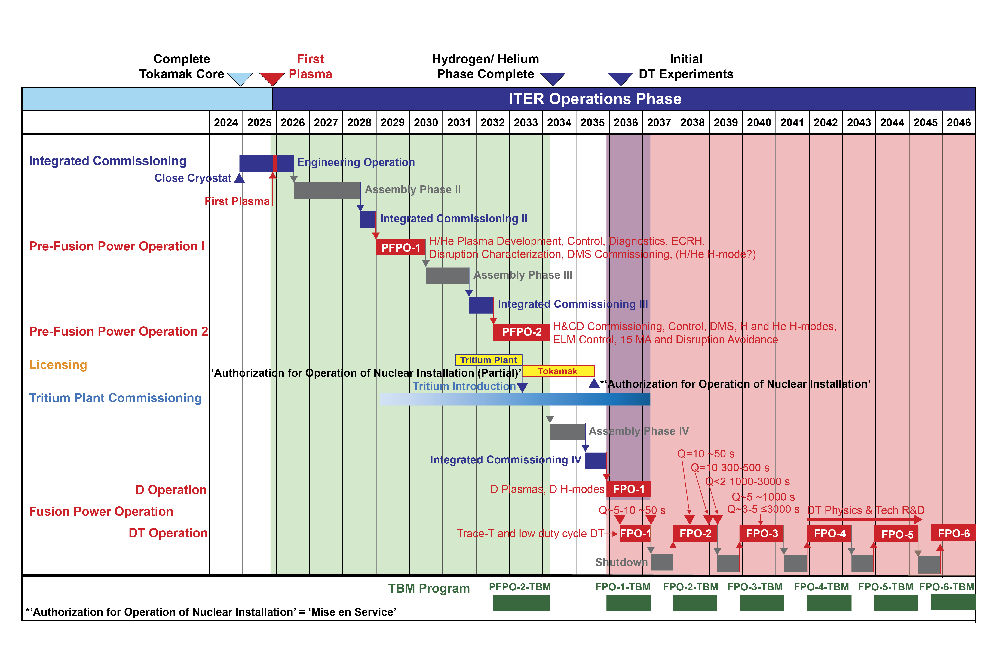
ITER Research Plan

Slide 4
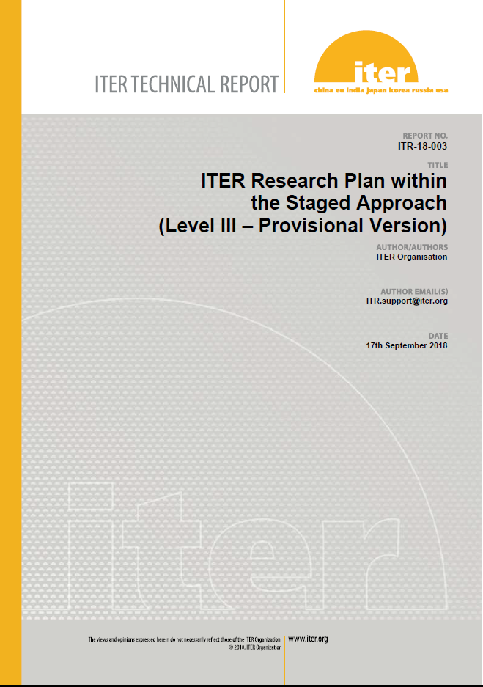
ITER Research Plan and Supporting R&D
Elaboration of IRP was supported by experts from ITER Members’ fusion R&D institutions and Domestic Agencies (available as ITER Technical Report (ITR-18-003)
IRP informs fusion community on details of experimental plans to achieve project’s goals and defines supporting R&D (ITR-20-008)

Slide 5
R&D Topics for IRP
  R&D for design completion (DMS, Diagnostics, etc.)
  Disruption characterization, prediction and avoidance
  Stationary H-mode plasmas, ELMs, ELM control and impact on H-mode and power fluxes
  Characterization and control of stationary power fluxes
  Plasma material/component interactions and consequences for ITER operation
  Start-up, ohmic and L-mode scenario development
  Conditioning, fuel inventory control
  Basic scenario control and commissioning of control systems
  Transient phases of scenarios and control
  Complex scenario control during stationary phases
  Validation of scenario modelling and analysis tools
  Heating and Current Drive and fast particle physics
  Long pulse/enhanced confinement scenario issues

Slide 6
Categories for IRP R&D issues
Categories
  1 → Outcome of R&D can have major impact on system design or on the ITER Research Plan (e.g. modifying overall experimental strategy in each phase or the objectives of the phases themselves)
  2 → Outcome of R&D expected to have medium impact on system design or on the ITER Research Plan (e.g. modifying significant details of experimental strategy to achieve objectives in each phase)
  3 → Outcome of R&D expected to optimize details of ITER Research Plan experimental strategy to achieve objectives in each phase by providing relevant experience

Slide 7
High Priority Cat. 1 and Cat. 2 R&D Topics (next ~3 years)
Support of DMS baseline design (Shattered Pellet Injection, SPI)
Resolution of diagnostic design issues
He H-mode operation and/or H+10% He operation for Pre-Fusion Power Operation
3rd harmonic ECH heating validation for 1.8 T operation in PFPO
Low <n_{e}> ECH heated H-modes for operation in PFPO-1
Electron Cyclotron Wall Conditioning (ECWC) for use in PFPO-1
ECH-assisted and ohmic start-up for First Plasma (FP) and PFPO-1
Disruption loads characterization in PFPO
Strategy for ELM control
n = 1 and n = 2 error fields and correction
Divertor lifetime appropriateness to allow operation until well into the Fusion Power Operation (FPO) phase with the first tungsten divertor
3-D field ELM suppressed H-mode as integrated scenario for ITER high Q scenarios
Specific issues for Q = 5 steady-state scenarios in ITER with NBI + ECH

Slide 8
A. R&D for design completion - I
A.19 Two Wavelength Thomson scattering
Demonstration of a working 2-wavelength Thomson Scattering system on a high temperature device.
  Extend the dynamic range in temperature of a classic Thomson scattering system and enable an auto-calibration procedure
Plasma in PFPO-1 H-modes: A. Loarte, et al., NF 2021

Slide 9
R&D for design completion - II
A.20 Pressure gauges
Pressure gauges for ITER based on “ASDEX-type” gauges → lifetime issue identified
LaB₆ electron emitter-based gauges can be an alternative option but need to be developed for ITER relevant conditions
  Extension of pressure range and total run time for measurements → continued testing in long pulse device (incl. Ne impurity seeding)
  Evaluate radiation hardness

Slide 10
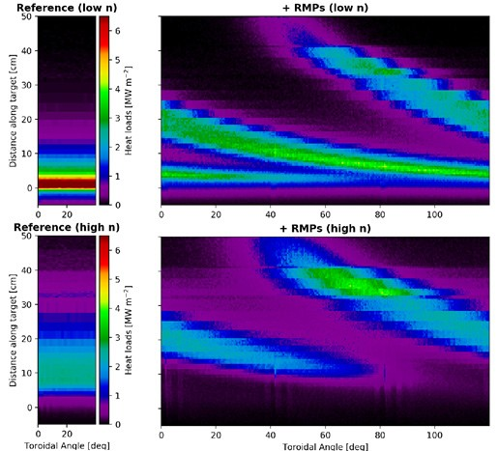
B. 3. Characterization and control of stationary power fluxes
B.3.2 Effect of plasma response on divertor power fluxes with 3-D fields for ELM control and 3-D field optimization
Determine effect of plasma response to 3-D fields on the spatial structure and magnitude of toroidally asymmetric divertor power fluxes with 3-D fields for ELM control and optimization to maximize wetted area
Required to determine the spatial structure of divertor power fluxes in ITER and to identify the physics basis on which to extrapolate experimental results to ITER taking into account the plasma response expected to be required
High density divertor with 3-D fields in PFPO-1 H-modes: H. Frerichs, et al., PRL 2021

Slide 11
B.6. Conditioning, fuel inventory control
B.6.1 ECWC conditioning
Perform ECWC conditioning and determine requirements for effective cleaning (and reliable plasma start-up including recovery from unmitigated and mitigated disruptions)
  Use ECRH for ECWC on a routine basis for general machine conditioning (and disruption recovery) and diagnose the ECWC plasma
  ECWC is one of the two cleaning techniques available in ITER with toroidal field on and only one available in PFPO-1

Slide 12
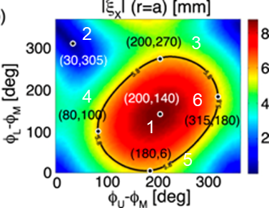
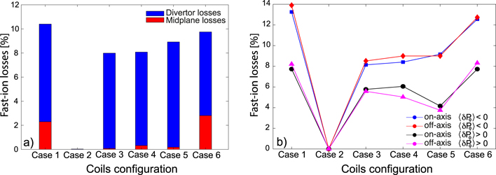
B.11. Heating and Current Drive and fast particle physics - I
B.11.3 Evaluate fast particle losses with 3-D fields and their correlation with plasma response and ELM control
Determine fast particle losses in H-mode plasmas when 3-D fields are applied and identify their correlation with plasma response and ELM suppression. Explore means to minimize fast particle losses while sustaining ELM suppression
Required to identify fast particle losses caused by the application of ELM control by 3-D fields and their possible optimization to reduce losses while sustaining ELM control
NBI losses with 3-D fields in Q =10 plasmas: L. Sanchís, et al., NF 2021

Slide 13
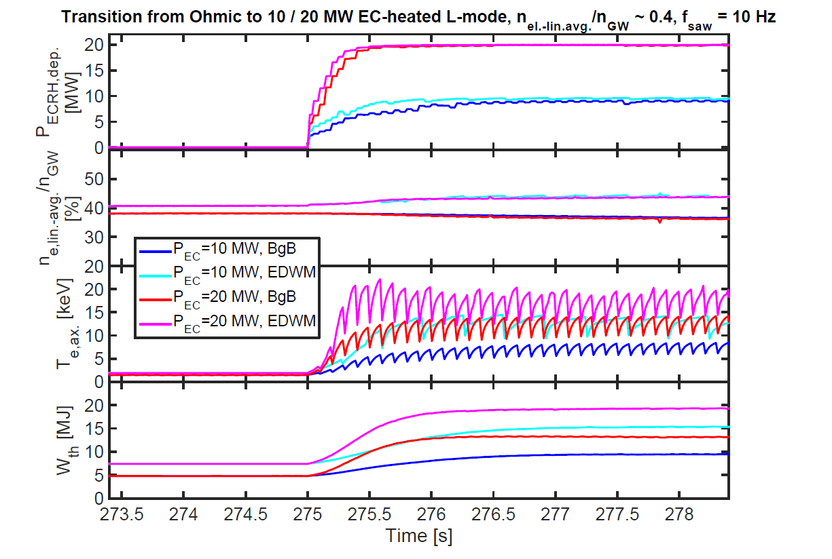
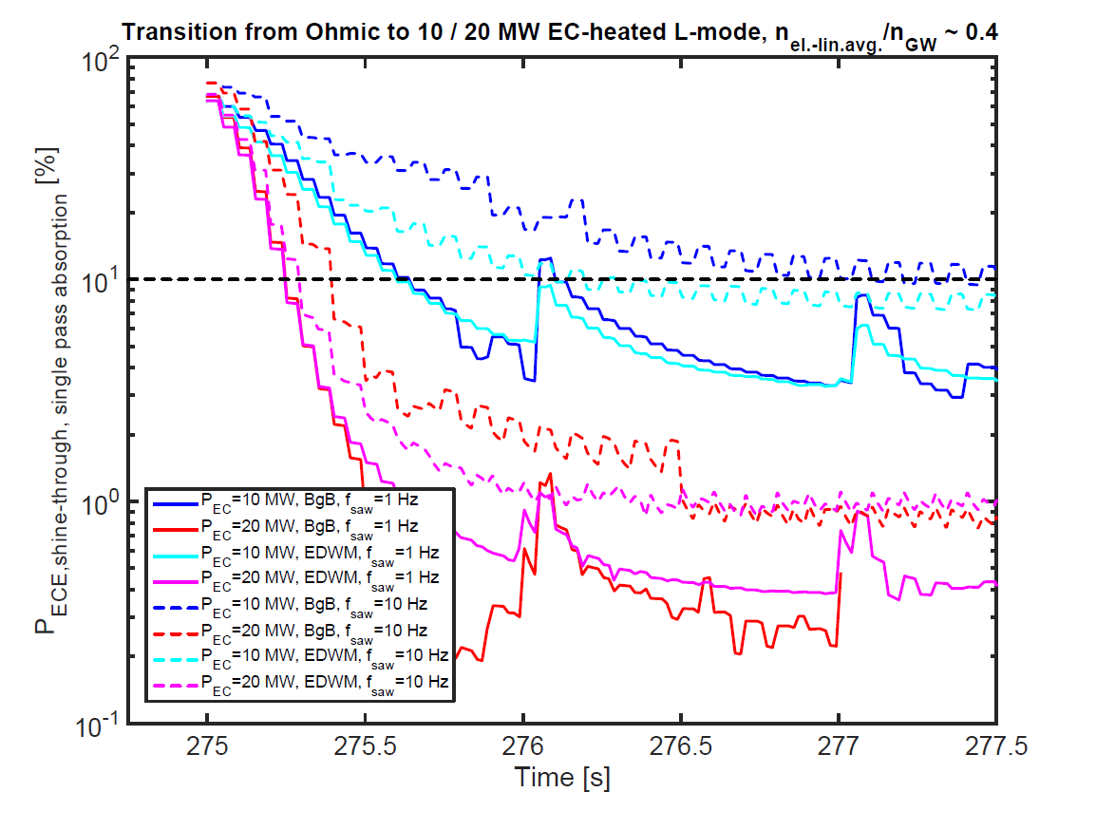
B.11. Heating and Current Drive and fast particle physics - II
B.11.6 Validation of models for ECH absorption in 3rd harmonic operation at 5 MA/ 1.8 T plasmas
Quantitative experimental evidence on 3rd harmonic absorption in conditions similar to those in 5 MA / 1.8 T plasmas and validate modelling predictions (PFPO-1 H-modes)
  Perform ITER-like experiments with 3rd harmonic ECH → start in plasmas with low ~ 10-20% absorption and study the temporal increase of the absorption for various levels of ECH powers
Modelling of 1.8 T ITER scenarios: M. Schneider, et al., NF 2019

Slide 14
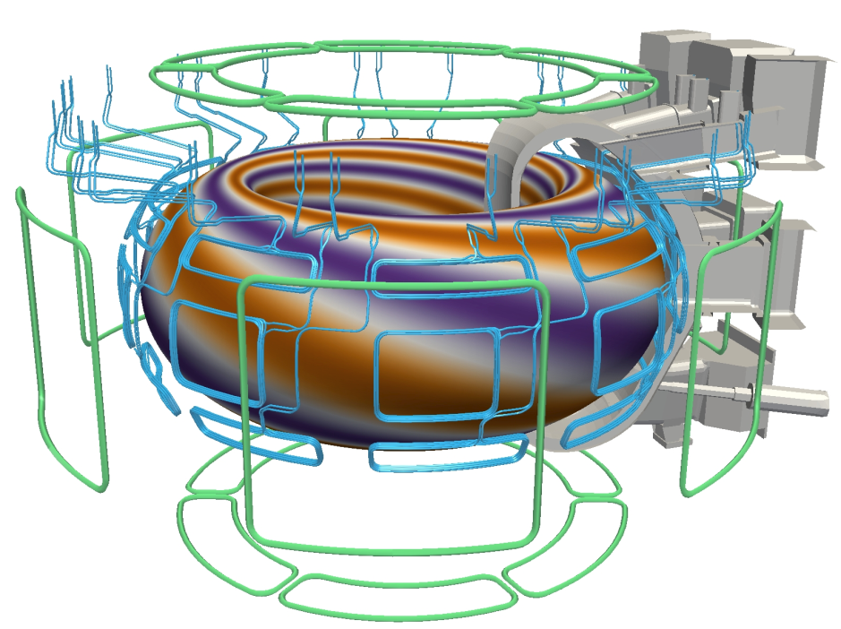
Other topics : 3-D equilibrium and stability
3-D equilibrium reconstruction and associated stability
ITER plasmas equilibria will have specific 3-D features
  Test Blanket modules (ferromagnetic) are installed in two nearby ports
  Ferromagnetic inserts are not the same for all ports (e.g. NBI ports)
  NBI systems have specific passive magnetic field reduction structures which create magnetic field perturbation
  In addition Error field correction and ELM control coils will apply specific 3-D fields
  3-D equilibrium reconstruction
  3-D equilibrium stability analysis

Slide 15
Conclusions
W-7X can contribute to support R&D for IRP on areas with specific features and/or expertise of the team associated with H&CD, diagnostics, 3-D fields and long pulse features of the device
  Diagnostics (high T_{e} and neutral pressure)
  3-D field impact on divertor power fluxes
  ECWC conditioning
  Fast Particle losses with 3-D fields
  3rd harmonic ECH heating physics
  3-D field equilibrium reconstruction and stability analysis
These issues are highlighted as high priority for IRP in next ~3 years. Priorities for 2022 need to be discussed in view of W-7X programme

